Slide 1
Test Information Distribution Engine (TIDE)
Training Module
2021–2022
Copyright © 2020 Cambium Assessment, Inc. All rights reserved.
Notes:
Welcome to the online training module for the Test Information Distribution Engine, also known as TIDE. This training module includes many examples of TIDE’s features. The TIDE User Guide on your state’s portal has additional information about features in your state's version of TIDE.
Please note that your state’s version of TIDE may differ from the images shown in this presentation.

Slide 2
Objectives
Preparing for Testing
Activating your new TIDE account and logging in to TIDE
Navigating the TIDE interface
Understanding account permissions
Managing user accounts
Managing student information and test settings
Administering Tests
Managing testing incidents
Monitoring test progress
After Testing
Managing non-participation codes
Notes:
This presentation will address numerous topics in TIDE, including tasks that typically take place while preparing for testing, during test administration, and after testing has concluded.
At its core, TIDE is a registration system for users who will access CAI systems and students who will take CAI tests. Users of all CAI systems must be added to TIDE before they can access any CAI system. Students must be added to TIDE before they can test in TDS. Classes must be added in TIDE so Reporting can display scores at the classroom, school, complex, complex area, and state level. During testing, TIDE users can print test tickets, manage testing incident requests, and monitor test progress. After testing, TIDE users can clean up data.

Slide 3
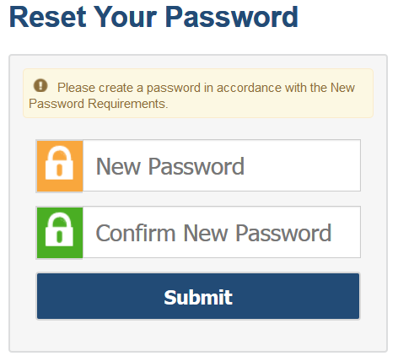
Activating Your Account
Follow the activation link in your email.
Create a password for TIDE that meets the password requirements:
At least 8 characters
At least 1 uppercase letter
At least 1 lowercase letter
At least 1 special character
At least 1 number
Submit your new password.
Notes:
When you are first added to TIDE, you will receive an account activation email containing a temporary link to reset your password. The sender’s address will appear as DoNotReply@cambiumassessment.com
The email contains two important links:
An activation link
A second link to request a new activation email
The activation link is only valid for 15 minutes. After that time, the link will expire, and you will need to click the second link to request a new activation email.
When you click the activation link, the Reset Your Password page will appear. Create the password you will use to access TIDE. If the password you enter is not processing, please ensure that you have met all system password requirements.
Your TIDE password must contain at least 8 characters, 1 uppercase letter, 1 lowercase letter, 1 special character, and 1 number.
If you do not reset your password, you will not be able to access the system.
If your password meets all requirements, click Submit.

Slide 4
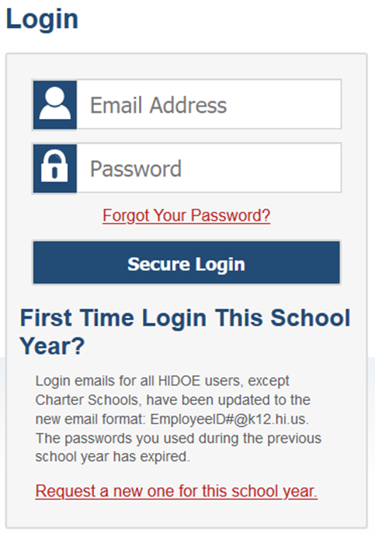
Logging in to TIDE
Notes:
After activating your account, you will have access to the various systems located on your portal.
To access TIDE, go to your portal and select the TIDE icon. On the login page, enter your email and password and click Secure Login.

Slide 5
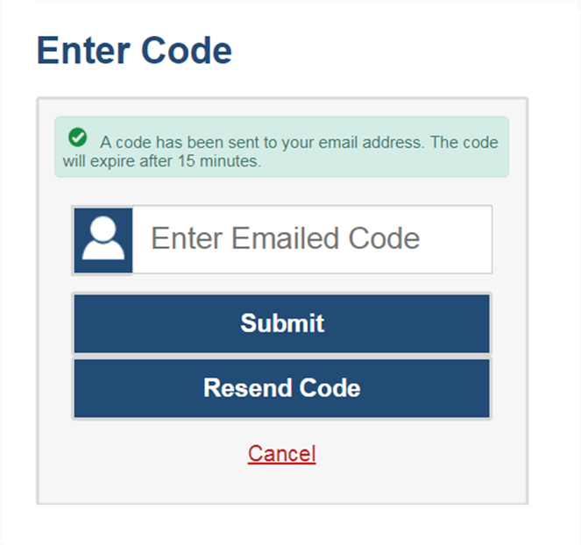
Logging in to TIDE, continued
The system has an authentication process that will be triggered when you log in from a different device or browser or after clearing your browser’s cache.
If you see this screen, an email containing the code will have been sent automatically to your email address.
Enter the code and click Submit.
If you need the code to be resent, click Resend Code.
Notes:
When logging in to the system using a new device or browser, or after clearing the cache on a previously used browser, you will see an Enter Code page.
If you see this screen, will need to enter the code on this page within 15 minutes of receiving the email. If you do not receive a code or do not enter the code within the 15-minute time limit, click Resend Code. Click Submit after entering the authentication code to access the system. You will be taken to the Reset Your Password page that was presented at the beginning of this module.

Slide 6
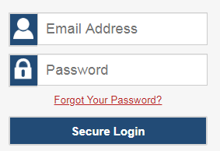
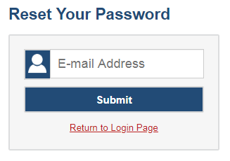
Resetting Your Password
Notes:
If you forget your password, you will need to reset it in order to access TIDE.
You may need to reset your password in the following situations:
You forgot your password.
Your activation link expired.
Your account is locked because you exceeded the account login attempt limit.
It is a new school year.
To reset your password, click the Forgot Your Password? link. You will be taken to the Reset Your Password page. Enter your email address and click Submit. You will receive an email with an activation link. Follow the same steps you would when initially setting up your TIDE account.

Slide 7
Logging in to TIDE, continued
Notes:
At the beginning of a new school year, your TIDE password and security details will be automatically reset. You will receive an email from DoNotReply@cambiumassessment.com to notify you of this occurrence. To reset your password and security details, go to your portal and select the TIDE icon. On the login page select Request a new one for this school year. The Reset Your Password page will appear, and you will follow the same steps to reset your password mentioned previously in this module.

Slide 8
Roles and Permissions
Task | Test Coordinator | Test Administrator | Teacher
Viewing and Editing Students | ✓ | ✓ | ✓
Editing Student Designated Support Test Tools | ✓ | ✓
Editing Student Universal Tools Test Tools | ✓ | ✓ | ✓
Adding and Uploading User Accounts | ✓
Viewing and Editing User Details | ✓
Creating and Uploading Testing Incident Requests | ✓
Working with Rosters of Students | ✓
Generating Plans and Managing Testing Reports | ✓ | ✓ | ✓
For a detailed list of user roles and associated permissions, see the HSAP User Roles & Access document.
Notes:
Your TIDE account is assigned a role, and that role has certain permissions. This table gives an example of the permissions associated with roles in your state. For example, a Test Coordinator may be able to perform tasks that are not available to a Test Administrator.
Permissions also limit the scope of data access. A complex-level user can work with data pertaining to that complex, and a school-level user can work with data pertaining to that school.

Slide 9
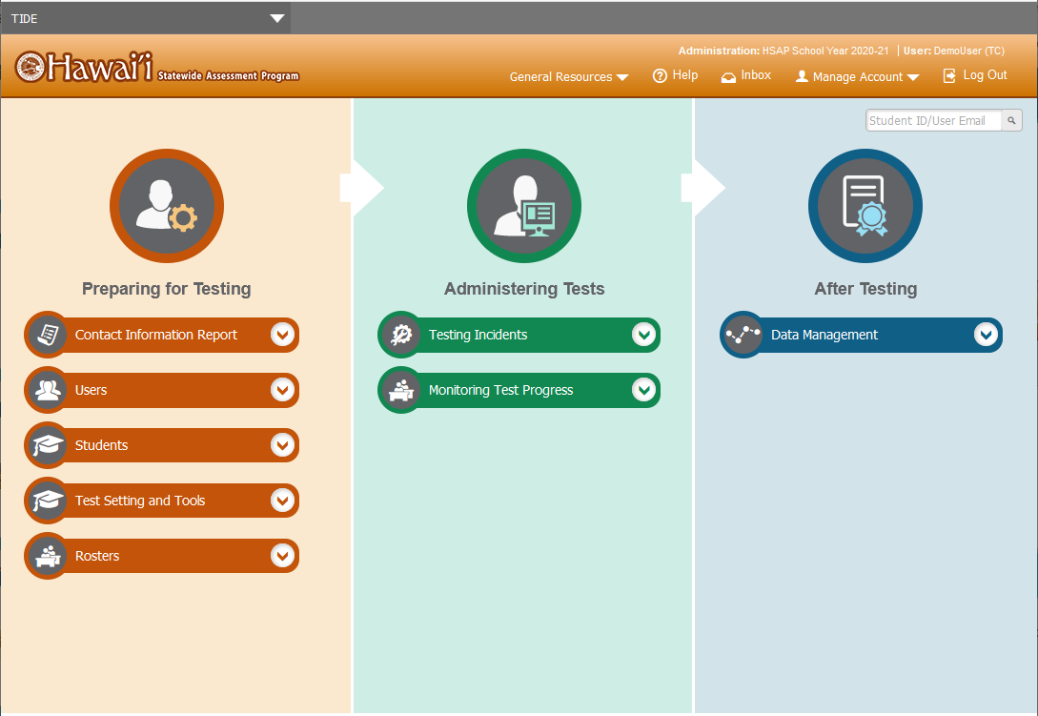
TIDE Home Page
Notes:
The TIDE home page appears after you log in. The home page is designed to reflect the stages of the testing process as directly and simply as possible. Each of TIDE’s three sections lists menus for the tasks available in that section. For example, the Users menu contains options for adding users; viewing, editing, or exporting users; and uploading users. To expand a task menu and view its set of related tasks, click the down arrow on the end of that menu. To perform a task, click the name of that task listed in the menu.

Slide 10
TIDE Tasks: Preparing for Testing
Notes:
Tasks in the Preparing for Testing section are typically performed before testing begins. This category includes tasks for managing records for users, students, test settings, and rosters.
TIDE can group students into rosters. A roster is a collection of students sharing a similar characteristic who are assigned to a specific teacher. Rosters typically represent classrooms, but they can also be used to group students with special needs or students participating in particular activities or programs. Once scores are calculated, users can visualize how a roster of students performed as a group.

Slide 11
TIDE Tasks: Administering Tests
Notes:
Tasks in the Administering Tests section are typically performed during the test window.
Test administrators may use TIDE to invalidate a test, reset a test, or reopen a test.
In this section, you may also monitor test progress and generate test participation reports.

Slide 12
TIDE Tasks: After Testing
Notes:
In the After Testing section, you can perform data cleanup operations such as entering codes to explain student non-participation and resolving test discrepancies.

Slide 13
TIDE Banner
Notes:
A banner appears at the top of each TIDE page showing the current test administration and your current user role. On the left, there is a drop-down list for accessing other Cambium Assessment applications. You will also find a General Resources drop-down list (if available in your state), a Help button that displays the TIDE User Guide, an Inbox button, a Manage Account drop-down list where you may set up your account details, and a Log Out button.

Slide 14
TIDE Banner: General Resources
Notes:
To download resources that may be needed for online testing, such as test administration forms and secure materials used for handscoring, click the General Resources drop-down list in the banner.

Slide 15
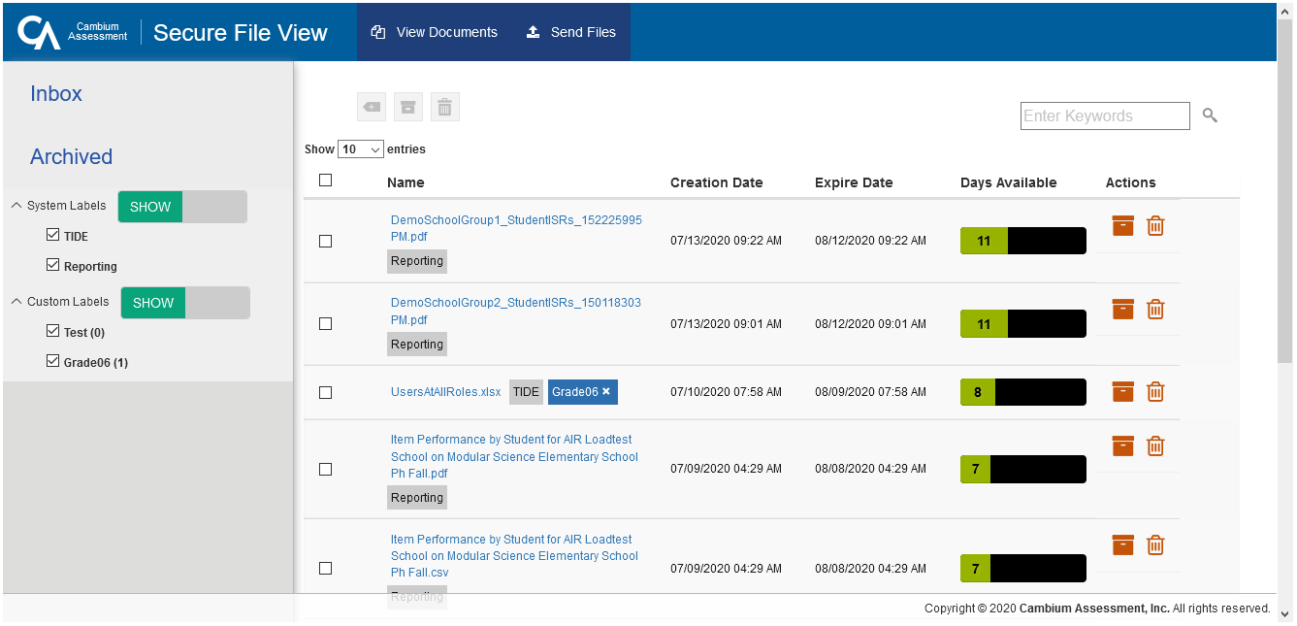
Inbox: View Documents
Notes:
To access secure documents and files you have previously exported in TIDE and other Cambium Assessment systems, click the Inbox button in the banner. Note that files are displayed in the order that they are generated, uploaded, or archived. The Inbox displays the name of the file, creation and expiration dates, days available, and an actions column. To show system and custom labels, select Show on the corresponding toggle bar and mark checkboxes for the label(s) you wish to display. To hide labels, select Hide on the appropriate toggle bar.
For more information on the Inbox and its features, see the TIDE User Guide.

Slide 16
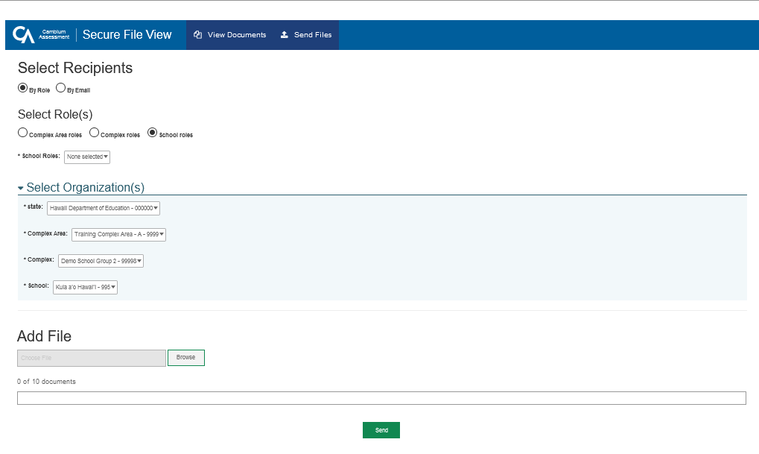
Inbox: Sending Files
Notes:
You can send a file or files from TIDE to individual recipients by email address or to groups of recipients by user role.
To send files, select the Inbox button from the TIDE banner. Next, select the Send Files tab at the top of the window.
Select By Role to send a file or files to a group of users by their user role. Select By Email to send a file or files to a single recipient by email address.
To send files by role, select the role group to which you want to send a file or files. A drop-down list appears.
Next, select the role or roles to which you want to send a file or files. You can choose Select all to send a file or files to all roles in the selected role group.
From the Select Organization(s) drop-down lists, select organizations that will receive the file(s) you send.
To send files by email, enter the email address of the recipient to whom you wish to send a file or files.
After selecting recipients, select Browse under the Add File field to select a file or files to send. A file browser appears.
From the file browser, select up to 10 files to send.
Select Send.

Slide 17
TIDE Banner: Manage Account
Notes:
The Manage Account drop-down list allows you to change the role you are using in TIDE (if you have been assigned multiple roles), update your contact information, and reset your password.

Slide 18
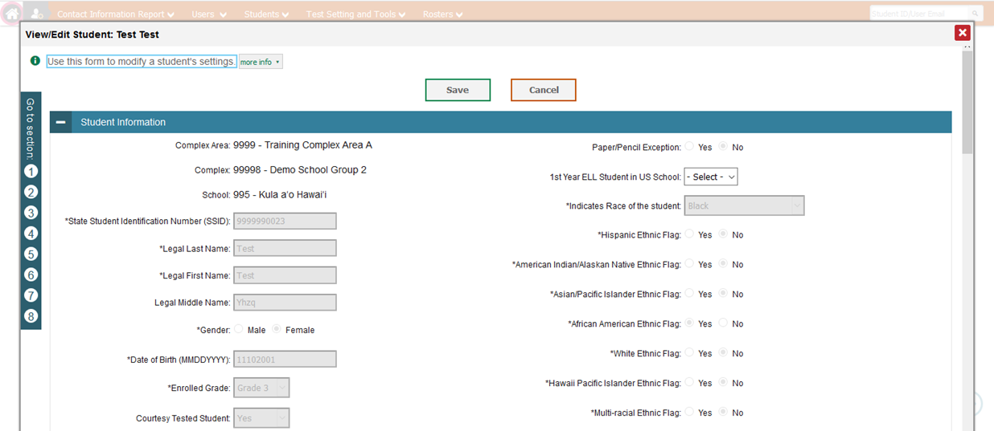
Navigation Toolbars
Notes:
When you enter any task page, a navigation toolbar appears at the top of the page. This toolbar allows you to access each task and action that was available on the dashboard. To view the task menus for a particular TIDE category, click the icon for that category above the toolbar.
Some pages in TIDE are divided into multiple panels. Each panel contains a group of related settings and fields that you can edit. You can click the minus sign in the upper-left corner of a panel to collapse it or click the plus sign in a collapsed panel to expand it. Additionally, a floating Go to section toolbar appears on the left side of each page with multiple panels. This toolbar includes a numbered button for each panel in the form. You can hover over a button to display the label of the associated panel and click the button to jump to that panel.

Slide 19
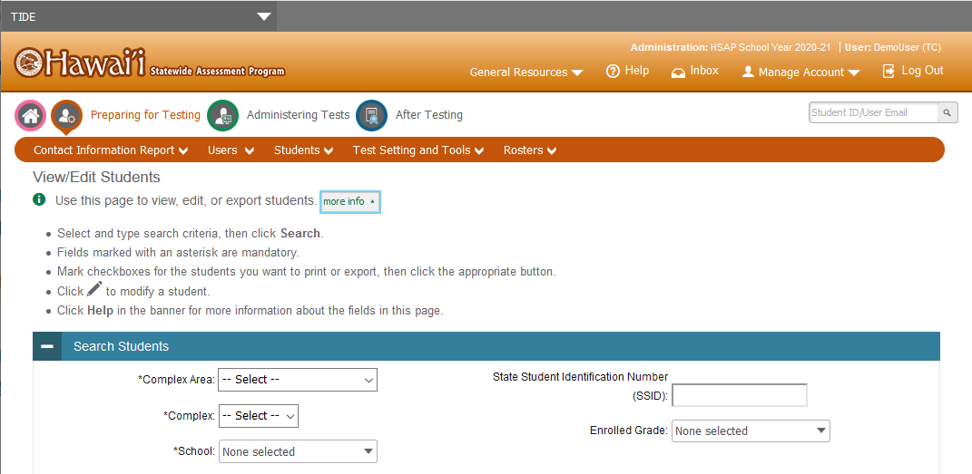
Help Text
Notes:
Most pages in TIDE have help text that describes the page and how to use it. To show or hide help text on a page, click the gray more info link under the page title.
To read more-detailed information about the page that you are currently viewing, click the Help button in the banner.

Slide 20
Quick Search
Notes:
To quickly search for a user or student to view or edit, enter the user’s email address or student’s SSID in the search box. Then, click the magnifying glass to the right of the search box.
If you are searching for a user to view or edit, the View/Edit User form will appear. If you are searching for a student to view or edit, the View/Edit Student form will appear.
When you are finished viewing/editing a student or user, click the Save button.

Slide 21
Three Things All TIDE Users Must Know How To Do
How to add records one at a time
How to modify records one at a time
How to add or modify multiple records at once
Notes:
Records for users, students, and rosters must be added to TIDE and kept up to date for the testing process to flow properly. Users not added to TIDE will not have access to any CAI systems, students who are not added will be unable to test, and rosters not added will not be available in Reporting. The process for adding and modifying records are similar for users, students, and rosters. This next section of the module will walk you through how to add records one at a time, how to modify records one at a time, and how to add or modify multiple records at once.

Slide 22
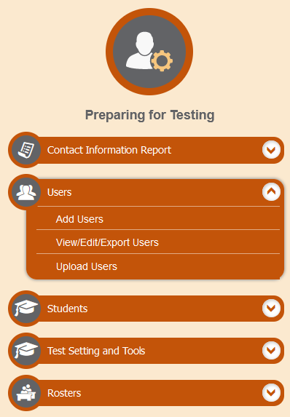
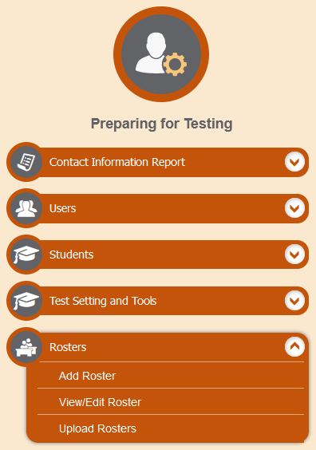
Add Records One at a Time
Notes:
To add records one at a time, start on the TIDE home page. In the Preparing for Testing section, choose the task for which you want to add a new record: users or rosters, then click Add.
On the following page, fill out the information, verify its accuracy, and select Save.

Slide 23
Add Users One at a Time
Notes:
When adding users one at a time, enter the email address for the user you want to add. Click + Add user or add roles to user with this email. If the email exists, then options will be available to add multiple roles for the user.
The new user’s email address will serve as his or her username when he or she logs in to any Cambium Assessment system (TIDE itself, the TA Interface, the Centralized Reporting System [CRS] and other Cambium Assessment systems). The new users you add will receive an activation email from DoNotReply@cambiumassessment.com.

Slide 24
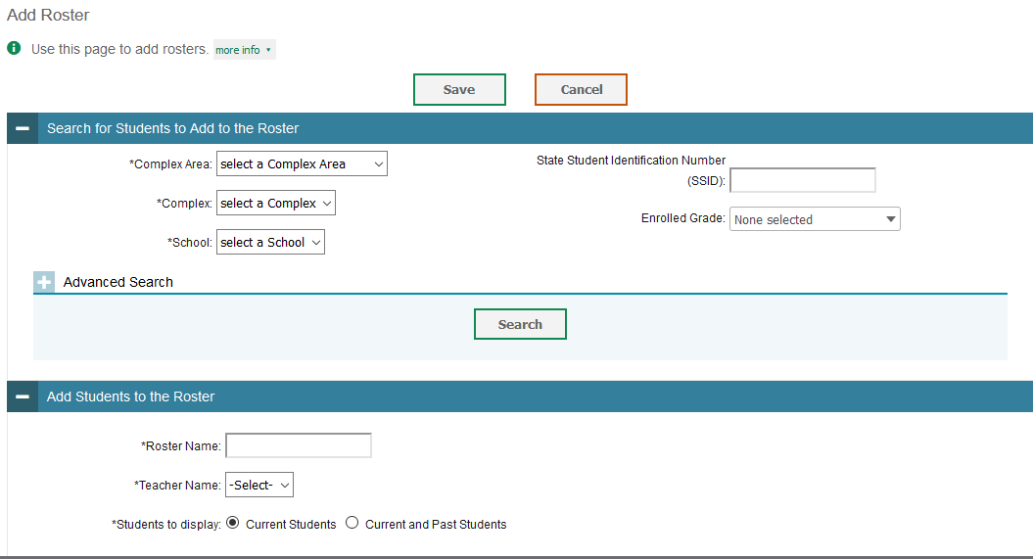
Add Rosters One at a Time
Notes:
On the Add Roster page, you can manually add students to a roster. This page contains two panels, a Search for Students to Add to the Roster panel and an Add Students to the Roster panel.
To search for students, complete the fields under the Search for Students to Add to the Roster panel. The fields marked with an asterisk are mandatory. You can further refine your search by selecting criteria under the Advanced Search section.
Refine the list of available students by completing the fields in the Add Students to the Roster panel. To display current students only, click the Current Students radio button. To display current and past students, click the Current and Past Students radio button. Then click Search.

Slide 25
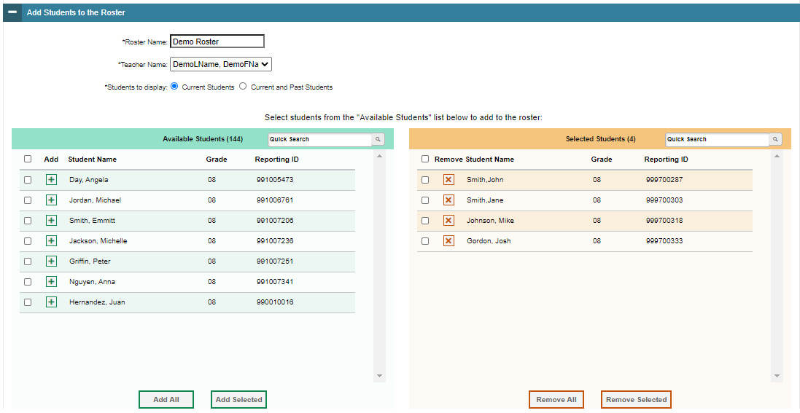
Add Rosters One at a Time, continued
Notes:
In the Add Students to the Roster panel, the students in the left column are available to be added to the roster, and students in the right column are currently in the roster.
First, enter a name for the roster and select the teacher who should be associated with the roster. Select if you want to display Current Students or Current and Past Students.
Next, add students to the new roster. To add a single student to the roster, click the green plus sign next to a student in the left column. You can add multiple students to the roster by marking checkboxes next to the students you want to add and then clicking Add Selected. Add all available students to the roster by clicking Add All.
To remove a single student from the roster, click the orange X next to a student in the right column. You can remove multiple students from the roster by marking checkboxes next to the students you want to remove and then clicking Remove Selected. Remove all students from the roster by clicking Remove All.

Slide 26
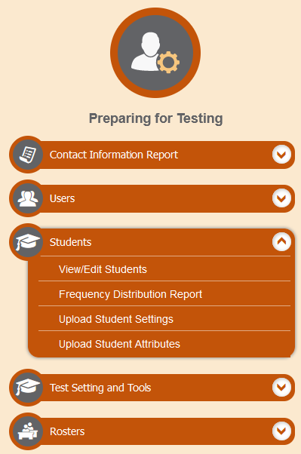
Modify Records One at a Time
Notes:
After a record has been added to TIDE, you may edit the record. You can do this by modifying existing records one at a time.
Begin on the TIDE homepage. In the Preparing for Testing section, choose the task for which you want to modify a record: users, students, or rosters, then click View/Edit.

Slide 27
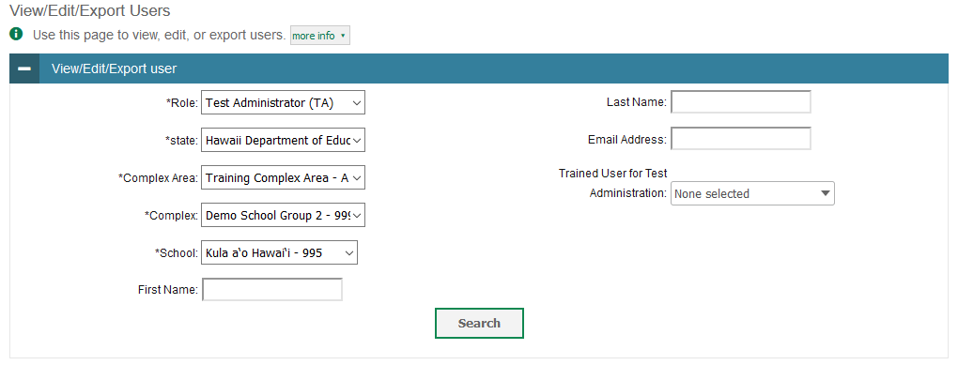
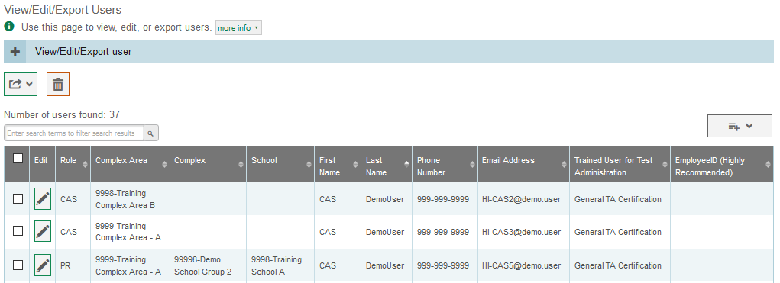
Modify Users One at a Time
Notes:
The View/Edit/Export Users page includes a form for setting selection criteria to retrieve users. In this example, the required criteria are the user’s role, state, complex area, complex and school. Other criteria are optional, such as the first or last name and email address. Click Search to continue. The search panel will automatically collapse, and your search results will appear below.
After you click Search, TIDE will display all the users satisfying the search criteria. If your user role permits, you can edit a user’s information by clicking the green pencil icon. Another page will appear for you to edit and save information.
To export user information, mark the checkboxes next to the users you wish to export and click the green export button above the search results. A pop-up window will appear with the option to export to the Inbox in either Excel or CSV format.
To delete users from TIDE, mark the checkboxes next to the users you wish to delete and click the orange trash can button above the search results.
To make the search form reappear and search for additional users, click the plus sign in the View/Edit/Export Users panel, which appears as a blue bar.
For more-detailed information on managing users, see your TIDE User Guide.

Slide 28
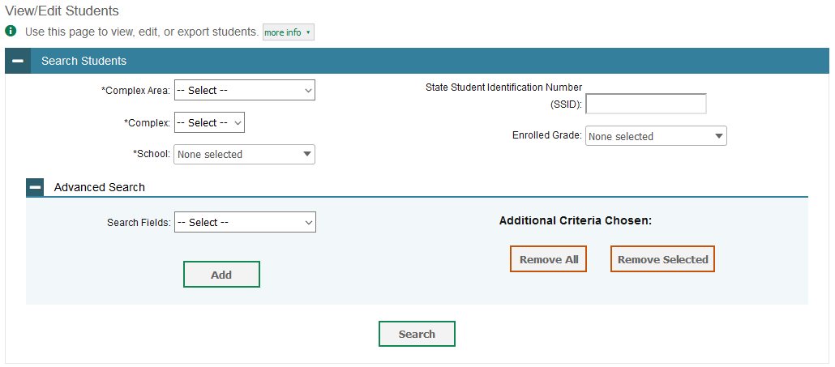
Modify Students One at a Time
Notes:
The View/Edit Students page includes a form for setting selection criteria to retrieve students. Required criteria, such as the complex area, complex, and school in this example, are marked with asterisks. Other criteria are optional, such as the SSSID and the student’s enrolled grade.
If available, you can further refine your criteria by entering additional demographic information or test settings in the Additional Search panel.
The students you can retrieve on this page are limited by your role’s scope. For example, if you are a complex-level user, you can retrieve only students enrolled within your complex. If you are a school-level user, you can only retrieve students enrolled within your school.
Click Search to continue. The search panel will automatically collapse, and your search results will appear below.

Slide 29
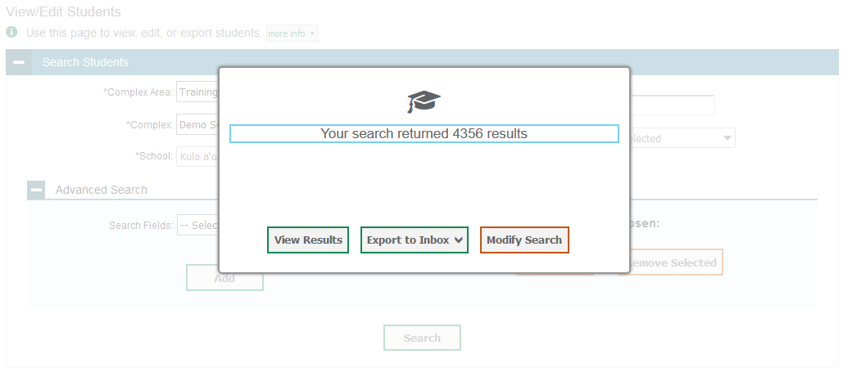
Modify Students One at a Time, continued
Notes:
After you click Search, you will see a message asking whether you would like to view the results of your search, export the list of students to your Inbox, or modify your search criteria and try again. If you choose to export the results to your Inbox, you will receive an email when the file is ready for you to download.

Slide 30
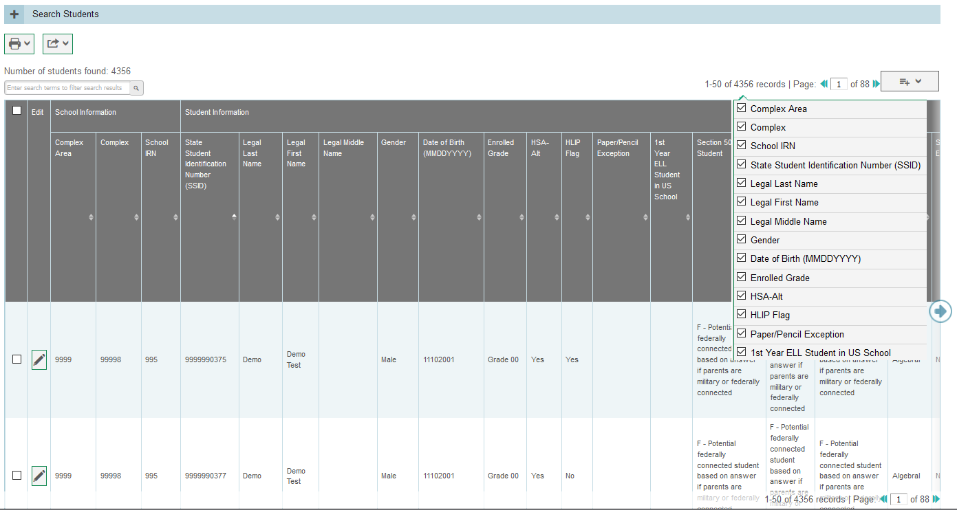
Modify Students One at a Time, continued
Notes:
When you click View Results, TIDE will display all the students satisfying the search criteria. Because not all columns can fit on the screen at once, click the blue arrow on the right side of the screen to scroll right and display more information. To add or delete columns to display, click the drop-down menu at the upper-right corner of the results. You can edit a student’s information, including test settings and accommodations, by clicking the green pencil icon.
Print students by selecting the desired students and clicking the Print button above the search results.
To export the results, mark the checkboxes next to the results you wish to export and click the green Export button above the search results. A pop-up window will appear with the option to export to the Inbox in either Excel or CSV format.
To make the search form reappear and search for additional students, click the plus sign in the Search Students panel, which appears as a blue bar. For more-detailed information on managing students, see your TIDE User Guide.

Slide 31
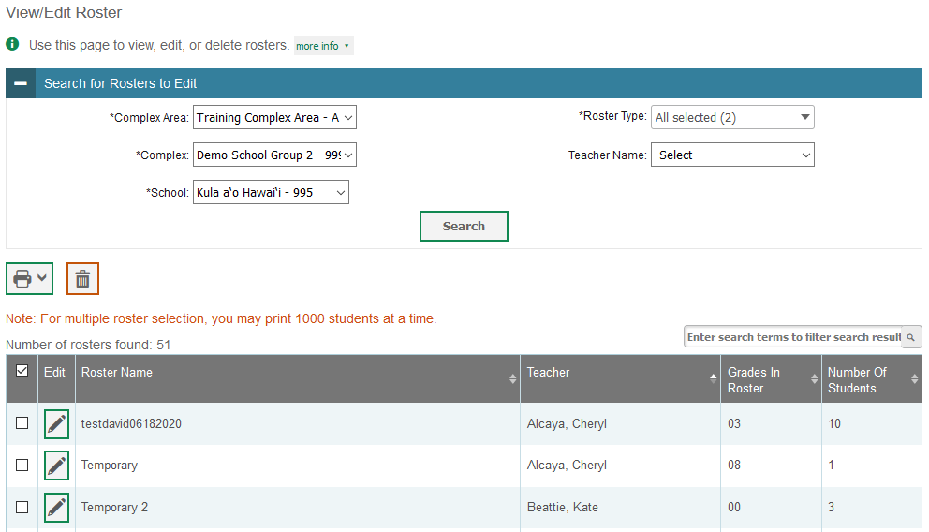
Modify Rosters One at a Time
Notes:
The View/Edit Roster page includes a form for setting selection criteria to retrieve rosters. In this example, the complex area, complex, school, and roster type criteria are required. Other criteria are optional, such as Teacher Name. Click Search to display a list of rosters matching your criteria.
Print or delete rosters from TIDE by selecting the desired rosters and clicking the Print or Delete buttons above the search results.
Click the pencil icon next to a roster to view or edit its details. The Edit Roster form will appear. This form is similar to the form used to add rosters, and you may edit the roster name, teacher name, and students to display in the roster in the same way that you would for a new roster.

Slide 32
Upload Multiple Records at Once
Notes:
Depending on your user level, you may also have the option to upload multiple records at once. To upload records, you must be familiar with spreadsheet applications or comma-separated value files. When you upload files to TIDE, records not previously set up will be added (for users and rosters) and records already set up in TIDE (for users, students, and rosters) will be modified with the updated content from the upload.
In the Preparing for Testing section, choose the task for which you want to upload a record: users, students, or rosters, then click Upload.

Slide 33
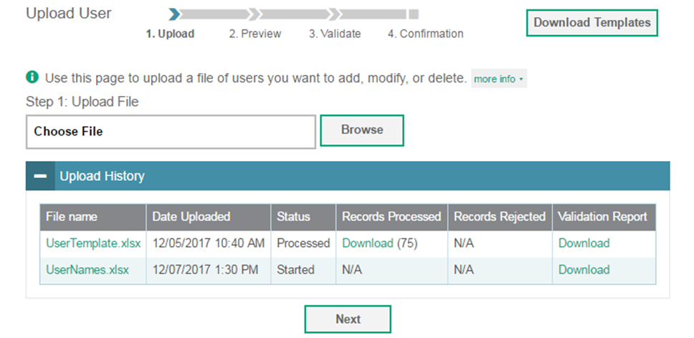
Upload Users
Notes:
A way to add multiple new users to TIDE is to use the Upload User page to compose an upload file in Excel or CSV format and then upload that file. This method is easiest if you have many new users and you do not want to add them one at a time from the Add User page.
The easiest way to compose an upload file is to download an available template by clicking Download Templates. You may also access files that you have previously uploaded by clicking the blue plus sign to expand the Upload History panel.
Open the template, enter information for the users you wish to add using Excel or another program, and save the file in Excel or CSV format. Detailed instructions for composing an upload file can be found in the TIDE User Guide.
Once you return to TIDE, click Browse, and select the file you just saved.
Click Next to upload the file. A file preview page will appear, allowing you to verify that you uploaded the correct file. If the preview is correct, click Next to continue.

Slide 34
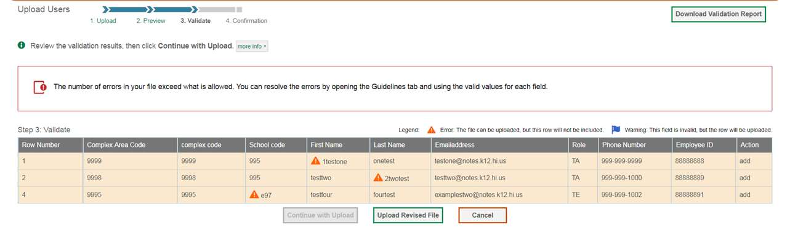
Upload Users, continued
Notes:
Next, TIDE will validate the file and display any errors or warnings according to the legend on the page. Click the orange error icons and blue warning icons in the validation results to view the reason that a field is invalid. If a record contains an error, that record will not be included in the upload. If a record contains a warning, that record will be uploaded, but the field with the warning will be invalid.
To complete the upload, click Continue with Upload.
To upload a different file, click Upload Revised File.
To cancel the upload, click Cancel.
If your file contains a large number of records, TIDE will process it offline and send you a confirmation email when complete. While TIDE is validating the file, do not click Cancel, as TIDE may have already started processing some of the records.
To view a PDF file listing the validation results for the upload file, click Download Validation Report in the upper-right corner.
When the upload is complete, a confirmation page will appear with a message that summarizes how many records were uploaded and how many were excluded.

Slide 35
Upload Student Settings
Notes:
A way to edit multiple student test settings and tools in TIDE is to use the Upload Student Settings page to compose an upload file in Excel or CSV format and then upload that file. This task is performed by following the same steps you would use to upload new users.
The easiest way to compose an upload file is to download an available template by clicking Download Templates. You may also access files that you have previously uploaded by clicking the blue plus sign to expand the Upload History panel. Open the template, enter information for the students you wish to add using Excel or another program, and save the file in Excel or CSV format. Detailed instructions for composing an upload file can be found in the TIDE User Guide.
Once you return to TIDE, click Browse, and select the file you just saved.
Click Next to upload the file. A file preview page will appear, allowing you to verify that you uploaded the correct file. If the preview is correct, click Next to continue.

Slide 36
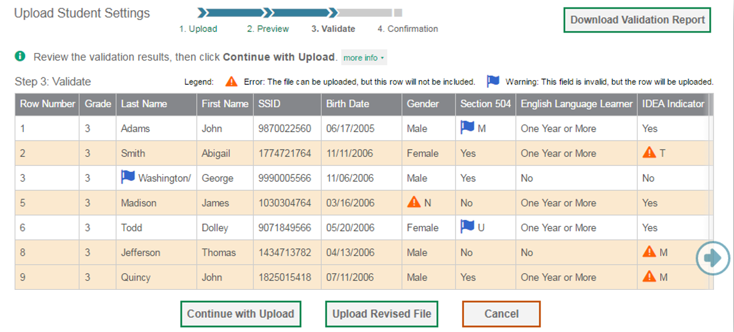
Upload Student Settings, continued
Notes:
TIDE will validate the file and display any errors or warnings according to the legend on the page. Because not all columns can fit on the screen at once, click the blue arrow on the right side of the screen to scroll right and display more information. Click the orange error icons and blue warning icons in the validation results to view the reason that a field is invalid. If a record contains an error, that record will not be included in the upload. If a record contains a warning, that record will be uploaded, but the field with the warning will be invalid.
To complete the upload, click Continue with Upload.
To upload a different file, click Upload Revised File.
To cancel the upload, click Cancel.
If your file contains a large number of records, TIDE will process it offline and send you a confirmation email when complete. While TIDE is validating the file, do not press Cancel, as TIDE may have already started processing some of the records.
To view a PDF file listing the validation results for the upload file, click Download Validation Report in the upper-right corner.
When the upload is complete, a confirmation page will appear with a message that summarizes how many records were committed and how many were excluded.

Slide 37
Upload Rosters
Notes:
A way to add multiple new rosters into TIDE is to use the Upload Roster page to compose an upload file in Excel or CSV format and then upload that file.
This task is performed by following the same steps used to upload new users and students: download a template file, enter information into the template, save, and click the Browse button to locate the file and upload it in to TIDE.
Users can also delete a student from a roster via an upload file. For specific instructions on deleting students from a roster via an upload file, see your TIDE User Guide.

Slide 38
Students
Notes:
TIDE also manages student information and keeps track of which assessments students are eligible to take. The Students task menu allows you to view/edit students; generate frequency distribution reports; upload student settings from an external file; and upload interim grades. We have shown you how to perform most of the tasks in the Students Task Menu. As you plan for testing it is helpful to use the Frequency Distribution Report to double check student information and test settings.

Slide 39
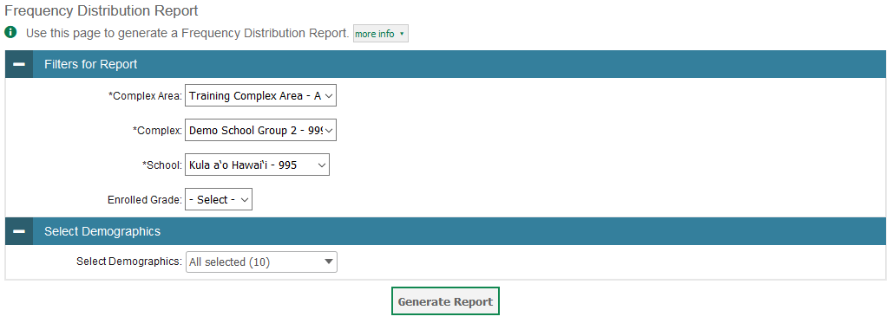
Frequency Distribution Reports
Notes:
A frequency distribution report pulls demographic and enrollment information based on the selected criteria.
To generate a report from the Frequency Distribution Report page, select a complex area, complex, and school from the drop-down lists. Select an enrolled grade and mark checkboxes in the Select Demographics panel to filter the report for additional demographics and accommodations, as desired.
Click Generate Report to display a frequency distribution report using the selected criteria.

Slide 40
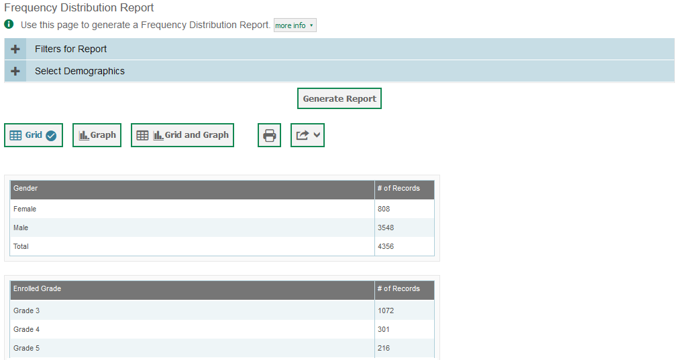
Frequency Distribution Reports, continued
Notes:
TIDE will display the frequency distribution report in grid format. This example shows a report by gender and grade.
To display the report in tabular format, click Grid.
To display the report in graphical format, click Graph.
To display the report in both tabular and graphical format, click Grid and Graph.
To download the report as a PDF file, click the print icon and then save the file to your computer. To export the report in Excel format, click the export button located next to the print button, and choose “Export to Excel” from the drop-down menu.

Slide 41
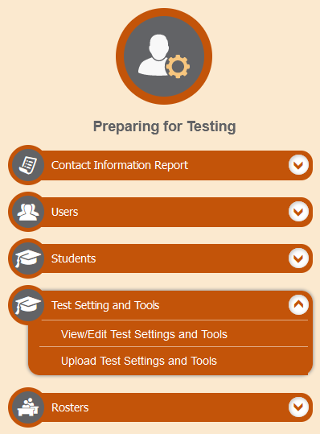
Test Settings and Tools
Notes:
TIDE keeps track of student test settings, such as font size and text-to-speech. The Test Settings and Tools task menu allows you to view and edit, or upload, test settings and tools.

Slide 42
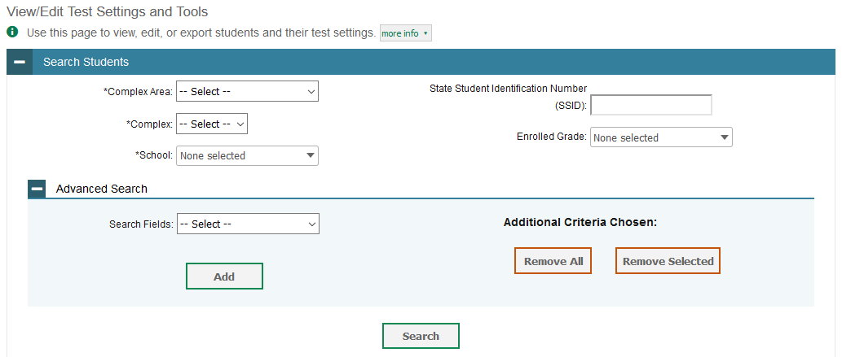
View/Edit Test Settings and Tools
Notes:
The View/Edit Test Settings and Tools page includes a form for setting selection criteria to retrieve a student’s test settings and tools. Required criteria, such as the complex area, complex, and school in this example, are marked with asterisks. Other criteria are optional, such as the SSID and enrolled grade.
You can further refine your criteria by entering additional demographic information or test settings in the Additional Search panel.
The students you can retrieve on this page are limited by your role’s scope. For example, if you are a complex-level user, you can retrieve settings for those students enrolled within your complex. If you are a school-level user, you can retrieve settings only for those students enrolled within your school.
Click Search to continue. You will see a message asking whether you would like to view the results of your search, export the list of students to your Inbox, or modify your search criteria and try again. If you choose to export the results to your Inbox, you will receive an email when the file is ready for you to download.

Slide 43
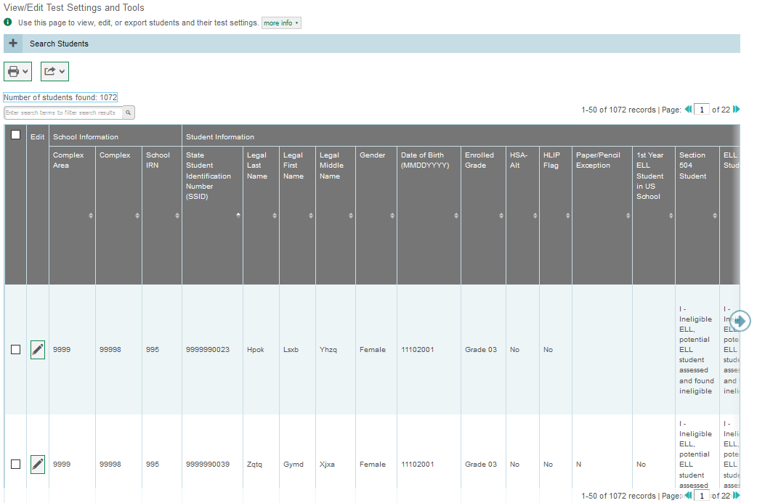
View/Edit Test Settings and Tools Results
Notes:
When you click View Results, TIDE will display all the students satisfying the search criteria. If all columns cannot fit on the screen at once, click the blue arrow on the right side of the screen to scroll right and display more information. You can edit a student’s test settings and accommodations by clicking the green pencil icon.
To make the search form reappear and search for additional students, click the plus sign in the Search Students panel, which appears as a blue bar. For more-detailed information on managing student test settings and tools, see your TIDE User Guide.

Slide 44
View/Edit Test Settings and Tools Results, continued
Notes:
Print student information by selecting the desired students and clicking the Print button above the search results.
To export the results, mark the checkboxes next to the results you wish to export and click the green Export button above the search results. A pop-up window will appear with the option to export to the Inbox in either Excel or CSV format.

Slide 45
Upload Test Settings and Tools
Notes:
A second way to edit test settings and tools in TIDE is to use the Upload Test Settings and Tools page to compose an upload file in Excel or CSV format and then upload that file. This task is performed by following the same steps you would use to upload new users.

Slide 46
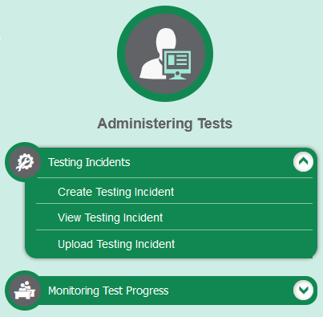
Testing Incidents
Notes:
In the Administering Tests section of the TIDE dashboard, the Testing Incidents task menu allows you to view pending testing incidents; create new testing incidents; view testing incidents; and upload testing incidents.
In the normal flow of a test opportunity, a student takes the test in the test delivery system (TDS) and then submits it. Next TDS forwards the test for scoring, and the Centralized Reporting System reports the test scores.
Testing incidents are a way of interrupting this normal flow. Reasons for testing incidents can vary. For example, a student may need to retake a test or have another test opportunity. A test administrator may need to invalidate a test because of a hardware malfunction or an impropriety.
For information on your state’s particular policies, and procedures, please consult the Test Administration Manual and the TIDE User Guide.

Slide 47
Create Testing Incidents
Notes:
The Create Testing Incidents page is where you can create a testing incident for a test.
The first step is to select the type of testing incident you want to create. The TIDE User Guide lists the available testing incident types and explains the implications of each.
Next, search for the test result for which you wish to create a testing incident. From the drop-down lists and in the text field, enter your search criteria and click Search. TIDE will display the search results below.
Mark the checkbox next to each test result for which you wish to create a testing incident, and click Create. A pop-up window will ask you to enter a reason for the testing incident. To create the incident, enter a reason and click Submit.

Slide 48
Status of Testing Incidents
Appeal Status | Description of Status
Error Occurred | An error occurred while the appeal was being processed.
Item Information Sent | Information regarding a Report Problem with Item testing incident was sent to the designated recipients.
Pending Approval | Testing incident is pending approval.
Processed | Testing incident was successfully processed and the test opportunity has been updated.
Rejected | Another user rejected the testing incident.
Rejected by System | Test Delivery System was unable to process the testing incident.
Requires Resubmission | Testing incident must be resubmitted.
Retracted | Originator retracted the testing incident.
Submitted for Processing | Testing incident submitted to Test Delivery System for processing.
Notes:
After a testing incident is created, its status can change throughout its life cycle. This table describes the possible statuses a testing incident can have.

Slide 49
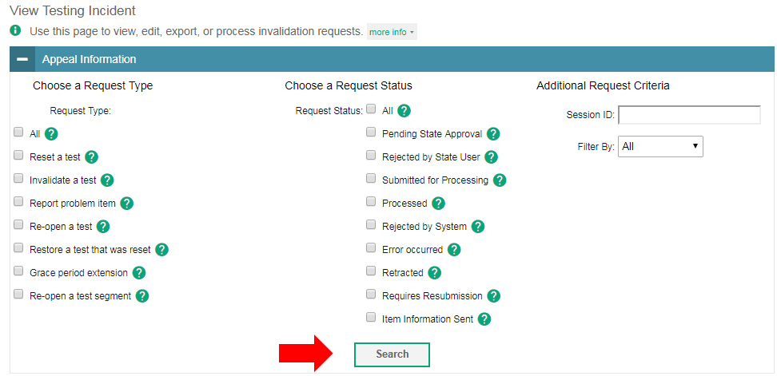
View Testing Incidents
Notes:
You can review submitted testing incidents from the View Testing Incidents page. Select a testing incident type and status and enter additional search criteria as desired. Click Search to display testing incidents matching your criteria.

Slide 50
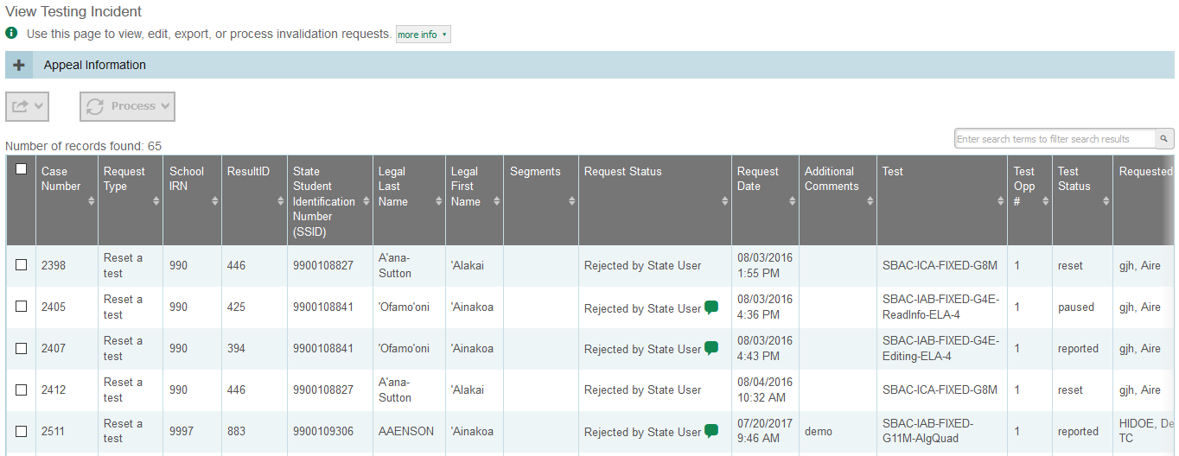
View Testing Incidents Results
Notes:
When you click Search, the search panel will automatically collapse, and your search results will appear below.
To view the approval and processing status of a testing incident, click the green comment icon in the Request Status column.
To retract, or resubmit a testing incident, mark the checkbox next to it, click Process, and then select the action you wish to perform.
To export the results, mark the checkboxes next to the results you wish to export and click the green export button above the search results. A pop-up window will appear with the option to export to the Inbox in either Excel or CSV format.

Slide 51
Upload Testing Incidents
Notes:
A second way to create new testing incidents in TIDE is to use the Upload Testing Incident page to compose an upload file in Excel or CSV format and then upload that file. This task is performed by following the same steps used to upload new users.

Slide 52
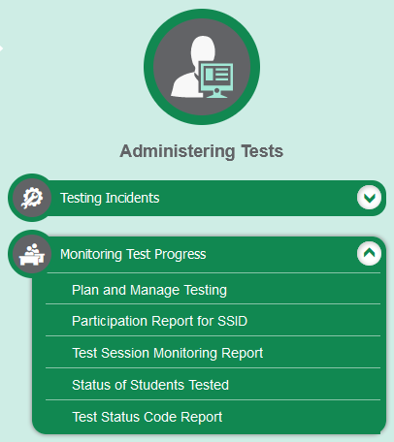
Monitoring Test Progress
Notes:
The tasks available in the Monitoring Test Progress task menu allow you to generate various reports that provide information about a test administration's progress.
Several types of participation reports are available:
The Plan and Manage Testing report details all of a student’s test opportunities and the status of those test opportunities.
The Participation Report for SSID report shows test participation for specified students.
The Test Session Monitoring Report shows a list of active test sessions at a school.
The Status of Students Tested report summarizes the number and percentage of students who have started or completed a test.
The Test Status Code Report displays all the non-participation codes for a test administration.

Slide 53
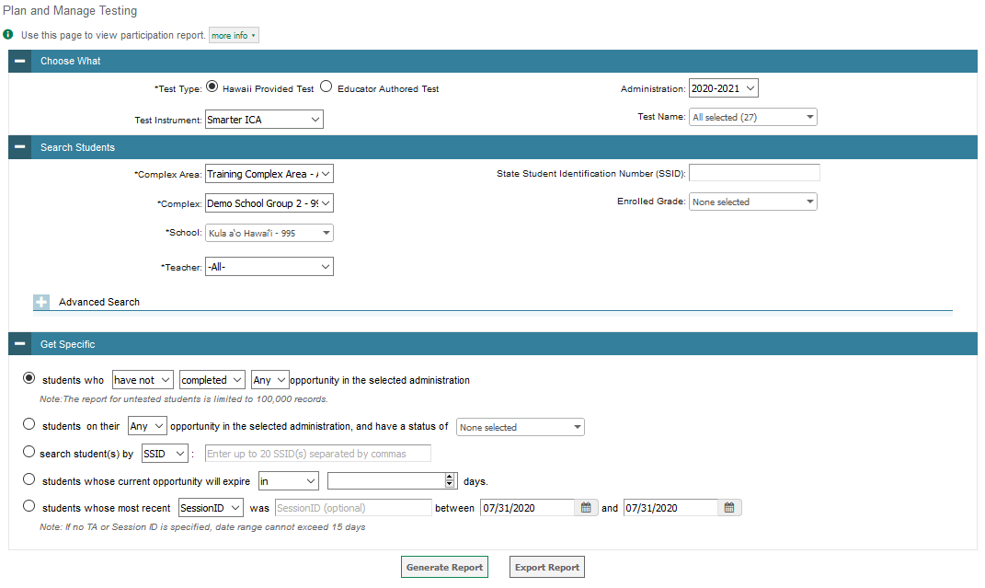
Plan and Manage Testing
Notes:
The Plan and Manage Testing reports detail all of a student’s test opportunities and the status of each test opportunity. Because the report lists testing opportunities, a student can appear more than once on the report.
To generate a report from the Plan and Manage Testing page, select a test instrument and administration under the Choose What panel.
Next, in the Search Students panel, select a complex area, complex, school, and Teacher, if applicable. The fields marked with an asterisk are mandatory. You can refine your search by adding additional criteria under the Advanced Search section.
Finally, in the Get Specific panel, choose one of the filter options available and select parameters for that option.
Click Generate Report to view your Plan and Manage Testing report, or click Export Report to open the report in Excel.

Slide 54
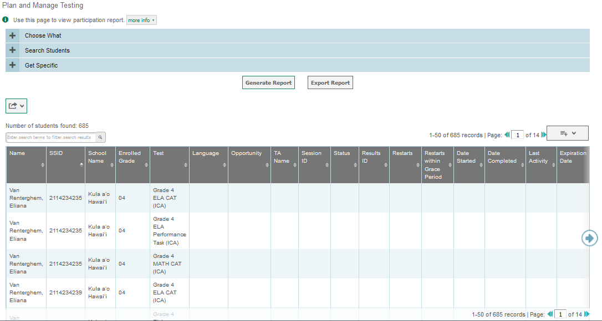
Plan and Manage Testing Results
Notes:
Clicking Generate Report will display the report and collapse the Report Criteria panel. Because not all columns can fit on the screen at once, click the blue arrow on the right side of the screen to scroll right and display more information.

Slide 55
Plan and Manage Testing Examples
Which students have not yet tested?
Which students have paused tests?
What is the testing status of specific student(s)?
Which students need to test in the next five days?
Did all students in a test session submit their tests?
Notes:
This slide illustrates some common questions that can be answered using the options available in the Get Specific panel.
To find students who have not yet tested, select the first radio button and search for students who have not completed their test opportunity in the selected administration.
To find students who have paused tests, select the second radio button and search for students on their first test opportunity in the selected administration with a status of paused.
To find the testing status of specific student(s), select the third radio button and enter the SSID(s) or Name(s) of the students.
To find students whose test opportunities are expiring, select the fourth radio button and specify the number of days or range of days you want to search.
To find out if all students in a test session submitted their tests, select the fifth radio button and search for students by test session ID between the dates when the test session took place.

Slide 56
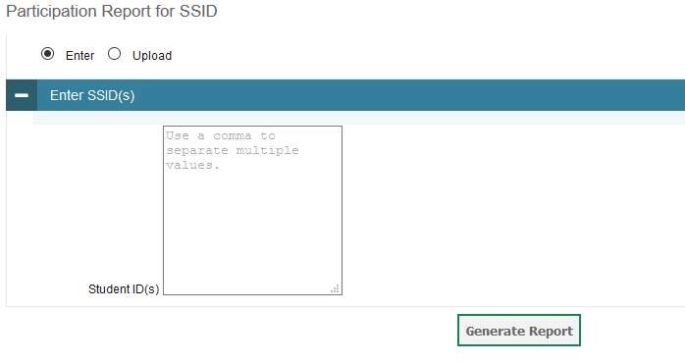
Participation Report for SSID
Notes:
The Participation Report for SSID page allows you to generate participation reports for specified students. Enter a single SSID or multiple SSIDs separated by commas in the Student ID(s) box. You can also upload a single-row Excel file containing student ID numbers. Click Generate Report to view the results.

Slide 57
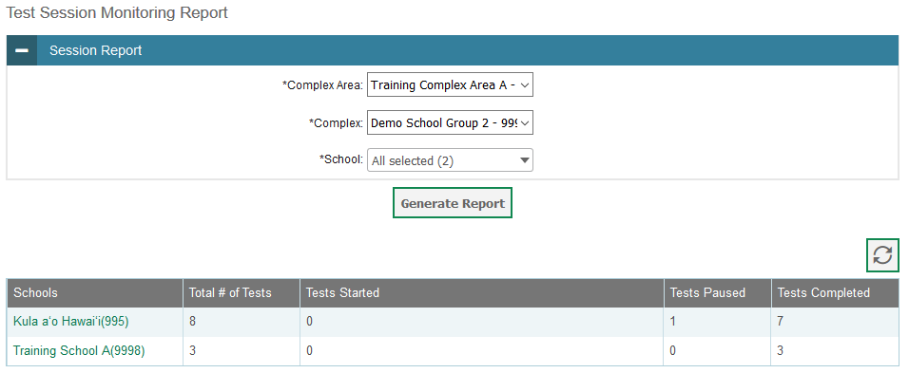
Test Session Monitoring Report
Notes:
The Test Session Monitoring Report details active and inactive test sessions happening in real time in the selected school. These reports show how many students in each school are testing and how many have started, paused, and completed their test. School-level Test Session Monitoring reports also include additional information such as proctor name, test name, and test session start time.
From the Test Session Monitoring Report page, select a complex area, complex and school from the drop-down lists. Then click Generate Report. A detailed report page will appear.
Note that if multiple schools were selected, a Summary Report page will first appear. From this page, select a school name to view a detailed report for that school.

Slide 58
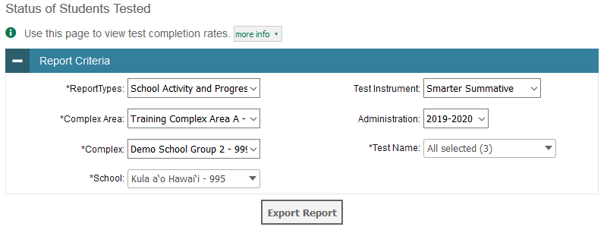
Status of Students Tested
Notes:
The Status of Students Tested report summarizes the number and percentage of students who have started or completed a test.
To download a report from the Status of Students Tested page, choose the type of report you wish to export from the Report Types drop-down list. Select a complex area, complex and school from the corresponding drop-down lists, if available. Finally, select a test instrument, administration, and test name. Note that fields marked with an asterisk are mandatory.
To download the report as an Excel spreadsheet, click Export Report.

Slide 59
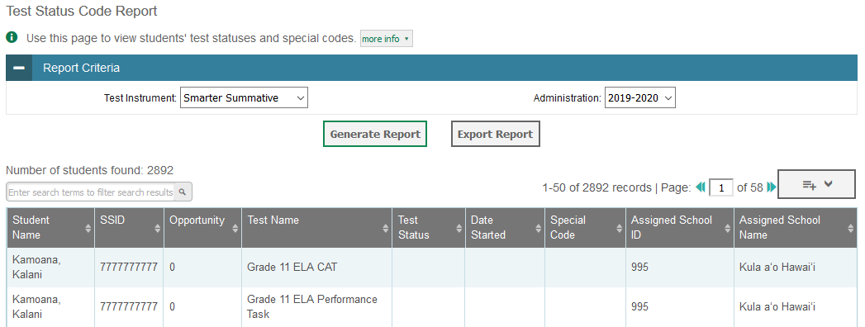
Test Status Code Report
Notes:
If students do not start or complete tests to which they are assigned, school officials assign non-participation codes to those tests indicating why students did not start or complete the test. For information on your state’s policies, and procedures, please consult the Test Administration Manual.
The Test Status Code Report displays all the non-participation codes that were entered during the test window. To generate a report from the Test Status Code Report page, select a test and administration from the drop-down lists. To view the report on the page, click Generate Report. The report will appear below the Report Criteria panel. To open the report in Excel, click Export Report.

Slide 60
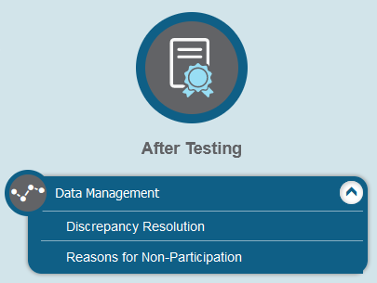
Data Management
Notes:
In the After Testing section of the TIDE dashboard, the Data Management task menu lets users enter non-participation codes to explain student non-participation and resolve test discrepancies.

Slide 61
Non-Participation Codes
A non-participation event occurs when a student does not take a test as scheduled.
You must assign a code to explain the non-participation for each test a student does not participate in.
Non-participation codes persist until they are changed.
Non-participation codes may also be referred to as special codes or reasons for non-participation.
Discrepancy Resolution
The Discrepancy Resolution (DRS) report will become active in TIDE approximately one month prior to the close of the summative test window.
The DRS report will list all students who have not yet started their eligible summative assessment(s) AND do not have a Non-Participation Code entered in TIDE. Once a Non-Participation Code is entered in TIDE for a student, that student will no longer be included in the school’s DRS report.
Notes:
There are circumstances in which a student did not participate in an expected summative test or participated in a summative test but in a non-standard way. Examples could include a student inadvertently taking an incorrect test, a parent opting a student out of testing, or the student not receiving appropriate instruction prior to the test. In such instances, you need to assign a non-participation code to the student’s test so that the TIDE system can accurately explain the non-participation.
Please note that once you apply a non-participation code, that code persists until it is changed.
For a list of non-participation codes and their descriptions, please consult the TIDE User Guide.
The Discrepancy Resolution (DRS) report will become active in TIDE approximately one month prior to the close of the summative test window.
The DRS report will list all students who have not yet started their eligible summative assessment(s) AND do not yet have a Non-Participation Code entered in TIDE. Once a Non-Participation Code is entered in TIDE for a student, that student will no longer be included in the school’s DRS report.

Slide 62
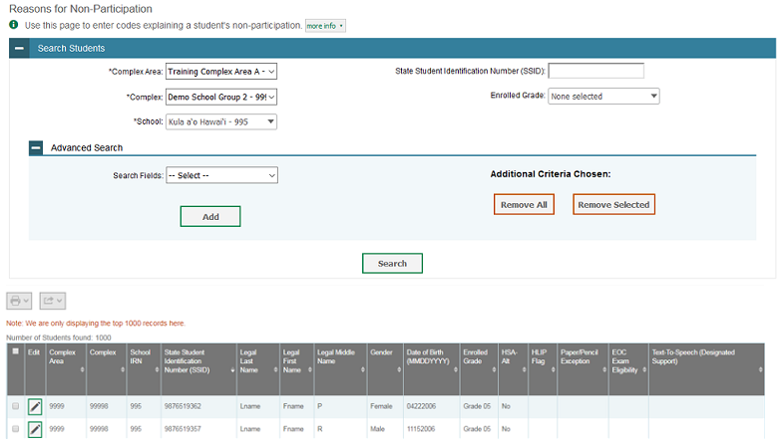
Reasons for Non-Participation
Notes:
To view or edit a student’s non-participation codes from the Reasons for Non-Participation page, select a complex area, complex and school from the drop-down lists, if available. You may enter a student ID, or enrolled grade if desired. You can further refine your criteria by entering additional demographic information or test settings in the Additional Search panel.
Click Search to retrieve a list of students matching your selected criteria. If your user role permits, you can edit a student’s non-participation codes by clicking the green pencil icon.

Slide 63
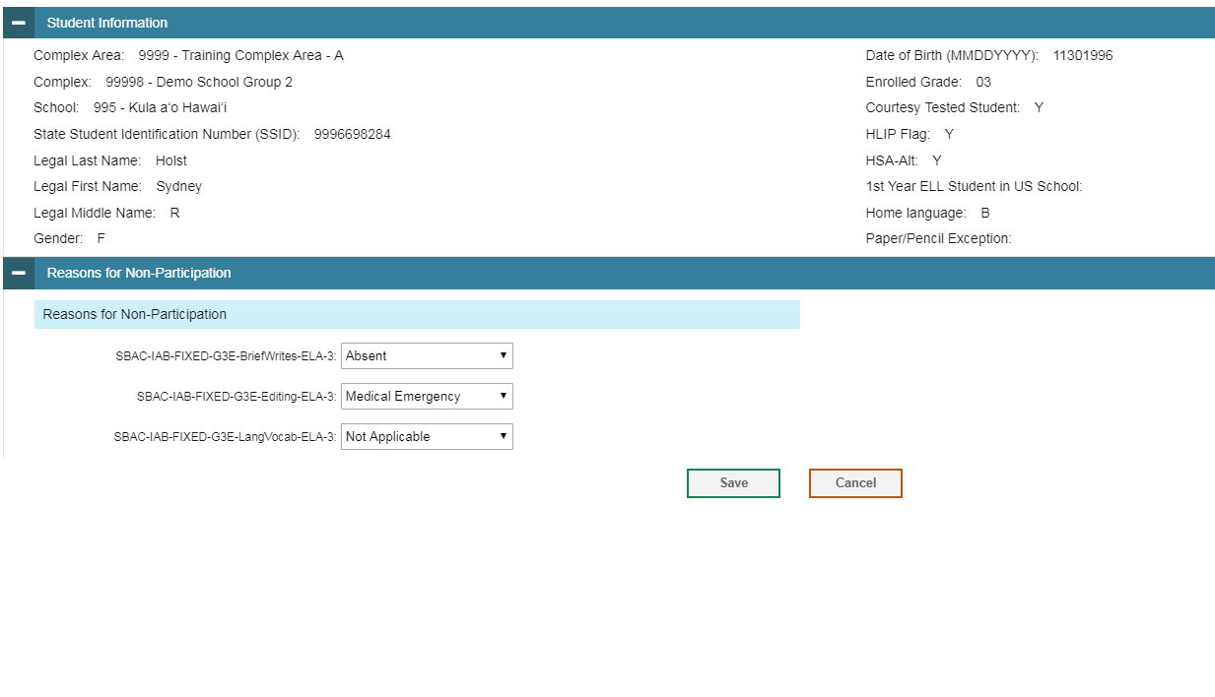
View Reasons for Non-Participation Results
Notes:
When you click the green pencil icon, another page will appear where you can edit and save the student’s non-participation codes. The Student Information panel provides the student’s demographic information. The student’s available tests and non-participation codes are listed in the Reasons for Non-Participation panel.
To edit the student’s non-participation codes, from the drop-down lists in the Reasons for Non-Participation panel, select the non-participation for each available test, as required, and click Save.

Slide 64
Contact Your Help Desk
You can contact the Help Desk for assistance with any technical issues you encounter.
When contacting the Help Desk, please be ready to provide the following information:
Any error messages that are appearing (including codes)
Your operating system and browser information
Your network configuration information
Your contact information for follow-up by telephone or email
Any other relevant information, such as test names or content areas, student IDs, session IDs, and search criteria
For test administration or policy issues, please contact your school Test Coordinator.
Notes:
You can find the TIDE User Guide and other helpful resources on your state assessment portal. However, if you still require assistance with troubleshooting a technical issue, you may also contact your Help Desk. When contacting your Help Desk, please be ready to provide the following information:
Any error messages that are appearing (including codes)
Your operating system and browser information
Your network configuration information
Your contact information for follow-up by telephone or email
Any other relevant information, such as test names or content areas, student IDs, session IDs, and search criteria
For questions about test administration or policy issues, please contact your school Test Coordinator.

Slide 65
Thank You!
Further Information
Visit
alohahsap.org
smarterbalanced.org
Call, fax, or email the HSAP Help Desk
Hours: 7:30 am to 4:00 p.m. HST, Monday-Friday (except holidays)
Phone: 1-866-648-3712
Fax: 1-877-231-7813
Email: HSAPHelpDesk@cambiumassessment.com
Notes:
Thank you for taking the time to view this training module. For additional information, refer to your TIDE User Guide located on your portal or contact the Help Desk.

