Slide 1
Interim Assessments Online
Notes:
Notes:
Remember turn chat feature off between participants and only allow chats to be directed to host. This will prevent student-to-student communications that could compromise the security of the test.

Slide 2
Before we start...
Let’s make sure you have everything you need...
SSID (this should be 10 numbers)
My Contact Information
Testing Session ID
Notes:
Notes:
Delete bullets in the slide that do not apply because you have provided the information in advance.
Remember that the testing session ID must be launched no earlier than 30 minutes prior to students entering the site. The platform is only allowed to idle without activity for a maximum of 30 minutes.

Slide 3
Training Site
Let’s take a look at what you will see when you take the interim assessment.
https://hsa.tds.cambiumast.com/student
Notes:
Notes:
Use slides 3-10 for a training day only.
Make sure to launch your practice test now: https://hsapt.tds.cambiumast.com/testadmin
Remember that this is different from the TA Live Site, which should be used to launch interim assessments.
You may need to place the student site URL in the chatbox if students do not have it in advance.

Slide 4
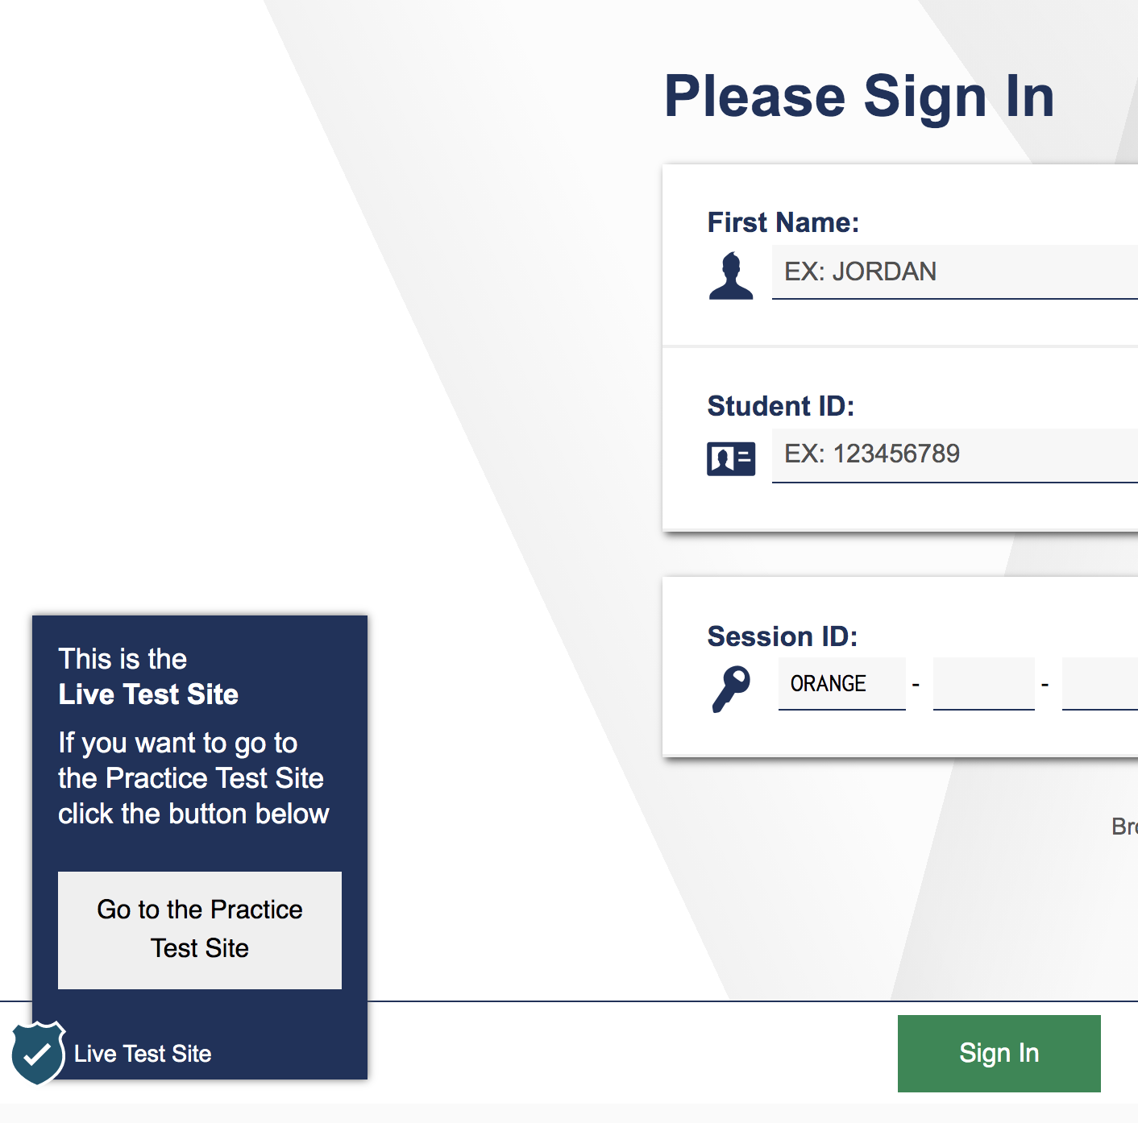
Step 1.
To see a training test, select the “Go to Practice Test Site” in the bottom left corner of the page.

Slide 5
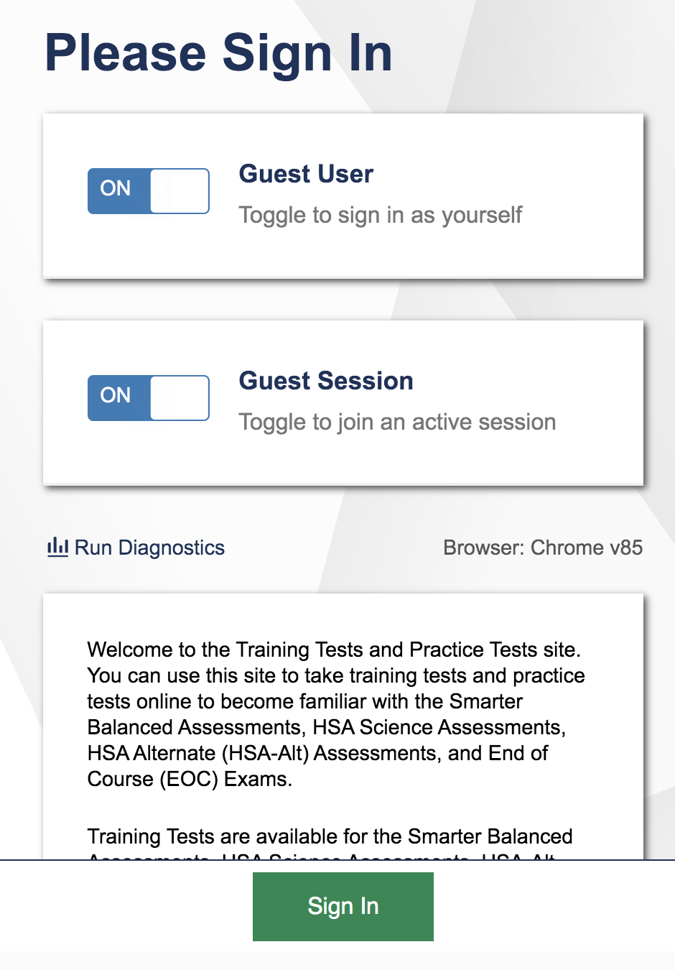
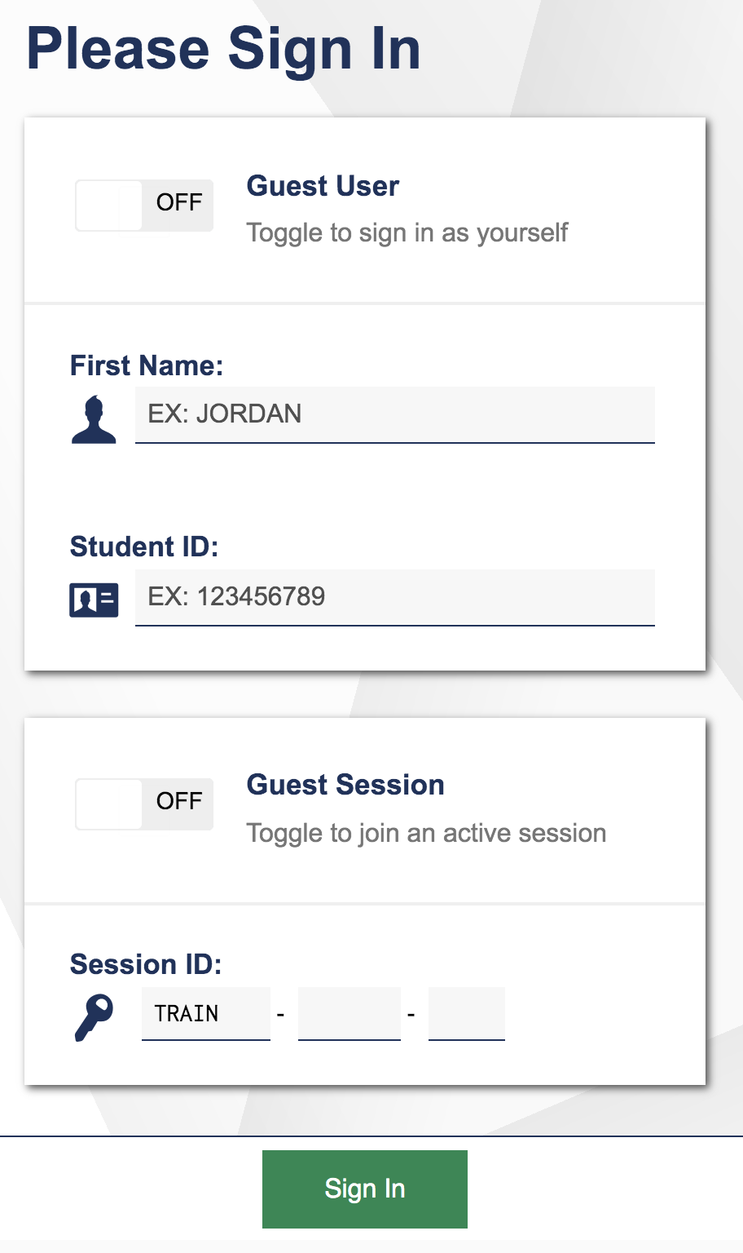
Step 2.
Click the “On” buttons so they say “Off” and allow you to enter in information.

Slide 6
Step 3.
Enter your first name in the top row, and your SSID (ten numbers) in the second row.
Enter the Session ID here. <enter session ID>

Slide 7
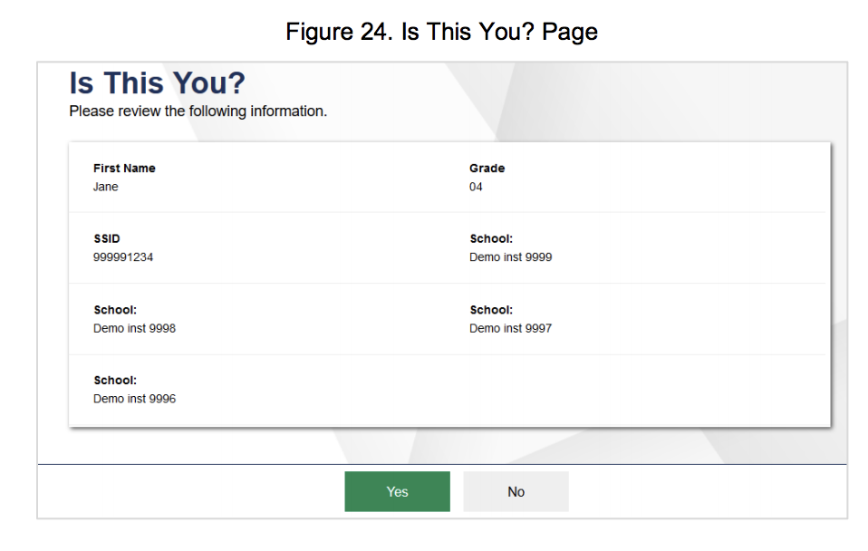
Step 4.
Once you have logged in, confirm that it really is you!

Slide 8
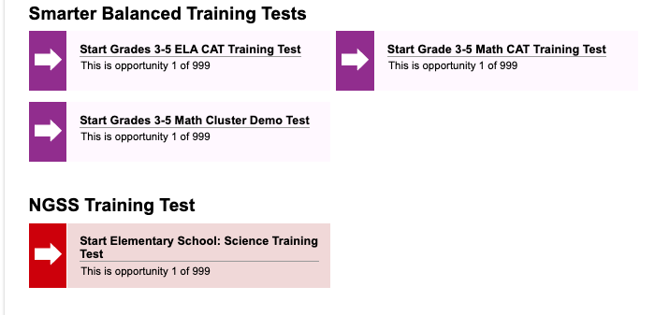
Step 5.
Select the <enter name> Training Test! When we take the Interim Assessments, you will select another test name.

Slide 9
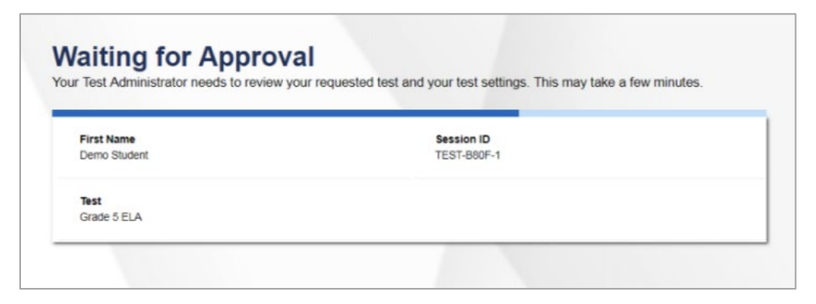
Step 6.
Wait here while I approve your test. Then you can get started!
Notes:
Notes:
Remember to approve all appropriate students for the appropriate tests.

Slide 10
Testing Day
Open this URL in your browser, and let’s begin!
https://hsa.tds.cambiumast.com/student
Notes:
Notes:
Place this link in the chat box in case if students do not have it in advance.
Make sure to launch your test now from the TA Live Site, if you have not already.

Slide 11
Ready to Start?
Testing Session ID: <enter here>
Test Name: <enter here>

Slide 12
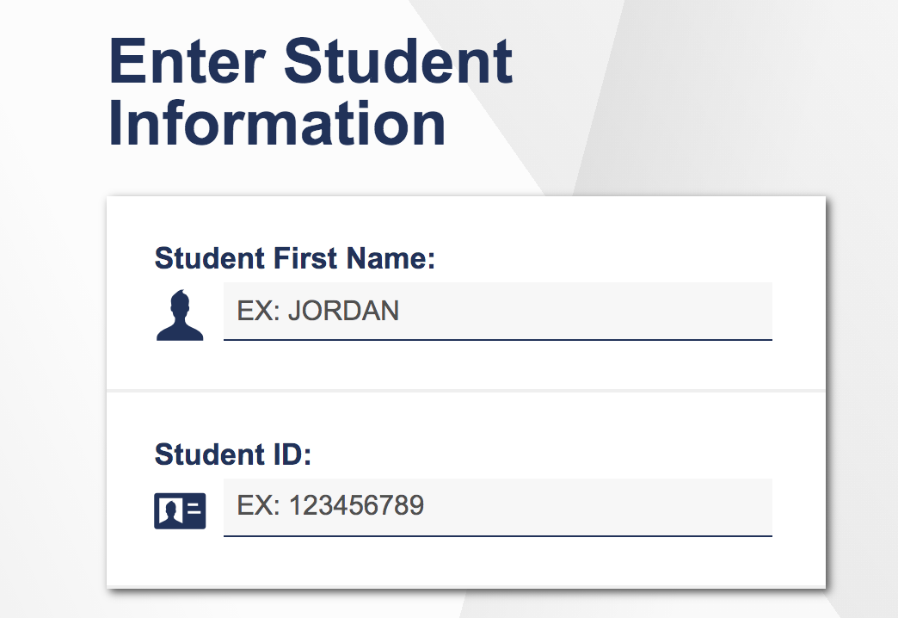
Step 1.
Enter your first name in the top row, and your SSID (ten numbers) in the second row.

Slide 13
Step 2.
Once you have logged in, confirm that it really is you!

Slide 14
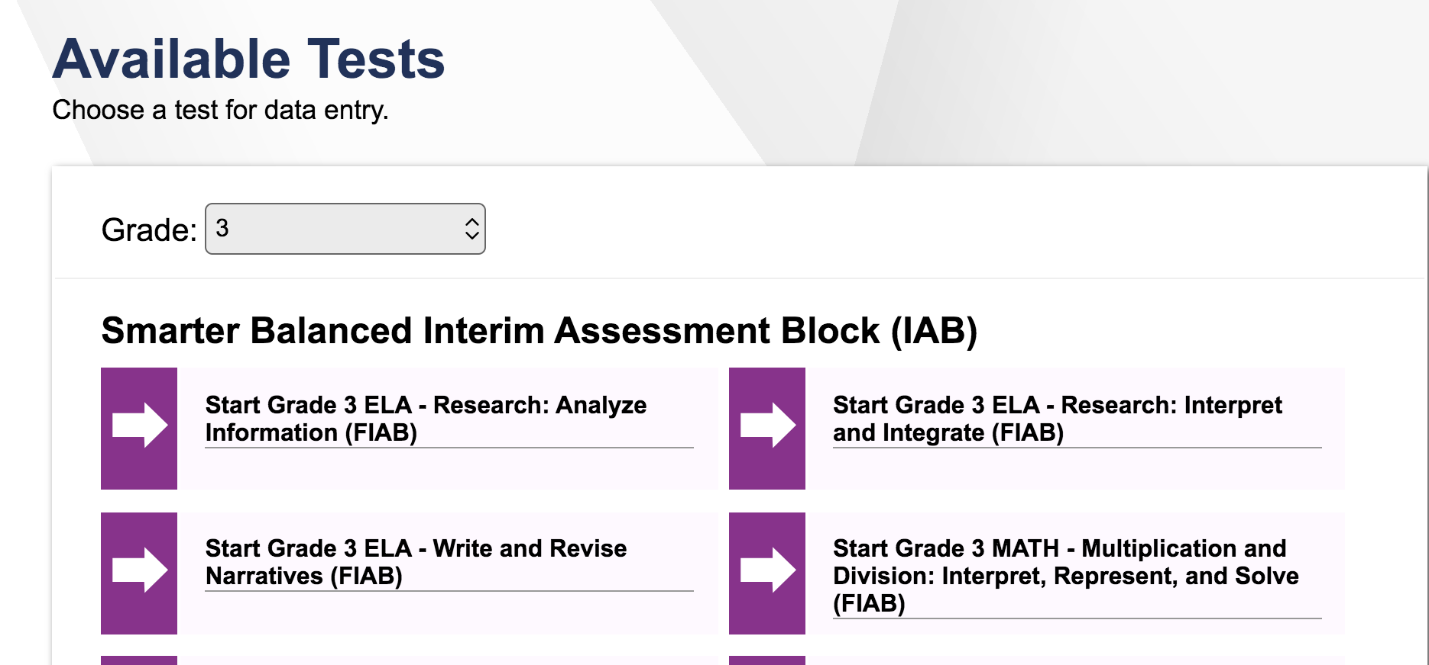
Step 3.
Select the <enter name of the test>!
Notes:
Notes:
You may remove this slide if it will confuse the student or replace with another screen capture using AVA.

Slide 15
Step 4.
Wait here while I approve your test. Then you can get started!
Notes:
Notes:
Remember to approve all appropriate students for the appropriate tests.

Slide 16
Need Help?
Chat me (in our Zoom chat)
Email me (enter email)
Call me (enter number)
Notes:
Notes:
Update this information as applicable.

