Slide 1
How to Take a Test at Home
Students and Families Training Module
Copyright © 2021 Cambium Assessment, Inc. All rights reserved.
Notes:
Welcome to the How to Take a Test at Home – Students and Families training module. This module will walk students and families through how students take summative tests when students are not in the classroom. Students will use the same testing system that they have been using prior to this to take tests in the classroom, with a few additional features that will allow the student to communicate directly with their school’s Test Administrator.

Slide 2
Course Objectives
This course will show you how to do the following:
Check to make sure you have the proper hardware and that it functions
Log in to the testing system to take a test from home
Communicate with your school’s Test Administrator while taking a test at home
Take and submit a test at home
Notes:
This course will show you how to do the following:
Check to make sure you have the proper hardware and that it functions
Log in to the testing system to take a test from home
Communicate with your school’s Test Administrator while taking a test at home
Take and submit a test at home

Slide 3
Security and Privacy
Students will not be asked to enter any additional personally identifiable information than they would in an ordinary test session in a classroom.
For additional information, please see the HIDOE Remote Test Administration Guidelines on the AlohaHSAP.org portal site: https://smarterbalanced.alohahsap.org/resources/resources-2021-2022/remote-summative-test-administration-2021-2022.
Notes:
The option to test students at home is built into the existing online testing system. This is the same online testing system that students used to complete their tests last year. Students will not be asked to share any personally identifiable information beyond what they would share in an ordinary test session in a classroom. For additional information, please see the HIDOE Remote Test Administration Guidelines on the AlohaHSAP.org portal site: https://smarterbalanced.alohahsap.org/resources/resources-2021-2022/remote-summative-test-administration-2021-2022.

Slide 4
Providing Consent
Parent or guardian and student consent is required for a student to participate in a remotely administered test session (signed Parent/Student agreement).
HIDOE Assessment Parent/Guardian Remote Test Administration Agreement Form:
https://smarterbalanced.alohahsap.org/resources/resources-2021-2022/remote-summative-test-administration-2021-2022
HIDOE Remote Test Administration Guidelines Spring 2022:
https://smarterbalanced.alohahsap.org/resources/resources-2021-2022/remote-summative-test-administration-2021-2022
Notes:
Parent or guardian and student consent is required for a student to participate in a remotely administered test session. Use the links to access the Parent/Guardian Remote Test Administration Agreement Form and the HIDOE Remote Test Administration Guidelines for Spring 2022.

Slide 5
Ensuring that You Have the Proper Hardware and Software
Hardware / Software | Who needs the hardware/software
Supported device such as a desktop, laptop, Chromebook, or iPad *For a list of supported devices please visit: https://smarterbalanced.alohahsap.org/secure-browsers.html | Test Administrators Students
Secure Browser | Students
Microphone, Speaker, and **Webcam (student test device and second device) | Test Administrators Students
Assistive Technology Software | Students requiring the use of assistive technology software such as text-to-speech or screen reader software
** In addition to the students webcam on the students device, a second device with a webcam will need to be in place facing the student and set up prior to beginning the assessment
Notes:
Before taking a test from home, make sure that you have the necessary hardware and software and that it functions properly.
Ensure that your testing device meets the following hardware and software requirements:
The student is using a supported device such as a desktop, laptop, Chromebook, or iPad. For a list of supported devices please visit: https://smarterbalanced.alohahsap.org/secure-browsers.html.
The student’s testing device has the Secure Browser installed.
The student’s testing device will require a built-in or plug-in webcam, microphone, and speaker as well as internet connectivity. In addition to the students webcam on the testing device, a second device with a webcam will need to be in place facing the student and set up prior to beginning the assessment.
Students in need of assistive technology, such as text-to-speech software or screen readers, will need this as well.

Slide 6
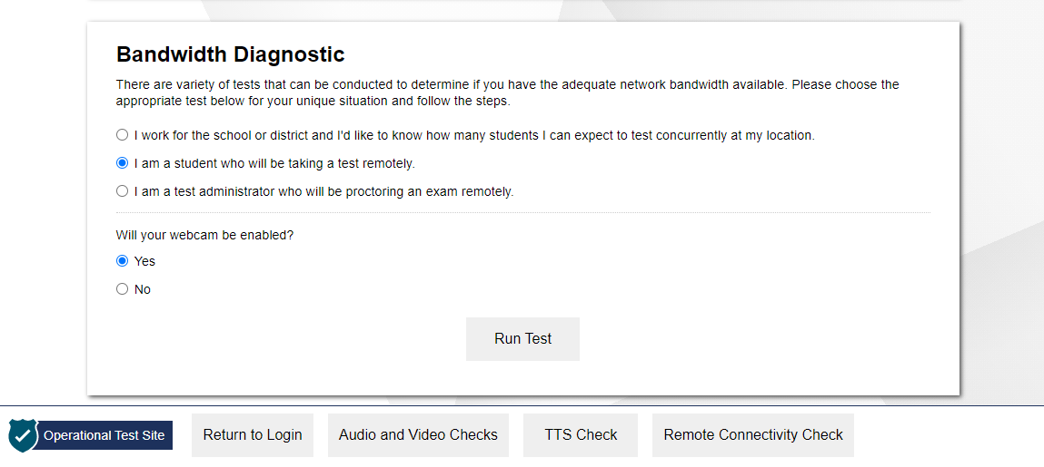
How to Test Your Internet Speed
https://bit.ly/check_my_speed
Notes:
Before the day of the test, you should make sure your Internet speed is fast enough to take a test at home.
To test your internet speed, go to the Bandwidth Diagnostic check at https://bit.ly/check_my_speed
You should select the second radio button that states “I am a student who will be taking a test remotely.” Then you will need to indicate if you will be using their webcam and select Run Test. You will see your download speed, upload speed, and summary letting you know if your Internet is fast enough to take a test at home. If your home Internet speed is fast enough to test at home, the summary will appear in a green box and will say “Given the current network conditions, your available bandwidth meets or exceeds the necessary requirements.”
If the diagnostic summary indicates that your Internet speed is not fast enough, let your school’s Test Administrator know. You will need to use the same communication method you used prior to this to contact your Test Administrator.

Slide 7
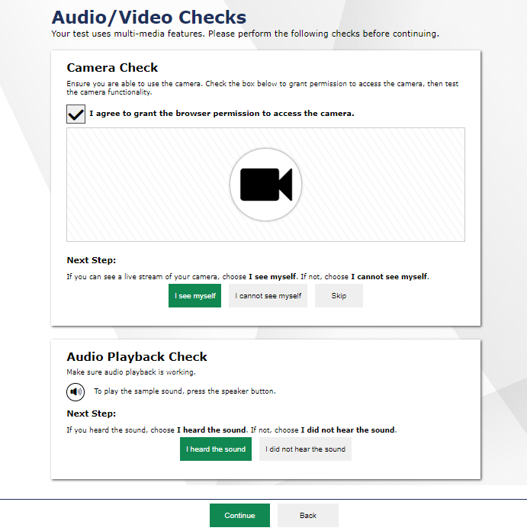
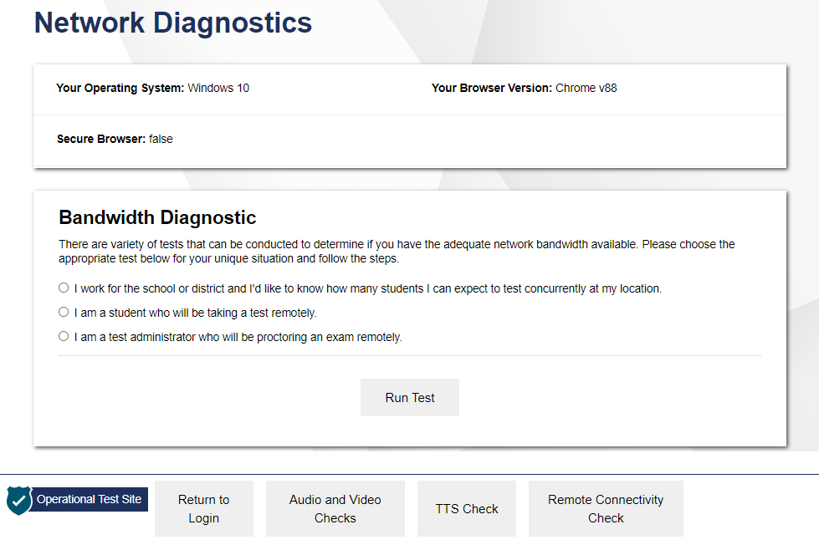
How to Check Your Hardware
https://bit.ly/check_my_speed
Notes:
In addition to ensuring you have the necessary hardware and checking your internet speed, you must also make sure that your hardware is functioning correctly prior to the day you take the test at home. You should work with your school’s Test Administrator and/or technology coordinator to test the functioning of each piece of hardware prior to taking a test at home.
You can check your hardware using the Network Diagnostics check located at the following URL: https://bit.ly/check_my_speed
Note that this is the same link you use to access the internet speed checker. You can use this tool to check both internet speed and your audio and video hardware.
Once on the Network Diagnostics page, select the Audio/Video Checks button. A series of audio and video checks will appear. To run the checks, follow the instructions for each individual check to determine if your hardware is functioning correctly.
If you encounter any problems during the audio and video checks, contact your school’s Test Administrator to help troubleshoot the problem. You will need to use the same communication method you used prior to this to contact your Test Administrator.

Slide 8
How to Obtain Necessary Assistive Technologies
Students who use assistive technologies during a test that takes place at school need access to the same assistive technologies when they take a test from home.
Parents, guardians, and students should work with their teacher and school’s technology coordinator to set up any necessary assistive technologies, such as text-to-speech software or screen readers.
If access to necessary technologies cannot be provided to students at home, parents, guardians, and students should work with their teacher to determine other options for taking the test, such as making arrangements to take the test in person at school.
Notes:
Students who use assistive technologies during a test that takes place at school need access to the same assistive technologies when they take a test from home.
Parents, guardians, and students should work with their teacher and their school’s technology coordinator to set up any necessary assistive technologies, such as text-to-speech software or screen readers.
If access to any necessary assistive technologies cannot be provided to the student at home, parents, guardians, and students should work with the teacher to determine other options for taking the test, such as making arrangements to take the test in person at school.

Slide 9
The Student Site
Notes:
Now that you have the necessary hardware and have checked to make sure it is working properly, let’s take a look at what you will see when taking a test at home.

Slide 10
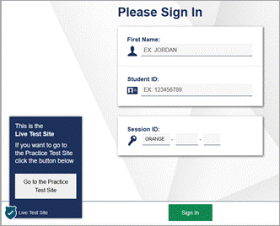
How to Sign Into the Remote Session
Sign into a remote session using the Secure Browser.
Secure Browser Icon
Notes:
Before taking a test, you sign in to the testing site for the remote session. Open the Secure Browser on the device you are using for remote testing and you will see the login page. This screen is exactly the same as the screen you see when taking a test in the classroom.
You will need to do the following:
log in using your first name;
enter your student ID number; and
enter the session ID that the Test Administrator provides.
Then select Sign In to continue.

Slide 11
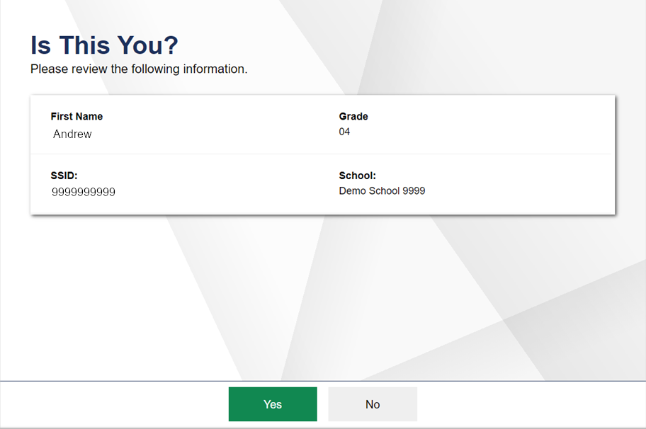
How to Confirm Your Student Information
Notes:
After signing in, you will see a screen asking you to confirm your student information. This screen is the same as the screen you would see when signing into the online testing system to take a test while present in the classroom.
You should carefully review your information to make sure it is accurate. If the information is correct, select Yes. If your information is incorrect, you will need to contact your Test Administrator using the same method you used to communicate with your Test Administrator prior to this.

Slide 12
How to Complete Audio/Video Checks
Notes:
Next, you will see an Audio/Video Checks screen with one or more check panels. These checks are similar to what you would see when taking a test in the classroom with the addition of the microphone and camera check needed for remote administration.
The next few screens will explain how to perform each audio and video check.

Slide 13
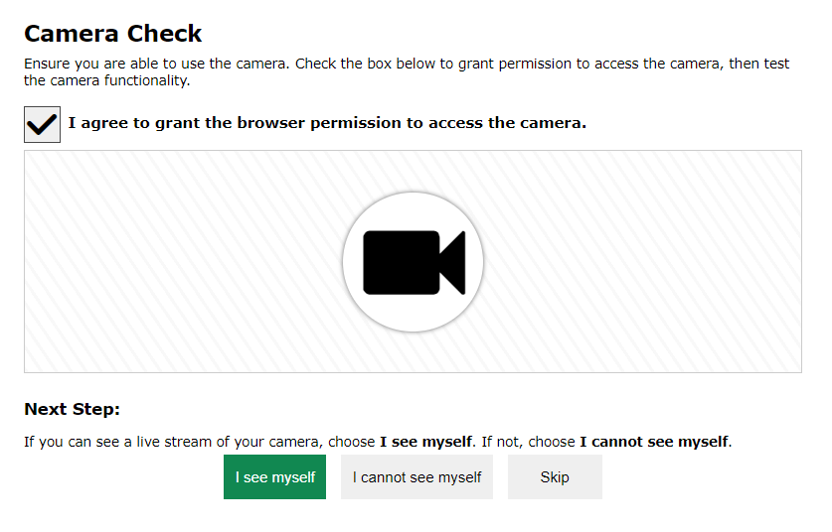
How to Check Your Webcam
Notes:
You will need to ensure your webcam is working properly by following the steps below.
You must mark the checkbox reading I agree to grant the browser permission to access the camera before you can proceed. You will then see a pop-up window that requests permission for the browser to access your device’s camera and microphone. If you do not select Allow, the online testing system will be unable to access the student’s web camera and you will not be able to continue to the test.
After allowing the browser access to your device’s webcam, live video should appear. If video appears, select I see myself. A checkmark will appear in the upper-right corner of the Camera Check field. If video doesn’t appear, select I cannot see myself and contact your Test Administrator to help troubleshoot the problem.

Slide 14
How to Check Your Audio
Notes:
To ensure your speaker is working properly, follow the steps below.
Select the speaker icon to play the sound. If you hear the sound from the speaker, select I heard the sound. A checkmark will appear in the upper right corner of the audio playback field.
If you do not hear the sound, you will need to click I did not hear the sound and contact your Test Administrator to help troubleshoot the problem.

Slide 15
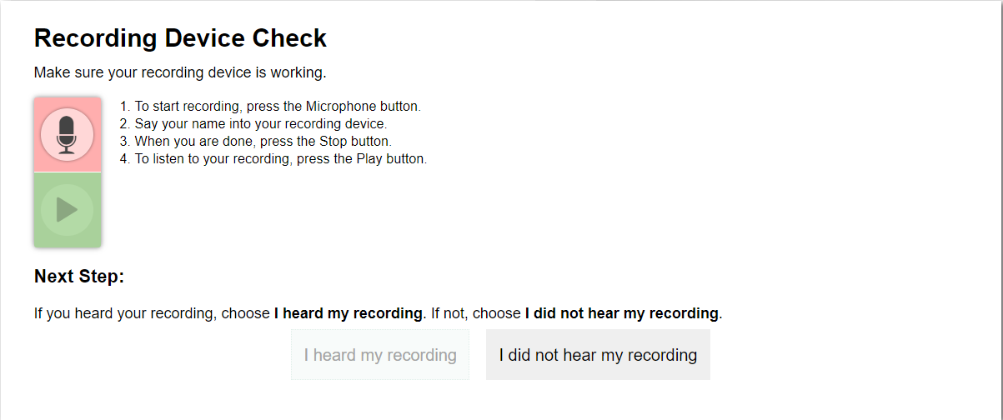
How to Check Your Microphone
Notes:
To ensure your microphone is working properly, follow the steps below.
First, click the record button which looks like a microphone. Next, speak into your microphone.
When you are done speaking, select the stop button to stop recording.
To listen to your recording, select the play button.
If you hear the audio you recorded play from your speaker, select I heard my recording. A checkmark will appear in the upper-right corner of the recording device check field.
If you do not hear your recording play, click I did not hear my recording. You should contact your Test Administrator to help troubleshoot the problem.
After all audio and video checks are completed, select Continue.
If you encounter a problem during a hardware check, the you should contact your Test Administrator using the same method of communication used prior to this.

Slide 16
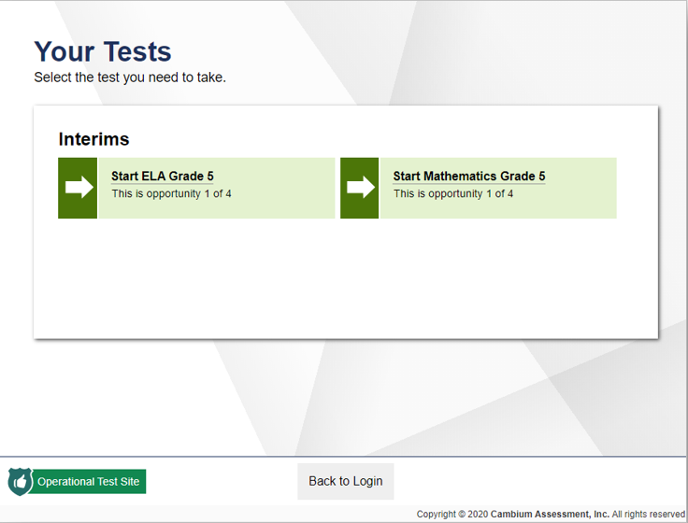
How to Select the Test You Will Take at Home
Notes:
On the next screen, you will select the test you need to take. This screen is the same screen you view when taking a test in the classroom.

Slide 17
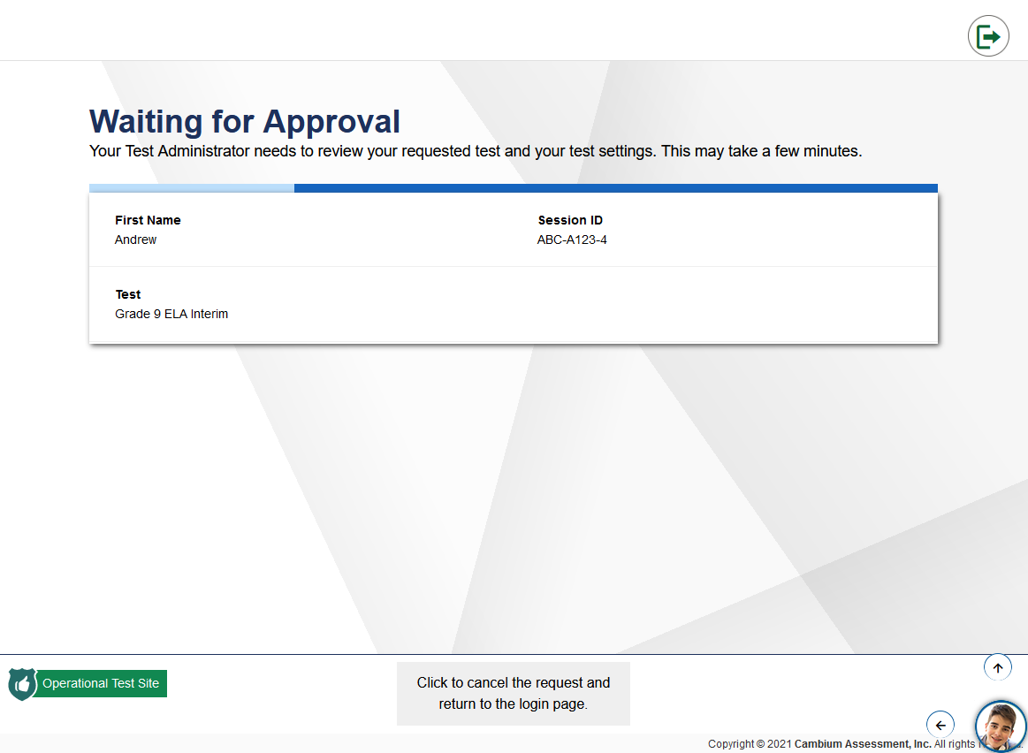
What You Will See When Waiting for Approval
Student video icon
Notes:
After selecting the test you need to take, a Waiting for Approval screen will appear. This screen is the same screen you see when taking a test in the classroom.
The Test Administrator will automatically be notified that you are waiting for approval, and they must approve you to enter the session before you can continue.
From this screen, you will also be able to start communicating with your Test Administrator. You will see the student video icon appear in the bottom right corner of your screen and you will see a live feed from your webcam. The image can be moved by clicking the arrows that appear when hovering over the image.
When you click on the student video icon, you will see an expanded video and chat window with features that will allow you to communicate with your Test Administrator. Let’s take a closer look at these features.

Slide 18
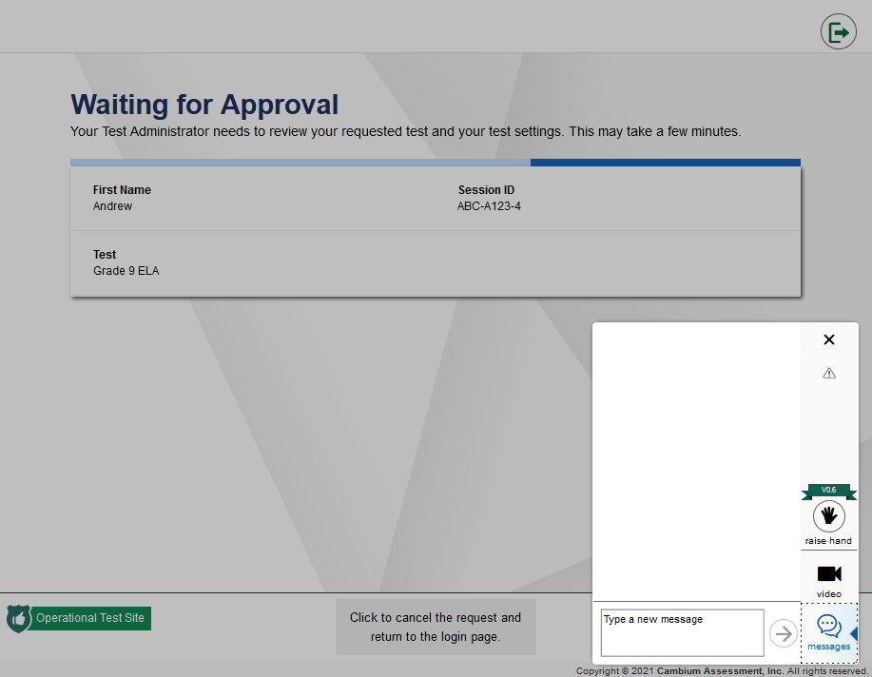
How to Send a Chat Message to Your Test Administrator
Student video icon
Send a chat message to your teacher
Notes:
You can send a chat message to your Test Administrator at any time once you are on the Waiting for Approval screen. To send your Test Administrator a chat message, select the student video icon to expand the chat/video window. Select the Messages button and type the message you want to send. Click the send button which looks like an arrow next to the message box to send the message to your Test Administrator.
The Test Administrator will receive an alert that you have sent a message. The Test Administrator can respond to your message by sending a chat message back to you. Test Administrators can also request a one-on-one video conference.

Slide 19
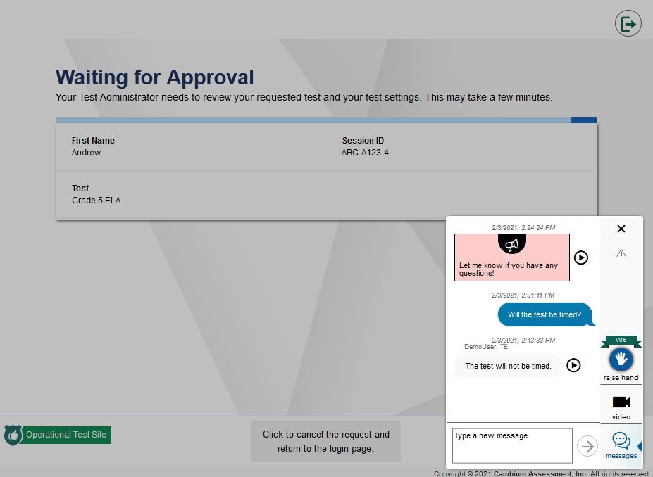
How to Virtually Raise Your Hand
Raise Hand icon
Notes:
If you need assistance or have a question, you can request help by virtually raising your hand using the Raise Hand feature. To virtually raise your hand, the student will select the Raise Hand button from the chat/video window. The button will then turn red indicating that you have raised your hand. If you want to lower your hand, you can do so at any time by clicking the button again. Once you have lowered your hand, the button will no longer appear in red.
Your Test Administrator will receive an alert that you have raised your hand. The Test Administrator can respond by sending you a chat message or requesting a one-on-one video conference.
Once the Test Administrator has responded to your raised hand, they can also lower your hand. If the Test Administrator lowers your hand, the hand icon will no longer appear in red on your screen.

Slide 20
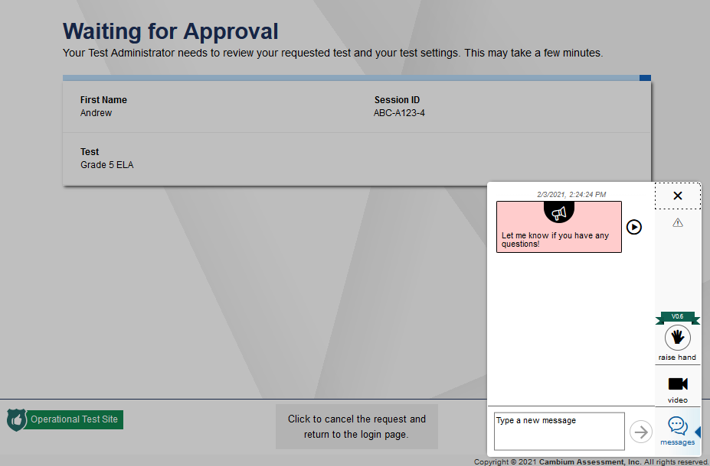
How Test Administrators Communicate with All Students at Once
Broadcast message to all students
Respond by sending a chat message
Notes:
Your Test Administrator can send a broadcast message to all students at once. Broadcast messages used to send important information to students, such as “Let me know if you have any questions.” or “Ten minutes left in the test!”
If your Test Administrator sends a broadcast message, it will appear automatically on your screen. If you want to respond to the broadcast message, you can do so by sending your Test Administrator a chat message. The chat message will only be visible to the Test Administrator and will not appear on any other student’s screen.
It is important to note that if you join a session after a message is broadcast, you will not see that broadcast message. Broadcast messages will only appear for students who have joined the test session and are waiting for approval.

Slide 21
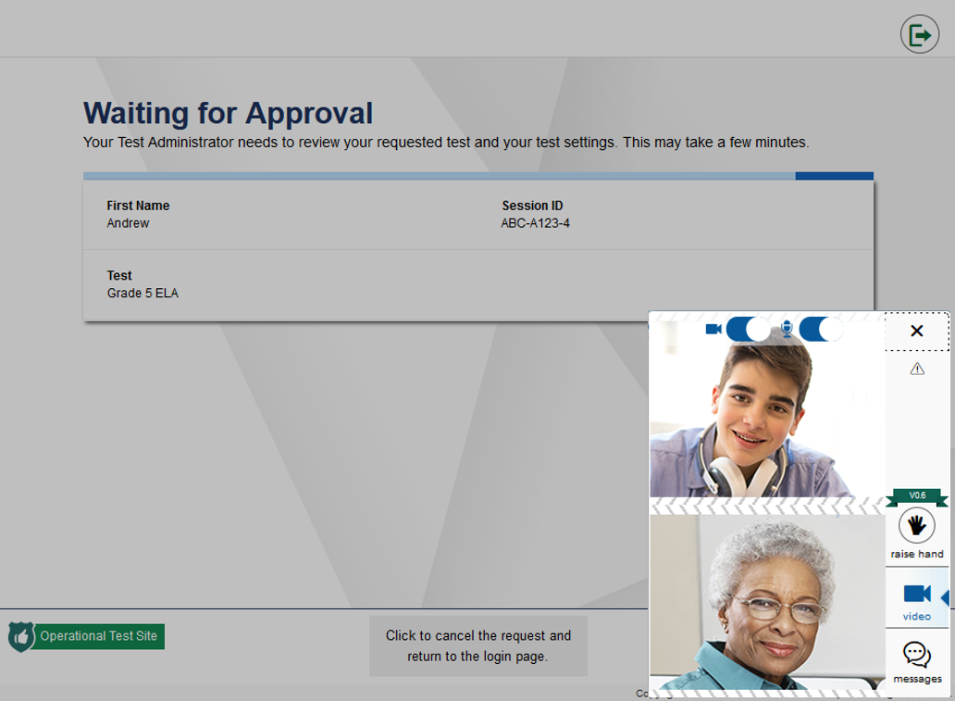
How Your Test Administrator Can Request a One-to-One Video Conference
Notes:
Test Administrators can also start a one-to-one video conference with a student. It is important to note that the Test Administrator must initiate the one-to-one video conference by calling the student.
After the Test Administrator places the call, you will see the video conference window with a split-screen video feed of you and your Test Administrator.

Slide 22
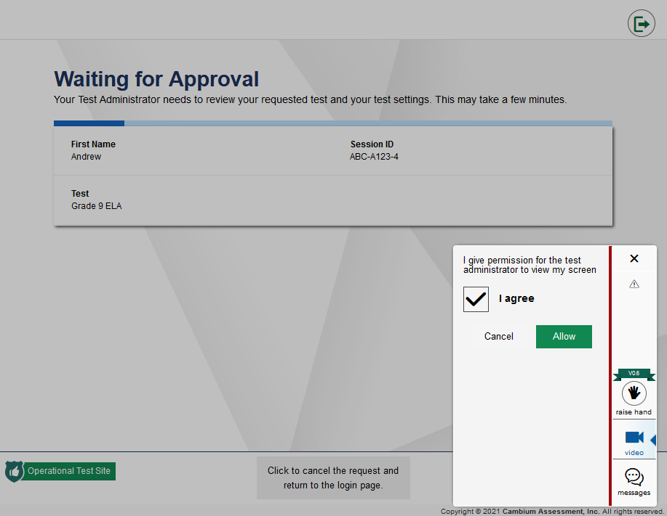
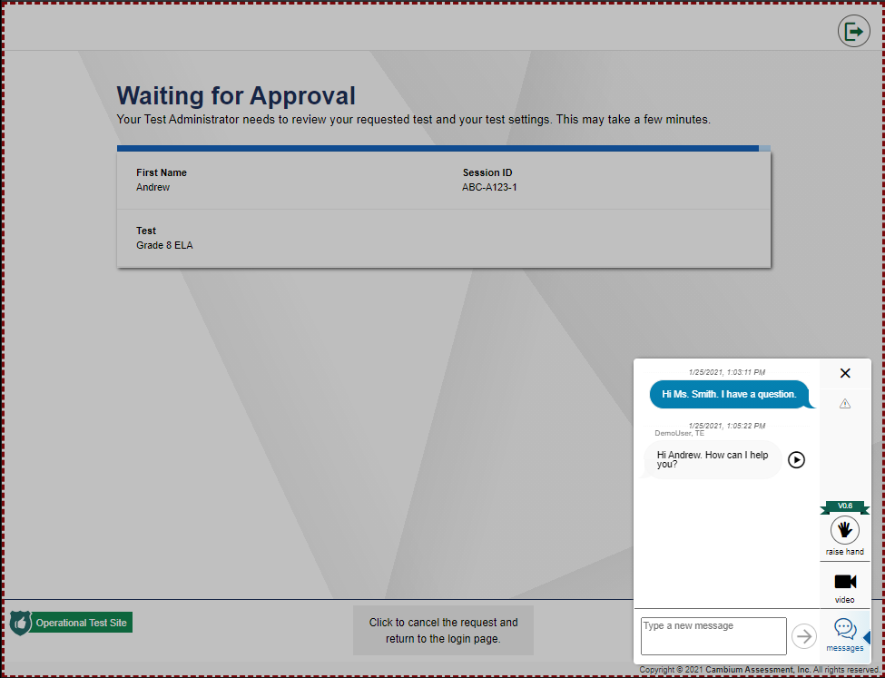
How Your Test Administrator Can View Your Screen
Teacher requests permission to view your screen
Teacher is viewing your screen
Notes:
Your teacher can also request to view your screen. If the Test Administrator wants to view your screen, they will first request permission.
A message will pop up on your screen, saying “I give permission for the test administrator to view my screen.” To grant your Test Administrator permission, mark the I agree checkbox and then select Allow.
A red dotted line will appear around your screen, letting you know that your Test Administrator is now viewing your screen. When the Test Administrator is finished viewing your screen, the red dotted line will no longer appear, letting you know the Test Administrator cannot see your screen.

Slide 23
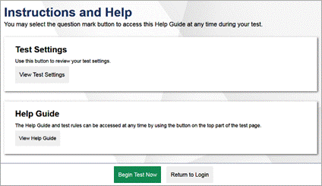
How to Access Test Instructions and a Help Guide
Notes:
After your Test Administrator approves you to enter the test session, you will see the same Instructions and Help screen you would see when taking a test in the classroom. This page will display a Test Settings section and a Help Guide section.
To view your test settings, select View Test Settings.
To access a help guide, select View Help Guide.
When you are ready to begin the test, select Begin Test Now.

Slide 24
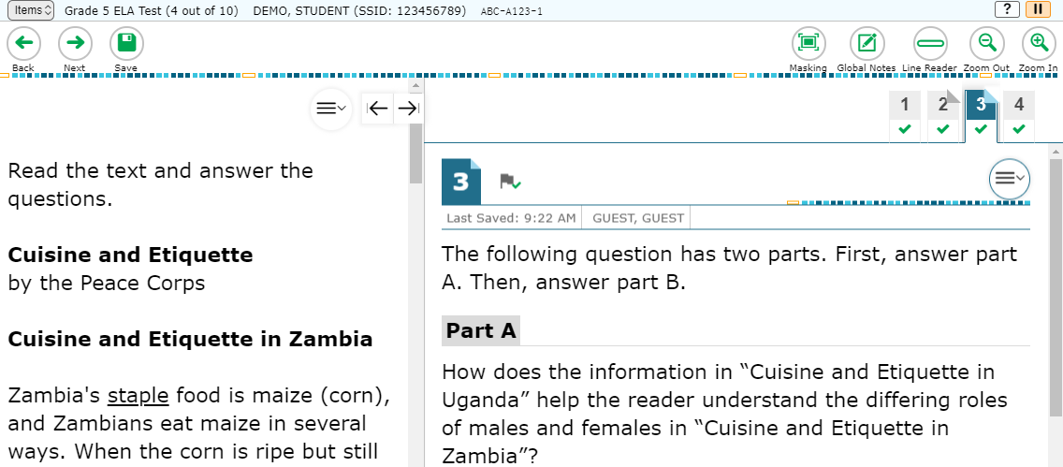
What You See After Entering a Test at Home
Notes:
After selecting Begin Test Now from the previous Instructions and Help screen, you will see the first question on the test. You will navigate through the test the same way you would when taking a test in the classroom.
It is important to note that you and your Test Administrator will be able to communicate using the features discussed earlier in this module while you are taking your test. Once you submit your test, you will no longer be able to communicate with your Test Administrator through the system.
If you lose your Internet connection during a test, the test is paused and your Test Administrator is notified. Your responses will automatically be saved up to the point you lost the Internet connection. When the connection resumes, you will need to sign into the test again using the same steps you did when you initially signed in to continue taking the test.

Slide 25
How to End a Test at Home
Notes:
When you answer the last question on the test you are taking at home, the End Test button will appear in the upper-left section of the screen, along with a message letting you know that the test has been completed and is ready to be submitted. Select the End Test button to end the test.

Slide 26
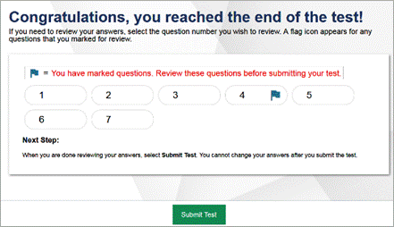
How to Submit a Test
Notes:
On the next screen, you will be prompted to review your answers before submitting their test. This screen is exactly the same as the one displayed when you take a test in the classroom. To review your answers, you can click on the question number to be taken back to that item on the test and review your answer.
Once you have reviewed your answers, select the Submit Test button.

Slide 27
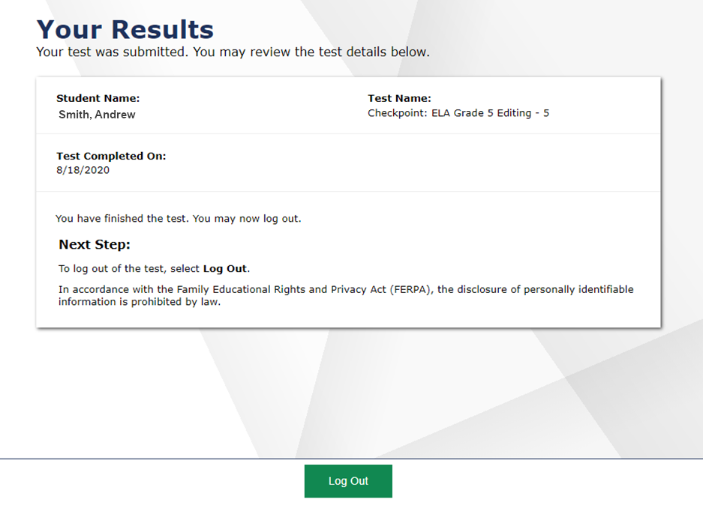
How to Confirm Your Test was Submitted
Notes:
Immediately after you confirm you want to submit your test, you will see the same test confirmation screen you would see when taking a test in the classroom. This screen lets you know that your test was successfully submitted. To log out and exit the test session, select the Log Out button.
As mentioned earlier, once you log out of the test session you will no longer be able to communicate with your Test Administrator through the system.

Slide 28
Additional Resources for Taking Tests at Home
FAQs
Troubleshooting Technology Issues for Students Testing at Home FAQs
Brochures
How to Test your Internet Speed
How to Take a Practice Test
Policies
HIDOE Remote Test Administration Guidelines Spring 2021
HIDOE Parent/Guardian Remote Test Administration Agreement
HIDOE Parent/Guardian Remote Testing Checklist
https://smarterbalanced.alohahsap.org/resources/resources-2021-2022/remote-summative-test-administration-2021-2022
Notes:
This slide lists some additional resources that are available on the Aloha HSAP portal.
These resources include the following:
Troubleshooting Technology Issues for Students Testing at Home FAQs
How to Check your Internet Speed brochure
Taking Tests from Home: A Quick Guide for Families brochure
HIDOE Remote Test Administration Guidelines Spring 2022
HIDOE Parent/Guardian Remote Test Administration Agreement
HIDOE Parent/Guardian Remote Testing Checklist
You can also contact your school’s Test Administrator, or other school staff, if you require additional assistance.
Thank you for viewing this training module.

