Slide 1
How to filter and search for items in Checkpoint
Checkpoint System training module
2021-2022
Copyright © 2021 Cambium Assessment, Inc. All rights reserved.
Notes:
Welcome to the How to Filter and Search for Items in Checkpoint training module. This module is part of a series of training modules on the Checkpoint system and its features. This module explains how you can use the search and filter features in Checkpoint so you can find an item you want to edit, find an item you need to review, and find an item to put on a test.

Slide 2
Objectives
Homepage Design—Content Tabs & Quick Links
Item Filter Options—Customize Your Search Results
Draft or Published Status—basic difference
Review Status of an Item—initial review and final approval
Find an Item in a Library & Add it to a Test
Add a Copy or the Original to the Test—basic difference
More Help
Notes:
First, we show you the design of the Homepage and the filtered links that display on the Items and Tests cards. We show you the filter options you can use to customize your search for items. We review the basic difference between draft status of an item and published status. We show you how to find the items you need to review. Then we show you how to find an item in your shared libraries so it can be added to a test. Finally, we conclude by reviewing the basic difference between adding a copy of an item to a test and adding the original.

Slide 3
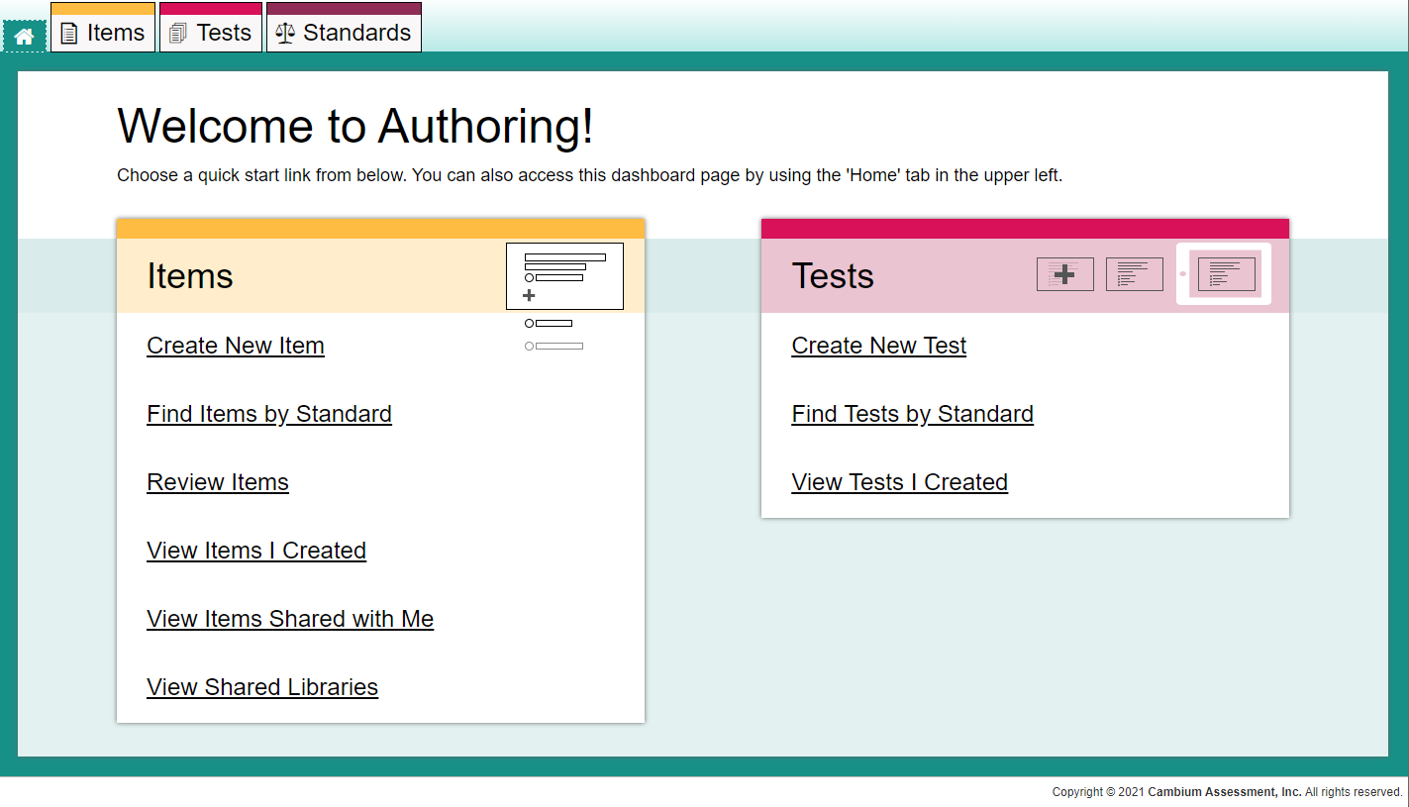
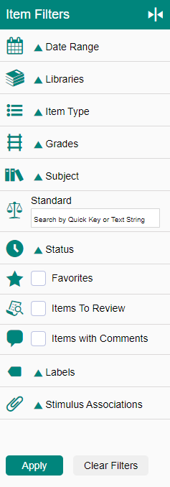
Homepage Design
1
4
2
3
Filtered Results
Notes:
The Checkpoint homepage has two main sections. Three content tabs, Items, Tests, and Standards, appear at the top of the page (1). Below them, the yellow Items card (2) and the pink Tests card (3) display quick links for common tasks. The tabs and the quick links both open your content pages. The tabs open as unfiltered content pages, which you can customize using the filters panel, shown here on the right (4).
These four quick links open with the contents already filtered:
Review Items,
View Items I Created,
View Items Shared with Me, and
View Tests I Created.
These filtered quick links can be further customized using the filters panel.
If you’re looking for an existing item to edit, use the Items tab or the Items quick links.
When you want to add an existing item from a shared library to a test, use the Tests tab or the Tests quick links.

Slide 4
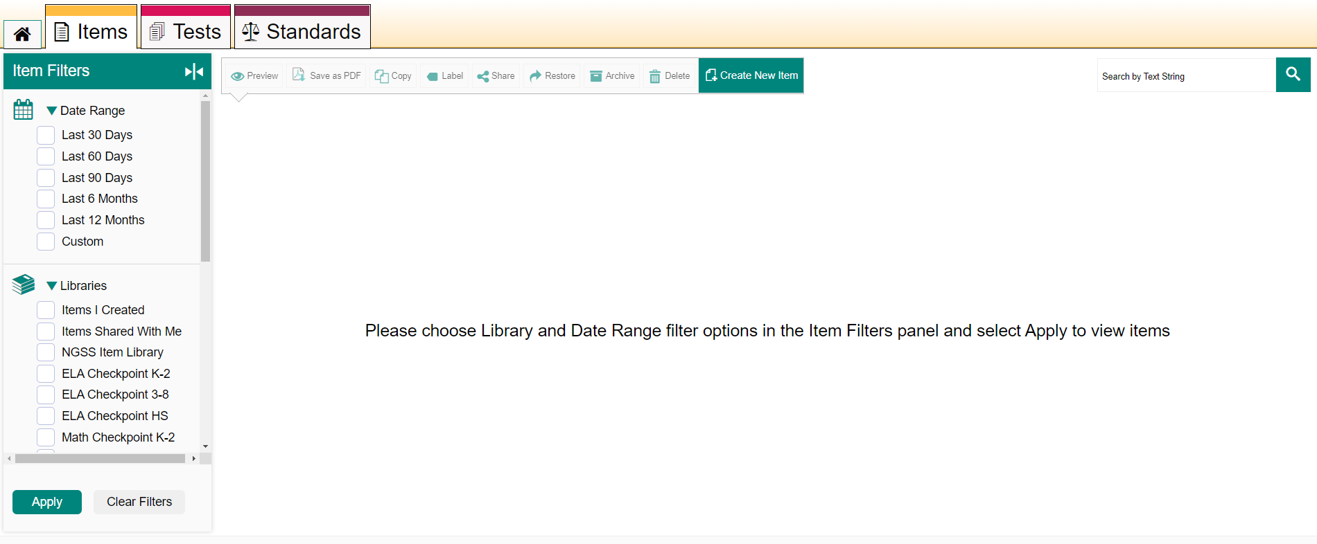
Unfiltered Content Page with Item Filters Open
1
3
2
Notes:
This is what a content page looks like before you customize it. You will always see a message suggesting you make your selections in the open Filters panel (1), which displays the extended menus for the options matching the instructions. You can select ANY options you want from the filters panel, but you must choose at least one, and then click Apply (2) to see your search results. There is a diverse list of filter options for both items and tests.
You can always perform a quick search for content by using the Search field (3) at the top right corner of the page. Enter a keyword that appears in the name or text of the item and click the magnifying glass button. Please note, the Standards search bar that appears within the filters panel on the left only allows you to search for items by their associated standards.

Slide 5
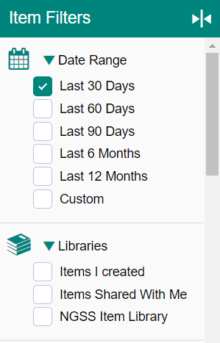
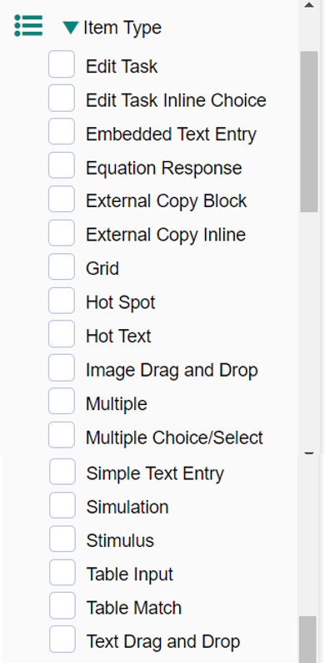
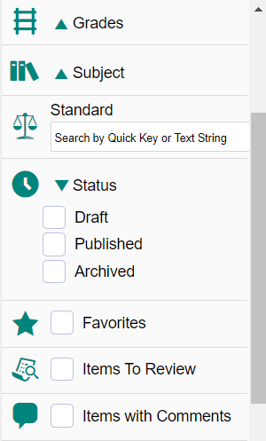
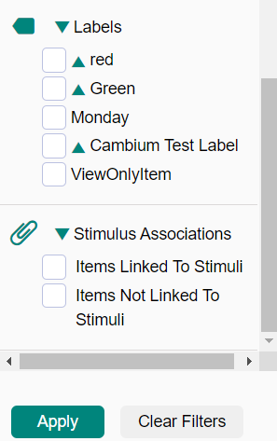
Item Filters—Options Available
Notes:
Here are all the options available on the Item Filters panel: Date Range, Libraries, Item Type, Grades, Subject, Standard, Status, Favorites, Items to Review, Items with Comments, Labels, and Stimulus Associations. You can clear your selections at any time by clicking on the Clear Filters button.

Slide 6
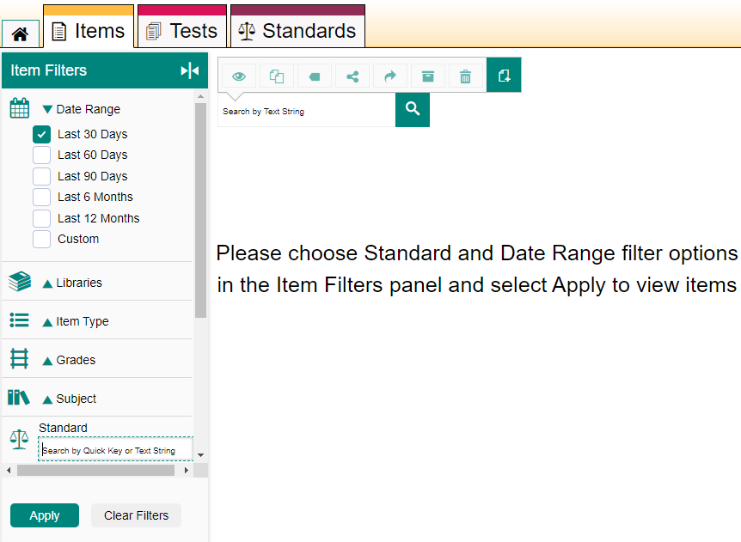
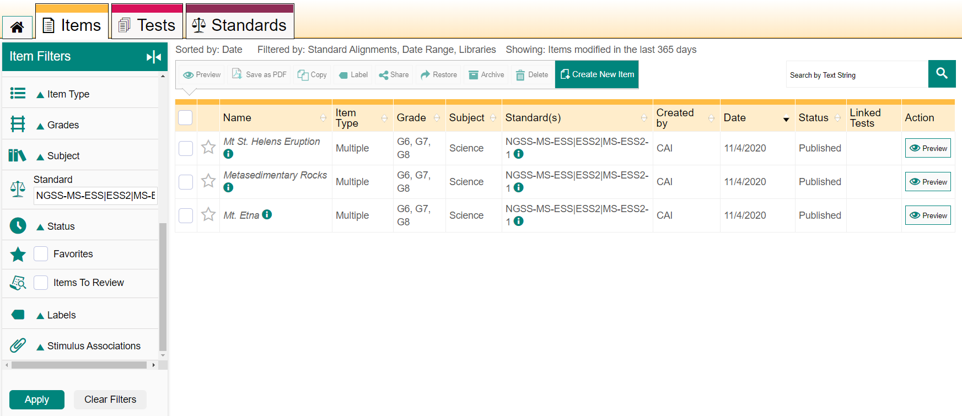
Find Items by Standard Using the Homepage Link
1
3
2
Notes:
To find items associated with a particular standard, click the Find Items by Standard link on the homepage (1). The message on the Items tab then instructs you to choose a Standard and a Date Range, and to select Apply (2). For example, the third image shows the items aligned to standard NGSS-MS-ESS2 that were published within the last year. The text at the top of the content tab shows you how the table is sorted and which filters were applied (3).

Slide 7
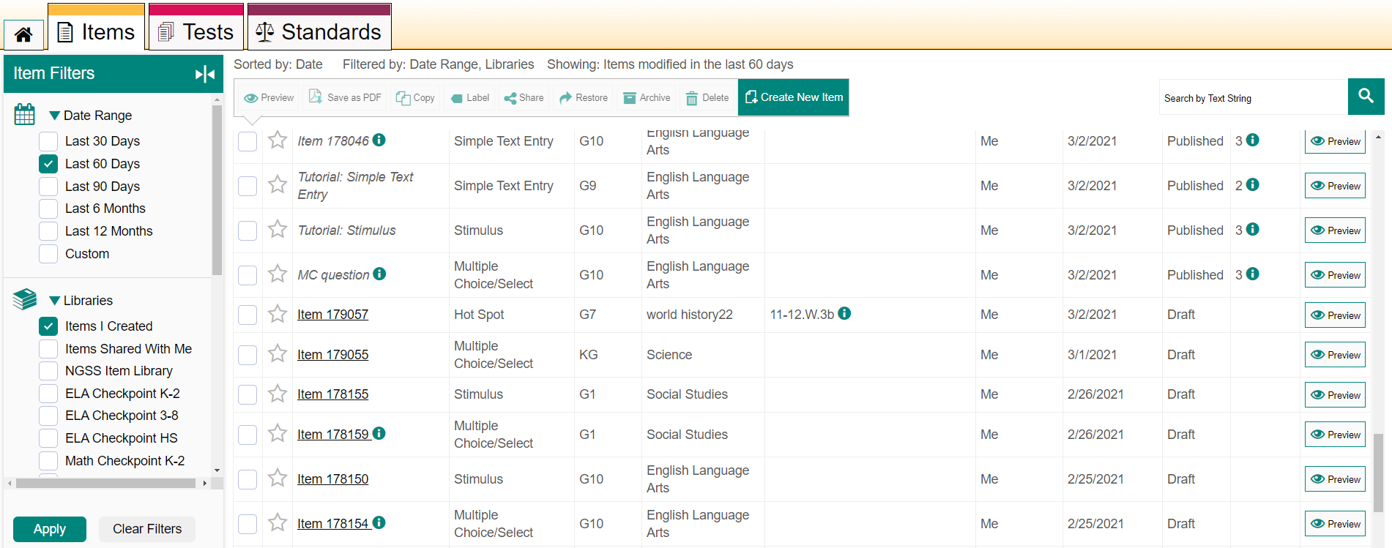
A Filtered Quick Link: View Items I Created
2
1
Notes:
To find an item you created, click the quick link: View Items I Created. This sample is further customized to include the date range of the last 60 days. However, please note that this link will show you items you created or edited in the last 30 days by default.
The Status column lists each item as “Draft” or “Published.”
1. Draft status means an item is new and that it is not part of any published test yet. It may already be linked to a Draft test as shown in Linked Tests column.
2. Published status means that the item has been added to a test that has been published so it can be administered to students. You cannot make changes to a published item. You can make a copy of a published item by using the Copy button in the item tool bar above the table and you can make edits to the copy.

Slide 8
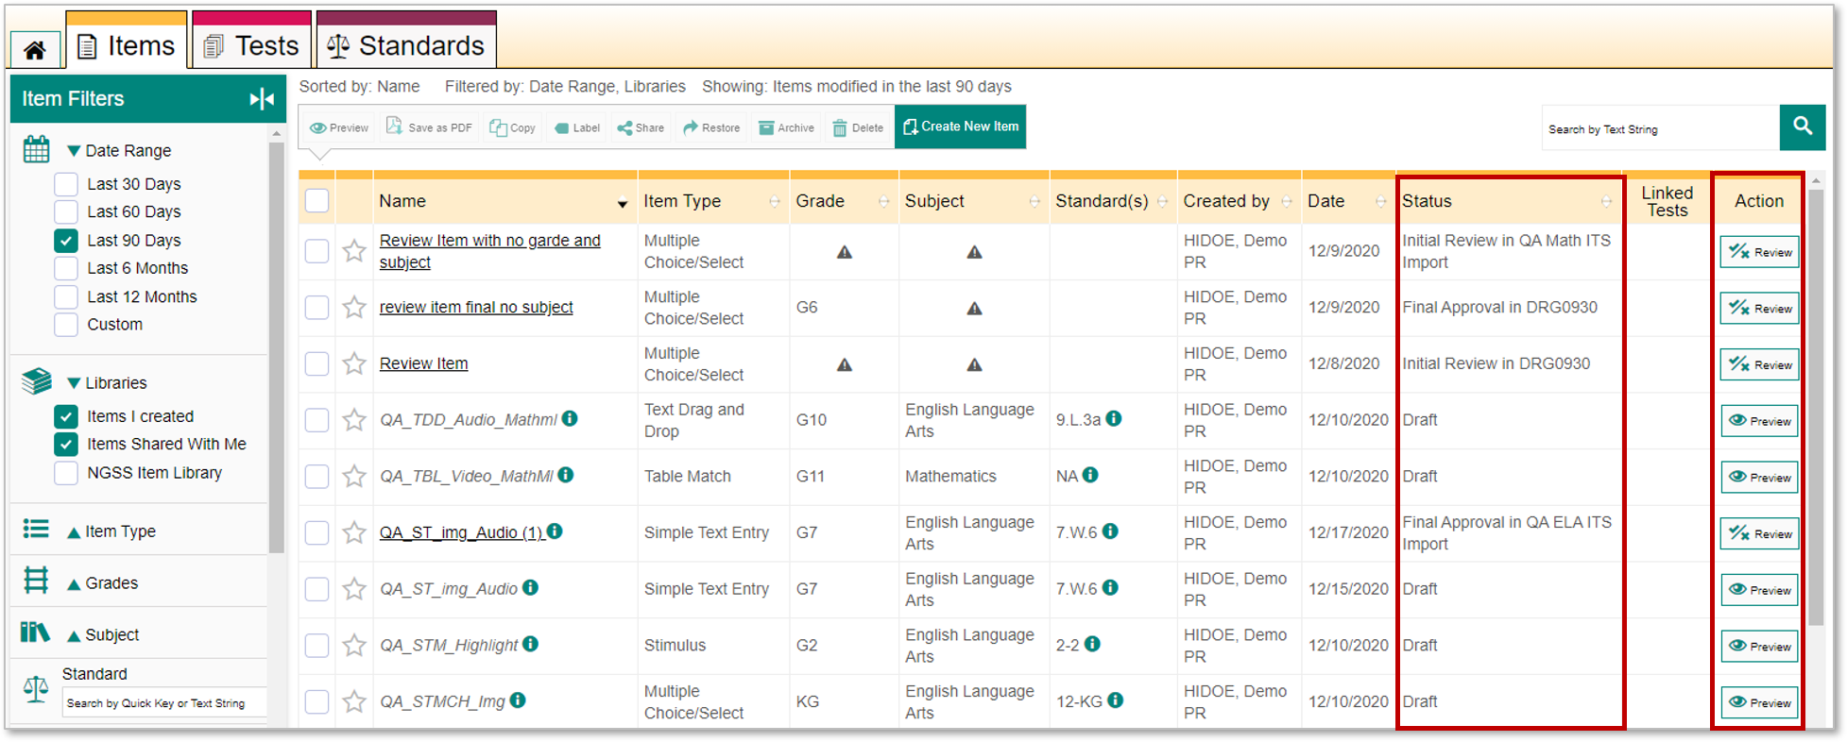
Items Shared With Me Quick Link
1
2
Notes:
To find an item that another Checkpoint user shared with you, click the quick link: View Items Shared with Me. The Items tab will appear, showing you items that other users shared with you in the last 30 days.
Sometimes when you are looking for items you will see items in review status, as shown here.
There are two steps in the item review process, Initial Review and Final Approval. Once an item is submitted and goes through the review process, it is added to the shared libraries.
If the item requires YOUR review, a Review button appears in the Action column instead of the Preview button that displays for Draft and Published items.
There is a separate training module for this process, How to Submit an Item for Review. It explains the whole process, in depth.

Slide 9
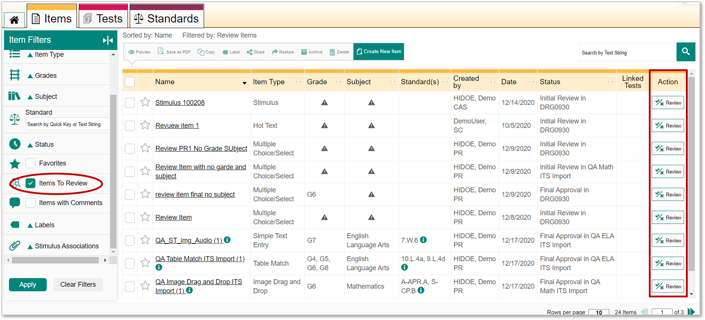
Items to Review Quick Link
Notes:
To find only the items that require your review use the Review Items quick link on the Homepage.

Slide 10
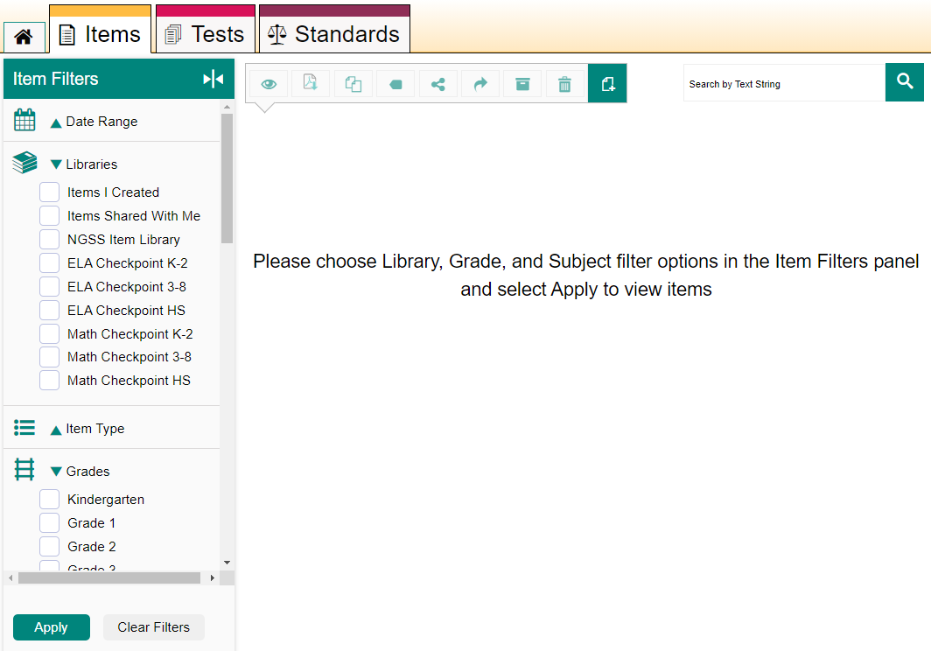
View Shared Libraries—Dashboard Link
Notes:
When you click the View Shared Libraries quick link on the Homepage, the Item Filters panel is open with the Libraries, Grades, and Subject menus expanded. You can use this quick link when you want to find items in a particular library, such as the NGSS, ELA, and Math Item Libraries shown here.

Slide 11
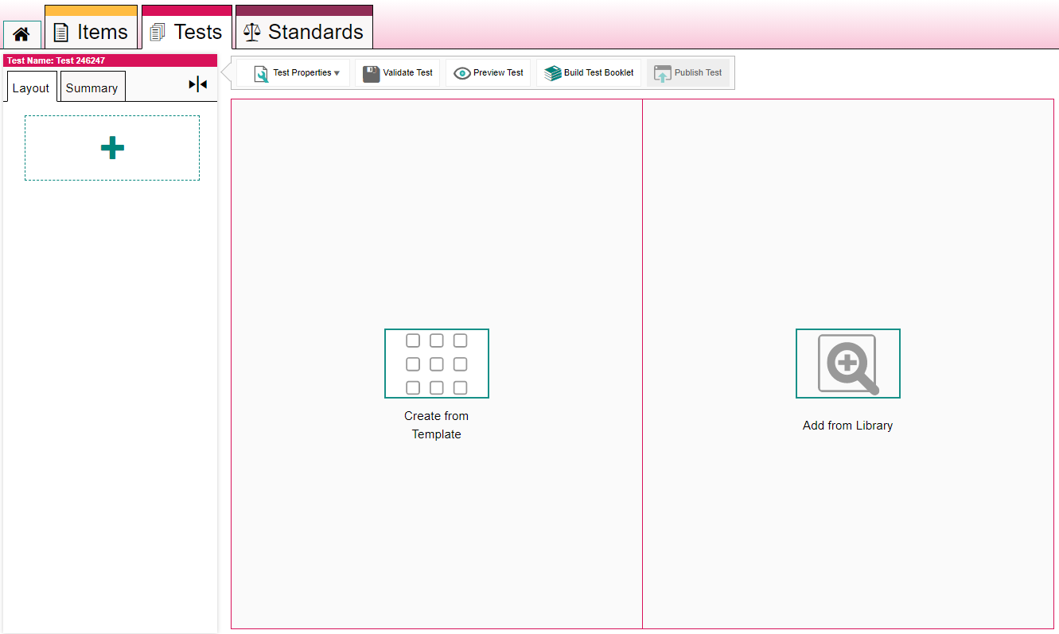
Add an Item to a Test
1
2
Notes:
When you create a test (1), you have the option of adding existing items from the libraries available to you. The search and filter tools you use to locate items on the Items tab can also help you locate the right items to add to your test.
To add existing items to your test, click the Add from Library (2) option on the test builder.

Slide 12
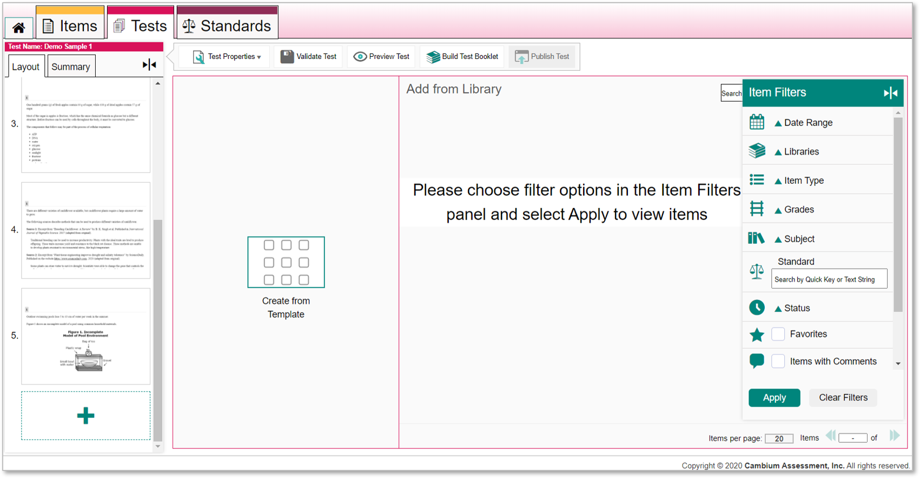
Use Item Filters Panel to Find Items You Need for a Test
3
4
Notes:
The Add from Library panel appears with the Item Filters (3) open on the right side of the page. You need to apply at least one filter to display items available for your use. After you select one or more filter options, click Apply (4) to display the list of items that match those filters.

Slide 13
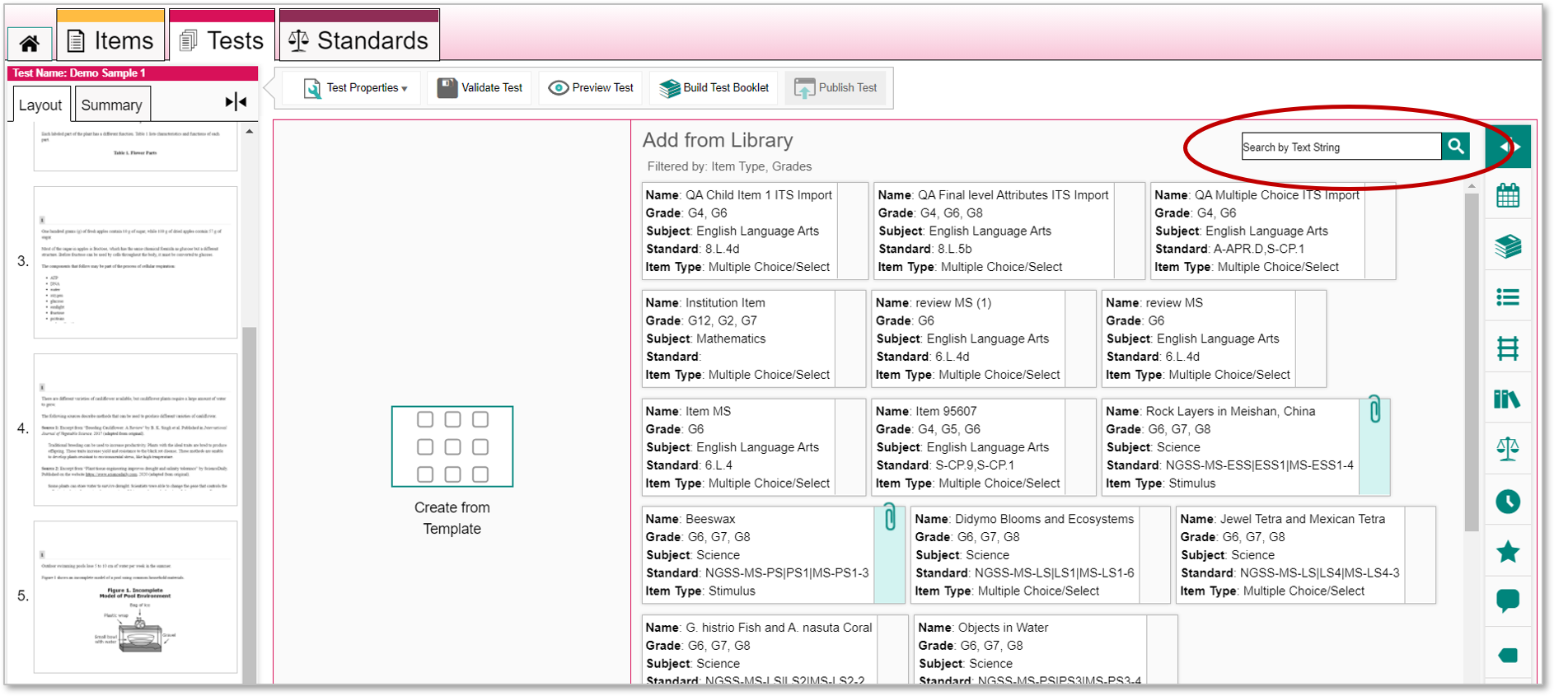
Filtered Items Display on the Add from Library Panel
Notes:
The test builder page displays the items that match your selections. Click the item you want to add. You can also use the search field in the Add from Library panel to search for a specific item by its name or content.

Slide 14
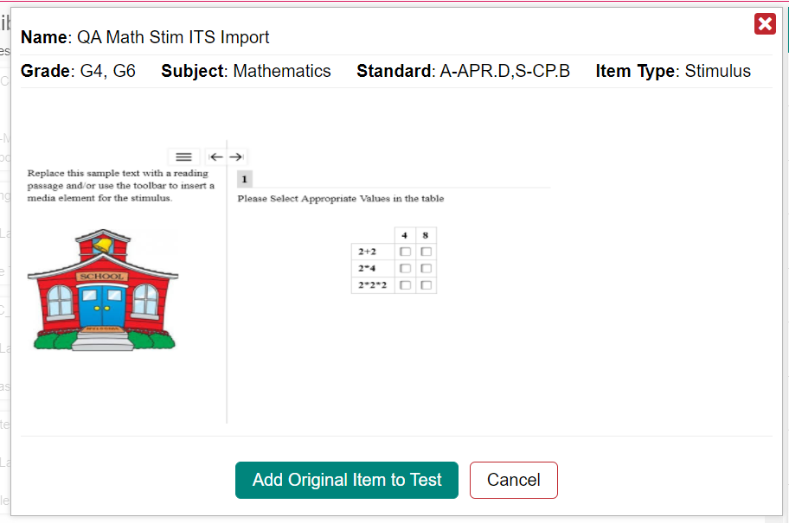
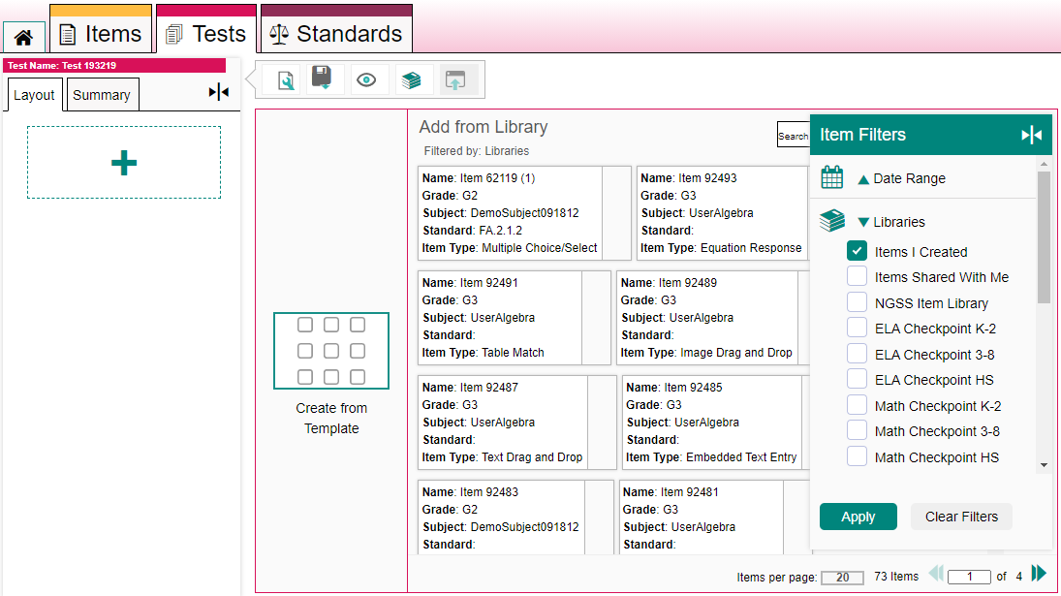
Add Original Item or Copy of the Item?
2
1
3
Notes:
When you select an item to add to the test (1), a pop-up window appears, giving you two options. Depending on the item selected, you can add the original item to the test (2), or you can add a copy of the item to the test (3). The basic difference between these options is what happens to this test item when you make changes to the same item if it appears on another test.
If you add an original item to the test, whenever you edit the item as it appears on a different test, the item on THIS test will be changed also. Likewise, if you edit the item on this test, the item will update on every other test you added it to. If you add a copy of an item to a test, the item will not change, regardless of what edits you make to the original item as it appears on other tests.
Here is a helpful tip: when you add an item copy to a test, you must make at least one edit to the item’s content in order to prevent validation errors when publishing the test. (To do this click Edit in the item toolbar and modify the content so that it is not identical to the content of the original item. Click Save in the top-right corner.)

Slide 15
For More Help
You can contact the HSAP Helpdesk for assistance with any technical issues you encounter. When contacting the HSAP Helpdesk, please be ready to provide:
Any error messages that are appearing (including codes)
Your operating system and browser information
Your network configuration information
Your contact information for follow-up by phone or email
Any other relevant information, such as test names or content areas, student IDs, session IDs, and search criteria
For test administration or policy issues, please contact your district test coordinator.
Further Information
HSAP Portal: https://alohahsap.org/
HSAP Help Desk
Phone: 1-866-648-3712
Email: hsaphelpdesk@cambiumassessment.com
Thank you!
Notes:
You can find additional Checkpoint resources on the Smarter Balanced, HSA Science, and EOC pages of the HSAP portal. However, if you still require assistance with troubleshooting a technical issue, you may also contact the HSAP Helpdesk. When contacting the HSAP Helpdesk, please be ready to provide the following information:
Any error messages that are appearing (including codes)
Your operating system and browser information
Your network configuration information
Your contact information for follow-up by phone or email
Any other relevant information, such as test names or content areas, student IDs, session IDs, and search criteria
For questions about test administration or policy issues, please contact your district test coordinator.
Thank you for taking the time to view this training module. For detailed information, consult your Checkpoint User Guide located on the Smarter Balanced, HSA Science, and EOC pages of the HSAP portal or contact the HSAP Help Desk.

