Slide 1
How to Align Items to Standards and Set Up Item Properties
Checkpoint System Training Module
2021–2022
Copyright © 2021 Cambium Assessment, Inc. All rights reserved.
Notes:
Welcome to the How to Align Items to Standards and Set Up Item Properties training module. This module is part of a series of training modules on the Checkpoint System and its features. This module explains how to align items to standards and set up item properties.
Consult your Checkpoint User Guide on the HSAP portal for information about additional features in Checkpoint.

Slide 2
Objectives
This presentation will show you how to do the following:
Log in to the Checkpoint System
View standards
Set up item properties
Item name, subject, and grades
Standards
Description, difficulty level, keywords, and source
Notes:
This presentation will show you how to do the following:
Log in to the Checkpoint System
View standards
Set up item properties
Set item name, subject, and grades
Align the item to standards
Set description, difficulty level, keywords, and source

Slide 3
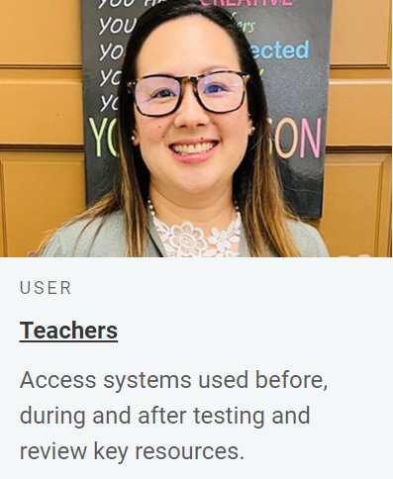
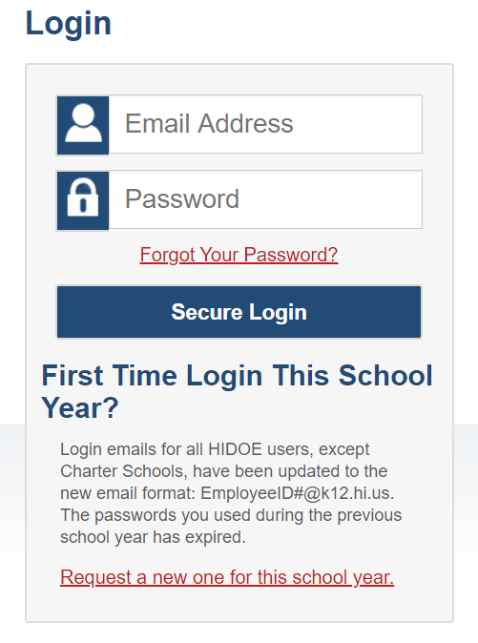
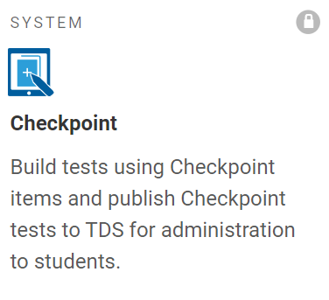
Logging in to the Authoring System
Notes:
To log in to Checkpoint, go to the Smarter Balanced, HSA-Science, or EOC portal. From the portal, select your user role card. On the next page, click the Checkpoint system card. Enter your username and password, and then click Secure Login to continue.

Slide 4
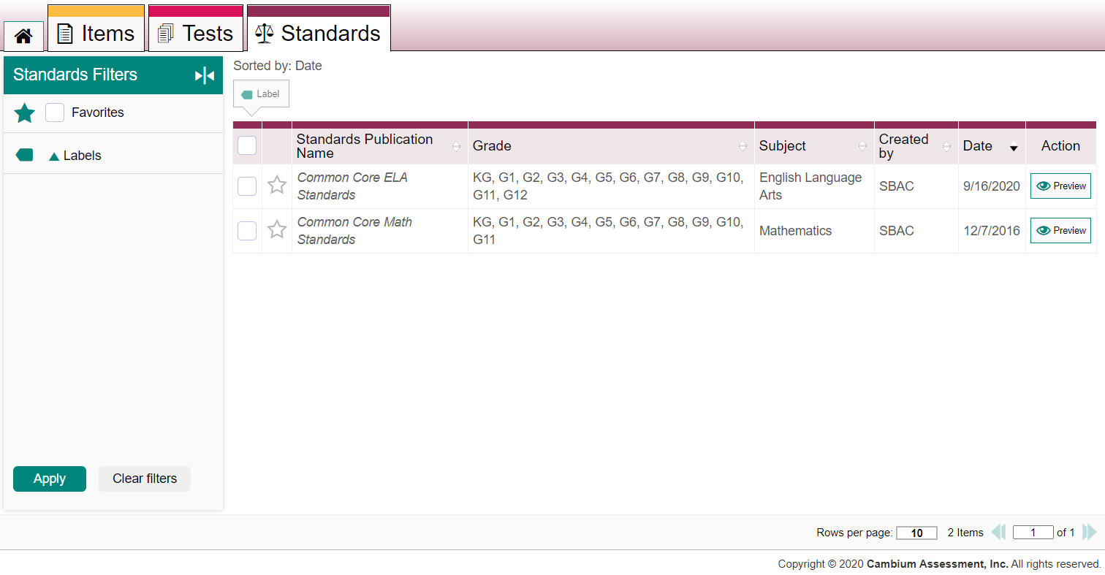
Finding Standards
1
2
3
Notes:
First, let’s view the standards provided by the HSAP assessment program for use with your items. Standards identify the specific skills or areas of knowledge that an item measures. An item’s aligned standards will appear in the reports for Checkpoint tests, helping you pinpoint the specific areas in which a student may be excelling or may need additional support.
You cannot create or modify standards publications, but you can view them and learn the standard keys.
To view standards, first click the Standards tab (1). A table appears, listing standards publications. This table can be filtered using the panel on the left (2). You can filter by the standards publications you’ve favorited and by labels. You can also click any column headers that have sorting arrows in them to sort by those columns.
When you’ve found the standards publication you want, click the Preview button (3) to the right of it.

Slide 5
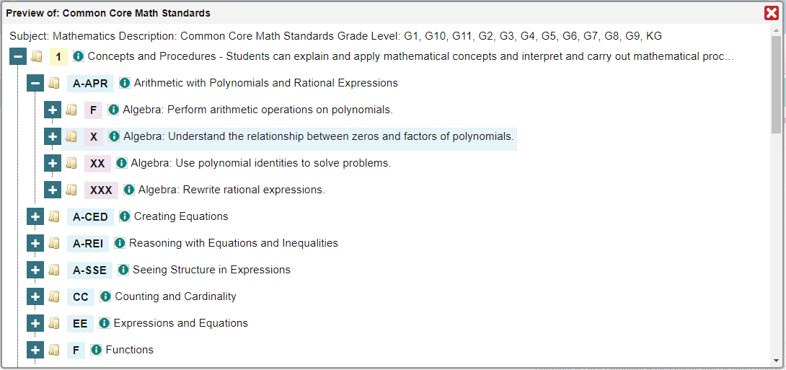
Viewing Standards
1
2
3
Notes:
In this example, the math standards publication for kindergarten through twelfth grade contains a hierarchy of standard categories that you can expand to show the standards within them. Each one has a unique key that you can use to align an item to it. Under the category Concepts and Procedures (key 1) [1], we see the category Arithmetic with Polynomials and Rational Expressions (key A hyphen APR) [2]. Under that, we see the standard Algebra: Understand the relationship between zeros and factors of polynomials (key X) [3].
Let’s take note of the standard key X so we can use it later.

Slide 6
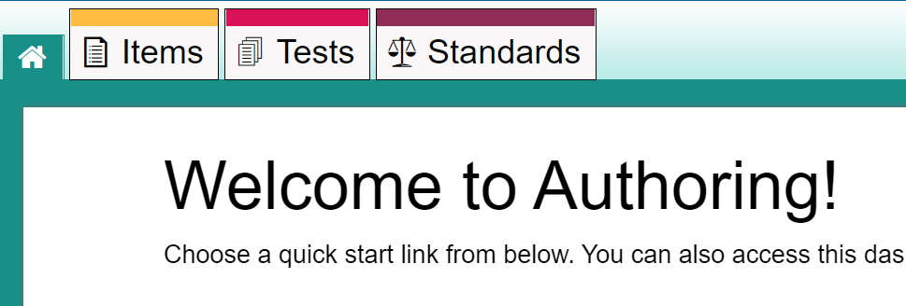
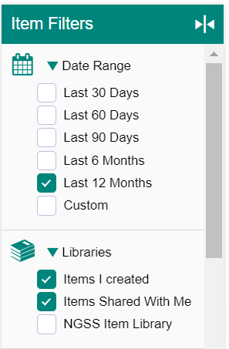
Setting Up Basic Item Properties
1
4
2
3
Notes:
You can set up properties that make it easier to filter items when adding them to tests or locating them on the Items tab. All item properties are optional and can be entered at any point while an item has a Draft status. However, once an item is added to a test and the test is published, the item status changes to Published and its properties will be locked, along with its content.
To set up item properties, including standard alignments, first open the item for editing. You can do this by clicking the Items tab (1). From there, filter for the item using the Date Range (2) and Libraries (3) filter on the Item Filters panel. Click the name of the item you’re searching for on the following screen (4).

Slide 7
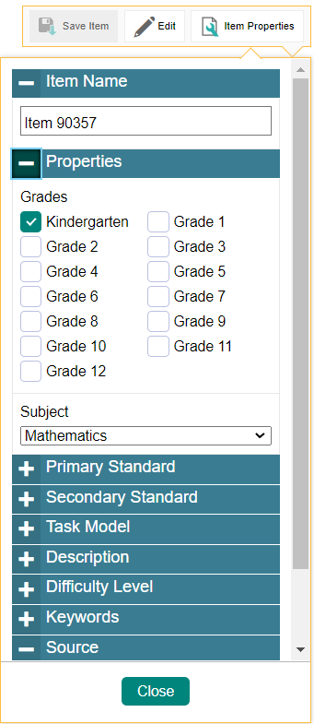
Setting Up Basic Item Properties
2
Item Properties Pop-Up: Top Two Sections Expanded
1
3
4
Click the Item Properties button
Notes:
Next, in the upper-right corner, click the Item Properties button (1). A pop-up opens (2), containing a number of sections you can collapse and expand by clicking them.
In the top two pop-up sections are the item name, subject (3), and grades (4). You can replace the default item name with any unique name you prefer. You may select one subject and any number of grades.

Slide 8
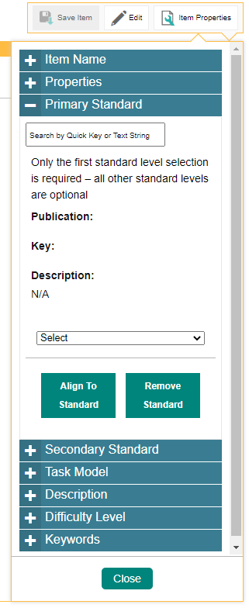
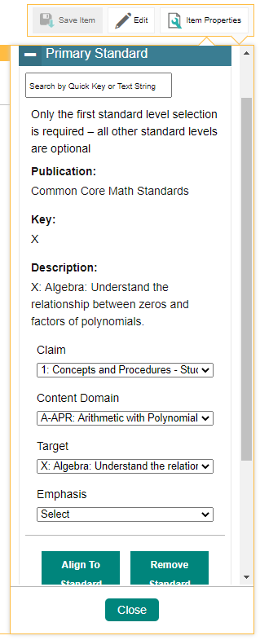
Aligning an Item to a Standard
Item Properties Pop-Up: Primary Standard Section Expanded
2
1
If you already know the key for the standard you want, enter it in the search field and select it from the dropdown that appears. For example, we can enter “X” to find the algebra standard.
If you don’t know a standard’s key, click Align to Standard and choose a standards publication from the dropdown. Additional dropdowns appear as you select from the available standard categories.
3
Notes:
The next section in the pop-up is called Primary Standard (1).
If you already know the key for the standard you want, enter it in the search field and select it from the dropdown that appears. For example, we can enter “X” to find the algebra standard we were looking at earlier (2).
If you don’t know a standard’s key, click Align to Standard (3) and choose a standards publication from the dropdown. Additional dropdowns appear as you select from the available standard categories. Continue selecting options until you select a specific standard.

Slide 9
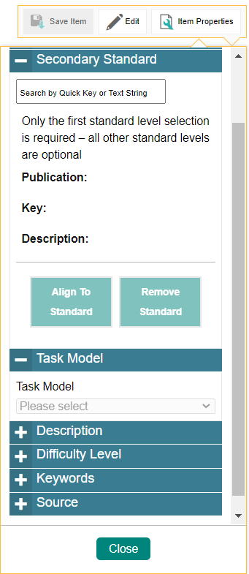
Aligning an Item to a Secondary Standard
Item Properties Pop-Up: Secondary Standard Section Expanded
Notes:
You’ve now aligned your item to a primary standard. If you want to align it to an additional secondary standard, you can do that in the Secondary Standard section in exactly the same way.

Slide 10
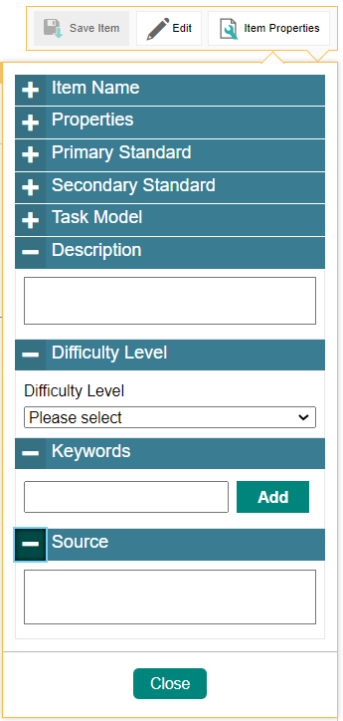
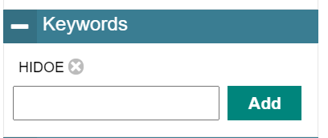
Setting Up More Item Properties
Item Properties Pop-Up: More Sections Expanded
3
1
To add a new keyword, enter it in the field and click Add. The new keyword appears above the field. To remove a keyword, click the remove button, which looks like an X, immediately to the right of the keyword.'
2
4
Notes:
The four bottom sections of the pop-up are Description, Difficulty Level, Keywords, and Source.
In the Description field (1), enter a user-friendly description for the item. Users will be able to see this description in the list of items by clicking the button that will appear immediately to the right of the item name.
From the Difficulty Level (2) dropdown, select whether the item is intended to be easy, moderate, or difficult.
Keywords (3) allow you to search for items on the Items tab. To add a new keyword, enter it in the field and click Add. The new keyword appears above the field. To remove a keyword, click the remove button, which looks like an X, immediately to the right of the keyword.
You can use the Source (4) field to explain the origin of any reading passage or other media you add to an item.

Slide 11
For More Help
You can contact the Helpdesk for assistance with any technical issues you encounter. When contacting the Helpdesk, please be ready to provide:
Any error messages that are appearing (including codes)
Your operating system and browser information
Your network configuration information
Your contact information for follow-up by phone or email
Any other relevant information, such as test names or content areas, student IDs, session IDs, and search criteria
For test administration or policy issues, please contact your district test coordinator.
Further Information
HSAP Portal: https://alohahsap.org/
HSAP Help Desk
Phone: 1-866-648-3712
Email:
hsaphelpdesk@cambiumassessment.com
Thank you!
Notes:
You can find additional Checkpoint resources on the Smarter Balanced, HSA-Science, and EOC portal. However, if you still require assistance with troubleshooting a technical issue, you may also contact the HSAP Helpdesk. When contacting your Helpdesk, please be ready to provide the following information:
Any error messages that are appearing (including codes)
Your operating system and browser information
Your network configuration information
Your contact information for follow-up by phone or email
Any other relevant information, such as test names or content areas, student IDs, session IDs, and search criteria
For questions about test administration or policy issues, please contact your district test coordinator.
Thank you for taking the time to view this training module. For detailed information, consult your Checkpoint User Guide located on the Smarter Balanced, HSA-Science, and EOC portal or contact the HSAP Help Desk.

