Slide 1
The Centralized reporting system for summative and interim assessments
Training Module
2021-2022
Copyright © 2020 Cambium Assessment, Inc. All rights reserved.
Notes:
Welcome to the training module on the Centralized Reporting System for Summative and Interim Assessments. Some users are familiar with the features of the AIRWays Reporting System for interim tests. Other users know the Online Reporting System (ORS) as it is used for data on summative tests. The enhanced Centralized Reporting System marries these two systems together, creating one reporting system to house data for both types of tests.
This training module is based on the Centralized Reporting System User Guide for Summative and Interim Assessments, 2021-2022, which is available on the HSAP assessment portal.

Slide 2
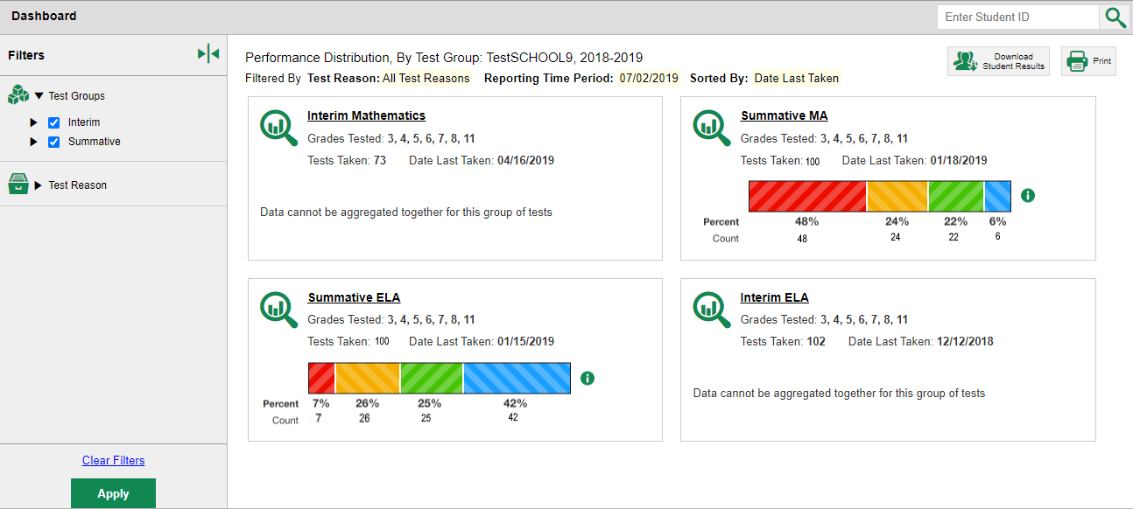
Purpose of the Improved Centralized Reporting System
1. Scalable—designed to handle lots of data and more features over time, 2. Accessible on different devices and by different user types
Notes:
The Centralized Reporting System is designed with a user interface that is accurate, scalable, and accessible. With the intent to provide the clearest picture with the fewest number of clicks, the system displays state-, district-, school-, teacher-, class-, and student-level data in tabular and graphical format. It is designed to handle lots of data for a variety of tests and it is continuously updated with more features over time. The system is accessible on different devices and by different users at the teacher, school, complex, complex-area, and state user levels. Users can sort and filter the data in various ways and can create custom groups to generate timely reports for intervention with groups or incoming classes.
The dashboard displayed here is the homepage for all users except those at the state level.

Slide 3
Objectives in Order of Presentation
Navigate the Centralized Reporting System for Summative and Interim Tests
See your results, sort them for analysis, expand them to view standard targets and measures, and quickly compare results at the state, district, and school level.
Interpret the Depth of Knowledge (DoK) section
Analyze the Writing Dimensions used for essay tests
Access the longitudinal reports to show performance trends over time, for associated tests.
Use the Student Portfolio report.
Set Up Reports That Make Sense for Your Specific Needs
Set preferences and filters.
Use demographic sub-groups.
Work with Interim Tests—Their Items, Rubrics, and Scoring Essentials
Generate Individual Student Reports (ISRs) and Student Data Files
Print and Export Any Data You Can View in Reports
Notes:
This training focuses on five main objectives: navigating the test results pages to display data with just a few clicks; using the settings and filters to customize your reports and eliminate irrelevant data; working specifically with interim tests and their items; generating ISRs and student data files; and printing and exporting your reports.

Slide 4
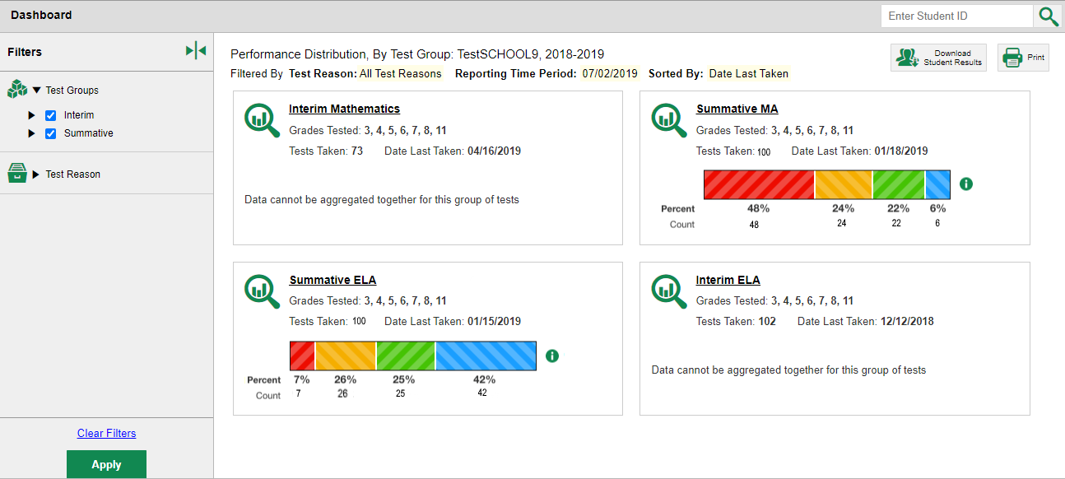
Dashboard Layout
Notes:
After logging in to the Centralized Reporting system, teachers and school- and complex-level users see the dashboard. Test information and results are displayed for the students assigned to you based on your role.
A card displays for each test, by subject, with the grades tested and the total tests taken. The performance distribution results display as a color-coded bar with the percent proficient and student count listed under each colored level. For example, 100 students took the Summative ELA test in grades 3-8 and 11. Seven percent of them performed at Level 1, 26% at Level 2, 25% at Level 3, and so on. The data on the dashboard gives teachers, administrators, and principals a way to quickly compare how their students performed across different test groups.
The test cards are sorted from left to right, then top to bottom based on the date last taken. When you click on the test name or the magnifying glass button the Performance on Tests report displays.
Filtering, setting preferences, sorting, and breaking down demographic groups are important functions for all users so that test data applies specifically to their needs. The graphic objects shown on the dashboard and on the report pages, allow you to make these choices. It only takes a few clicks to create a highly customized report, no matter the test type or level of user.

Slide 5
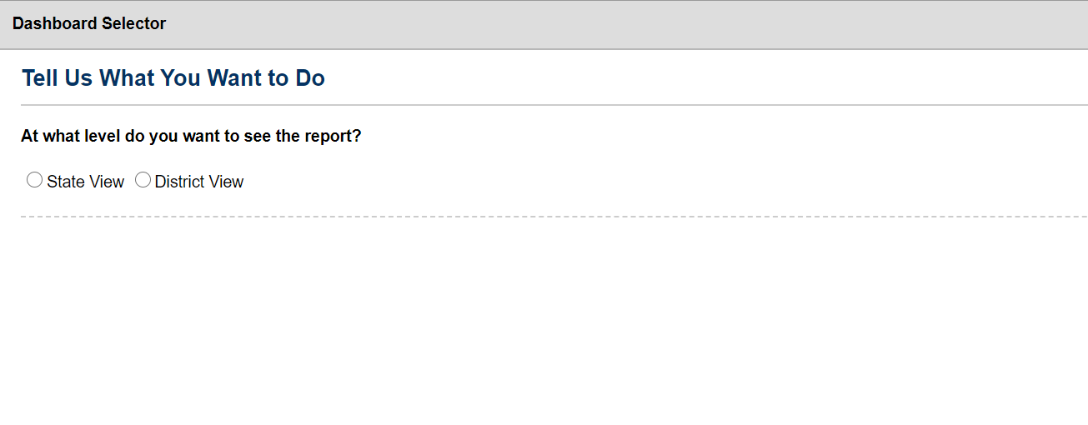
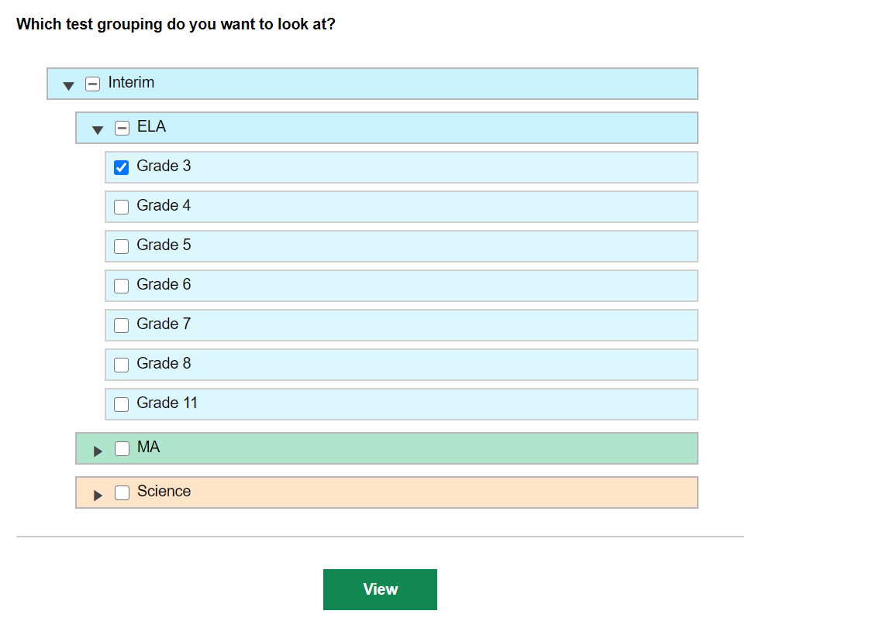
State Dashboard Selector—State View Selected
Demo School 2018-2019
Notes:
After state users log in to the Centralized Reporting System, they see a Dashboard Selector with a series of directives, starting with “Tell Us What You Want to Do.” State users can choose to view results at the district or state level. State users have access to test data for all the districts and schools in their state.
To generate a State View dashboard, choose the State View button, make your selections from the menu of nested test groups, and click the green View button. A State Dashboard displays with an identifier in the gray navigation trail. The tests selected are listed in the assessment table.

Slide 6
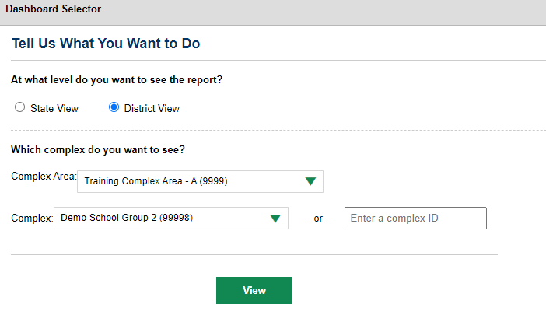
State Dashboard Selector—District View Selected
1
2
Notes:
When the District View button is selected you are prompted to select a district from the drop-down menu in the District search field or you can enter the district ID in the second search field.
Click View and the district Dashboard displays. It displays with the same layout as the teacher, school- and complex-level user dashboards, with the selected complex-level data.
To navigate to the test reports click on the name of a test group or the magnifying glass button. The Performance on Tests page will display.

Slide 7
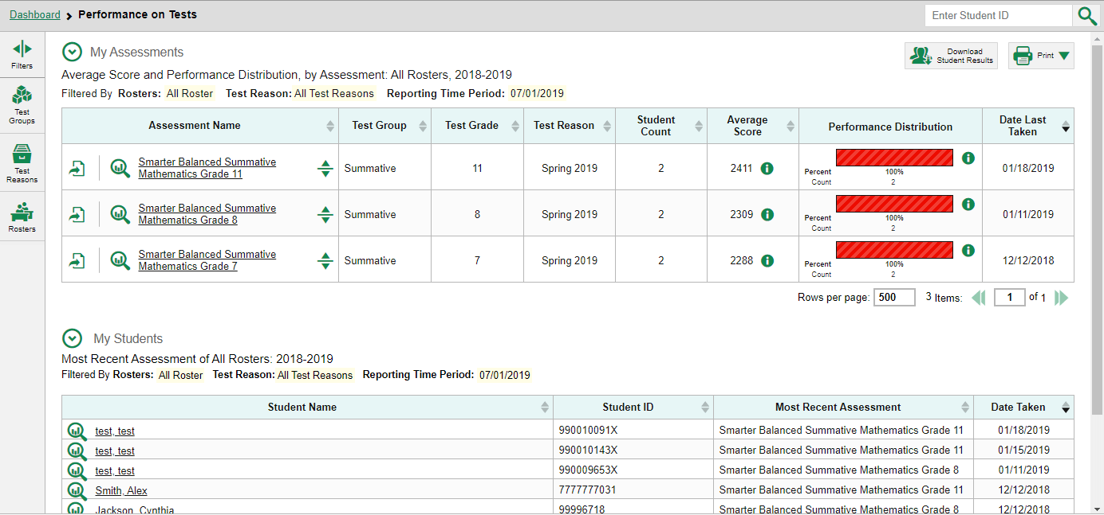
Performance on Tests Report for a Teacher—Page Layout
1
2
Notes:
Here you see the Performance on Tests report for a teacher who clicked on the Summative Mathematics test group. It displays all tests the students have taken for the selected test group. The teacher report displays two stacked tables, My Assessments on top and My Students below.
The My Assessments table lists all the teacher’s students who took one of those tests in Date Last Taken order. You can use the table to quickly compare how your students have performed across test groups.
The My Students table is a fast pass to the individual Student Portfolio report. This report is useful for teachers as they prepare for parent-teacher conferences where student performance across all tests is needed.

Slide 8
Performance on Test Report for a Teacher—Sorting Options
Notes:
The Performance on Tests report tables in Centralized Reporting include headers that describe any filters or reporting time periods applied to the report. The columns in the My Assessments table are Assessment Name, Test Group, Test Grade, Test Reason, Student Count, Average Score, Performance Distribution, and Date Last Taken.
The My Students table, which displays for teachers only, organizes students by Name, Student ID, Most Recent Assessment, and Date Taken.
You can sort your results directly from the Performance on Tests report by clicking each column header that has a set of expansion arrows in it.
For example, you might want to sort the Average Score column in ascending order to show tests with the lowest scores at the top of the table. You might want to sort the students in the My Students table alphabetically.

Slide 9
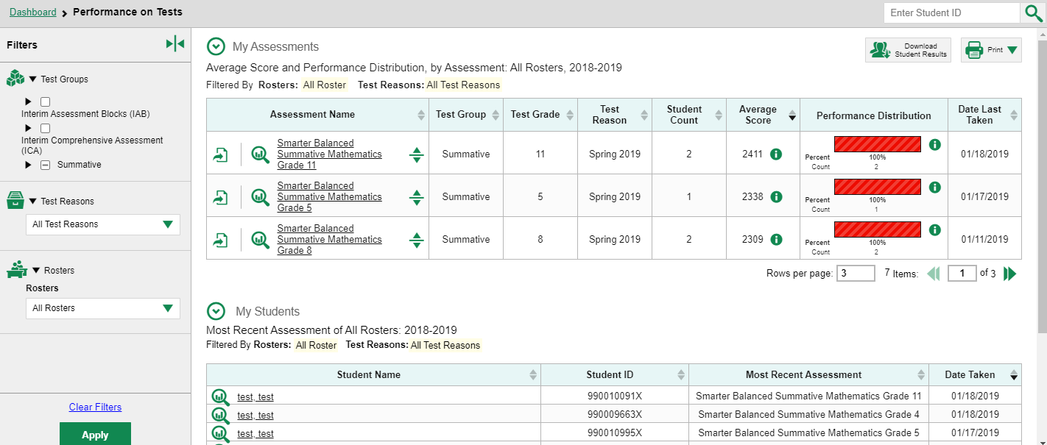
Clickable Features: Buttons, Arrows, and Filters
1
1
2
Notes:
This slide shows the numerous clickable objects on the Performance on Tests report. These buttons include, but are not limited to the Inbox, My Settings, the Help feature, the Student Search box, the Print button, the Download Student Results button, and the Filters panel (by Test Groups, Test Reasons, and Rosters). These filters and how to apply them will be discussed later in the presentation.
In the My Assessments table, included with the name of an assessment are the Export button, the magnifying glass view button, and a set of up/down arrows that expand to show state-, complex-, and school-level results. This aggregate comparison view is shown on the next slide. Click on the assessment name to display the My Students’ Performance on Test report.
Both tables can be set to size preferences. Change the number of rows per page, as desired. Use the forward and back arrows to move to different pages of the table.

Slide 10
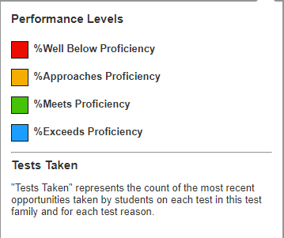
State, District, School Aggregates from Performance on Tests Report
1
2
Notes:
You can compare your results to aggregate state, complex, and school data directly from the Performance on Tests report, depending on your user role.
Simply click the expansion arrow to the right of the assessment name to display them. The aggregates are highlighted in yellow on the report.
Clicking the information buttons displays more information about the performance measures being displayed.

Slide 11
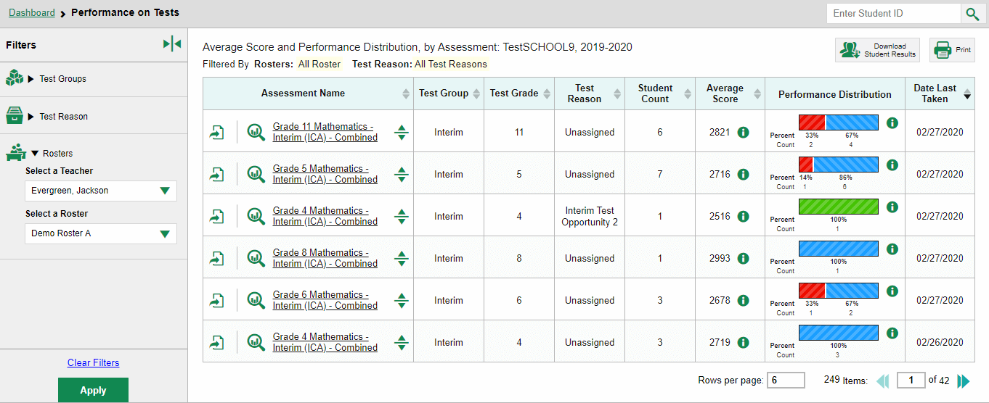
Performance on Tests Report for a Principal
1
2
Notes:
Here is the Performance on Tests report for a school-level user who clicked on the Interim Mathematics card. Each test is listed in the report table.
You can expand the aggregate results for each test listed in the table. School users can filter the Performance on Tests report by Test Groups, Test Reasons, and Rosters.
The roster filter allows users to filter by teacher or by teacher and roster.

Slide 12
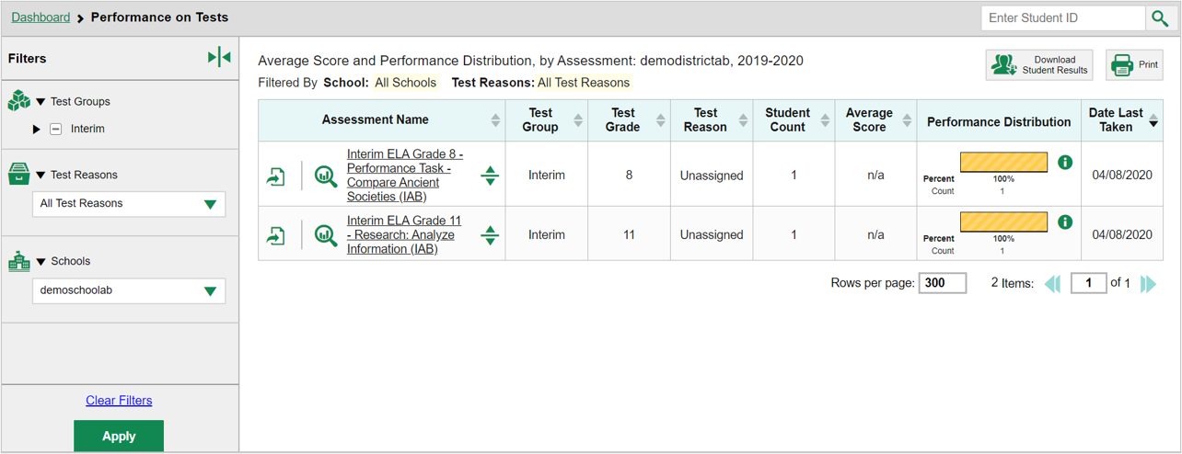
Performance on Tests Report for a District-Level User
1
2
Notes:
Here is a Performance on Tests report for a Complex-level user.
Notice that the Filters panel includes a School option so that the complex-level user can select an individual school instead of seeing aggregate results for the whole district. When an individual school is selected in the filter, the test links will lead to School Performance on Tests reports, not District Performance on Tests reports.
The Centralized Reporting System storehouses data for lots of different tests. Despite the variety of tests and client preferences, most reports are designed to mirror the Performance on Tests report layout. When you navigate away from the Dashboard the gray navigation trail at the top of the page marks your path. This is a good way to keep track of what report you are seeing, and you can always return to a previous one from the trail. Click on the name of an assessment or the magnifying glass view button next to it.

Slide 13
Navigate the Test Results Pages

Slide 14
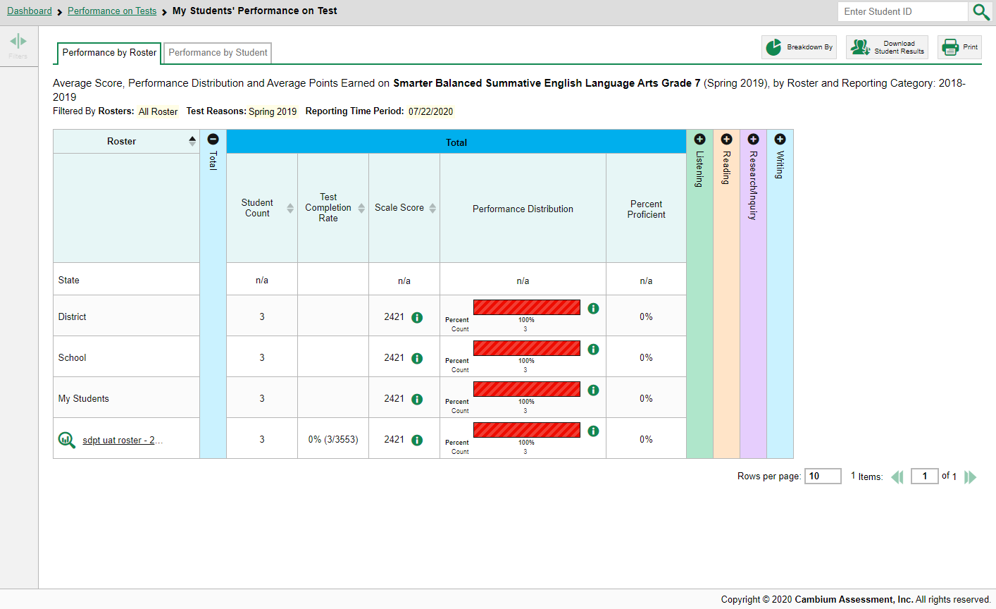
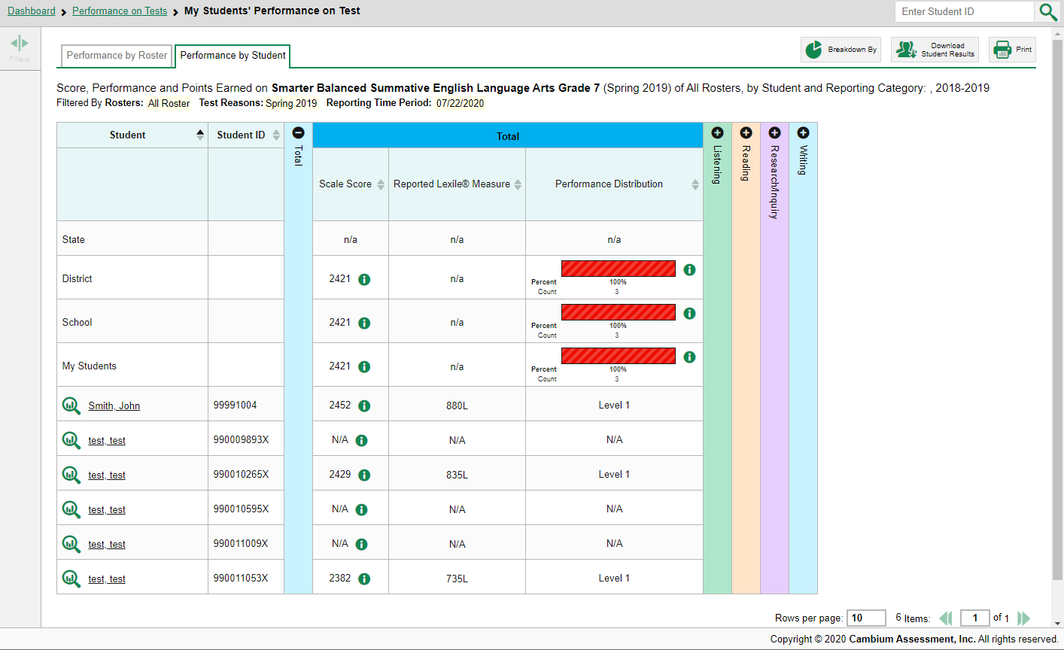
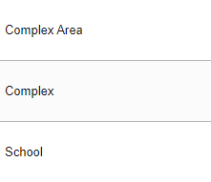
The My Students’ Performance on Test Report—Page Layout
Grade 7 SUM ELA
1
2
3
Notes:
The image on the left is a My Students’ Performance on Test report for a teacher who clicked on a Grade 7 Summative ELA test from the Performance on Tests report.
The My Students’ Performance on Test table lists the class rosters in the left column. Multi-colored accordion sections are used to display the reporting categories. Expand or collapse them by clicking the + and – signs at the top of the vertical bars or click on the bars themselves. This test includes four reporting categories. They are Listening in green, Reading in tan, Research and Inquiry in purple, and Writing in blue.
School users and teachers see two tabs under the navigation trail: Performance by Roster and Performance by Student. You can toggle between the tabs to change the table from a list of rosters to a list of students. The image on the right shows a sample report with the Performance by Student tab open. District users do not have these tabs on their reports because of the volume of data generated at the district level.
Notice that state, complex, complex area, and school aggregate results display above the rosters or students in the tables. We explain the performance measures and sorting on the next two slides.

Slide 15
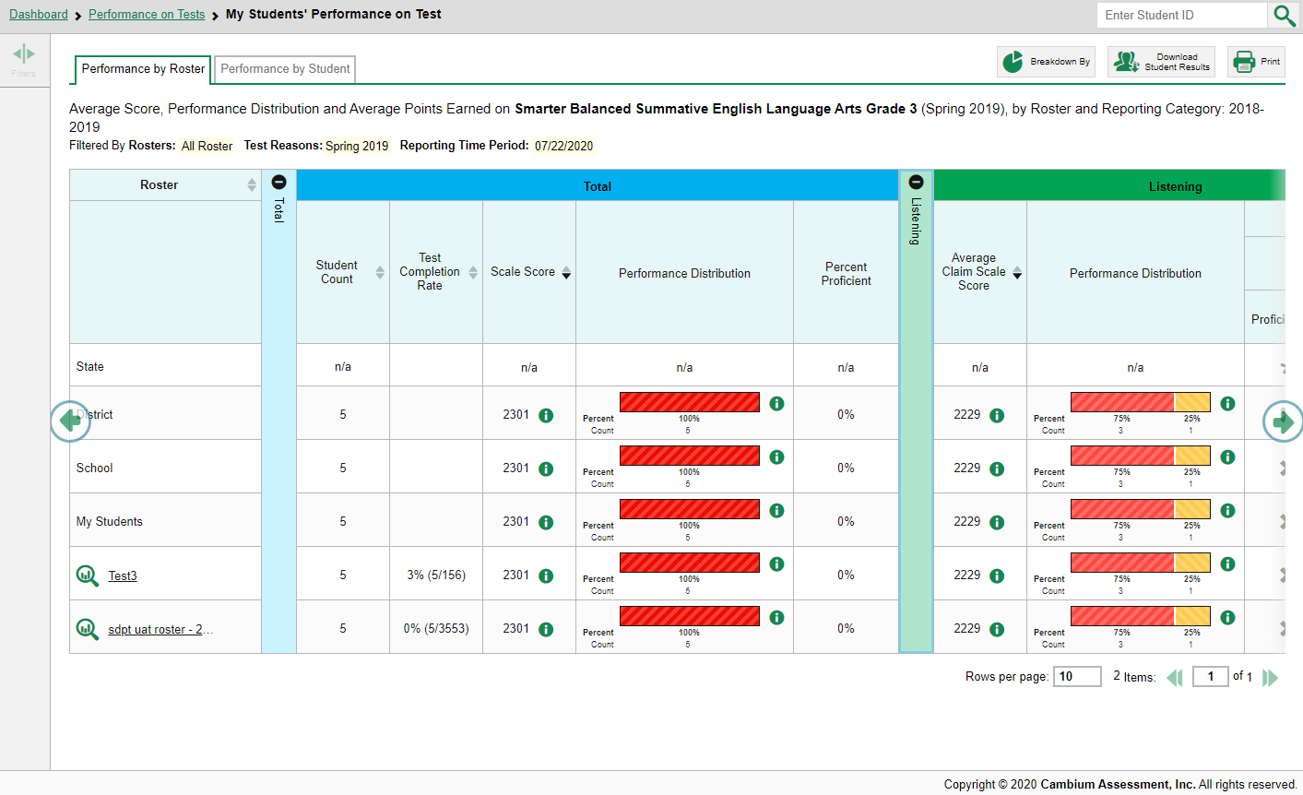
Performance Measures
Grade 3 SUM ELA
Notes:
The performance measures used in a report depend on your state or complex and the type of assessments administered. Two typical measures are scale score, or average scale score and performance distribution as shown on this My Students’ Performance on Test report for the Summative ELA test for Grade 3. Interim tests typically report average scale scores while shorter benchmark tests report raw scores. We cover interim tests in a separate section of this module.
Performance distribution levels are color coded and some aggregate reports show the percentage of students and student count in each performance level.

Slide 16
Sorting by Performance Measure
Grade 3 SUM ELA
Notes:
The performance measures included in each reporting category help you understand how students have performed on the different areas of the selected tests. For example, a teacher might notice that their students are struggling in the Listening area within the ELA assessment because most of the students are performing below mastery in that area.
You can sort your results by performance measure whenever you see a set of sorting arrows in the column header.

Slide 17
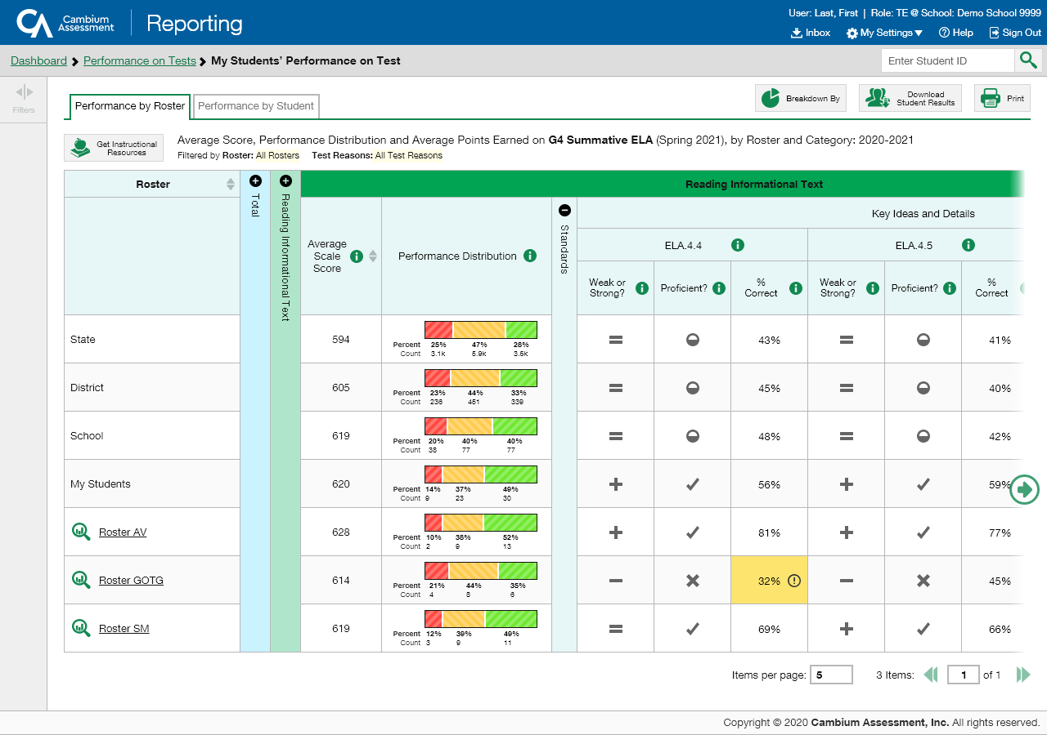
The Standard Measures Report for Adaptive Summatives
Grade 4 SUM ELA
Standards may be grouped into clusters (sometimes called targets).
Reporting Category
Standard Cluster
Standards
Measurement Sub-columns
Notes:
Adaptive summative tests will generate a “standard measures report,” notable for its target measures and the symbols indicating performance results. This image shows the My Students Performance on Test report for the Summative English Language Arts Test for Grade 4. The teacher’s rosters are listed in the column on the left. Aggregate state, complex, complex area, and school performance levels are listed above the rosters.
The expandable table contains information organized by Reporting Category, with test results, organized by standard, nested in a hierarchy below. ELA tests typically include two, three, or even four different reporting categories that together make up one test score. Here you see the Reading Informational Text category expanded. Underneath each reporting category, standard clusters are listed. Standard Clusters are divided into numbered Standards (sometimes called targets). Results for each standard are reported using three Measurement Sub-columns: Weak or Strong? and Proficient? and % Correct, depending on the specific test. To advance to another topic, click on the green, circled arrow on the right side of the page.
Each standard is matched with a more information button that displays the actual target. The legend for the symbols used in the three measurement sub-columns are displayed on the next two slides. Standard terminology varies based on your state or complex and type of test.

Slide 18
Standard Measures for Adaptive NGSS Tests
Notes:
This shows an example of a report for the NGSS Assessment.
Refer to pages 15-19 of the HIDOE Science Assessment Interpretation and Action Guide (https://hsa.alohahsap.org/-/media/project/client-portals/hawaii-science/pdf/2021q3/hidoe-science-assessment-interpretation-and-action-guide-2021-2022.pdf) for more details about standard measures in adaptive NGSS tests.

Slide 19
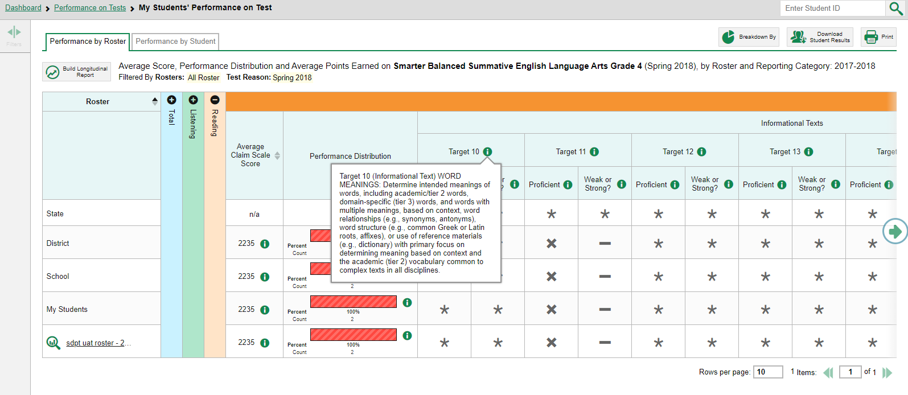
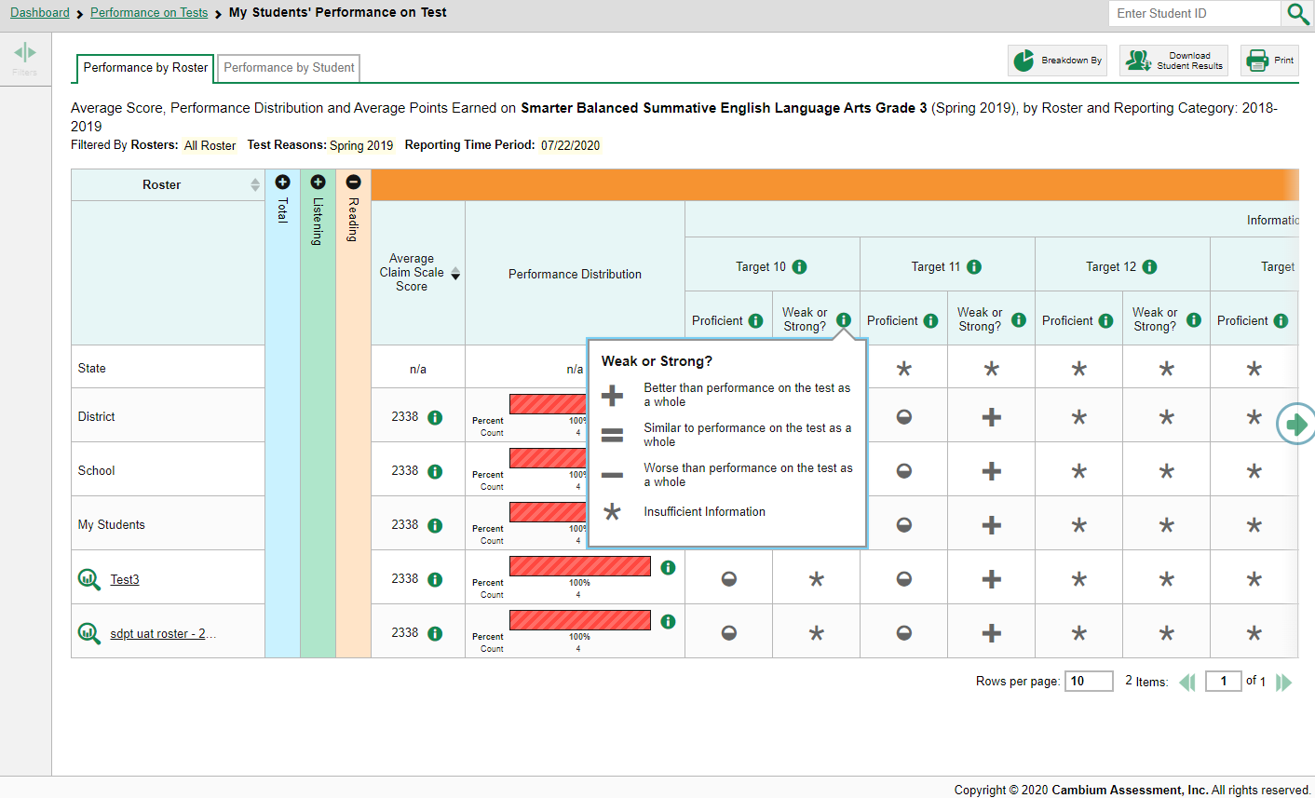
Standard Measurement Columns—Weak or Strong?
Grade 3 SUM ELA
Notes:
For the Smarter Balanced Summative Assessment, an educational standard, sometimes called an assessment target, describes at a more granular level than claim, the expectations of the knowledge, skills, and/or abilities assessed by the items and tasks within each claim. A target can be aligned to one or more standards.
The legend for any standard in the cluster describes exactly what students must do to hit the target. The performance indicators under that standard reflect how close the students came to the target, relative to how the student performed on the rest of the test.
The Weak or Strong? Column shows this group’s performance on the standard compared to their performance on the rest of the test. A ’+’ sign indicates that this group of students demonstrates strength in this standard. In other words, they performed better on items aligned to these group of standards than they did on the rest of the test. The minus sign indicates that this is an area of weakness. The students did not perform as well on items aligned to this group of standards as they did on the rest of the test. An equal sign indicates that their performance on this standard is around the same as their performance on the rest of the test.
An asterisk displays when there is insufficient information to report.

Slide 20
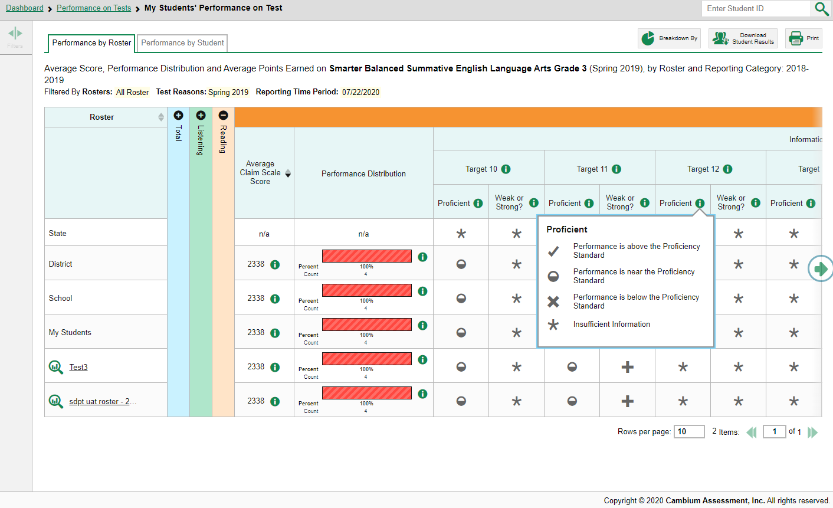
Standard Measurement Columns (cont.)
Grade 3 SUM ELA/Grade 4 SUM MATH
Notes:
The Proficient column reflects the students’ performance on the standard compared to the cut score that determines proficiency.
Students may perform above the standard proficiency cut, as indicated by a checkmark, they may be borderline, as indicated by a half-full circle, or they may perform below the standard, indicated by an X.

Slide 21
Writing Dimensions
Notes:
The Writing Dimensions section appears for aggregate reports of assessments that include an essay component.
The columns within the Writing Dimensions category are nested with the types of essays under the Essay header and Writing Dimensions applicable to that type of essay below. Each dimension sub-column is split into additional sub-columns based on the possible points students can earn in that dimension. These point columns show the percentage of students in a roster who earned each point value in each dimension.

Slide 22
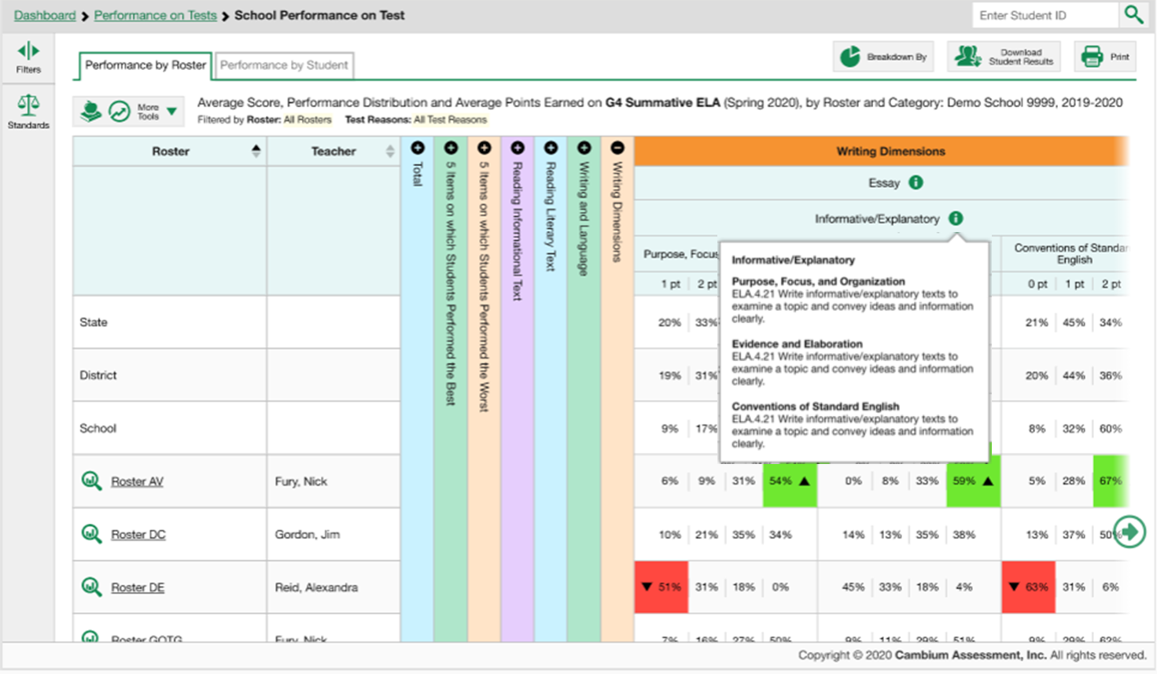
Writing Dimensions—Information Legends
Notes:
The legend for each type of essay describes the dimensions that are measured for that essay. Each dimension is identified by ID number in the legend.

Slide 23
Writing Dimensions—High and Low Point Values
Notes:
To help you analyze your students’ performance in the different dimensions, certain cells are highlighted green or red.
The cell with the highest percentage of students earning the highest point value for a dimension is shaded green and displays an up arrow in the cell. These students performed well in that dimension as compared with other students.
The cell with the highest percentage of students earning the lowest point value for a dimension is shaded red and displays a down arrow. These students performed comparatively poorly.
For example, look at the three dimensions measured under the Informative/Explanatory type of essay. The students in Roster AV did well in all three dimensions, with over half of the students earning the maximum point values, at 54%, 59%, and 67%.
Compare that with Roster DE where 51% of the students got 1 point in Purpose, Focus, and Organization which is the lowest point value and 63% earned 0 points in the third dimension. The shading serves as a red flag. The goal is to help users identify a pattern where Roster AV is consistently doing well, across the dimensions, whereas Roster DE is not doing so well. These markers allow users to detect a pattern. And even if there is no pattern, it allows the user to focus on areas that need remediation and figure out what is working well and can be shared across classes.

Slide 24
Longitudinal Report Buttons
Notes:
The Longitudinal Report allows users to view students’ performance over the current school year and over the span of multiple years to see if performance has improved or declined. It is especially helpful if you have students who have taken pre-instruction and post-instruction tests. The report helps educators and administrators refine the instructional and programmatic decisions they have made in that they can see the effect of intervention over time.
The appearance of the tables and graphs in a longitudinal report are based on whether the test data is for an individual student or a group of students who all took the same test or tests. Reports can span multiple school years, not just the latest school year. They are sometimes called “trend reports” because they help you recognize patterns of performance. The Longitudinal Report shows progressions for different test groups, like interim test to summative test.
You can tell that a test will generate a Longitudinal Report when the “Build Longitudinal Report” button or the “More Tools” button displays to the left of a report header. Click either of those buttons to display the Longitudinal Report window.

Slide 25
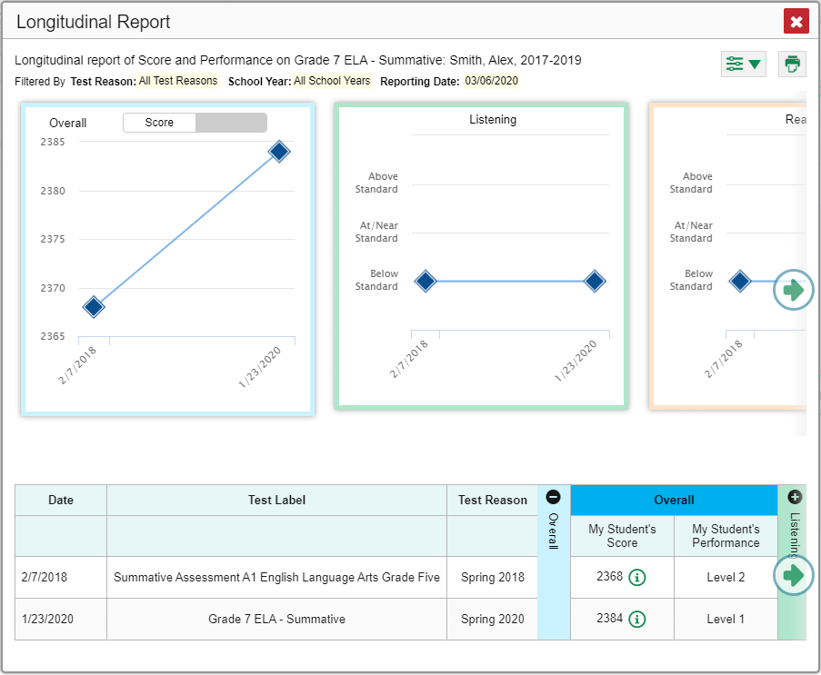
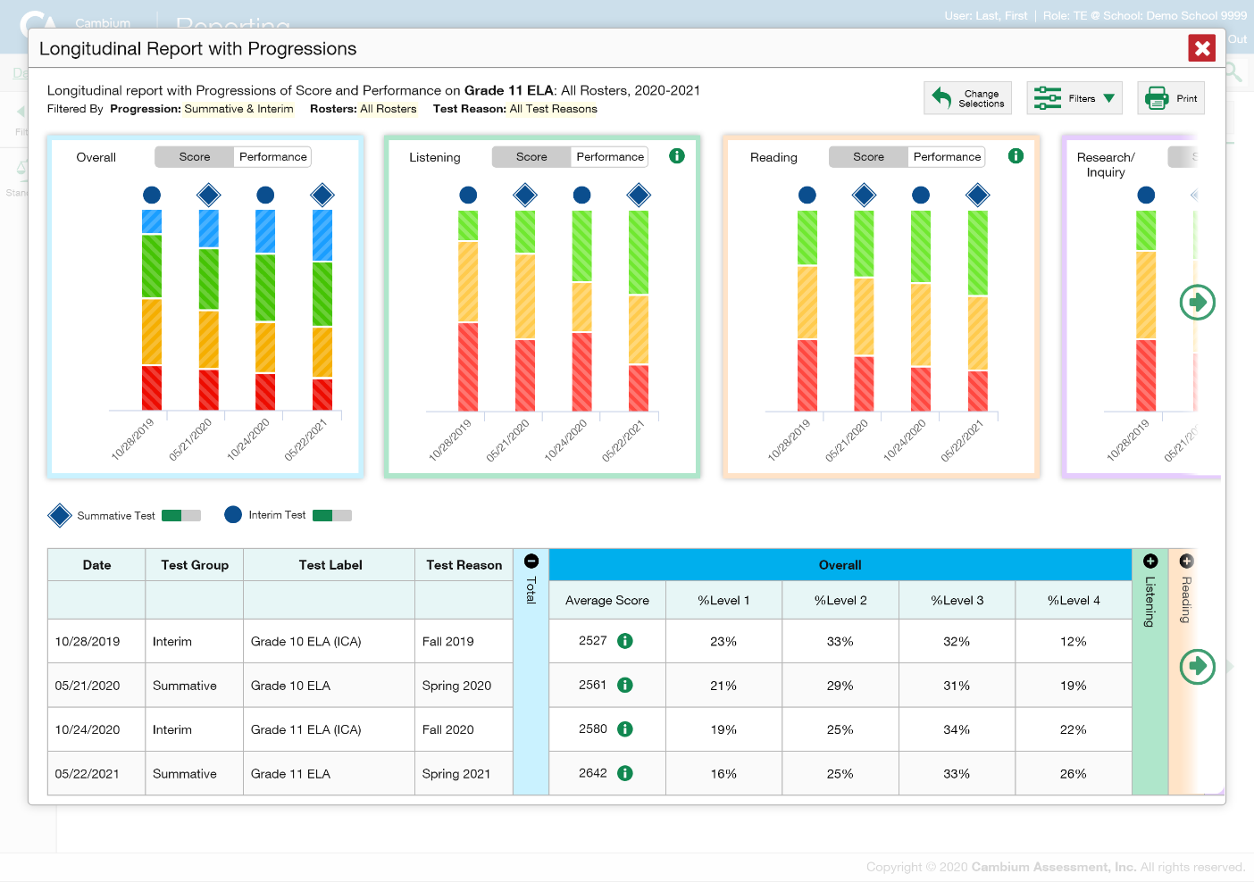
What Does the Longitudinal Report Look Like?
Notes:
Two sample reports are shown here; one for an individual student who took two related summative ELA tests, and another for multiple students who took related summative and interim ELA tests with multiple reporting categories. You see graphs in the top half of the report and tables in the bottom half. The information is the same. It is simply displayed differently.
If different related tests belong to different test types, the Progression drop-down list appears before the trend report displays.
If you are a teacher looking at results for multiple students, a report options page appears before the trend report displays.
Both of these windows are shown on the next slide.

Slide 26
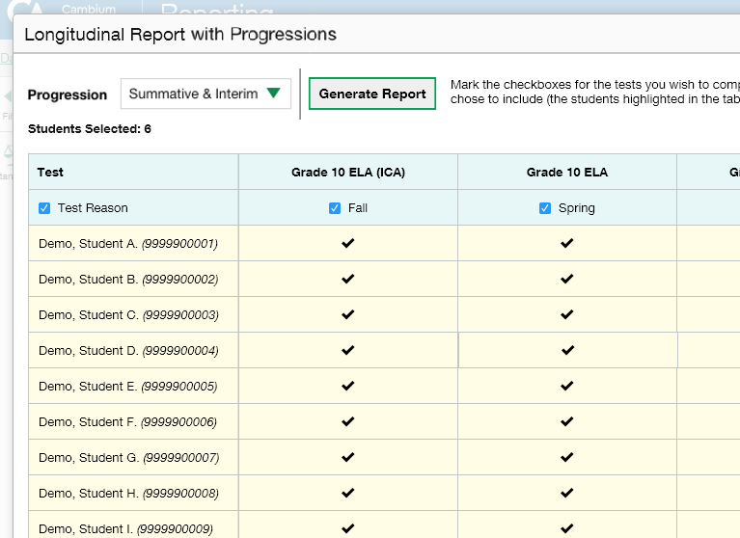
Progression Options Feature
4
2
1
3
Drop-down options are:
Summatives
Interims
Both
Only students highlighted in yellow will appear on the Longitudinal Report
Notes:
After you click on the More Tools button, a Longitudinal Report pop-up window may appear. If it does, you know the related tests on the report are of different types, meaning one of them must be a summative and another one must be an interim test.
Click the green drop-down arrow to select summative tests only, interim tests only, or a combination of both. Then click the green Generate Report button.
Teachers viewing a longitudinal report for multiple students are presented with the Longitudinal Report with Progressions pop-up window. The Progression drop-down menu is located at the top of their window followed by a table of their students and the related tests. Each test appears in its own column, with sub-columns below for each test reason (categories of tests, or, for a summative, a test window.) The cells in the columns display checkmarks to indicate which students completed which test and test reason combinations. The students highlighted in yellow have completed all of the related tests and will appear on the longitudinal report, unless you change the tests you want included in the report.
Mark the checkbox for each test/test reason combination you wish to include in the report. Mark the Test Reason checkbox on the left to include all test reasons or clear it to remove all.
The Weak or Strong? Column shows this group’s performance on the standard compared to their performance on the rest of the test. A ’+’ sign indicates that this group of students demonstrates strength in this standard. In other words, they performed better on items from this standard than they did on the rest of the test. The minus sign indicates that this is an area of weakness. The students did not perform as well on items from this standard as they did on the rest of the test. An equal sign indicates that their performance on this standard is around the same as their performance on the rest of the test.
Click the green Generate Report button at the top of the window to view the Longitudinal Report

Slide 27
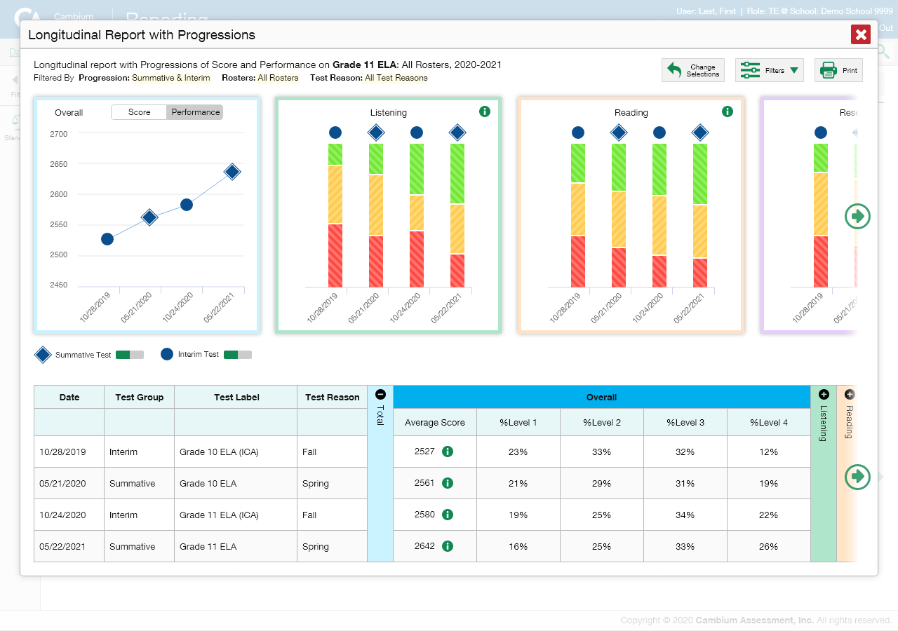
Students’ Overall Performance Over Time
Notes:
Look at the graph in the upper-left corner of the Longitudinal Report. When a graph offers both score and performance level data, a toggle bar appears at the top of it. Click the toggle to switch.
Score data are plotted along a line. A symbol appears on each data point. When multiple test types are present, refer to the legend immediately below the graphs to find out which symbols correspond to which types. You can click the test type toggles in the legend to hide or show data for each one. The interim test is identified with a blue circle and the summative test is identified with a blue diamond to help you distinguish between the test types.
Performance level data are shown either the same way or, for multiple students, in performance distribution bars.
Mouse over the data points in a line graph or the sections in a bar to get more information.
Alternatively, in the table at the bottom of the report, the data is replicated.

Slide 28
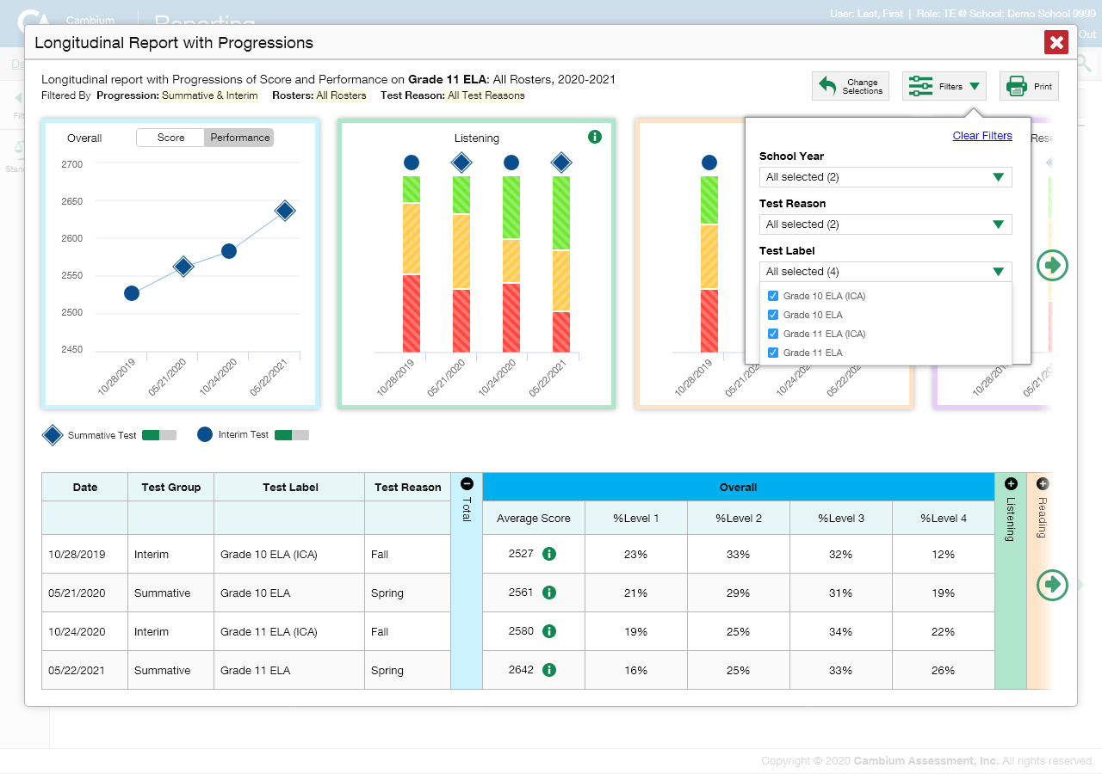
Filter Test Opportunities to Show Some and Not Others
School Year: By default, data is shown for all years. Selecting a date, such as “2019,” will filter the results for the 2019—2020 school year results.
Test Reason: Most helpful for numerous interim and benchmark tests that can be screened by category, omitting those you do not need to see. Test reasons for summative tests are determined by administration date, typically the end of the school year or the course.
Test Label: Deselect the names of the tests you don’t need to see.
Notes:
You may want to filter a Longitudinal Report in order to focus on some test opportunities and not others.
Note that filtering tests may affect the set of students whose data are included in the report.
Open the filter menu at the upper-right corner and select the filter options you prefer from the drop-down lists.
You may want to filter by a particular school year or years. Note that years are not calendar years. “2019” refers to the 2019–2020 school year. By default, Longitudinal Reports show data for all years. Longitudinal Reports can show student performance from a time when the students were not yet associated with you. For example, if you are a seventh-grade teacher, you can use these reports to view your current students’ performance on last year’s sixth-grade tests.
If the report includes interim assessments, you may wish to filter by a test reason (a category of test), which means excluding all other test reasons from the data. For example, you may want to narrow the report down to show only tests taken in the spring. For summative assessments, test reasons are the same as test windows and are not useful.
Finally, you may find that certain individual tests are less relevant than others. In that case, you can use the Test Label options to deselect the names of the tests you don’t want to see.
Click Apply.
Optional: To revert all filters to their defaults, open the filter menu again and click Clear Filters. Click Apply.
A row of filter details appears below the report header, showing the test reasons and school years included in the report.

Slide 29
Longitudinal Reports—Ways to Customize
Results from current & previous school years
Results for current & former students
Filter options: school year, test reason, test label
INDIVIDUAL REPORTS
GROUP REPORTS
Multiple instances of the same test (interims and benchmarks)
Related tests (typically related by standard and determined by school/district administration)
Students who completed the same test multiple times (interims and benchmarks)
Students who completed related tests
Notes:
To review, you can set up your Longitudinal Reports using results from current and previous school years, including data for your current and former students. Three filter options, school year, test reason, and test label, allow you to drill down into a Longitudinal Report to access specific data relevant to your needs.

Slide 30
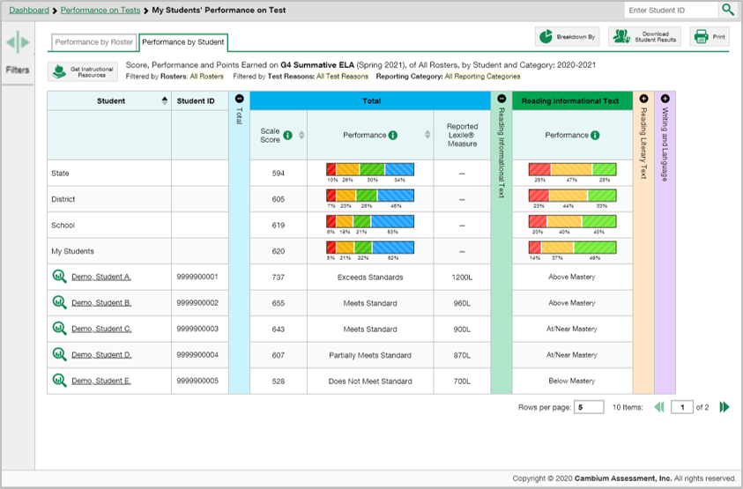
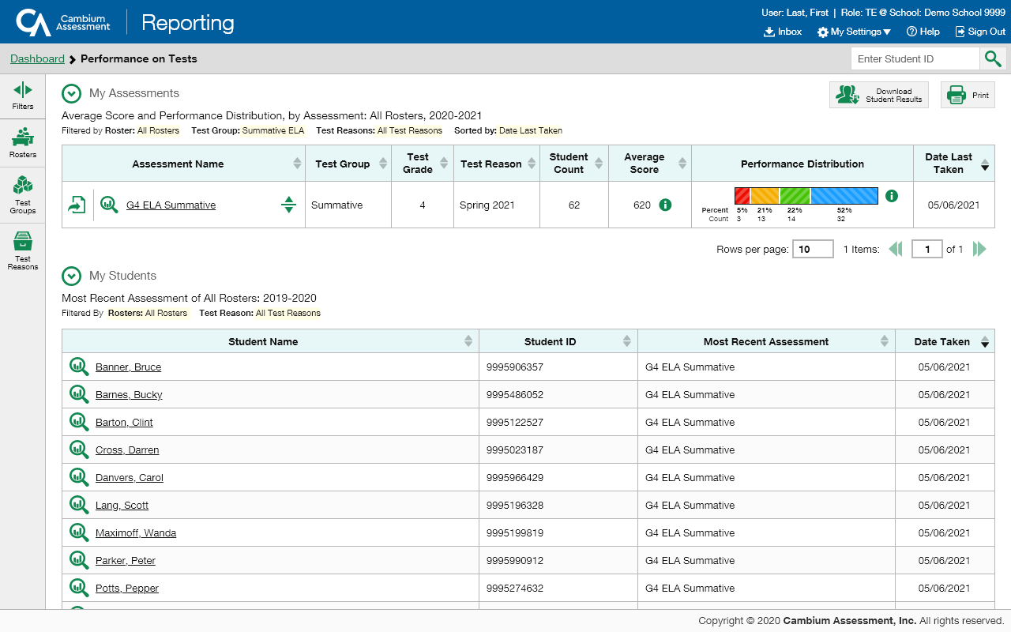
The Student Portfolio Report
Sdt Porfolio Report
1
2
31
Notes:
The Student Portfolio Report allows you to view all the assessments an individual student has completed over time. All users can access the Student Portfolio report from any test report page.
Copy and paste the student ID number into the search box and then click the search button, as shown in the top image. The Student Portfolio Report for Demo student A is shown here and explained on the next slide.
Teachers have a fast pass to this report from their My Students table on the Performance on Tests report page. Simply click the student name or the magnifying glass and the report displays.

Slide 31
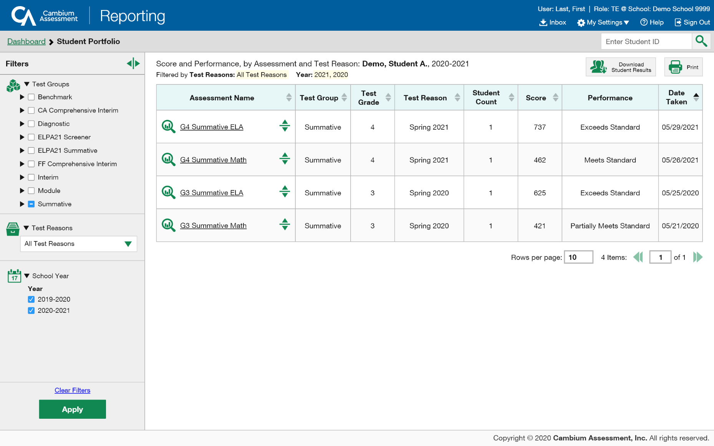
Ways to Use the Student Portfolio Report
Sdt Porfolio Report
Filter the report by Test Groups, Test Reasons, and School Year
Compare a student’s results with state-, district-, school-, and teacher-level data
Sort results in any column with a set of sorting arrows in it
Generate and print an ISR or a Student Data File
Access specific test data and individual student item responses directly from the report
1
3
4
2
5
Notes:
The report is designed so that users can quickly:
Filter by Test Group and temporarily filter the report using the School Year filter,
Compare a student’s results with state-, district-, school-, and/or teacher-level data,
3. Sort results in any column with a set of sorting arrows in it
4. Generate and print an ISR or a Student Data File,
5. And access specific test data and individual student item responses directly from the report.

Slide 32
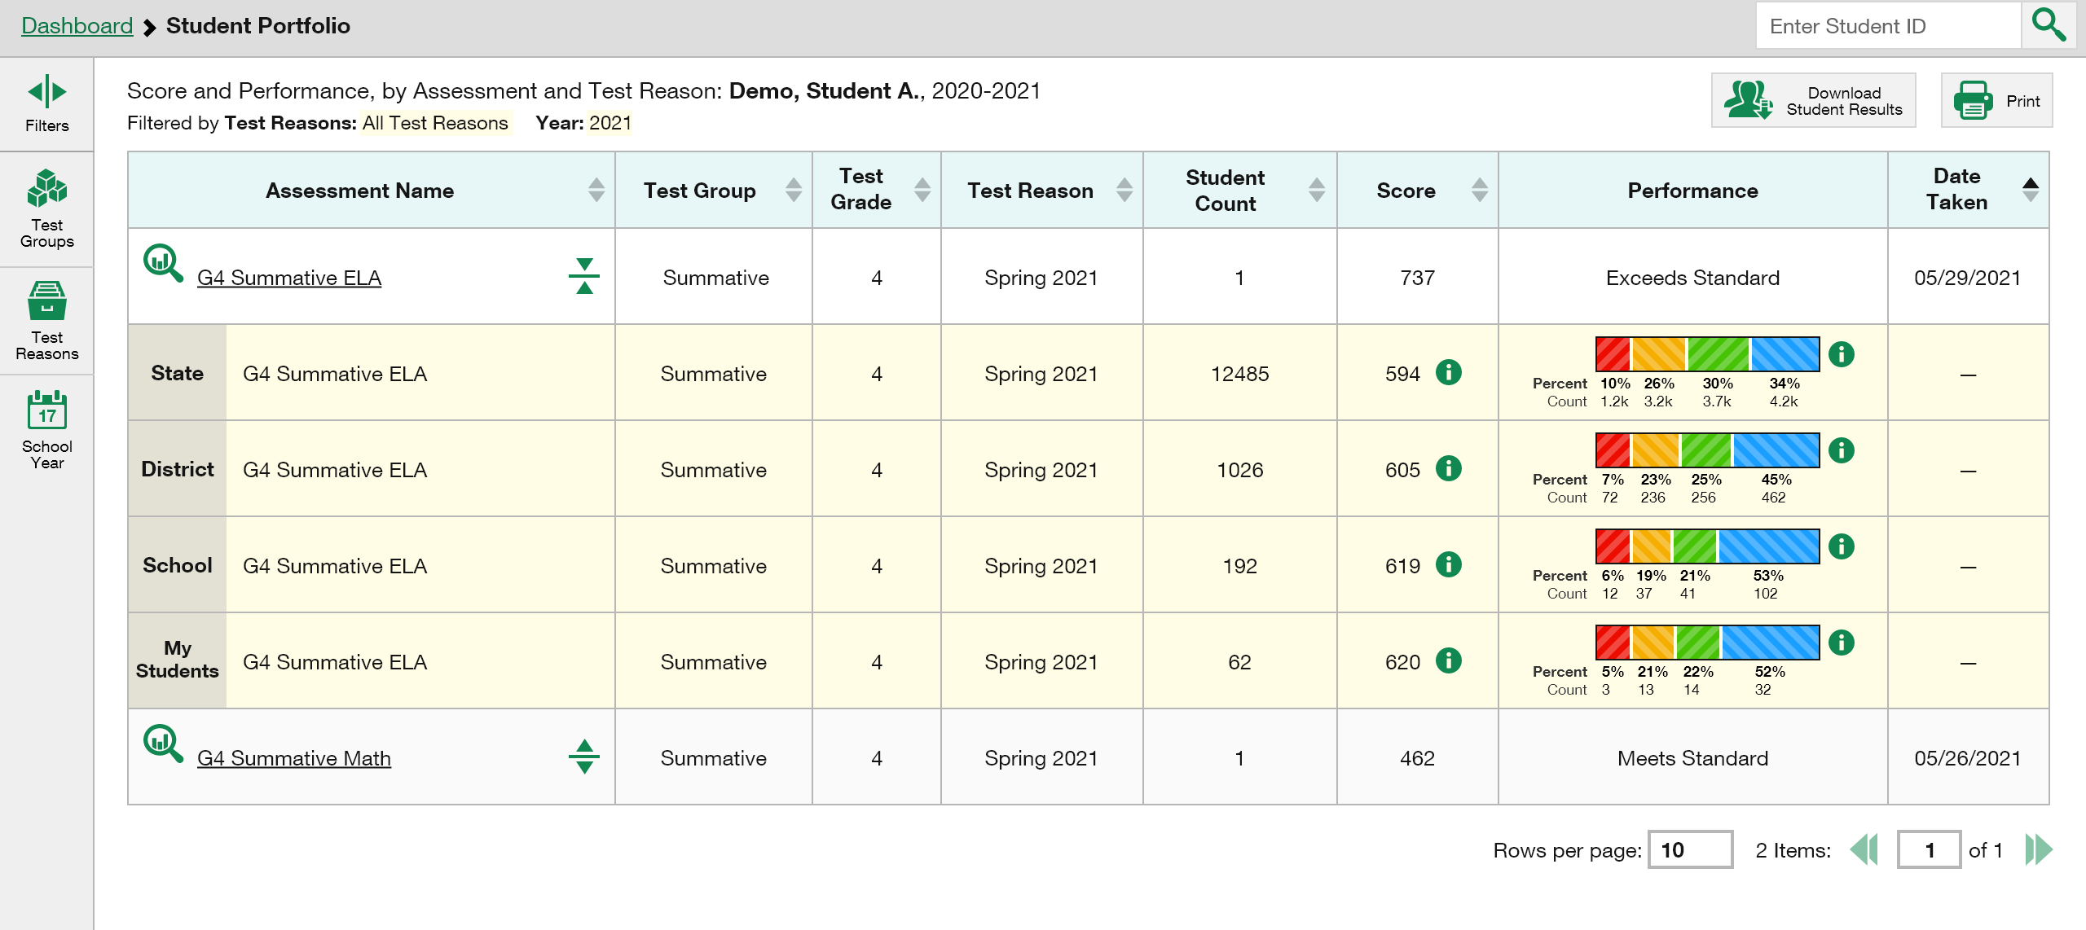
Student Portfolio—Analysis By Sorting/Comparing
Sdt Porfolio Report
Notes:
All the assessments taken by the student are listed in the Assessments Table.
Assessments can be sorted by Test Group, Test Grade, Test Reason, Student Count, Score or Date Taken using the sorting arrows. Sorting gives the user a rough idea of how the student is performing over time.
Comparison rows of State, Complex, School, and My Students results are shown when the expansion arrow is clicked.

Slide 33
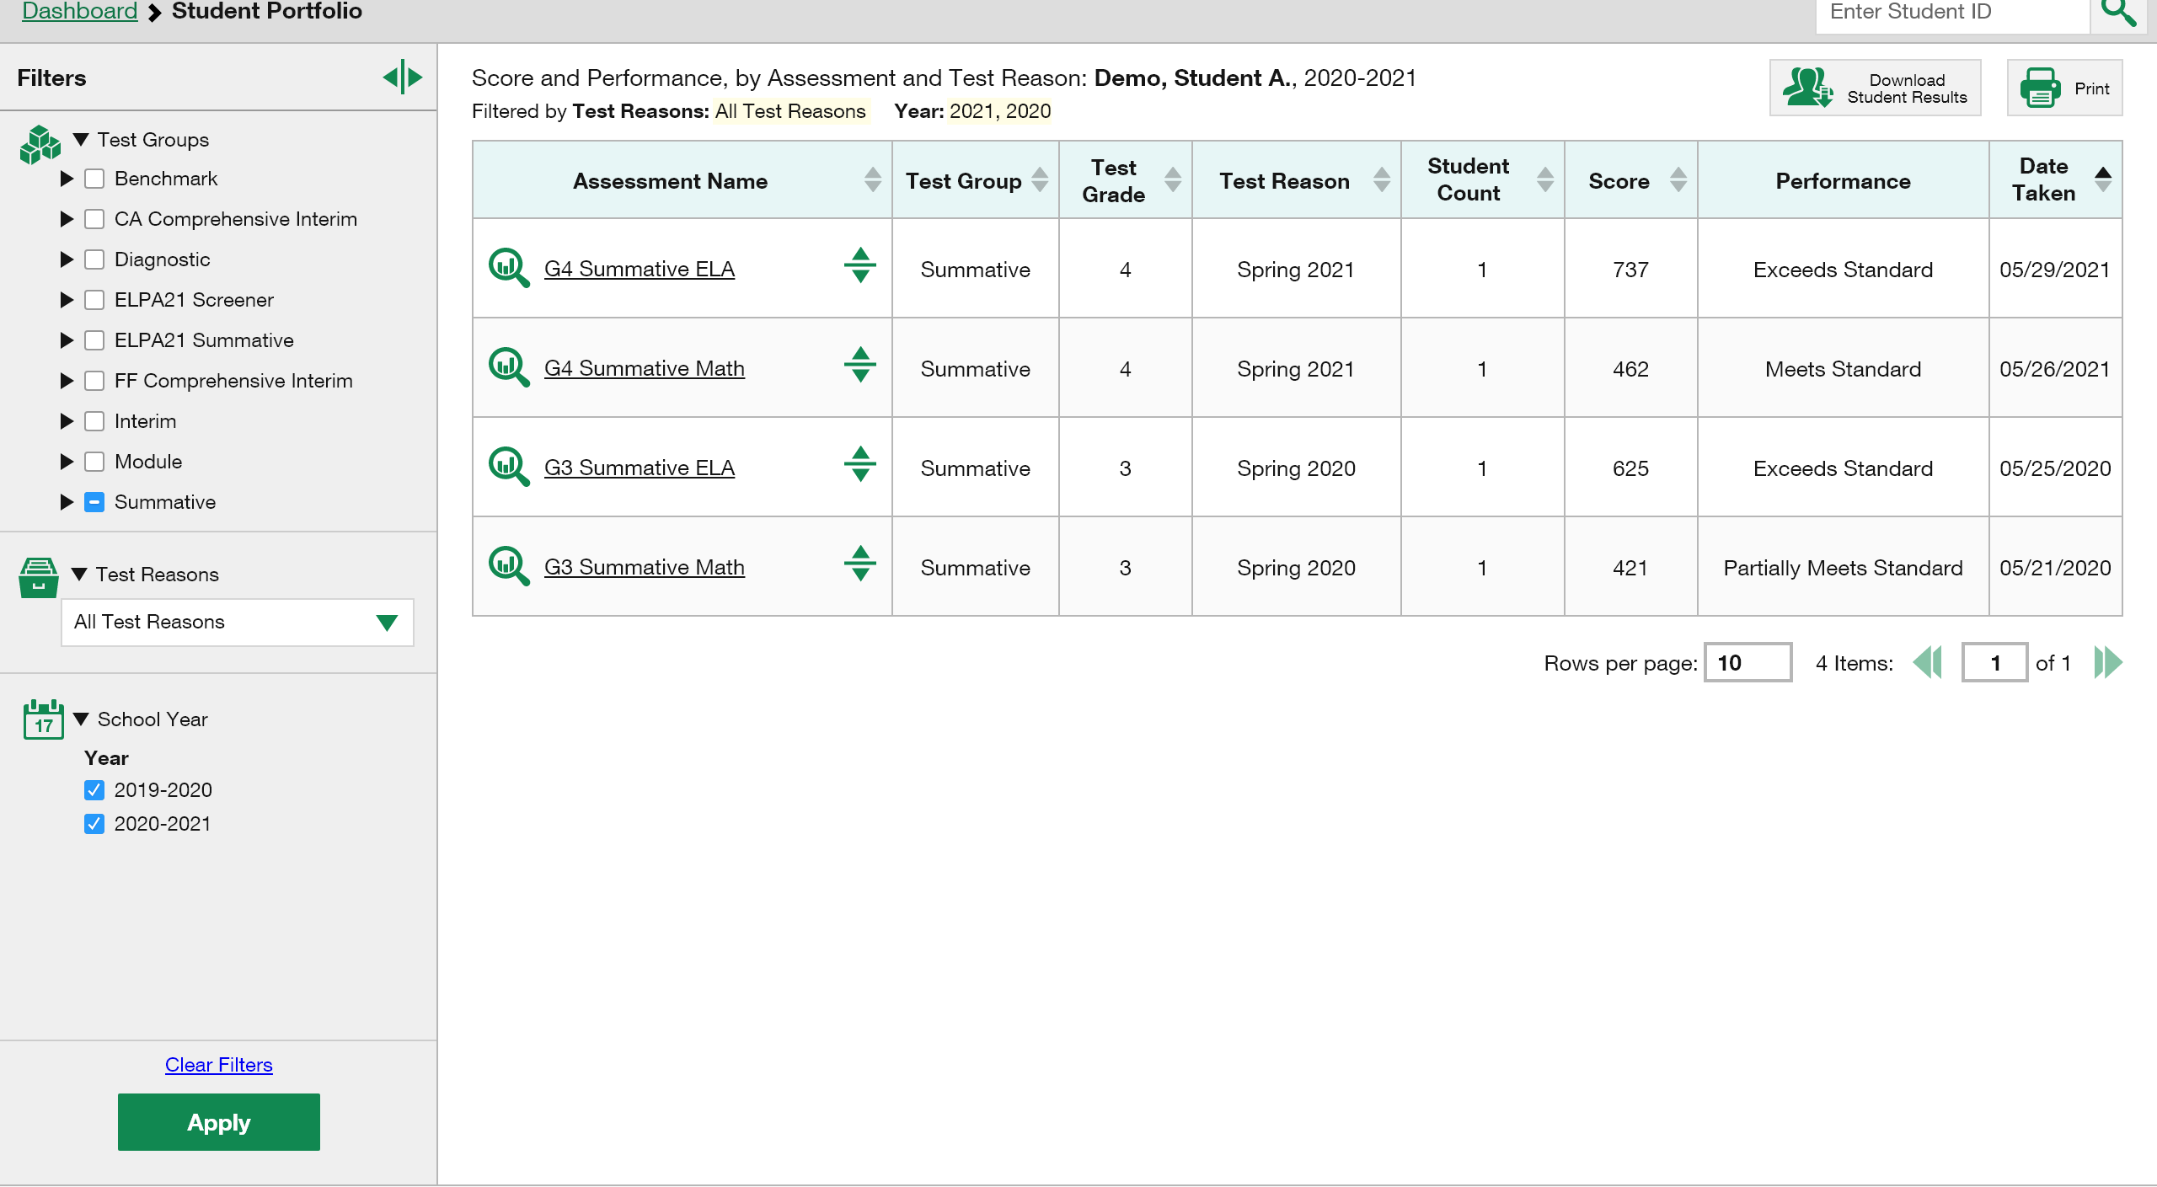
Filter Assessments by School Year
Sdt Porfolio Report
Notes:
To filter the report by school year, click the School Year option from the expanded Filters menu. Select the desired years you need to view and Click Apply.
The assessments from the selected school years are now displayed in the table.
To clear filters, click Clear Filters and then Apply.

Slide 34
Set Up Reports That Make Sense For Your Specific Needs
Notes:
You can use the options under the My Settings button and the Filter panel buttons to customize your reports.

Slide 35
My Settings—Teacher Options
My Settings
Manage Access
Change Role
Reporting Options
Manage Test Reasons
Select Tests to Include on Reports
Change Reporting Time Period
Set Student Setting on Item View
Roster Settings
Add Roster
View/Edit Roster
Upload Rosters
Filters Panel
Notes:
To drill down to the most relevant results and eliminate unnecessary details, teachers and other users should take the time to set their preferences by using the options in the My Settings drop-down menu. The options in this list will vary, depending on user role and state. These preferences will persist after you log out or change your user role.
Teachers will typically utilize these three main settings: Manage Test Reasons, Select Tests to Include on Reports, and Change Reporting Time Period.
The Manage Test Reasons option is used to organize interim assignments into categories, making data analysis more digestible.
The Select Tests to Include on Reports allows teachers to downsize the amount of data shown in their tables. Once a teacher has selected certain tests to display these choices are reflected when a school or district user elects to mirror the teacher’s choices in their data displays. This feature allows all users to bypass test data that does not suit their specific needs.
The Change Reporting Time Period allows a user to view results from a previous point in time. These three options are explained in the following slides.
The Set Student Setting on Item View option, when toggled on, will allow teachers to see test items exactly the way the student saw them on the test, with the specific settings options in place. Settings such as large font, font color, and language choice can be seen by the teacher. This setting applies only to interim tests that include item-level data.
Teachers also have options related to their class rosters. They can Add, View/Edit and Upload rosters.
Filter panel options are discussed at the end of this section.

Slide 36
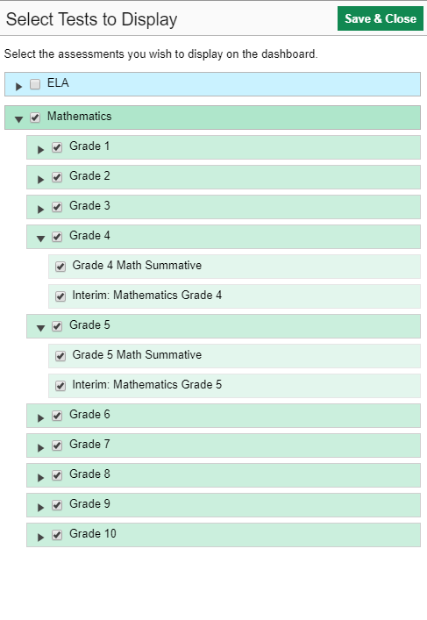
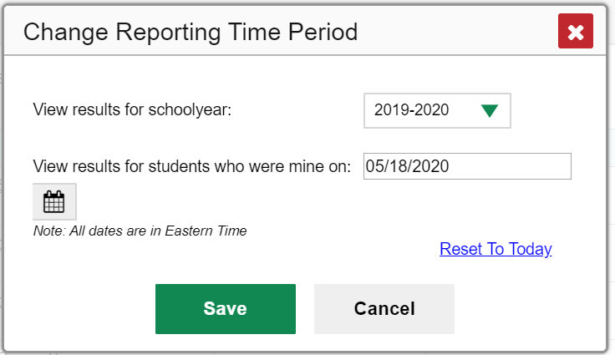
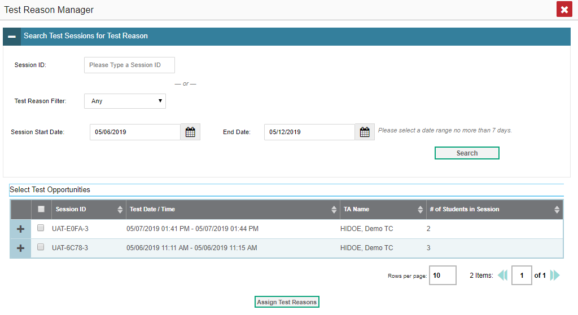
3 Popular Options From My Settings—Teachers
1
2
3
Notes:
Under the Select Tests to Include on Reports option, teachers can use the expandable menus under each subject to choose the tests they want included in their reports. Once a teacher has selected certain tests to display these choices are reflected when a school or district user elects to “Use Teachers’ Test Selections” from their Settings drop-down menu. This feature allows all users to bypass test data that does not suit their specific needs. These three options are explained on the next slide.
Users can select Change Reporting Time Period to view test results from a previous point in time. There are two time period settings: you can select a school year for which to view tests, and you can enter a date for which to view students. When a school year is selected, the reports show data for test opportunities completed in the selected school year. When a data is set for which to view students, the reports show data only for the students who were associated with the user as of the selected date. Student’s enrollment and demographic information is all given as of the selected date as well. Users can view students who have left rosters, school, or district, or even the state.
The Test Reason Manager is a tool used to organize interim tests into categories that will help users keep track of the various tests taken by their students. Reasons are set at the time of testing or after testing has been completed. When students take the same assessment multiple times, assigning different test reasons can help distinguish scores for more manageable analysis of results. Test reasons for summative tests are simply test administration windows and cannot be changed. Some administrators will create reasons to be used by all teachers and other users.

Slide 37
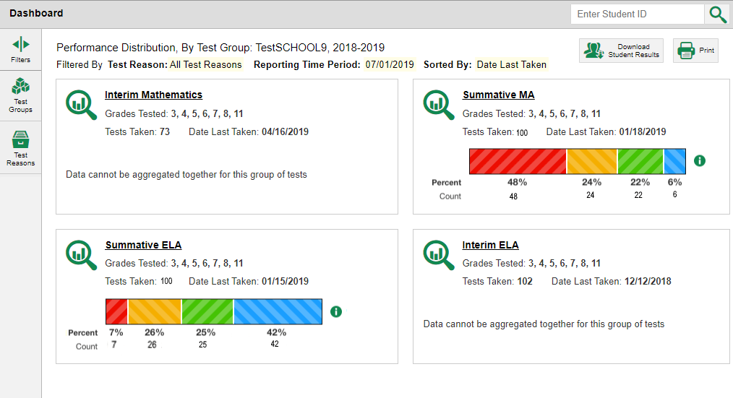
My Settings—School & District Options
1
Manage Access
Change Role
Reporting Options
Manage Test Reasons
Use Teachers’ Test Selections
Change Reporting Time Period
Set Student Setting on Item View
Roster Settings
Add Roster
View/Edit Roster
Upload Rosters
2
3
Notes:
School and complex users can narrow down their data results by utilizing My Settings preferences, as well. Popular options include: Use Teachers’ Test Selections, Change Reporting Time Period, Add Roster, View/Edit Rosters, and Upload Rosters.
To limit the data to the results relevant to teachers and the specific tests they give, school and district users set the Use Teachers’ Test Selections option accordingly.
The default setting for school and district users under Use Teacher’s Test Selections is All Rosters. This option displays ALL rosters for ALL teachers and schools, depending on the user role. To select the Teacher Preferences setting, click Use Teachers’ Test Selections from the drop-down My Settings menu. Mark the Teacher Preferences button and click Save & Close.
If you select this option, results for any teachers who excluded a given assessment from their own reports will not appear in the school test results for that assessment. This option can be useful when you want to exclude tests for classes a teacher didn’t teach. With this option assigned, the school or district user is seeing only the roster results for the tests chosen by the individual teachers according to what they have chosen to view in their reports.

Slide 38
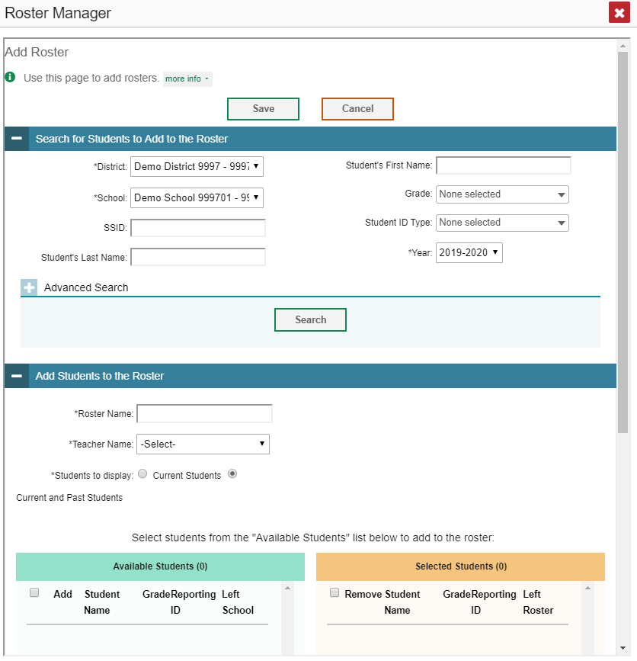
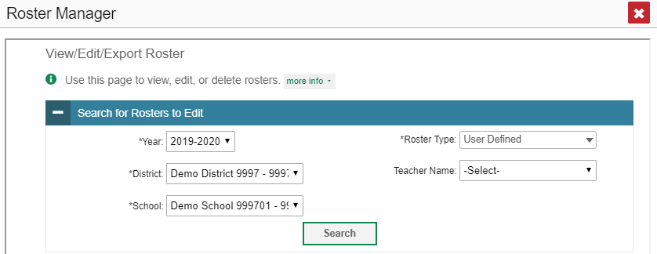
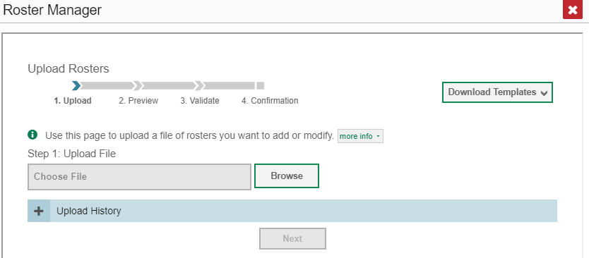
My Settings—Roster Management For All Users
Notes:
Users, depending on their role, can add, edit, export, and upload rosters using the Roster Manager pop-up windows. This mirrors the roster management functionality in TIDE. Complex test coordinators, school test coordinators, and teachers can build groups and assign students to them, allowing them to customize and update classroom rosters. Managing classes using these features is a great way to organize students, allow teachers to view their students’ performance, and generate information on incoming classes.
Refer to the Centralized Reporting System User Guide on the HSAP portal for specific instructions on using the Roster Manager windows.

Slide 39
Filters Panel: Options
Filter Button | Description
 | Use to focus on a particular class’s performance. By switching filters, a user can easily compare one class with another. Data for a single roster is easier to understand.
 | Use to focus on a single school. This filter option is for district-level users. Once applied, the School Performance on Test report displays
 | Use to filter out tests that you don’t want to see. For example, an ELA teacher might not want to see math scores. Set this group to exclude all math tests.
 | Test reasons are categories used to classify test opportunities for reporting purposes. They typically indicate the timeframe or season in which tests were taken. For example, a user may want to filter by fall and ELA, then filter by spring to see if students have improved. Not filtering brings up data for all different test reasons.
 | Use this filter to limit test results to one or several standards. This filter works on fixed-form tests with item-level data or adaptive tests for individual students.
 | Use this filter to access data from previous school years. This is helpful when analyzing performance gains over time. Available for Longitudinal Reports or the Student Portfolio.
Notes:
A second feature helpful in drilling down to specific data is the Filters panel on the left margin of the dashboard and test results pages. Clicking on any of the graphic buttons in the panel will expand to show the selection options. The available buttons vary, depending on the User and the Test Performance page. These filters do not persist after you log out or change user role. They are temporary.
To expand the selections for each option, click the corresponding graphic button. Check the desired selections and click the Apply button. The table shows the filter buttons that appear on the various pages in Reporting.
This table provides a quick overview of each of the filter options. Some of these options are discussed throughout the presentation.

Slide 40
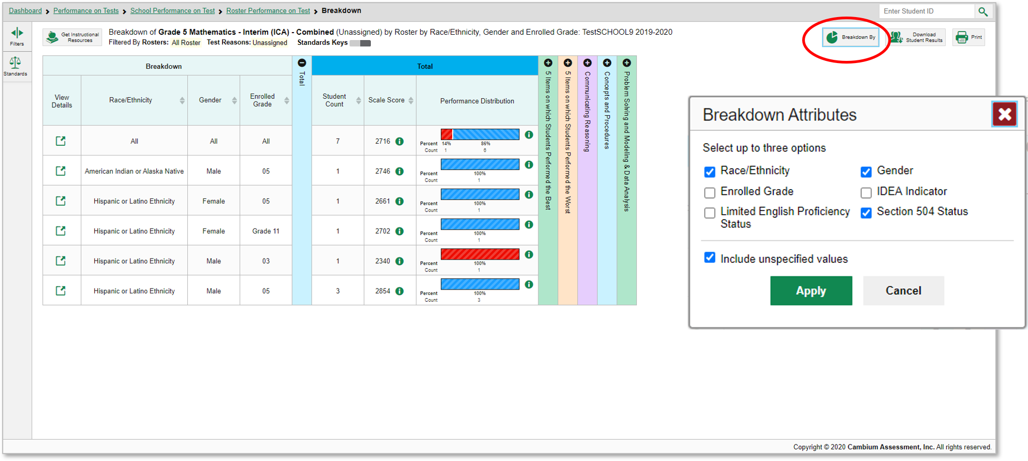
How to Build a Demographic Breakdown Report
Grade 5 Interim MATH
Notes:
There is another setup tool that allows users to break down data by demographic sub-group. You can create a breakdown report from any page in Reporting that displays data for multiple students. Click the Breakdown By pie chart button located below the student search box, upper-right corner of the page. A Breakdown Attributes window opens displaying the options available to you. These choices vary by state and district.
For example, here you see a teacher’s My Students’ Performance on Test report for the Grade3 Summative ELA test. The Performance by Roster tab is open showing all the teacher’s rosters. You can build a report for a specific group of students based on any three attributes listed in the Breakdown Attributes window.
For a sample report we have marked the Race/Ethnicity, Gender and Section 504 Status options. A checkbox is displayed next to the term “Include unspecified values”. This option, when selected, will include any of the user’s students with no demographic information assigned to them in TIDE. Click Apply. The customized report displays, as shown on the next slide.

Slide 41
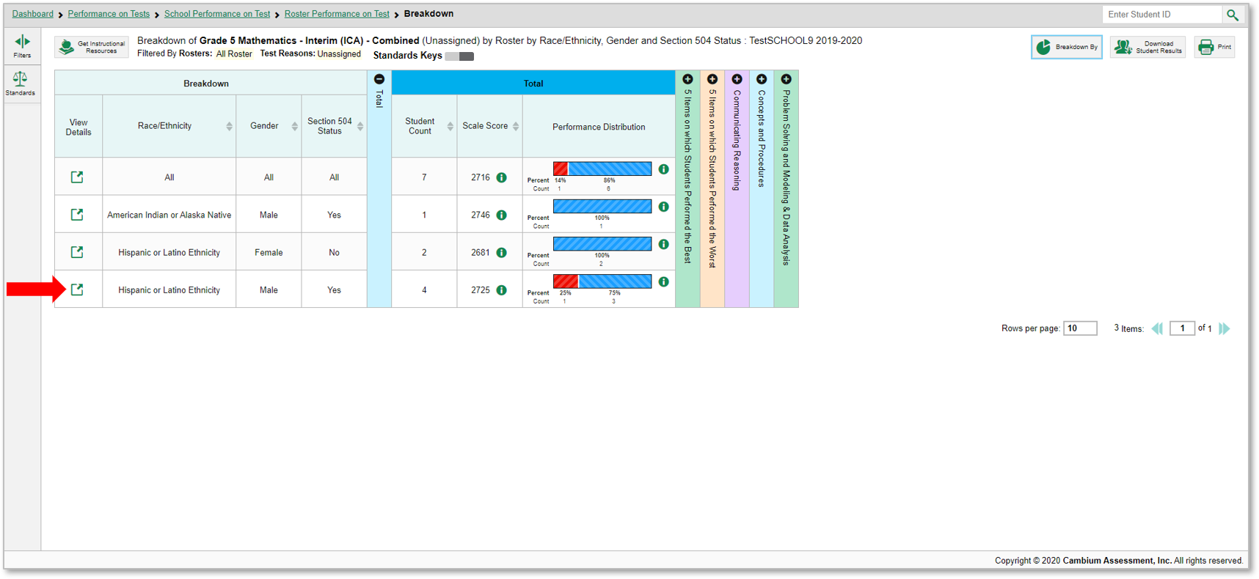
The Demographic Breakdown Report
Grade 5 Interim MATH
To look closer into a specific sub-group, click the View Details button in that row.
Notes:
The breakdown report page is organized according to the combinations selected. The number of rows in the table will depend on how the students fall into the demographic categories. A row appears for each possible sub-group combination.
For example, here you see a row for ALL the students, followed by some possible combinations. If a combination does not appear in the table, it means none of the teacher’s students fall into that sub-group. Notice that the table header has updated to reflect the chosen attributes. You see from this breakdown report that there are 7 students who are divided into three sub-groups. You can sort the sub-groups in several different ways, by Race/Ethnicity, Gender, Section 504 Status, Student Count, and Scale Score. To look closer into a specific sub-group, click the View Details button in that row.

Slide 42
The View Details Window/Breakdown Report
Grade 5 Interim MATH
Notes:
A Breakdown window opens, displaying detailed results for that sub-group. A row of drop-down menu buttons appears above the table, displaying the attributes of the group you chose. To quickly transition to another demographic sub-group, you can apply the breakdown menu options that display above the table of results. Select an attribute you want from the drop-down menus and click Apply. The new sub-group will display.

Slide 43
Work with Interim Tests
Items, Rubrics, and Scoring Essentials

Slide 44
All Tests
Non-Summative Tests
Checkpoint:
—fixed-form tests with 8–12 items within a specific reporting category (topic or skill area) or user built fixed-form tests from available Cambium or HI teacher authored standalone items.
—users can compare item-level scores across all students
—a.k.a. module, modular, benchmark module, benchmark, diagnostic
Interims:
—fixed-form or adaptive tests that cover some or all of the standards students are required to learn
—users can see item-level scores for individual students who took an adaptive interim
—a.k.a. Interim Comprehensive Assessment (ICA), Interim Assessment Block (IAB)
Summative Tests
Types of Non-Summative Tests that Report Item-Level Data
Our Focus:
Item-Level Data Included on Checkpoint and Interim Test Reports
Notes:
The focus of this section will be on non-summative test reports that contain item-level data, access to the items themselves and access to student responses to the items. This chart shows how tests in Centralized Reporting can be categorized.
All tests are either summative or non-summative assessments. Summative tests are end-of-year or end-of-course comprehensive tests that assess the student’s command of an entire subject. Non-summative tests vary by state and district and can be divided into benchmark and interim tests.
Checkpoints are small tests in single reporting categories with non-secure items. Users can compare item-level scores and the items themselves, for all their students.
Interims are larger than benchmarks, but smaller than summative tests. Many interim tests will report item-level data, depending on the type of test and on state and district policies.
In the next slide, we will show you how to navigate to a non-summative test report.

Slide 45
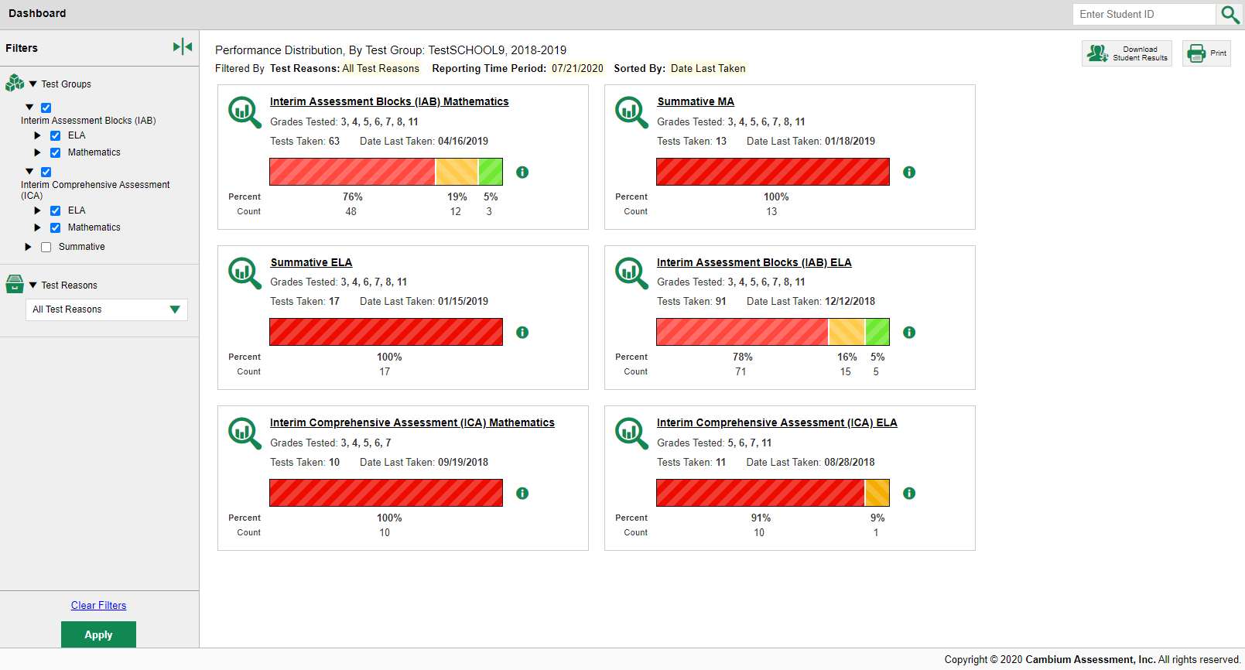
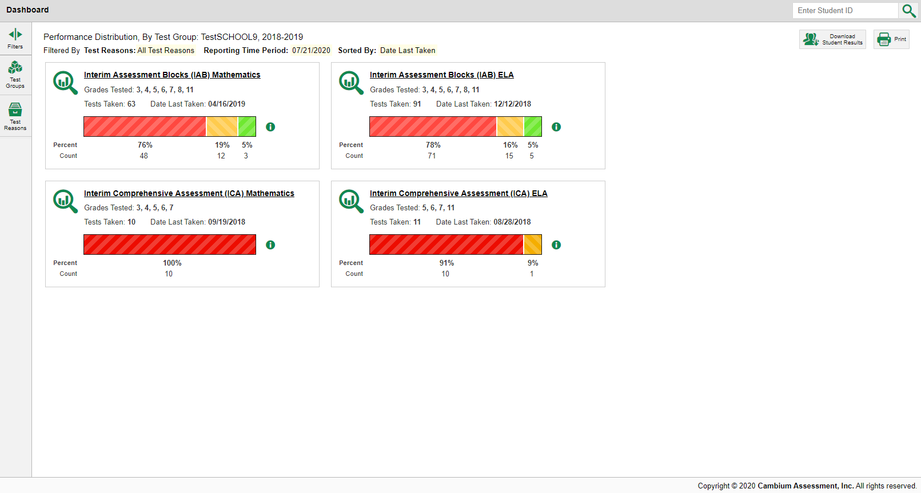
Dashboard: Filtering
Notes:
Click on Test Group and select the non-summative test groups you want to view.
Click the Apply button at the bottom of the Filters panel.
The dashboard updates to display the groups selected. Click a test group name or the magnifying glass view button beside it. This takes you to the Performance on Tests report displaying high-level data for that group.

Slide 46
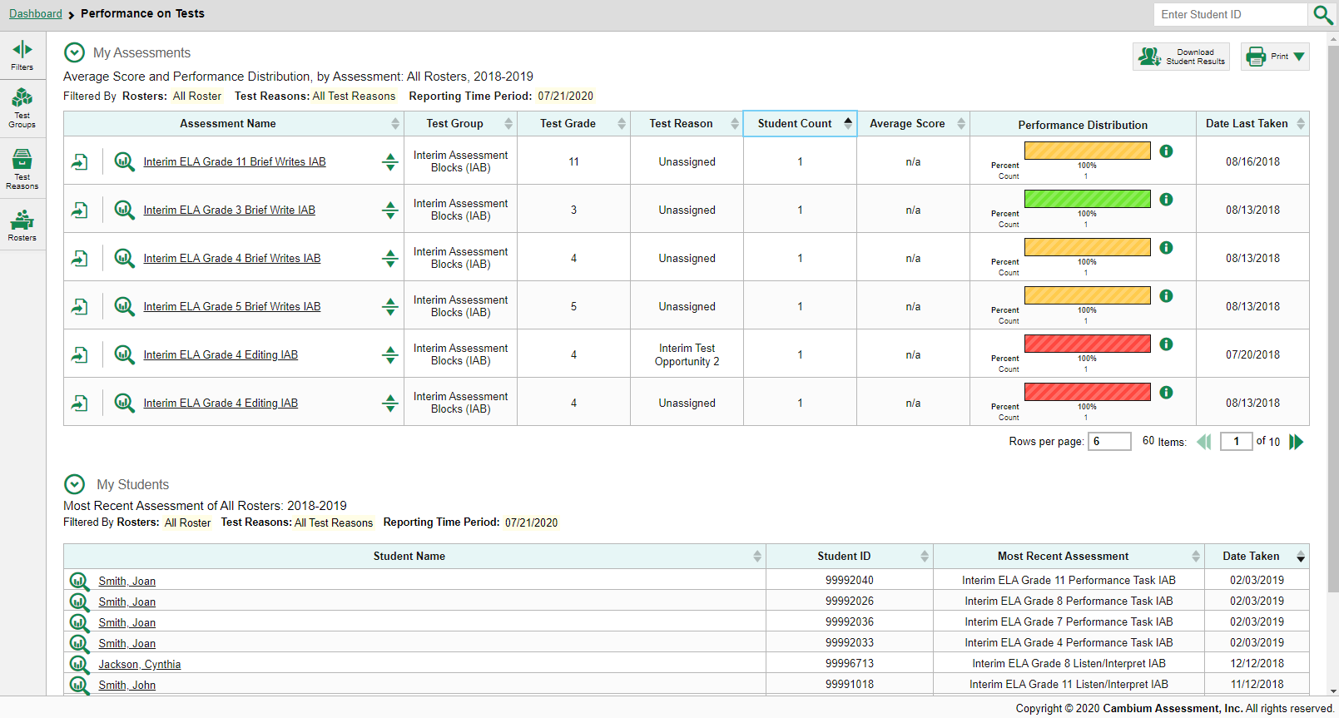
Performance on Tests Report View
Notes:
Here is the Performance on Tests report. It is filtered to display only tests that fall within the single test group you clicked on.
From here, click on any one of the tests in this test group in order to view a report devoted to that particular test. You can navigate from there to the Performance by Student tab of a report, or to the Roster Performance on Test report, just the way you would navigate to deeper-level reports for a summative.
Test items can be analyzed to provide a clear view of the student’s reasoning and subsequent performance on the test.
The first report we show you is a Roster Performance on Test report for an interim assessment with more than ten items that tests a single standard.

Slide 47
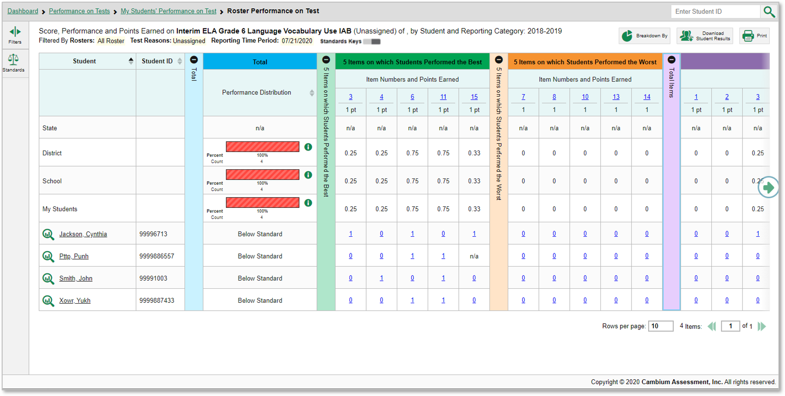
Test Report View: Single Reporting Category
Grade 6 Interim ELA
Notes:
Here is the Roster Performance on Test report for a roster of students who took the Grade 6 ELA test on Language Vocabulary Use.
The colored sections in the table include a Total performance section in blue, a green section for 5 Items on which Students Performed the Best, an orange section for 5 Items on which Students Performed the Worst, and another section in purple for Total Items. You can expand or collapse the sections by clicking the vertical section bars, which display plus and minus signs. Clicking the green arrow button on the right allows you to scroll right.
To show you how to analyze your results, we focus first on the green section, showing the five items on which students performed the best.

Slide 48
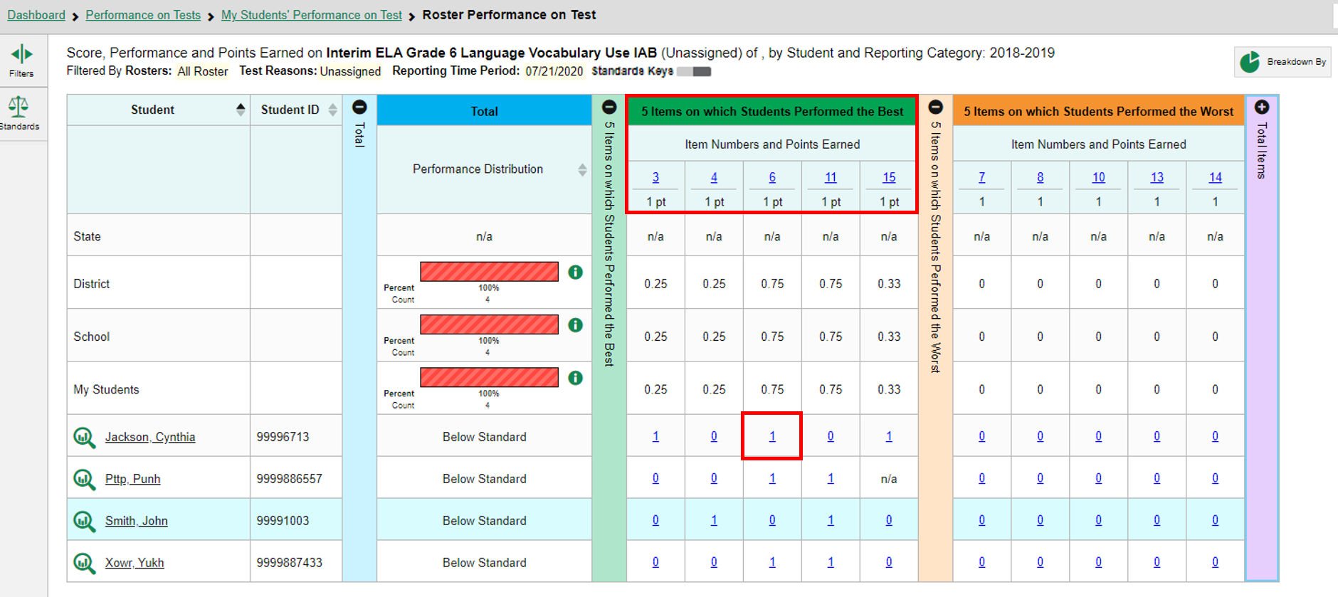
Test Report View: Single Reporting Category (continued)
Grade 6 Interim ELA
Notes:
The first two rows under the section header, 5 Items on which Students Performed the Best, list the item number and the number of points earned for the item. The students on this roster performed the best on items #3, #4, #6, #11, and #15.
For example, the first student listed earned 1 out of 1 points on item #6.
In reports with item-level data, you may occasionally see “n/a” instead of a score for an item. It means that the student did not respond to the item, or the item was not included in that form of the test.
Next, we show you a similar report with fewer than ten items on the test.

Slide 49
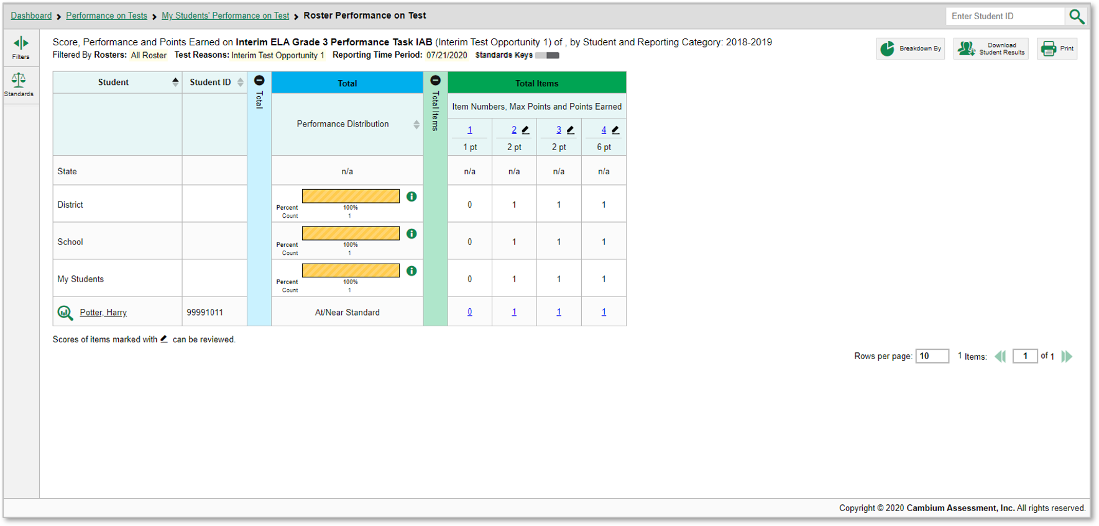
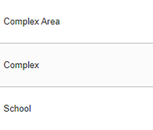
Test Report View: Single Reporting Category (<10 items)
Grade 3 Interim ELA
Notes:
This is a Roster Performance on Test report on the Grade 3 ELA Performance Task. Because this test has fewer than 10 items, it does not display the 5 Best and 5 Worst sections. Instead, item-level data are shown only in the Total Items section.
Next, we show you a similar report on a comprehensive interim test with multiple reporting categories, also known as skill areas or topics.

Slide 50
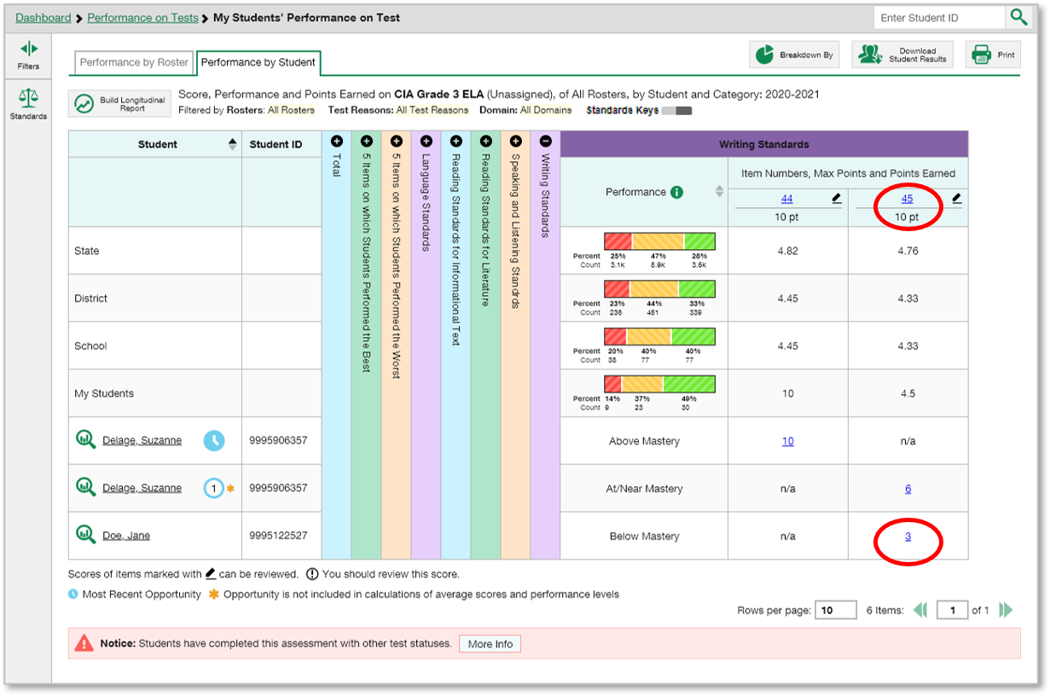
Reports with Multiple Reporting Categories
Grade 3 Comprehensive Interim ELA
Notes:
Here are the Performance by Student results of the My Students’ Performance on Test report for the Grade 3 ELA Comprehensive Interim Assessment.
Notice that the table includes five reporting categories in addition to the blue Total section and the 5 Best and 5 Worst sections. The items included in each reporting category are the ones that assess that skill area.
Under each reporting category the item number displays as a blue item link and the maximum points for the item displays under the link.
The blue score links in the grid give the number of points each student earned for each item. For example, you can see that item #45 under Writing Standards is worth 10 points. The last student listed on this page earned 3 points for their answer to that item.
Every reporting category section in this report includes a performance column that can be sorted. Click the up or down arrow next to the column header to sort in ascending or descending order. When you sort your students this way you can quickly see who needs more support in each reporting category.
Next, we show you how to access an actual item and a student’s response to it.

Slide 51
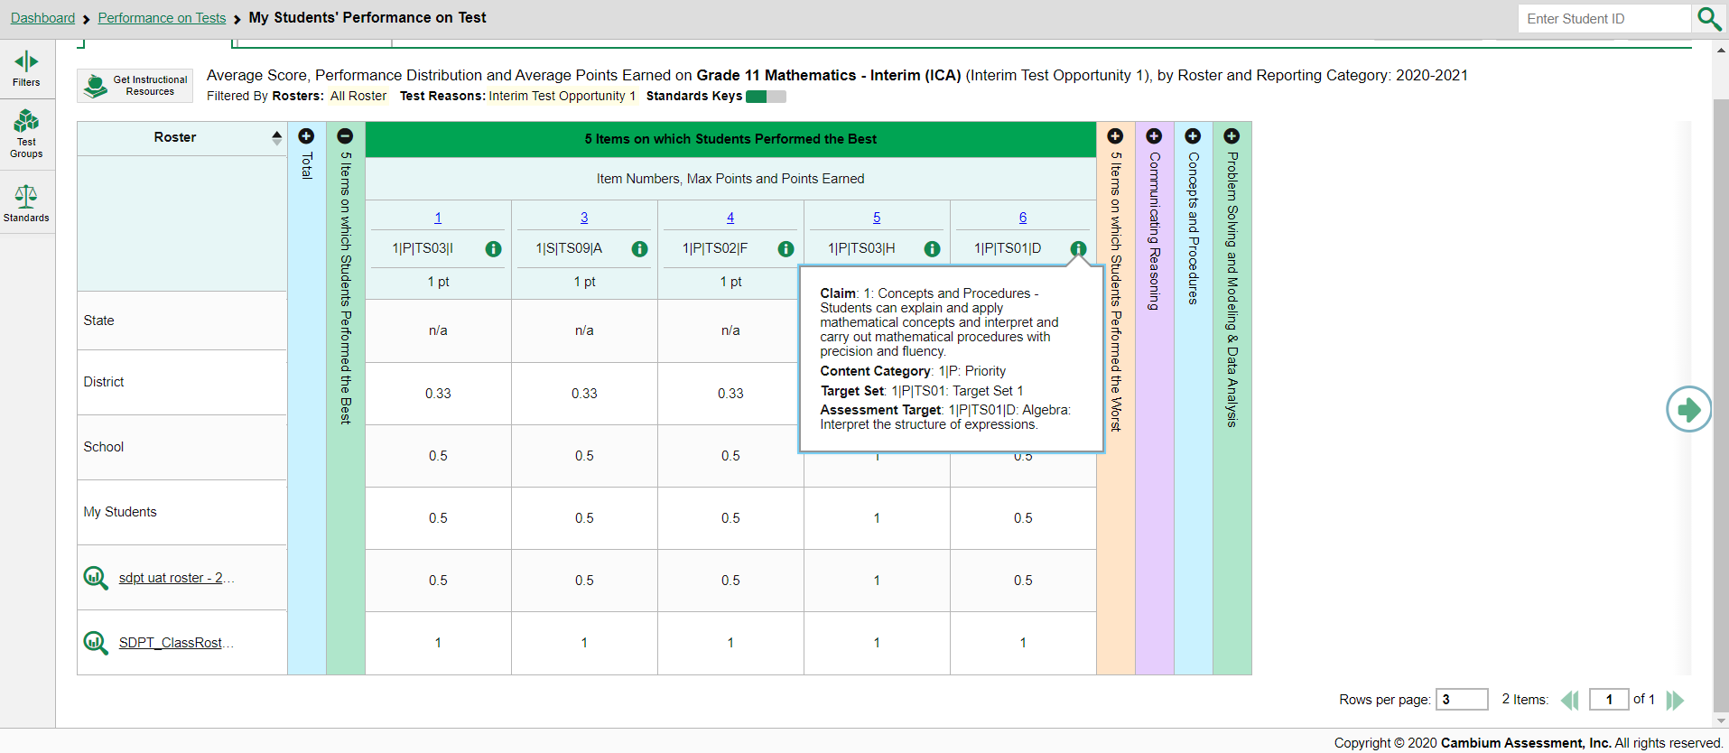
How to View Standards for Each Item
Grade11 Interim Comprehensive Math
1
3
2
Notes:
For the Smarter Balanced Summative Assessment, an assessment target describes at a more granular level than claim, the expectations of the knowledge, skills, and/or abilities assessed by the items and tasks within each claim. A target can be aligned to one or more standards.
In a report displaying item-level data, you can view the standard to which each item is aligned. This allows you to determine at a glance what the item measures.
To show or hide item standards, click the Standards Keys toggle in the row of filter details below the report table heading.
The standards display beneath the blue item numbers.
Click the more information buttons beside the standard keys to view the legend for each standard.

Slide 52
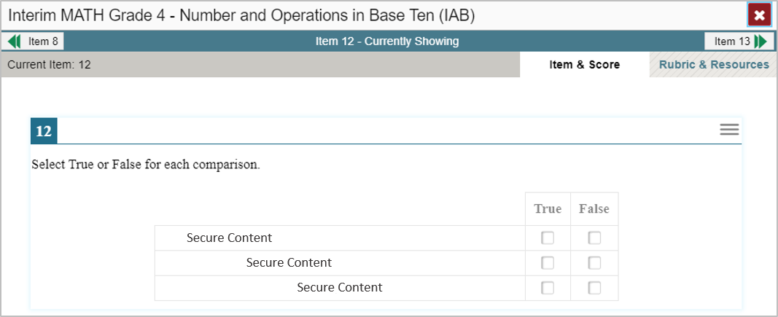
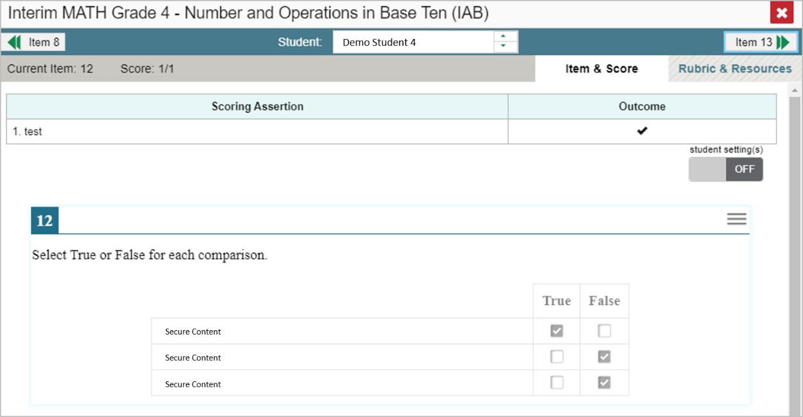
Viewing an Item and Student Response
1
2
Notes:
To view a test item in a blank, unanswered state, click the item number link in the first row of a report table. The item view window displays the test question as it appeared on the assessment on the Student Testing Site.
To view an item with a student’s response, find that student’s name in the Student column on the left. Then click the blue score link under the numbered item. In this example we look at item #3 for the last student listed.
The item view window displays the item along with the answer provided by that student.
On the next slide, we will explain the features of an item view window that includes the student’s response.

Slide 53
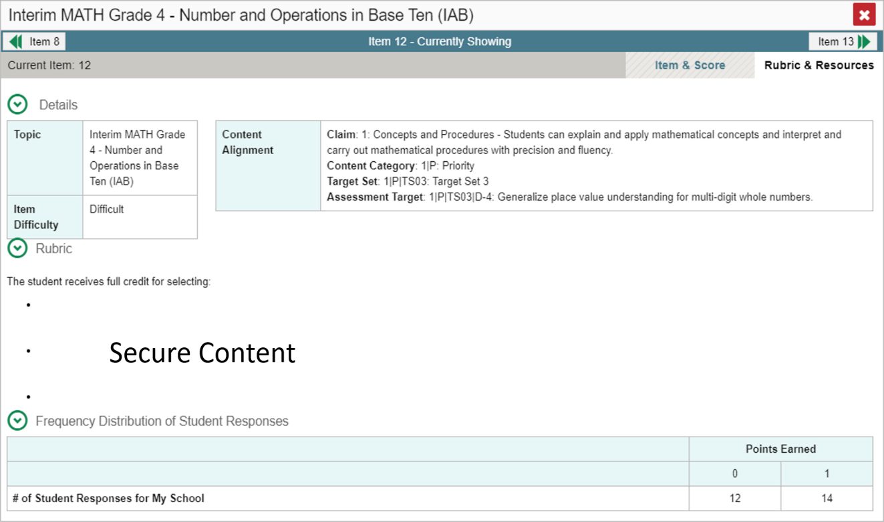
Item & Score Tab
Notes:
You can see the current item number and the score for that item in the gray bar in the banner. The student answered correctly for a score of 1 out of 1 point on item #12.
Moving to the right in the gray bar you see two tabs, Item & Score and Rubric & Resources. You can toggle between these tabs to display associated content. The Item & Score tab is open in the upper-left image and the Rubric & Resources tab is open in the lower-right image.
In the teal-colored bar at the top of the window are three navigation tools to help you move between students and items without returning to the report. The name of the selected student displays in the middle box. Clicking the down arrow takes you to the next student listed in the report table. Clicking the up arrow takes you to the previous student. The arrow button on the left moves you to the previous item. The arrow button on the right takes you to the next item. Because we opened item #4 from the 5 Worst section on the report, item #8 displays as the previous item listed under the 5 Worst column.
Underneath the teal and gray banners, the scoring assertions are displayed with their outcomes.
In the Scoring Assertion column, each assertion states exactly what the student must do to earn points. The Outcome column shows a checkmark for a correct answer, or an X for each incorrect answer. This item has a single scoring assertion.
Some items display “Scoring Criteria” instead of “Scoring Assertion.”
Below, the test item is displayed along with the student’s response to it. Reviewing a student’s response may provide clues to the student’s thinking.
You can show or hide a student’s visual settings, like large fonts, different color contrasts, or Spanish language, on a per-item basis. To do so, click the toggle above the item on the right side.
We explain the Rubric & Resources tab on the next slide.

Slide 54
Rubric & Resources Tab
Notes:
The Rubric & Resources tab has the same teal and gray banner features and is divided into multiple sections, which may include Details, Resources, Rubric, and Frequency Distribution of Student Responses. The sections are expanded and collapsed using the circled arrows to the left. The information included in each section varies, depending on the test item.
The Topic lists the skill area to which the item belongs. The Content Alignment section describes, in detail, the academic or learning standard to which the item is aligned.
The Resources section (not shown) contains links to any resources related to the item.
The Rubric displays the criteria used to score the item. A simple correct answer may be listed, or this section may include a score breakdown, a human-readable rubric, or an exemplar, which provides an example of a response for each point value. The rubric is not shown here.
The Frequency Distribution of Student Responses provides a breakdown of how many students earned each possible point value available for the item. In this example, 4 students in the school responded to item #15 on this Math test. Two of them earned one point for the item and two of them earned 0 points.

Slide 55
Multiple Scoring Assertions
Elementary School Science Modular
Notes:
Some test items have Multiple Scoring Assertions. Typically these items feature a reading passage, along with graph images like a map, table, or illustration. Several test items are then associated with this prompt. Students are instructed to use what they have learned from the stimuli to perform the associated sub-item tasks.
Each scoring assertion contains both a statement that provides information about what the student did in their response, and the content knowledge, skills, or ability that is evidenced by their response. This slide shows the Scoring Assertions window from question 1 on the Elementary School Earth Space Science modular test. It features a reading passage, a graphic, and five sub-items. Each sub-item is worth 1 point. The sub-items are listed as 1-1, 1-2, 1-3, and so on. The information pop-up displays the scoring assertions associated with each of the sub-items. The Item & Score page shows all five scoring assertions listed in that section of the page. It shows that this student answered 1 of the 5 sub-items correctly, #1-5.

Slide 56
Use the Standards Filter
Grade 4 Interim ELA
Notes:
Sometimes it is helpful to use the Standards filter to trim a comprehensive interim test so that you can focus on the students’ item-level performance in a single standard or cluster of standards. Then you can switch filters to compare it with their performance in another skill. If you don’t filter by standard, the reports will show results for all standards by default. You may find that switching between different sets of standard data and comparing them helps you understand students’ abilities better.
Please note that the terminology and filter options vary by state, district, and test.
There are 41 items on this comprehensive interim assessment in Grade 4 ELA. The items are associated with four reporting categories: Listening in purple, Reading Standards in blue, Research and Inquiry and Writing.
Open the Filters panel by clicking the Filters button or the Standards button. Use the drop-down list under Standards to select a Claim. Keep making selections from the drop-down lists as they appear. This allows you to drill down further.
This Filters panel displays with a Claim menu and an Assessment Target menu.
Click Apply to filter the report by your selections.
On the next slide, we show you the effects of the filter we applied.

Slide 57
Use the Standards Filter (continued)
Grade 4 Interim ELA
Notes:
This is the same CAI Grade 4 ELA test report, now filtered to show only items associated with the claim and target. Items #14 and #34 are aligned to that Claim and Assessment Target.
The filter details under the report header have updated to specify which Claim and Target.
Now we explain the Test Reason Manager and the Test Reason filter. These are two options that are useful only with interim and benchmark tests.

Slide 58
Assign Test Reasons
Manage Access
Change Role
Reporting Options
Manage Test Reasons
Select Tests to Include on Reports
Change Reporting Time Period
Set Student Settings on Item View
Roster Settings
Add Roster
View/Edit Roster
Upload Rosters
Notes:
Test reasons are categories used to classify test opportunities for reporting purposes. If your students take the same assessment multiple times, assigning different test reasons can help you to distinguish scores for the different test opportunities in the Centralized Reporting System. Test administrators can assign a test reason at the time of testing, when they start a test session in the TA Interface. Otherwise, the test reason will appear as “Unassigned.” You can assign Test Reasons from the Reporting System, as well. From the My Settings drop-down menu in the banner, select Manage Test Reasons. The Test Reason Manager window opens.
To search for test opportunities to categorize, do either of the following:
In the Session ID field, enter the session ID in which the opportunities were completed in the Test Delivery System (TDS).
Or select a test reason associated with the opportunities you want to edit.
Then select a range of dates during which the test session was administered. The range cannot exceed seven days. Finally, click Search.

Slide 59
Assign Test Reasons (continued)
1
3
2
Notes:
A list of retrieved test sessions appears in the section Select Test Opportunities.
Click the plus sign buttons to expand the list of tests in each session and, under a test, the list of students who took that test in that session. Mark the checkboxes for each session, test, or opportunity that requires a test reason.
Click Assign Test Reasons.
In the confirmation window, select a new test reason to assign to the selected opportunities and click Confirm.
Assigning or reassigning test reasons will make the filter by test reason option more useful. We explain why on the next slide.

Slide 60
Filter by Test Reason
Notes:
When your test opportunities have test reasons, you can filter reports by a single test reason.
For example, you may want to filter by interim opportunity 1 and look at Math performance, then filter by another opportunity and see if students have improved on Math material. If you don’t filter, you’ll see data for all different test reasons. Filtering allows you to view a single test reason instead of multiple test reasons side by side. You may find reports easier to understand when you’re viewing only a single test reason.
The test reasons filter is available on the dashboards for teachers as well as school- and complex-level users, and in the Performance on Tests report. Here we show the Performance on Tests report. On the left side of the page, click the Test Reason button to display the drop-down list of test reasons. Make a selection from the drop-down list and click Apply. For our example we selected the Interim Test Opportunity 1.
The filtered report displays with an updated table header. You see only the tests identified with that reason in your results. You can return to the Filters drop-down menu and select another reason to make comparisons.

Slide 61
Enter Scores for Unscored Items
Notes:
The Centralized Reporting system allows users (with appropriate permission) to handscore unscored test items. It also allows modification of some automated scores suggested by the machine scoring system. If a test contains unscored items, its performance data is excluded from your Dashboard and Assessment Reports until you or another user with scoring permissions enters scores for all the unscored items in at least one opportunity of that test.
When you have tests awaiting item scoring, a Tests to Score notification appears in the banner.
To enter scores for unscored items, click the Tests to Score notification. The Scoring Mode window will open and display a list of tests with unscored items. Click the magnifying glass icon next to the name of the test you wish to score.

Slide 62
Enter Scores for Unscored Items (cont.)
1
3
2
Notes:
The Scoring Mode window now displays a list of students and items awaiting scoring for the selected test.
To enter scores for an item, click the score link for the item in the student’s row.
The Item View window will open.
You can review the item rubric and available resources on the Rubric & Resources tab, if necessary.
On the Item & Score tab, review the student’s entered response for scoring. Click the pencil icon to display the points earned options and condition codes.
To enter a score for the response, select or type a numerical score in the Points Earned drop-down menu and click Save.
If you need to assign a condition code to the response, select the appropriate option from the Condition Code drop-down list. Condition codes include instances such as blank or insufficient answer, off-topic or off-purpose answers, and the use of non-scorable language.
You can continue scoring unscored items in the Item Preview Window.
To view another unscored item for the same student, use the previous/next arrows on the left and right sides of the Item View banner.
To view the same unscored item for another student, use the up/down arrows in the Student field box in the center of the banner to switch between students.

Slide 63
Modify Scores
1
2
Notes:
Users can modify scores for some items.
Reports display a pencil icon in the column headers for each item with editable scores.
If a machine-suggested score has a low confidence level, a yellow warning triangle appears next to the score number. It is highly recommended that teachers review low-confidence scores.
Click the item score link in the student’s row of the report. The Item View window opens.

Slide 64
Modify Scores in Item & Score Tab
2
1
Notes:
Click the pencil icon in the Scoring Criteria table.
To enter a score for the response, select a numerical score from the Points Earned drop-down list. If the item consists of multiple scoring criteria, select a numerical score from the score drop-down list for all scoring criteria. To save the score, click Save. When you close the item view window, any average scores or performance distributions on the assessment report update automatically.
Users can choose to assign a Condition Code in lieu of selecting the number of points earned.

Slide 65
Condition Codes
Condition Code | Source of Code | Description
Insufficient Text (Duplicated Text) | Machine | The response contains a significant amount of text repeated over and over.
Blank | Machine | The student did not enter a response.
Non Specific* | Machine | This condition code is assigned to machine-scored responses when TDS identifies that the response requires a condition code but cannot determine which specific condition code it requires. Resolution is required.
Insufficient Text (Too Few Words) | Machine | The response contains too few words to be considered a valid attempt.
Non-Scorable Language (Uninterpretable Language)* | Machine | The response is in a language other than English or Spanish. Resolution is required.
Insufficient Text (Copied Text from the Prompt) | Machine | The response is largely composed of text copied from the prompt.
Off Topic | Human | A writing sample will be judged off topic when the response is unrelated to the task or the sources or shows no evidence that the student has read the task or the sources (especially for informational/explanatory and opinion/argumentative).
Foreign Language | Human | The response is written in a language other than English.
Unreadable | Human | The response is unreadable. For example, an online response is unreadable if it only contains repeated/random keystrokes (e.g., “yyyyyyyyyyy”; “av:aeoiahvb;e”; “hhrrttuuvv”).
Blank | Human | The student did not enter a response.
Notes:
Here is a sample list of condition codes that you may see in your drop-down menus. As you can see from the table, some of the condition codes are assigned by machine and other condition codes are assigned by human. When a condition code of Non-Specific or Uninterpretable Language has been assigned by machine, it is highly recommended that you review items flagged with this icon.

Slide 66
Generate Individual Student Reports (ISRs) and Student Data Files
Notes:
Individual Student Reports (ISRs) and Student Data Files are generated using the Student Results Generator button.

Slide 67
Student Results Generator
Notes:
The Student Results Generator button is the “head and shoulders” icon located in the top-right corner of the dashboard and report pages, outfitted with the label, “Download Student Results.” When you click on it, the Student Results Generator pop-up window displays. Both reports, the ISR and the Data File, are built by completing three numbered and colored sections, #1 Select Test Reasons, #2 Select Assessments, and #3 Select Students. In this section we show you several sample ISRs and then take you through the steps of generating an ISR. You construct the Student Data File in the same way, but your report will be in the form of an Excel or CSV spreadsheet. What you see in your Student Results Generator pop-up window may vary slightly from these images depending on the type of assessments administered in your state or district.

Slide 68
Sample ISRs: Simple ISR with Reporting Categories
Notes:
An ISR is a PDF that displays the performance results of one test taken by one student. It may consist of a single page, called the “simple report,” or multiple pages, called a “detailed report.” Simple Reports show the most pivotal information about the test the student took on a singular page for easy viewing. On the screen is a simple ISR (it’s one page but divided on screen to show details more clearly), showing the results for a Grade 5 Interim English Language Arts assessment. Student, test, and school information is located at the top, followed by a summary of performance. A vertical scale of cut scores and performance levels features prominently on the report page. State, district, and school aggregate scores are included, if available. If the test is structured with reporting categories, levels and descriptors for those are reported, as well. Other data are displayed depending on the state and type of test.

Slide 69
Sample ISRs: Detailed ISR with Item-Level Data
Notes:
An ISR is a PDF that displays the performance results of one test taken by one student. It may consist of a single page, called the “simple report,” or multiple pages, called a “detailed report.” The Detailed Report will show more in-depth results the student achieved on different aspects of the test. If the report is for a fixed-form interim test, like the ISR page on the right, item-specific data are included in the detailed, multiple-page report. This report is for the Interim Comprehensive Assessment in English Language Arts Literacy. Two pages of the detailed report, shown here, group the test items into the five reporting categories. Each item has its target descriptor along with the points the student scored on that item out of the points possible.

Slide 70
Sample Trend ISR (Longitudinal Reports)
Notes:
Here we have another page in the detailed report, showing a trend report. A trend report is similar to the Longitudinal Report accessed in the Centralized Reporting System. Here we see that the student’s scores on the three instances of this Interim ELA test have risen over time. Your ISRs’ layout may vary from the samples used in this module, depending on your state configurations. However, the content will still be similar. Now we show you how to build the ISRs you need.

Slide 71
Two Ways to Build an ISR
1. From Dashboard—Generate ISRs from Scratch
Notes:
You can build your ISRs from scratch or you can build them using pre-populated data. If you click the generator button from the dashboard, as shown here, the Student Results Generator window opens with all the selection choices unpopulated. You generate the ISR or ISRs by selecting the test reasons, assessments, and students that match your ISR needs. You can choose any combination of test reasons, assessments, and students. The pop-up window displays with column #1, Test Reasons, open.

Slide 72
Two Ways to Build an ISR
2. From Test Report—Generate ISRs Using Pre-Populated Data
Notes:
If you open the generator from a report page, as shown in this image, the Student Results Generator is pre-populated with data associated with the specific test report. The selections are made for you and you only need to confirm them or change them to generate the ISR or ISRs you need. On the next slide we demonstrate the process using a pop-up window with pre-populated data.

Slide 73
Student Results Generator – Pre-Populated from Report Page
Notes:
Here is the Student Results Generator window showing pre-populated selections. Typically, when the generator button is clicked on from a test report page, the Select Students column, #3 displays in the open position. This slide shows the window for a teacher who is viewing the roster results for Rosters A, B, D, and D. The Select Students column displays the rosters with students nested below. Each roster can be expanded to show the students on that roster, by clicking on the arrow next to the roster name. Depending on the ISRs you need to generate, confirm that the pre-selections are those that you want or mark the checkboxes for the rosters and/or students you need. Now go to the other two sections and confirm or change the selections. You open and close each column by clicking the + or - symbols at the top of the columns, or you can click the Previous and Next buttons at the top of each open column. We explain the sections on the next slide.

Slide 74
Sections #1
1. Select Test Reasons
Notes:
Column #1 is labeled Select Test Reasons. Test Reasons are the test administration windows for summative tests. Test reasons for interim, benchmark, and modular tests can be categories, like Pre-test or Post-test, or a numbered opportunity. Mark the boxes for the Reasons that apply to the ISRs you need to generate. The Selections panel on the right displays a count indicating the total number of students selected and the number of ISRs you have ordered.

Slide 75
Section #2
2. Select Assessments
Notes:
Column #2 lists assessments by subject and grade. Select individual assessments or mark All Subjects. You can generate ISRs for any test in the list. The Selections panel on the right displays a count indicating the total number of students selected and the number of ISRs you have ordered.

Slide 76
Section #3
3. Select Students
Notes:
The Select Students column, #3, will load results depending on the user’s role. Teachers and school-level users will see a list of rosters with student names below. District users will see a list of schools. The Selections panel on the right displays a count indicating the total number of students selected and the number of ISRs you have ordered.

Slide 77
Fourth Customizing Option
4. Set Date Range
Notes:
A fourth customizing option is accessed via the filter button which is located to the right of the Next and Previous buttons. You can select a range of dates to be included in the ISR by using the calendar to enter a start date and an end date. Click Apply. After making your customizations, click the ISR radio button under Report Type in the Selections Panel. We now explain the Print Options available.

Slide 78
Generate a Student Data File
Student Data File—Excel Worksheet
Notes:
A Student Data File is a user report of performance data, in Excel, CSV, or text format. Files of this nature allow the user to employ the workbook features of a spreadsheet application to organize and sort the data. A sample is shown here. The generation process for a Student Data File is the same one used for the ISR with different print options. Customize the Student Data File using the same three selection columns and the Filters button. Choose your desired print format and click the green Generate button. The Student Data File displays in the user’s Inbox.

Slide 79
Print and Export Any Data You Can View in Your Reports

Slide 80
Print or Export Data You Can View
From a Dashboard: Print
From the Performance on Tests Report: Print & Export
Notes:
Users can print or export any data from Centralized Reporting. Use the print button (upper-right corner) to create a quick hard copy of any report or results displayed on the results page. The export button (to the left of each assessment on the Performance on Tests report) generates a detailed report of any specific test. Users may choose from a PDF file (a picture) or a CSV file (an Excel spreadsheet) and may choose to print test results with item performance or without it. The file will generate in the user’s Inbox and can be downloaded from there for up to 31 days.
Different options are available depending on the report being viewed.

Slide 81
Choices Available From the Print Button
Notes:
This slide shows the print choices for a teacher who is viewing My Students’ Performance on Test for the Grade 11 Mathematics Interim. The table shows the two rosters of students and their results. Zoom Levels (Normal, +1, +2, or +3) are only for previewing purposes. The teacher can choose to print the report with or without item scores and can choose a simple print or can save the report to Excel, PDF or CSV. Clicking Confirm will bring up the printing page, or if Excel, PDF or CSV is chosen, the user’s Inbox will open.

Slide 82
Use the Inbox
Notes:
Typically, the Inbox will open automatically after making report selections based on the choices available. Click on the name of the report to open it to a browser tab. Print as usual.
All ordered reports appear in a user’s Inbox. The Inbox button is found in the banner. The Inbox stores any PDF or CSV versions of reports, any file exports created in TIDE or the Online Reporting System (ORS), as well as secure files uploaded by administrative users. These files automatically expire after a designated period unless archived.
The Archived button displays files that have been archived.
To filter the files by keyword, enter a search term in the text box above the list of files. The table allows users to download, archive, and delete downloaded files. To download a file, click the file name in the Name column. To archive a file, click the file box icon in the Actions column. To delete a file, click the trashcan icon in the Actions column.
The Days Available column displays how many days the report will be available for download before expiration.
The System Labels and Custom Labels can be toggled on and off to Show or Hide these identifiers. The Show Tags button can be used to Save New Label or Apply Label.

Slide 83
Choices Available From the Export Button
Notes:
This slide shows the export choices for a teacher who has clicked the Export Assessment Data button for the Grade 11 Mathematics Interim from the teacher Performance on Tests report. The user must choose a type of report with or without item performance, and a file type. Clicking the green button, Export Assessment Data, brings up a Confirmation Page that shows the name of the assessment, the type of report chosen, and the type of file chosen. Click Yes. The user’s Inbox will immediately open and display the report at the top of the inbox.

Slide 84
How Can I Get More Information?
You can contact the HSAP Help Desk for assistance with any technical issues you encounter.
When contacting the HSAP Help Desk, please be ready to provide:
Any error messages that are appearing (including codes)
Your operating system and browser information
Your network configuration information
Your contact information for follow-up by phone or email
Any other relevant information, such as test names or content areas, student IDs, session IDs, and search criteria
For test administration or policy issues, please contact your District Test Coordinator.
You can find more announcements on the HSAP Portal.
Notes:
We hope this webinar has given you a solid, basic understanding of the enhanced features of the Reporting system. Watch for future announcements on your assessment portal page. A Centralized Reporting System User Guide will be posted there, along with a Quick Guide and an Information Brochure. You can also call or email the Help Desk with your questions.

Slide 85
Thank You!
Further Information: Centralized Reporting System User Guide for Summative and Interim Assessments, 2021-2022
HSAP Portal Website: https://alohahsap.org/
HSAP Help Desk Email: hsaphelpdesk@cambiumassessment.com
Help Desk Phone Number: 1-866-648-3712
Notes:
Thank you for taking the time to attend this webinar. For detailed information, consult your Centralized Reporting System User Guide for Summative and Interim Assessments, 2021-2022, located on the HSAP Portal, or contact the HSAP Help Desk.

