Slide 1
How to understand a demographic breakdown report and a student portfolio report
The Centralized reporting system series #3
Copyright © 2021 Cambium Assessment, Inc. All rights reserved.
Notes:
Welcome to the third module in the Centralized Reporting System video series: How to Understand a Demographic Breakdown Report and a Student Portfolio Report. These reports allow you to closely monitor your students’ progress at the demographic sub-group and individual level.

Slide 2
Objectives
Design a Demographic Breakdown Report
Read a Student Portfolio Report
2
Notes:
We show you a way of looking at very specific groups of students, based on their demographic attributes such as gender, grade, English Language Proficiency, or IEP status. This is called the demographic sub-group report, also known as a Breakdown report.
Then we explain how to access the Student Portfolio report and the data displays found there.

Slide 3
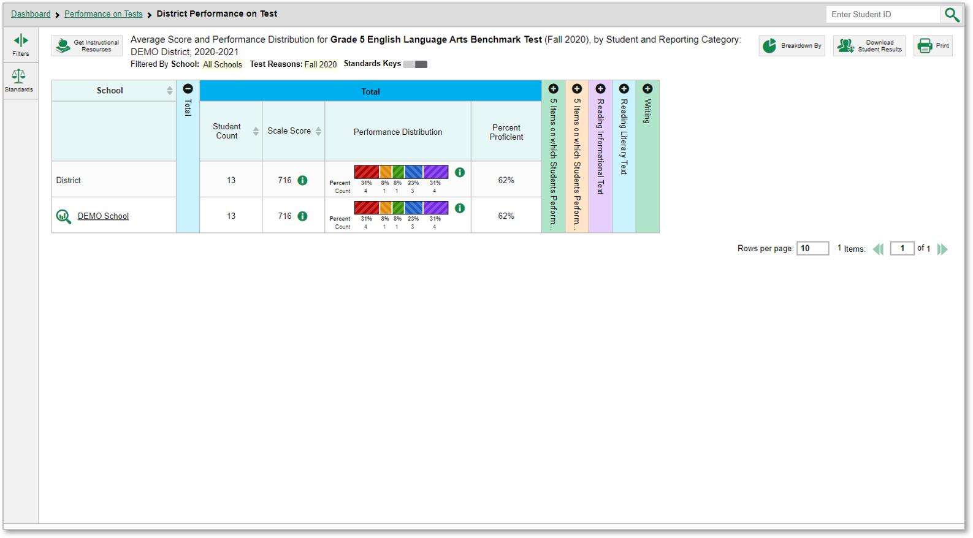
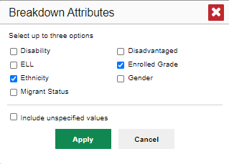
How to Build a Demographic Breakdown Report
1
2
3
3
Notes:
You can create a breakdown report from any page in Reporting that displays data for multiple students.
1. Click the Breakdown By button located below the student search box, upper-right corner of the page.
2. A Breakdown Attributes window opens displaying the options available to you. These choices vary by state and complex.
For example, here you see a Complex Performance on Test report for a Grade 5 ELA Benchmark test.
3. You can build a report for a specific group of students based on any three attributes listed in the Breakdown Attributes window.
For a sample report we have marked the Gender and Race/Ethnicity options. To include any students without assigned demographic information in TIDE, click “Include unspecified values.” Click Apply. The customized report displays, as shown on the next slide.

Slide 4
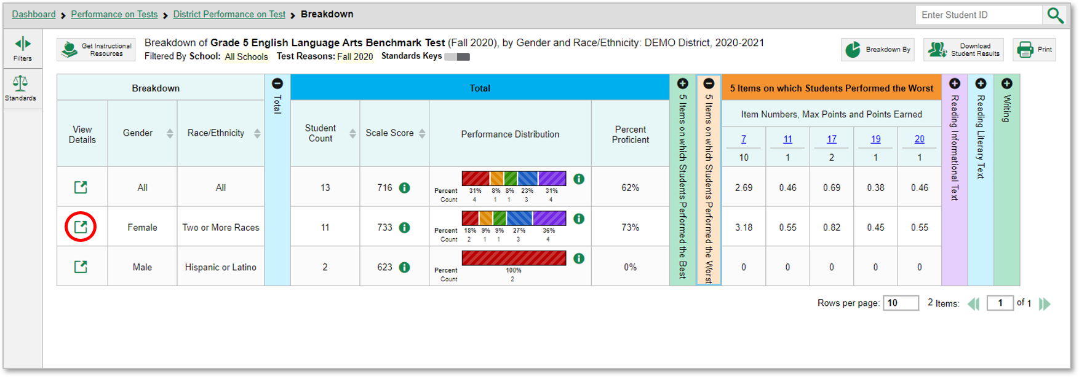
The Demographic Breakdown Report
To look closer into a specific sub-group, click the View Details button in that row.
4
Notes:
The breakdown page is organized according to the combinations selected. The number of rows in the table will depend on how the students fall into the demographic categories. A row appears for each possible sub-group combination.
For example, here you see a row for ALL the students, followed by some possible combinations. If a combination does not appear in the table, it means none of the teacher’s students fall into that sub-group. Notice that the table header has updated to reflect the chosen attributes. You see from this breakdown report that there are 13 students who are divided into two sub-groups. Eleven students are females of Two or More Races and two students are males of Hispanic or Latino ethnicity. You can sort the sub-groups in several different ways, by Gender, Race/Ethnicity, Student Count, and Scale Score. To look closer into a specific sub-group, click the View Details button in that row.

Slide 5
The View Details Window/Breakdown Report
A row of drop-down menu buttons appears above the table, displaying the attributes of the group you chose. To quickly transition to another demographic sub-group, you can apply the breakdown menu options that display above the table of results. Select an attribute you want from the drop-down menus and click Apply. The new sub-group will display.
5
Notes:
A Breakdown window opens, displaying detailed results for that sub-group. A row of drop-down menu buttons appears above the table, displaying the attributes of the group you chose. To quickly transition to another demographic sub-group, you can apply the breakdown menu options that display above the table of results. Select an attribute you want from the drop-down menus and click Apply. The new sub-group will display.

Slide 6
The Student Portfolio Report
Notes:
Another feature of the Centralized Reporting System is the Student Portfolio Report. It shows you results for all the tests taken by an individual student. This report can be particularly useful as teachers prepare for the parent-teacher conference, where the teacher needs to quickly access all test results.

Slide 7
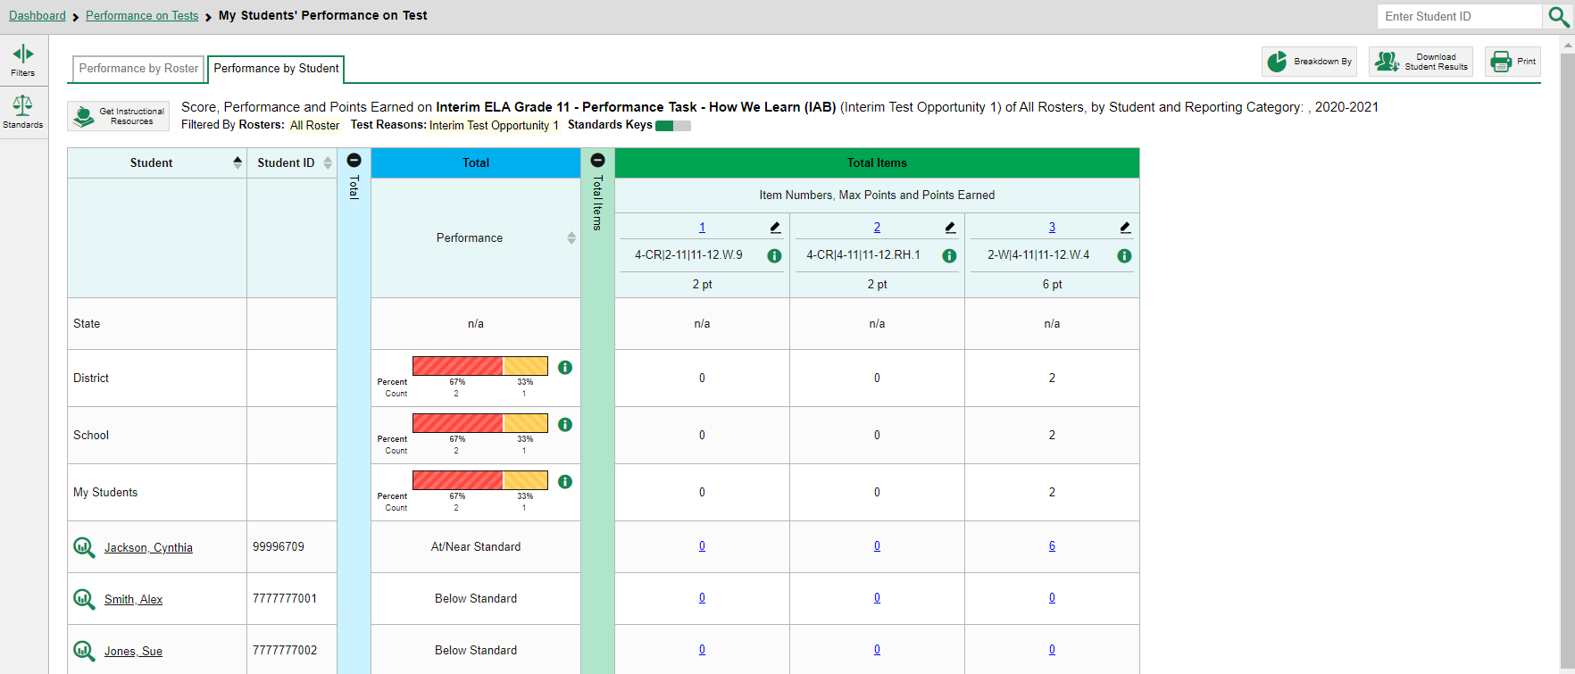
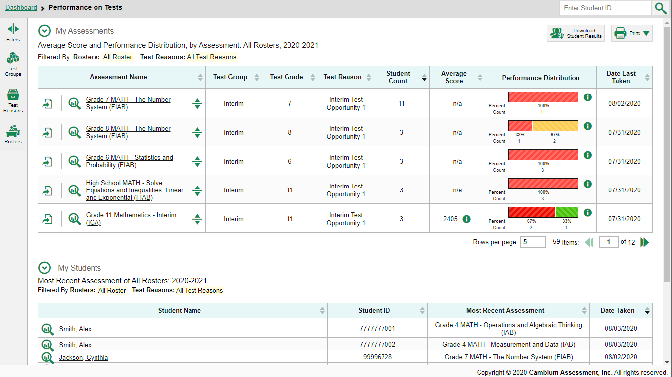
The Student Portfolio Report
1
2
7
Notes:
All users can access the report from any test report page.
Type in or copy and paste a student ID number into the search box.
Teachers have a fast pass to this report from their My Students table on the Performance on Tests page. Simply click the student name or the magnifying glass and the report displays.

Slide 8
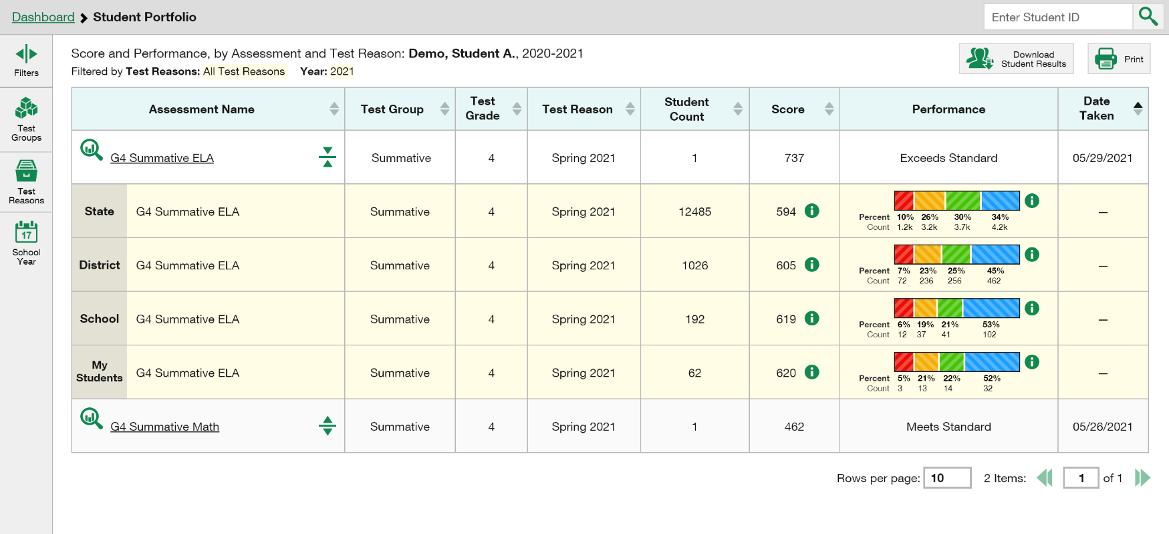
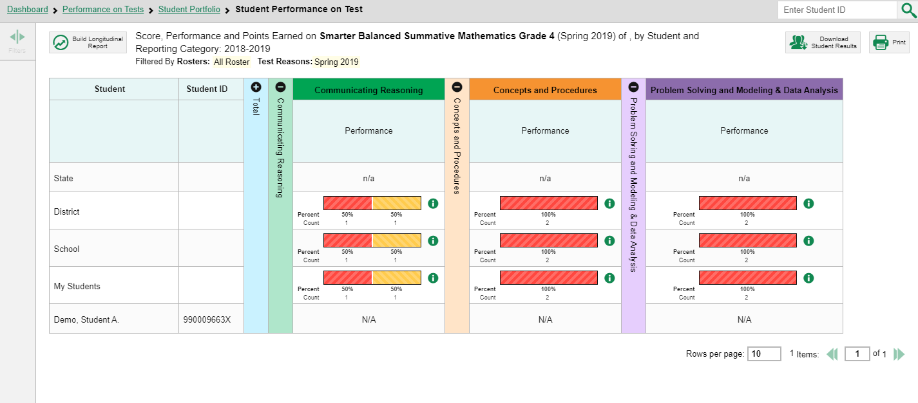
The Student Portfolio Report/Student Performance on Test Report
1
2
3
8
Notes:
The Student Portfolio report features a comprehensive list of assessments taken by the student. Aggregate comparison rows for your state, complex, school, and/or total students are displayed when you click the expansion arrow set beside a test name.
To view the results for a specific test, click on the test name or the magnifying glass view button next to it. The Student Performance on Test Report displays.
You can expand each reporting category to see the performance in that topic area. Remember, you can click on the more information buttons at any time to display more information about the performance distribution levels.

Slide 9
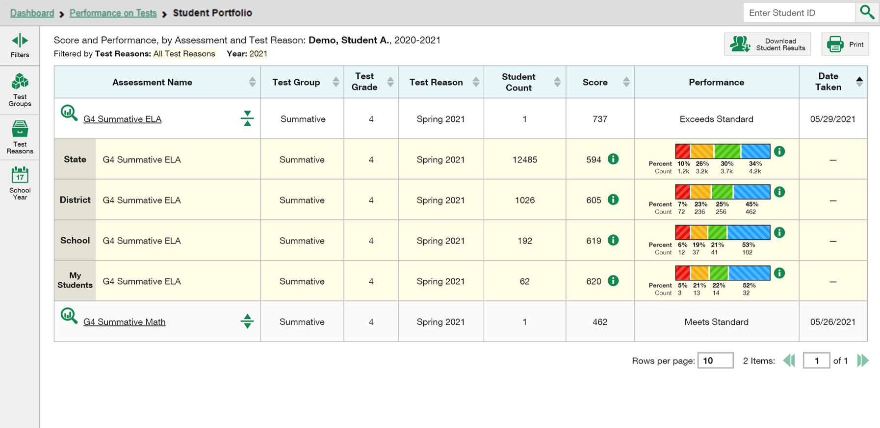
Ways to Use the Student Portfolio Report
Filter by Test Groups, Test Reasons, and School Year
Sort Results to see the Most Recent Test Scores
Generate an ISR or Student Data File and print reports
Access Specific Test Data and Individual Student Item Responses from the Report
1
2
3
4
Notes:
There are more uses for the Student Portfolio report shown here. You can:
Filter by Test Group, Test Reasons, and School Year
Sort results to see the most recent test scores,
3. Generate and print an ISR or a Student Data File,
4. And access specific test data and individual student item responses directly from the report.

Slide 10
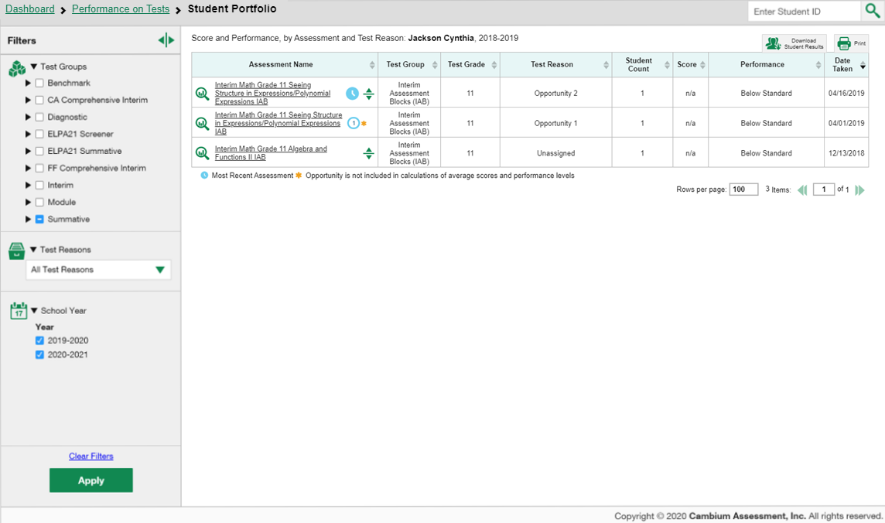
Filter Assessments by Test Reasons & School Year
Filtering by test reasons can help to distinguish scores for different test opportunities.
Notes:
Test reasons are categories used to classify test opportunities for reporting purposes. If your students took the same assessment multiple times, filtering by test reasons can help you to distinguish scores for the different test opportunities. You can also filter by school year. Select options based on your needs and Click Apply.
The table updates, displaying only your selections.
To clear filters, click Clear Filters and then Apply.

Slide 11
The Centralized Reporting System Series
1. How to Navigate the Dashboard and Access Your Summative Results
2. How to Understand Measures for Standards, Depth of Knowledge (DoK) Levels, and Writing Dimensions
3. How to Understand a Demographic Breakdown Report and a Student Portfolio Report
4. How to Drill Down into Your Results by Selecting Specific Tests & Classes
5. How to Drill Down into Your Results by Selecting Previous School Years & Previous Students
6. How to Track Student Performance Over Time Using the Longitudinal Report
7. How to Print Individual Student Reports (ISR) and Student Data Files
8. How to Print and Export Data You Can See in Your Reports
9. How to Use the Roster Manager to Add, Modify, and Upload Rosters
10. How to Analyze a Basic Interim Test Report
11. How to Use the Advanced Features of Reporting to View Interim Data
12. How to Hand-Score Unscored Items and Modify Machine Scores
Interim and Benchmark Assessments Only
11
Notes:
Thank you for viewing this module on the demographic breakdown report and the student portfolio report. More training modules are posted on the HSAP portal.

Slide 12
More Help
Further Information: The Centralized Reporting System User Guide for Summative and Interim Assessments, 2021-2022
HSAP Portal Website: https://alohahsap.org/
HSAP Help Desk Email: hsaphelpdesk@cambiumassessment.com
Help Desk Phone Number: 1-866-648-3712
Notes:
For detailed information, consult the Centralized Reporting System User Guide for Summative and Interim Assessments, 2021-2022, located on the HSAP portal, or contact your Help Desk.

