Slide 1
How to analyze Basic Interim Assessment Reports
The Centralized Reporting system series #10
Copyright © 2021 Cambium Assessment, Inc. All rights reserved.
Notes:
Welcome to training module #10 in the Centralized Reporting System series, How to Analyze Basic Interim Assessment Reports. In this module we show you some of the unique reporting characteristics of interim tests that include item-level data.

Slide 2
Objectives
Understand the types of tests that report item-level data in the Centralized Reporting System
Navigate from the dashboard to interim and Checkpoint assessment data
Interpret simple interim and checkpoint assessment reports
View and understand items on tests
2
Notes:
The objectives of this module are to first introduce the types of non-summative tests that are reported in the Centralized Reporting System.
Next, we show you how to navigate from the dashboard to your interim and checkpoint assessment data.
We then help you interpret simple interim and checkpoint assessment reports.
Finally, we show you how to view and understand items on your interim and checkpoint tests.

Slide 3
All Tests
Non-Summative Tests
Checkpoint:
—fixed-form tests with 8–12 items within a specific reporting category (topic or skill area) or user built fixed-form tests from available Cambium or HI teacher authored standalone items.
—users can compare item-level scores across all students
—a.k.a. module, modular, benchmark module, benchmark, diagnostic
Interims:
—fixed-form or adaptive tests that cover some or all of the standards students are required to learn
—users can see item-level scores for individual students who took an adaptive interim
—a.k.a. Interim Comprehensive Assessment (ICA), Interim Assessment Block (IAB)
Summative Tests
Types of Non-Summative Tests that Report Item-Level Data
Our Focus:
Item-Level Data Included on Checkpoint and Interim Test Reports
3
Notes:
The focus of this training module is on non-summative data in the Centralized Reporting System.. For these kinds of low-stakes tests, CRS provides item-level data, access to the items themselves and access to student responses to the items. This chart shows how tests in the Centralized Reporting System are categorized.
Summative tests are end-of-year or end-of-course comprehensive tests that assess the grade-level standards for an entire subject. Non-summative tests vary by state and district and can be divided into checkpoint and interim tests.
Checkpoint tests are typically short tests in a single reporting category with non-secure items. Users can compare item-level scores and the items themselves, for all their students.
Interim tests are typically longer than checkpoint tests, but shorter than summative tests. Many interim tests will report item-level data, depending on the type of test and on state and complex policies.
In the next slides, we show you how to navigate to the interim and checkpoint test results for your students.

Slide 4
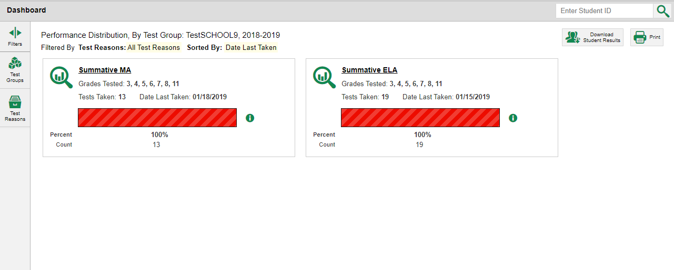
Dashboard View
Click here to view your Interim and Checkpoint test data.
Note: The dashboard is automatically filtered to display summatives only. Users must filter to retrieve interim assessment data.
4
Notes:
Here is a teacher dashboard. It displays all the tests your students have completed. If your students have completed summative assessments, the dashboard is automatically filtered to display summatives only.
To navigate from the dashboard to your interim and checkpoint test data, click the Filters button at the top of the panel on the left. The Filters panel opens.

Slide 5
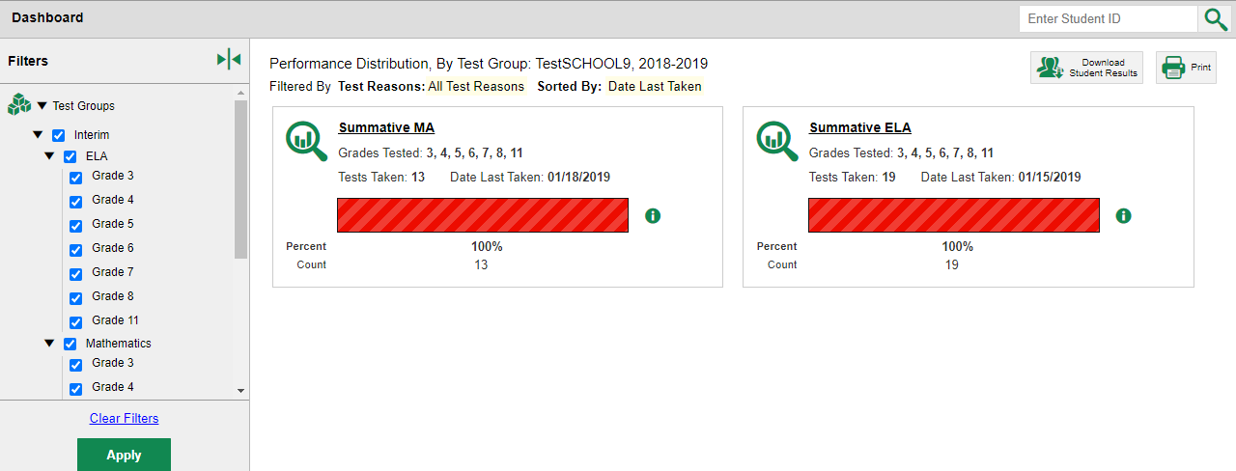
Dashboard View: Filtering
1
3
2
4
5
Notes:
Click on Test Group and select the interim or checkpoint tests that you would like to view.
Click the Apply button at the bottom of the Filters panel.
The dashboard updates to display the aggregate test results for the tests you have selected.
Click a test name or the magnifying glass beside it. This takes you to the Performance on Tests page displaying aggregate data for that group.

Slide 6
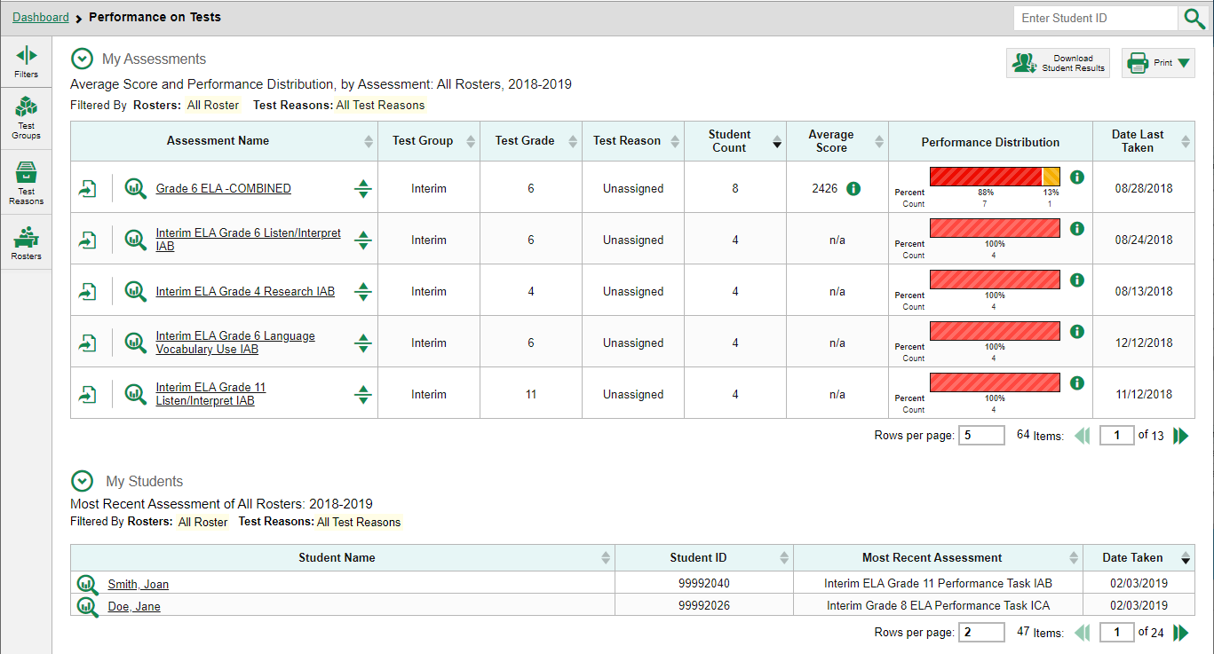
Performance on Tests Report View
6
Notes:
Here is the Performance on Tests page. It is filtered to display only tests that fall within the single test group you clicked on. You can use the table to quickly compare how your students have performed across tests.
From here, you can click on any one of the tests in order to view the data for the specific test. You can navigate from there to the Performance by Student tab, or to the Roster Performance on Test page.
The first page we show you is a Roster Performance on Test page for a checkpoint assessment.

Slide 7
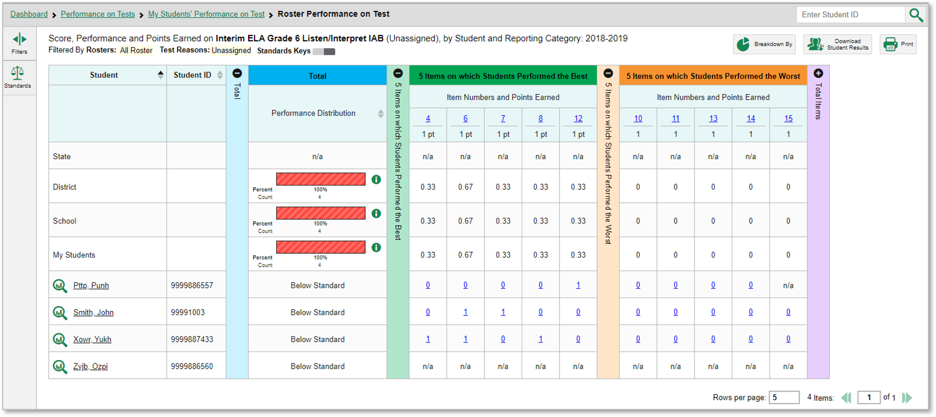
Test Report View: Single Reporting Category
7
Notes:
Here is the Roster Performance on Test page for a class roster that took the Interim ELA Grade 6 Listen/Interpret IAB. This test assesses a single reporting category, also known as a topic or skill area.
The colored sections in the table include a Total performance section in blue, a green section for 5 Items on which Students Performed the Best, an orange section for 5 Items on which Students Performed the Worst, and a purple section for Total Items. You can expand or collapse the sections by clicking the vertical section bars, which display plus and minus signs.
To show you how to analyze your results, first focus on the green section, showing the five items on which students performed the best.

Slide 8
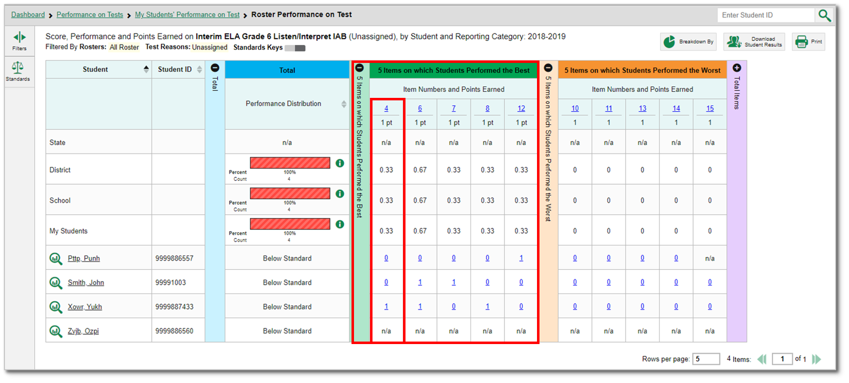
Test Report View: Single Reporting Category (continued)
The rows under the section header, 5 Items on which Students Performed the Best, list the item number, the points possible, and the average number of points earned for the item. This roster’s students performed the best on items #4, #6, #7, #8, and #12.
8
Notes:
The rows under the section header, 5 Items on which Students Performed the Best, list the item number, the points possible, and the average number of points earned for the item. This roster’s students performed the best on items #4, #6, #7, #8, and #12.
For example, the next-to-last student listed earned 1 out of 1 point on item #4.
In reports with item-level data, you may occasionally see “n/a” instead of a score for an item. It means that the student did not respond to the item, or the item was not included in that form of the test.
Note that the average point values for the state, district, school, and teacher’s total students display at the top of the table, so you can compare your roster’s performance to that of those larger groups.
Next, we show you a similar report with fewer than ten items on the test.

Slide 9
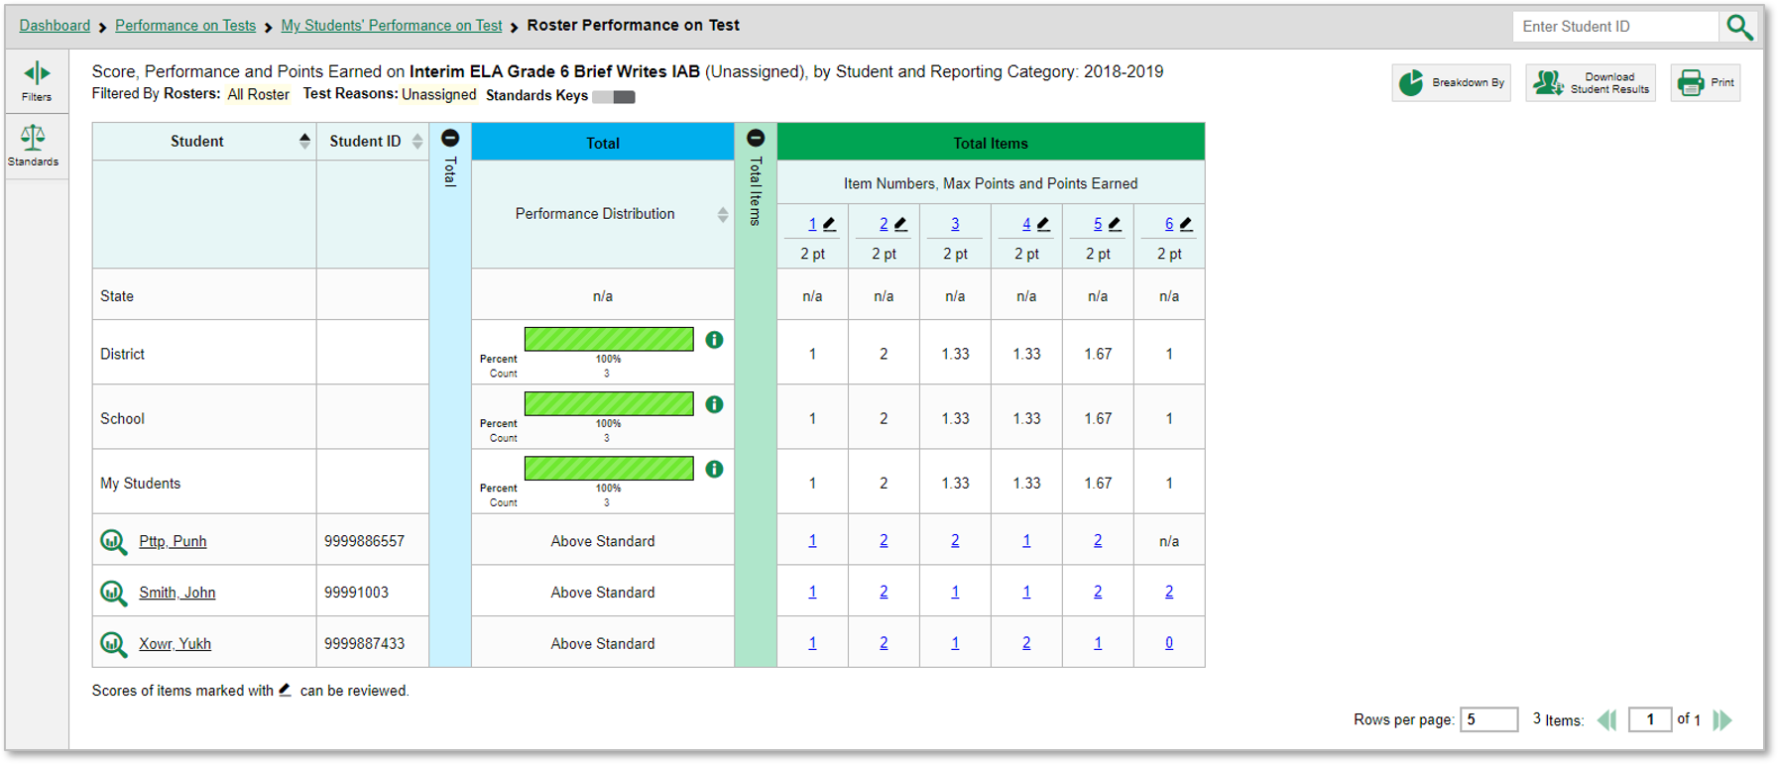
Test Report View: Single Reporting Category (<10 items)
9
Notes:
This is a Roster Performance on Test report on the Interim ELA Grade 6 Brief Writes IAB assessment. Because this test has fewer than 10 items, it does not display the 5 Best and 5 Worst sections. Instead, item-level data are shown only in the Total Items section.
Next, we show you a similar comprehensive interim test with multiple reporting categories, also known as skill areas or topics.

Slide 10
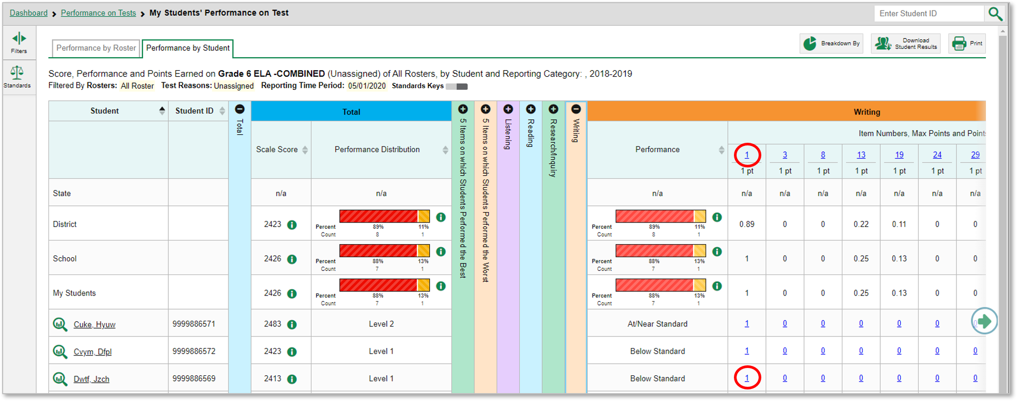
Reports with Multiple Reporting Categories
10
Notes:
Here is the Performance by Student tab of the My Students’ Performance on Test report for the Grade 6 ELA—COMBINED assessment.
The table includes several reporting categories. The items included in each reporting category are the ones that assess that skill area. Clicking the green arrow button on the right allows you to scroll right.
Under each reporting category you can see the item number (blue item link) and the maximum points for the item. For example, you can see that item #1 under Writing is worth 1 point. The last student listed on this page earned 1 point for their answer to that item.
Every reporting category section in this report includes a performance column that can be sorted. Click the up or down arrow next to the column header to sort in ascending or descending order. When you sort your students this way you can quickly see who needs more support in each reporting category.
Next, we show you how to access an actual item and a student’s response to it.

Slide 11
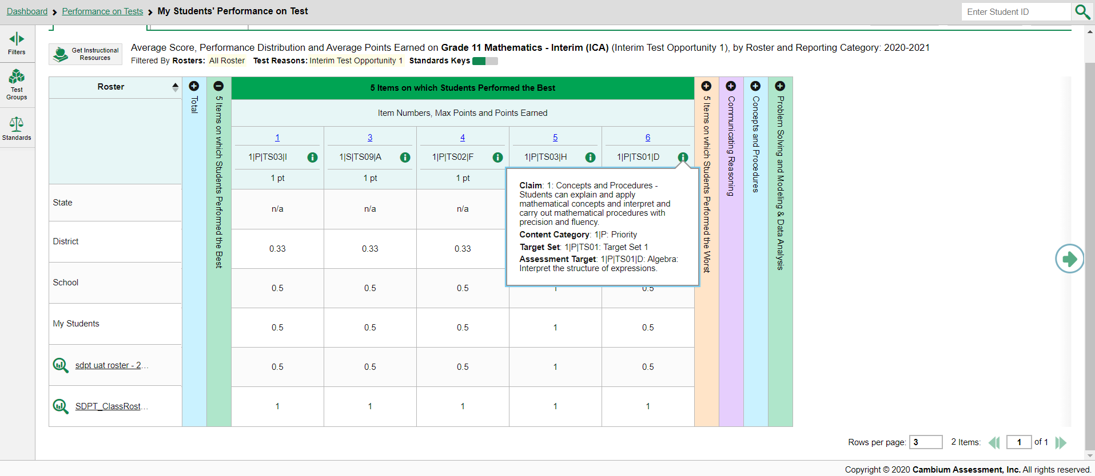
How to View Standards for Each Item
Notes:
In a report displaying item-level data, you can view the standard to which each item is aligned. This allows you to determine at a glance what the item measures. To show or hide item standards, click the Standards Keys toggle in the row of filter details below the report table heading. The standards display beneath the blue item numbers. Click the more information buttons beside the standard keys to view the legend for each standard.

Slide 12
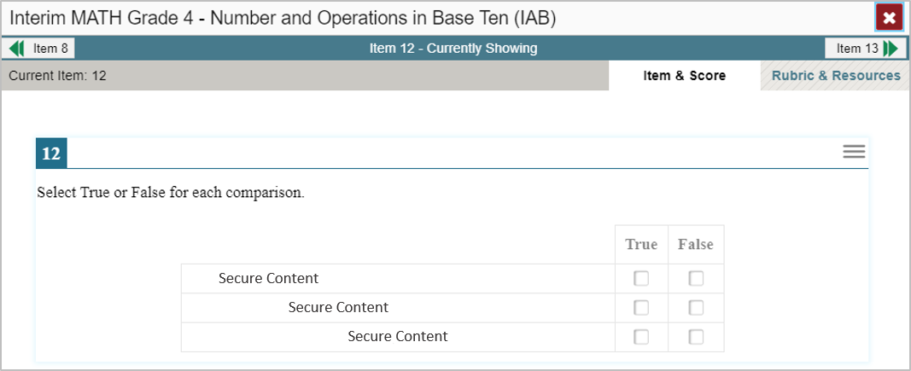
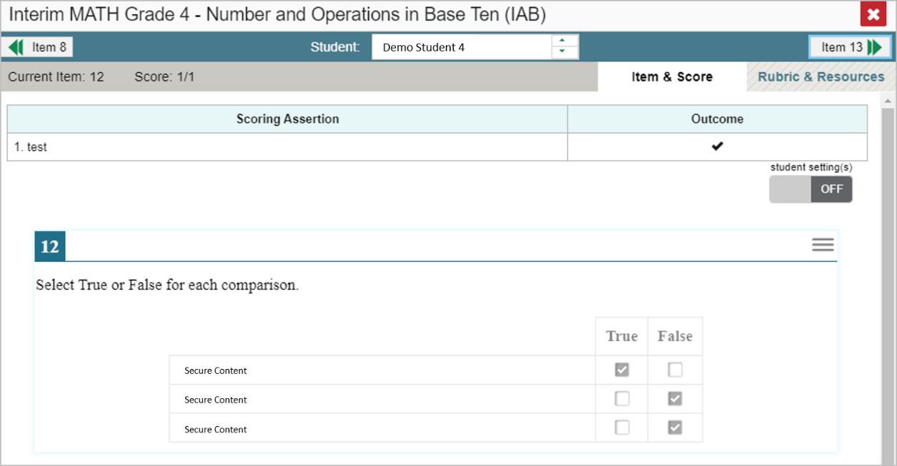
Viewing an Item and Student Response
1
2
12
Notes:
1. To view a test item, click the item number link in the first row of a report table. The item view window displays the test question as it appeared during the test for the student.
2. To view the student’s actual response to an item, find that student’s name in the Student column on the left. Then click the blue score link under the numbered item. In this example we look at item #12 for the next-to-last student listed.
You can see the item along with the actual answer provided by that student.
On the next slide, we explain the additional item information you can access in the reporting system.

Slide 13
Item & Score Tab
1. The student correctly graphed the correct function, showing evidence of the ability to model relationships between two quantities.
Scoring Assertion
13
Notes:
You can see the current item number and the score for that item at the top-left of your screen in the gray bar. The student in our example answered the item correctly for a score of 1 out of 1 point on item #12.
In the top right gray bar, you will see two tabs, Item & Score and Rubric & Resources.
The Item & Score tab (open in the upper left of your screen) shows the score a particular student obtained for that item.
To make it easier for you to access your student level item results, you can move between students and items without returning to the report by using the fields in the teal bar.
You can view different students’ scores on the same item by clicking the down arrow beside the student bar. This will take you to the next student listed in the report table so you can see how the next student performed on the same item.
You can also view the next item in the test by clicking on the arrow button at the top right of the screen. You can view the previous item by clicking on the arrow button at the top left of the screen. Because we opened item #12 from the 5 Best section on the report, item #8 displays as the previous item listed under the 5 Best column.
Below the item scores, you see the Scoring Assertion. Each scoring assertion contains both a statement that provides information about what the student did in their response, and the content knowledge, skill or ability that is evidenced by their response. For example, an assertion for a mathematics graphing item might be: The student correctly graphed the correct function, showing evidence of the ability to model relationships between two quantities. To ensure we capture every meaningful piece of information about a student’s knowledge, skill or ability from his or her responses, each test item (question) is typically scored with several scoring assertions.
The Outcome column shows a checkmark for a correct answer, or an X for each incorrect answer. This item has a single scoring assertion.
At the bottom of the screen, you can see the test item along with the student’s response to it.
We explain the Rubric & Resources tab on the next slide.

Slide 14
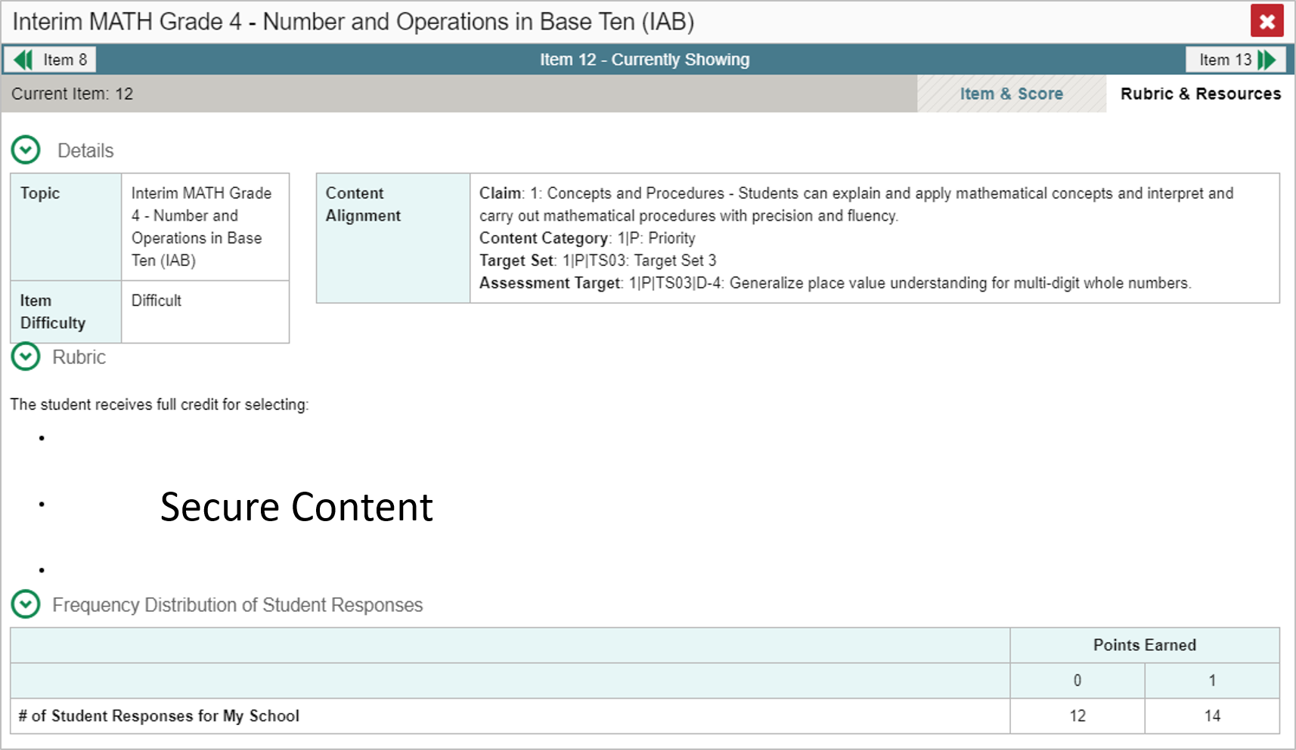
Rubric & Resources Tab
14
Notes:
On the Rubric & Resources tab you can see additional item information including the standard to which the item is aligned, the Scoring Rubric, and Frequency Distribution of Student Responses. The sections are expanded and collapsed using the circled arrows to the left.
The Rubric displays the criteria used to score the item. A simple correct answer may be listed, or this section may include a score breakdown, a human-readable rubric, or an exemplar, which provides an example of a response for each point value. The rubric is not shown here.
The Frequency Distribution of Student Responses provides a breakdown of how many students earned each possible point value available for the item. In this example, 26 students in the school responded to item #12 on this Math checkpoint test. Fourteen of them answered correctly and earned one point for the item.

Slide 15
The Centralized Reporting System Series
1. How to Navigate the Dashboard and Access Your Summative Results
2. How to Understand Measures for Standards, Depth of Knowledge (DoK) Levels, and Writing Dimensions
3. How to Understand a Demographic Breakdown Report and a Student Portfolio Report
4. How to Drill Down into Your Results by Selecting Specific Tests & Classes
5. How to Drill Down into Your Results by Selecting Previous School Years & Previous Students
6. How to Track Student Performance Over Time Using the Longitudinal Report
7. How to Print Individual Student Reports (ISR) and Student Data Files
8. How to Print and Export Data You Can See in Your Reports
9. How to Use the Roster Manager to Add, Modify, and Upload Rosters
10. How to Analyze a Basic Interim Test Report
11. How to Use the Advanced Features of Reporting to View Interim Data
12. How to Hand-Score Unscored Items and Modify Machine Scores
Interim and Checkpoint Assessments Only
Notes:
Thank you for viewing this training module on how to analyze the basic data from your interim and checkpoint tests. Additional training modules listed on this slide are posted on the HSAP portal.

Slide 16
Thank You!
Further Information: Centralized Reporting Guide 2021–2022
HSAP Portal Website: https://alohahsap.org/
HSAP Help Desk Email: hsaphelpdesk@cambiumassessment.com
Help Desk Phone Number: 1-866-648-3712
Notes:
For detailed information on this system, consult your Centralized Reporting Guide 2021–2022, located on your HSAP portal, or contact your Help Desk.

