Slide 1
How to drill down into your results by selecting specific tests and classes
The Centralized reporting system series #4
Copyright © 2020 Cambium Assessment, Inc. All rights reserved.
Notes:
Welcome to the fourth training module in the Centralized Reporting System series, How to Drill Down into Your Results By Selecting Specific Tests and Classes. These features help you customize your reports with precise and specific data so that you see exactly what you need.

Slide 2
Objectives
Use Settings to Customize Results
Teachers: Select Tests to Include on Reports
Other Users: Use Teachers’ Test Selections
Use Filters to Customize Results
Filter by Test Group
Filter by Roster
Filter by Test Reason
Filter by School: District Users
2
Notes:
In this training module we cover the settings and filters specifically related to drilling down into data to see specific tests and classes. First, we show teachers how to eliminate unnecessary test reports from their results. Then we show other users how to mirror those teacher selections in their results. The second half of the video covers the four filters that eliminate even more reports from your results.

Slide 3
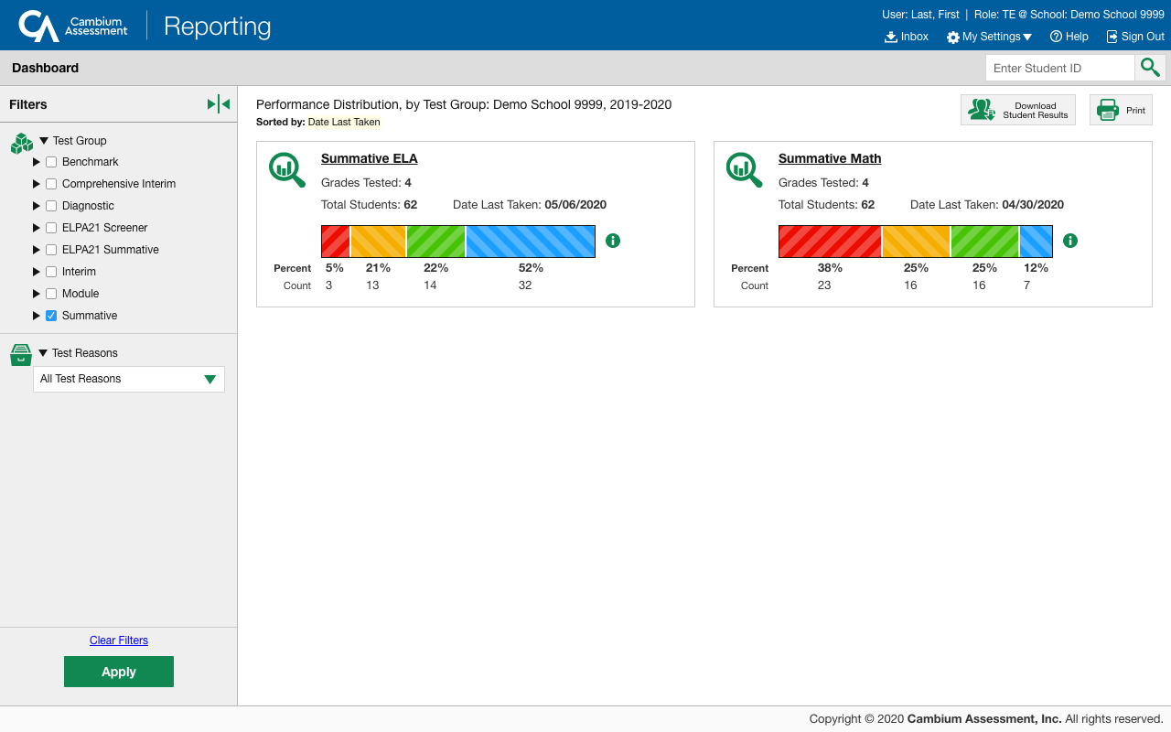
Where are Your Settings and Filters Located?
My Settings
Manage Access
Change Role
Reporting Options
Manage Test Reasons
Select Tests to Include on Reports
Change Reporting Time Period
Set Student Settings on Item View
Roster Settings
Add Roster
View/Edit Roster
Upload Rosters
Filters Panel
Notes:
Settings and filters are accessed from the dashboard and from your report pages. The My Settings button, located in the Reporting banner, includes several options, depending on your district or state configurations. This teacher dashboard is a generic sample of what you will see. Please note you will only have the “Manage Access” category under the My Setting button if you have multiple roles.
The Filters panel, on the left side of the dashboard and report pages, provides options to temporarily limit the results that display in your report tables. Typically, you can select to filter by Test Group and Test Reason from the Dashboard. From the Performance on Tests report you can filter by Test Roster and district-level users can filter by School. Use the expansion arrows in the panel to open each drop-down list. The options available to you are nested under the heading.
In this training module we cover the settings and filters specifically related to drilling down into data. There are additional training modules in the series for training on other features like roster settings, test reasons, and student settings.
The next slide displays a graphic organizer of settings and filters used by teachers and other users, in a step-by-step process.

Slide 4
Select Tests to Include on Reports
My Settings menu
Filter by Test Group
For all users:
Filter by Roster
Filter by Test Reason
Omits tests that are NOT relevant to your needs
Setting will persist until you change it
Filter panel
Temporarily hides selected tests in all reports
For teachers and school-level users:
Filter panel (Performance on Tests report)
Temporarily hides selected classes in all reports
Filter resets when you log out
For all teachers, school- and complex-level users:
Filter panel
Filter resets when you log out
For complex-level users:
Use Teachers’ Test Selections
For school and complex users:
My Settings menu
Omits those teachers’ rosters from the tests the teachers have omitted
Setting will persist until you change it
Filter resets when you log out
Temporarily displays results from a specific category of test reasons, like Spring or Fall
Filter by School
Filter panel (Performance on Tests report)
Temporarily displays results from a specific school
Filter resets when you log out
For teachers:
Note: Users above a teacher level will not see “select tests” and will have to defer to the teachers’ selections.
6 Ways to Drill Down into Your Reports
FIRST…
THEN…
4
Notes:
Settings and filters are covered in this order, as this is the way you will most likely move through your reports. The dark blue header boxes are choices from the My Settings menu, while the light blue header boxes are options from the Filters panel. This chart provides an overview of the drill down features. Teachers start by selecting tests to include on reports while other users start by choosing to use the teachers’ test selections in their own reports. Then users may choose to filter by test group, by test reason, by test roster, and by school.
Settings persist until you change them. Filter options reset when you log out.
Now we start drilling down into test results.

Slide 5
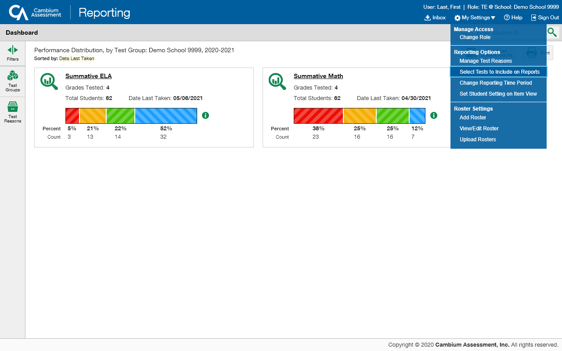
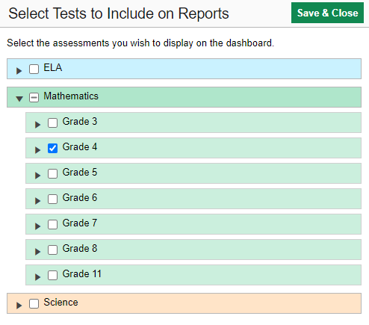
Teachers: Select Tests to Include on Reports
5
Notes:
To begin, teachers choose the tests they want included in their reports and omit those that do not apply to their needs. For example, if you are a Math teacher you can omit your students English Language Arts test scores. By default, all of the tests taken by your students, in the current school year, appear in your reports. Removing some of them will trim your reports to exactly the results you need to see. Click the My Settings menu in the banner and choose Select Tests to Include on Reports. Select the checkboxes beside the tests or groups of tests you want included in your reports. Here you can see that Grade 4 Math tests are selected, and ELA and Science tests are omitted. Click Save & Close. This setting remains in place until you change it and your reports will include only the tests you selected.

Slide 6
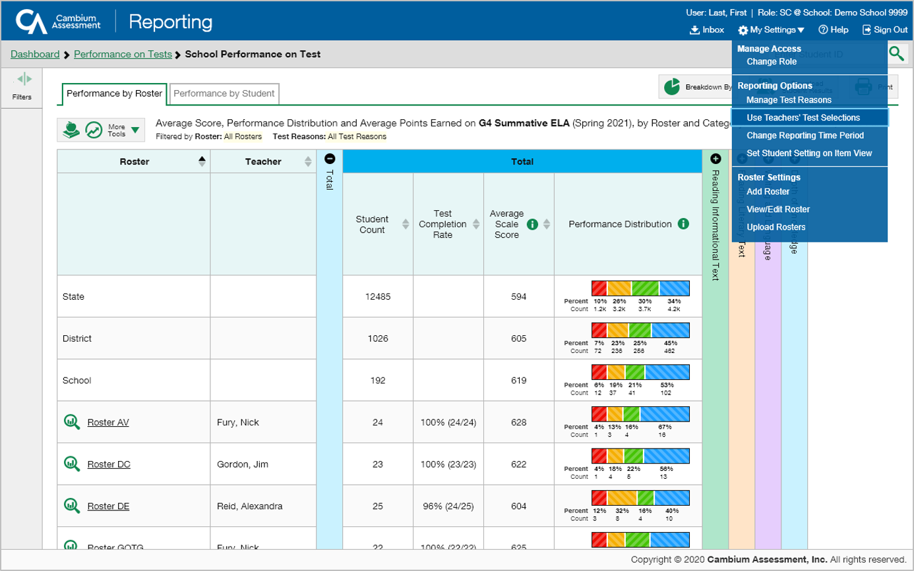
School & District Users: Use Teacher’s Test Selections
6
Notes:
If you are a school- or complex-level user, you can use your teachers’ test preferences to eliminate rosters that aren’t relevant to a test. For example, suppose a math roster belongs to a math teacher who has excluded ELA tests from their reports. By using teacher preferences, you can view a set of ELA test results without that math teacher’s roster. All students who took the ELA test will still appear in the report, whether or not they belong to the math teacher’s roster, but the Performance by Roster tab will not list them as belonging to that math teacher’s roster. By hiding rosters that are not relevant to the test, and by preventing a student from appearing more than once in the same report, this setting makes reports easier to read and more subject appropriate. To turn this setting on, open the My Settings menu and choose Use Teachers’ Test Selections. In the pop-up box, select the Teacher Preferences radio button and click Save & Close. To turn this setting off and view all rosters regardless of teacher preferences, select the All Rosters radio button and click Save & Close. This setting persists until you change it. Now we will explain the Filter panel options. They can be used to temporarily hide certain elements of your reports that you don’t need to see.

Slide 7
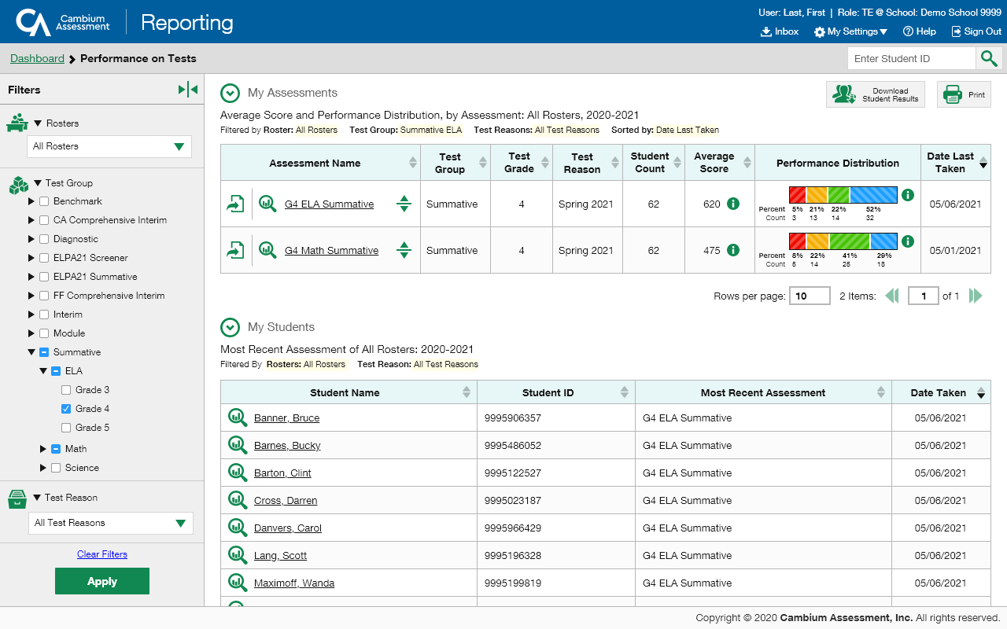
Test Group Filter—For All Users
7
Notes:
The Test Group filter is located in the Filters panel on your dashboard and reports pages. It is similar to the teachers’ Select Tests to Include in Reports option in My Settings, except that it will not persist or mirror in other users’ results. Tests in this filter menu are organized by test type, subject, and grade. Click the down arrow next to the type of test results you need to view. Mark as many selections as you like from the options displayed and click Apply. You see here that the ELA and Math Summative tests for Grade 4 have been selected. The table and the header reflect these selections. To revert all filters to their default settings, click Clear Filters and Apply. Filters also revert when you log out, switch user role, or switch systems.

Slide 8
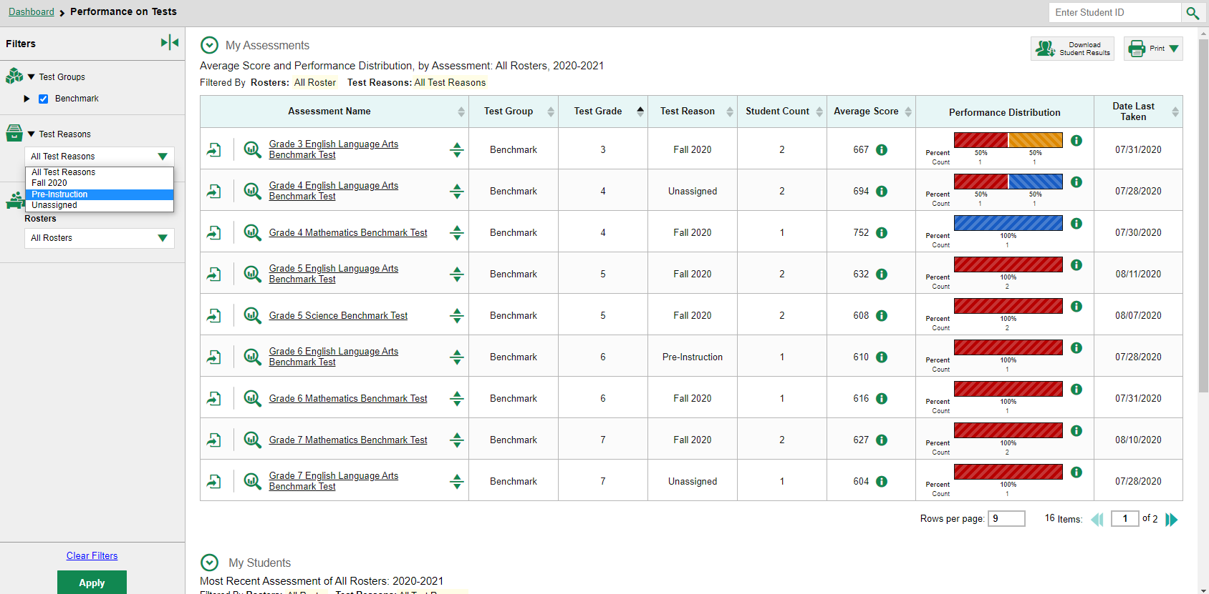
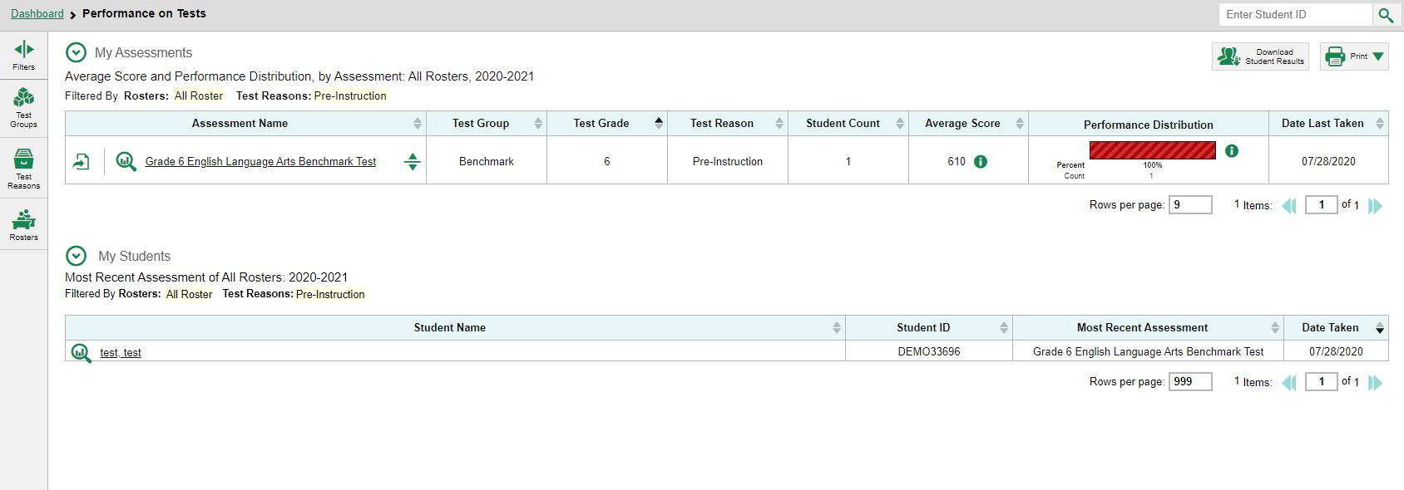
Test Reasons Filter—For All Users
8
Notes:
Test reasons are categories used to classify test opportunities for reporting purposes. They typically indicate the timeframe in which interim and benchmark tests were taken, like Fall 2020, or Pre-Instruction, and they are a good way to organize tests into groups. If your students will take the same assessment multiple times, assigning different test reasons can help you to distinguish scores for the different test opportunities in Centralized Reporting.
For example, you might want to categorize students’ assessments into “Pre-Instruction” to use as a baseline their class’s strengths and weaknesses at the beginning of the year. For those same students, you might want to categorize their tests as “Post-Instruction” to see whether students understand the concepts that are being taught right after receiving the relevant instruction.
Open the Test Reasons menu from the Filters panel. Make a selection from the drop-down list and click Apply. The affected report updates to show only data for that test reason. All the reports accessible from this page will be filtered the same way.

Slide 9
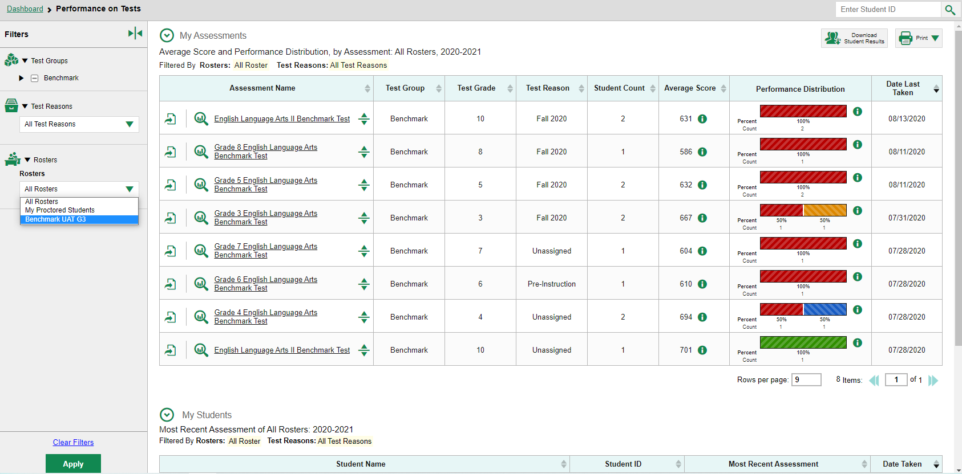
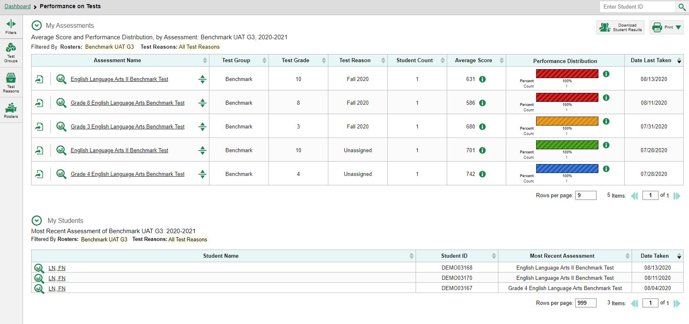
Rosters Filter—For Teachers—Performance on Tests Report
9
Notes:
The Roster filter is available to teachers from the Performance on Tests report. Rosters generally represent classes but can also represent students who have been grouped together because of having something in common, such as needing extra help on a particular assessment standard. Open the Rosters filter from the panel. Make a single selection from the Rosters drop-down list. Click Apply. The report updates to show data for the roster you selected. When you navigate deeper into the results from this page this roster filter will apply to all your reports. All filter options will revert to the default when you log out, switch user roles, or switch systems.

Slide 10
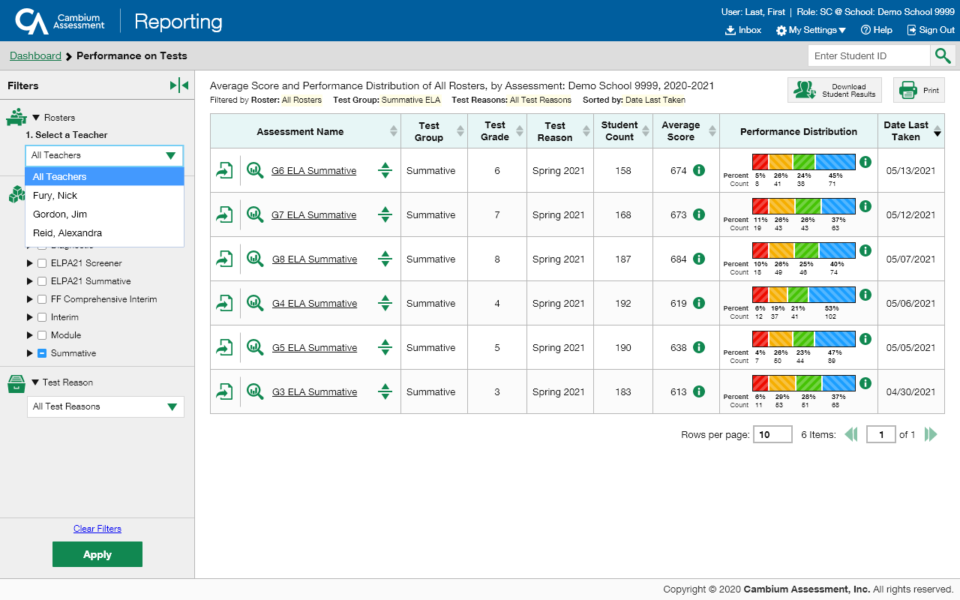
Rosters Filter—For School-Level Users—Performance on Tests Report
Notes:
The Roster filter is available for school-level users from the Performance on Tests report, as well. Users select a teacher from the drop-down menu options and select a roster. Test groups and reasons can be selected, as well. Click Apply and the table updates. When you click on the name or the magnifying button of a test from the table the School Performance on Test report displays. When you log off the filter re-sets.

Slide 11
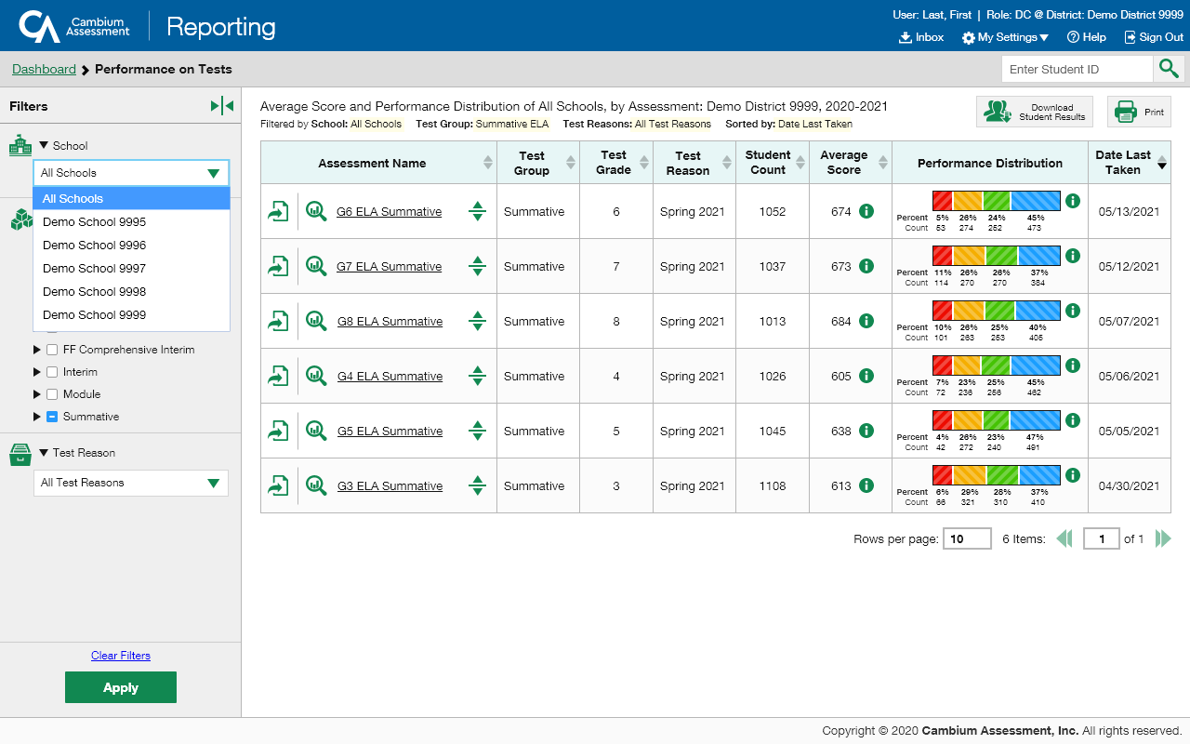
School Filter
Notes:
The School filter is available for complex-level users from the Performance on Tests report. Users can select a single school and options from the Test Group and Test Reason filters. Click Apply to update the table. When you click on the name or the magnifying glass button of a test from the table, the School Performance on Test report displays. When you log off the filter re-sets.

Slide 12
The Centralized Reporting System Series
1. How to Navigate the Dashboard and Access Your Summative Results
2. How to Understand Measures for Standards, Depth of Knowledge (DoK) Levels, and Writing Dimensions
3. How to Understand a Demographic Breakdown Report and a Student Portfolio Report
4. How to Drill Down into Your Results by Selecting Specific Tests & Classes
5. How to Drill Down into Your Results by Selecting Previous School Years & Previous Students
6. How to Track Student Performance Over Time Using the Longitudinal Report
7. How to Print Individual Student Reports (ISR) and Student Data Files
8. How to Print and Export Data You Can See in Your Reports
9. How to Use the Roster Manager to Add, Modify, and Upload Rosters
10. How to Analyze a Basic Interim Test Report
11. How to Use the Advanced Features of Reporting to View Interim Data
12. How to Hand-Score Unscored Items and Modify Machine Scores
Interim and Benchmark Assessments Only
Notes:
Thank you for viewing this module on drilling down into your reports. More training modules are posted on the HSAP portal.

Slide 13
More Help
Further Information: Centralized Reporting System User Guide for Summative and Interim Assessments, 2020-2021
HSAP Portal Website: https://alohahsap.org/
HSAP Help Desk Email: hsaphelpdesk@cambiumassessment.com
Help Desk Phone Number: 1-866-648-3712
Notes:
For detailed information, consult your Centralized Reporting System User Guide for Summative and Interim Assessments, 2020-2021, located on the HSAP portal, or contact the Help Desk.

