Slide 1
How to Write an Item in Checkpoint
Checkpoint System Training Module
2020–2021
Copyright © 2020 Cambium Assessment, Inc. All rights reserved.
Notes:
Welcome to the How to Write an Item in Checkpoint training module. This module is part of a series of training modules on the Checkpoint System and its features. This module explains how to create an item that you can add to a test.
Consult your Checkpoint Guide for information about additional features in Checkpoint.

Slide 2
Objectives
This presentation will show you how to do the following:
Log in to the Checkpoint System
Create an item
Fill out an item template
Fill out the template for each type of item
Notes:
This presentation will show you how to do the following:
Log in to the Checkpoint System
Create an item
Fill out an item template
Fill out the template for each type of item

Slide 3
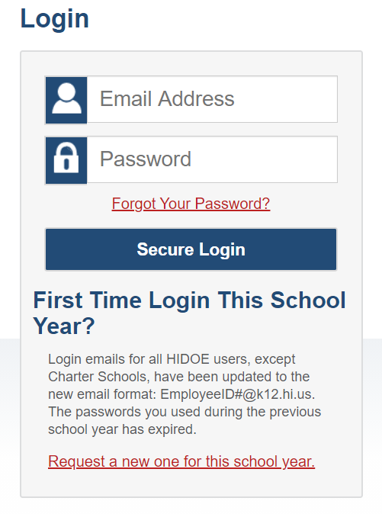
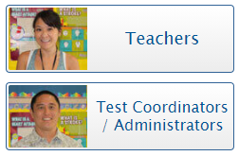
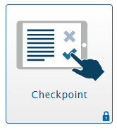
Logging in to the Checkpoint System
Notes:
To log in to Checkpoint, go to the HSA-Science or EOC portal. From the portal, select your user role card. On the next page, click the Checkpoint system card. Enter your username and password, and then click Secure Login to continue.

Slide 4
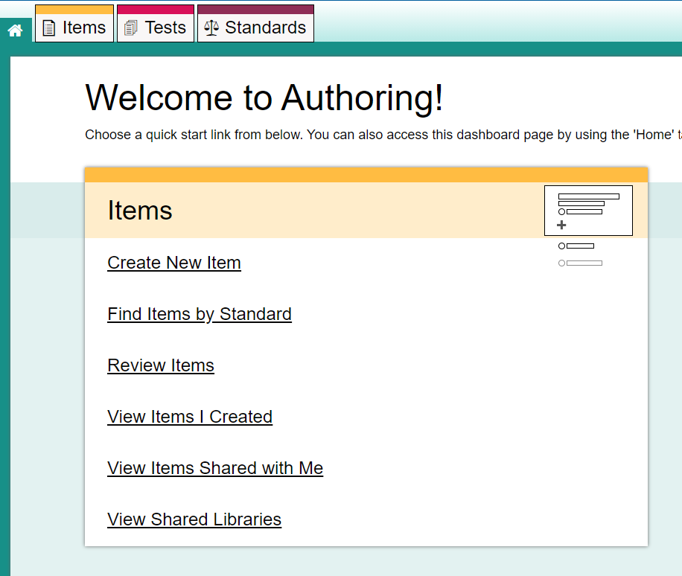
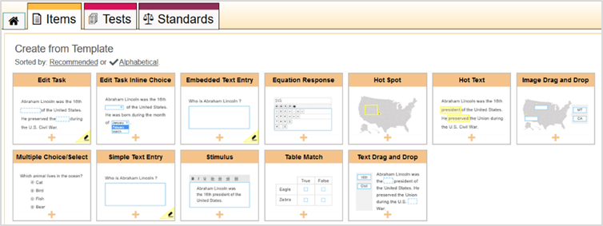
Creating an Item
Dashboard
Item Builder
Notes:
To create a new item, select Create New Item from the Dashboard, or click Create New Item on the Items tab. The item builder appears, displaying a list of available item templates. You can sort this list by alphabetical order or by the default recommended order of common item types.
Select an item template to create an item based on that template. Templates with a pencil icon in the corner will need to be scored by a user in the Reporting system.

Slide 5
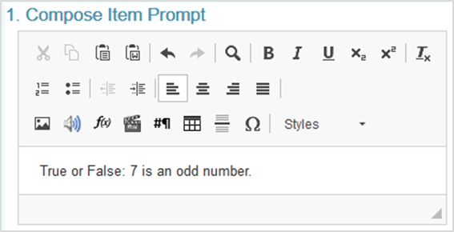
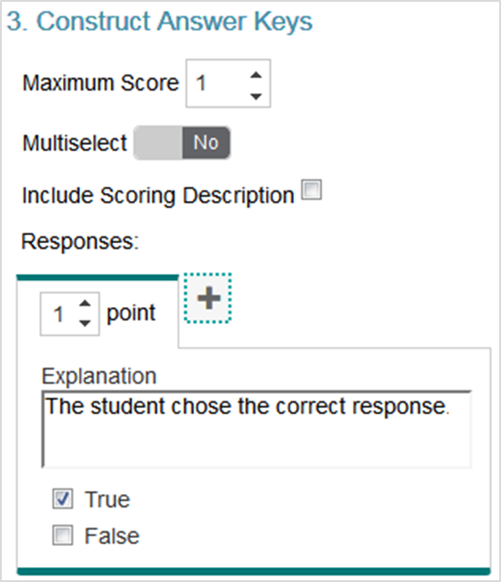
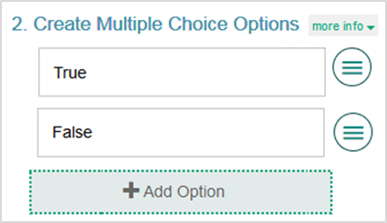
Filling Out the Item Template
Notes:
After you select an item type, the item template appears, along with an item toolbar and instructions you can expand by clicking More Info. Item templates display sample content in each field, including the answer key. You will need to replace this content when you create the item’s new content.
You can fill out the item template in three simple steps.
Step one is to compose the item prompt. The prompt is the question or the directions that students respond to in an item. Enter the prompt in a text box at the top of the template. You can use the text box toolbar to format the text and insert media elements, such as images, videos, and tables.
Step two is to create the response area. The response area is the part of the item that students interact with in order to answer the question. Here you see a Multiple Choice item response area. The steps for creating the response area are different for each type of item template. We will explain each type later in this module.
Step three is to construct the answer key. The answer key determines how many points an item is worth and how a student’s response will be scored. Students do not see this information, but it is used by the Checkpoint system (for machine-scored items) and educators (for hand-scored items). The steps for constructing the answer key are slightly different for different types of item template. We will give instructions for each type later in this module.
Next, we explain how to fill out the template for a stimulus and for each type of item.

Slide 6
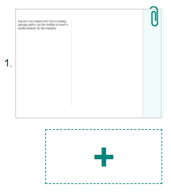
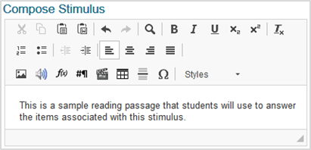
Stimuli That You Can Link with Items
Template
Toolbar
Add New Item
Notes:
Stimulus templates allow you to create a reading passage or other type of media, such as an image or video, that students will view in order to answer items linked to the stimulus. For example, you could create a reading passage about a historical event and link it with items that will evaluate the students’ understanding of that event.
You can link multiple items with a stimulus on a single test page. A stimulus does not include a response area or an answer key, but the items you link with it do.
To fill out the template, enter the content for the stimulus in the provided text box. You can use the toolbar in this box to format the text and insert media elements.
In the item toolbar above the template, click Save Item.
To create items to link with the stimulus, click the add new item button, which looks like a plus sign, to the left of the template. Then select an item type to proceed with adding the item.

Slide 7
Stimuli That You Can Link with Items
You can…
Enter the content for the linked item by following the instructions for the appropriate item type.
Add more items as necessary.
You cannot…
Link a stimulus with another stimulus.
Link a stimulus to an original item that already exists in your library.
Note: when an item is linked to a stimulus, the Items tab table displays an info button, which looks like a lowercase “i”, beside the item’s name. You can click this button to see which stimulus the item is linked to.
Notes:
Note that you cannot link a stimulus with another stimulus. You can enter the content for the linked item by following the instructions for the appropriate item type, as presented later in this module. You can add more items as necessary. Note that you cannot link a stimulus to an original item that already exists in your libraries. Also note that when an item is linked to a stimulus, the Items tab table displays an info button, which looks like a lowercase “i”, beside the item’s name. You can click this button to see which stimulus the item is linked to.

Slide 8
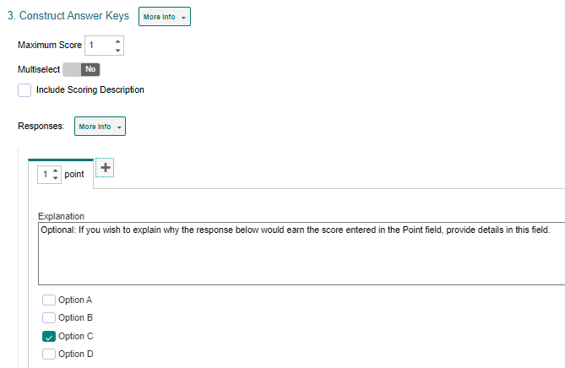
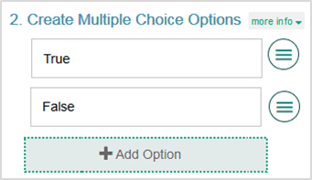
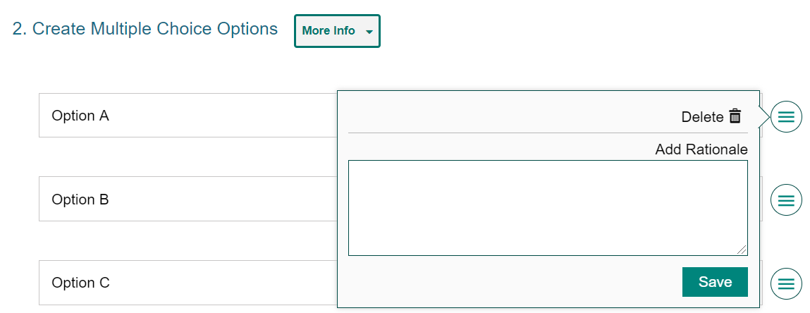
Multiple Choice and Multiple Select Items
Notes:
Multiple Choice items require students to select a single option from a list of possible answer options, while Multiple Select items require students to select one or more options from a list of answer options. For example, a Multiple Choice item could be used for a “true or false” question, as in the example shown, while a Multiple Select item might ask students to select all the synonyms for a vocabulary word from a list of options. The same template is used to create both item types.
To fill out the template, in the Compose Item Prompt section, replace the sample text with the item’s question or directions. You can use the toolbar to format the text and insert media elements. In the Create Multiple Choice Options section, sample response options are already provided. You can click each option to replace the sample text with the desired text for that response option.
If you want to add additional response options to the item, click Add Option and then enter the content for the new option that appears. To remove an option, click the menu button beside it and then click Delete. If you want to enter the rationale for why a response option is correct or incorrect, click the menu button beside it, then enter a description in the Add Rationale field and click Save.
In the Construct Answer Keys section, enter the item’s highest possible score in the Maximum Score field. If you want to allow students to select more than one response option, set the Multiselect toggle to Yes. Then specify the maximum number of options they can select in the Maximum Selections field. To create answer keys for the item, do the following. In the Point field, enter the score for a correct or partially correct response. Note that if a sample response is already entered, you may need to clear its checkbox first. Then, in the provided response area, select the response options that students would need to select in order to earn the score you entered in the Point field.

Slide 9
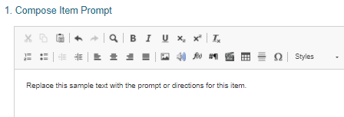
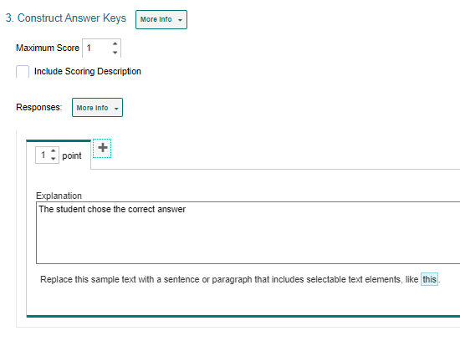
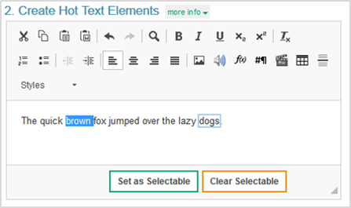
Hot Text Items
Notes:
Hot Text items require students to select words or phrases in a section of text. The words and phrases appear shaded when students select them. For example, a Hot Text item might provide a sentence and ask students to select all the verbs in it.
To fill out the template, do the following. In the Compose Item Prompt section, replace the sample text with the item’s question or directions. You can use the toolbar to format the text and insert media elements. The Create Hot Text Elements section displays sample text, including a selectable word. Delete this sample text and enter new text containing the words or phrases students will select.
To tag a word or phrase that will be selectable to students, do the following. First, click and drag the cursor across a word or phrase to highlight it. Next, click Set as Selectable below the text box. A border appears around the selected word. If you need to untag a word you marked as selectable, click that word and then click Clear Selectable.
In the Construct Answer Keys section, enter the highest possible score in the Maximum Score field. To create answer keys for the item, do the following. In the Point field, enter the score for a correct or partially correct response. Then, in the provided response area, click the words or phrases that students would need to select in order to earn the score you entered in the Point field.

Slide 10
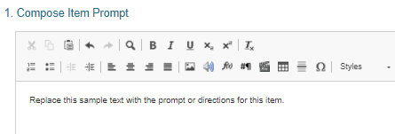
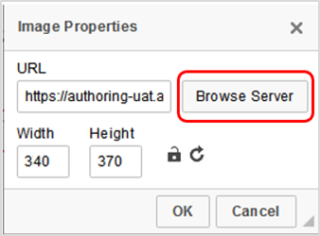
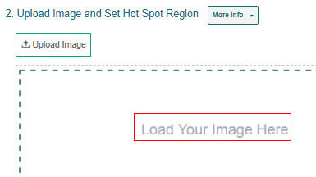
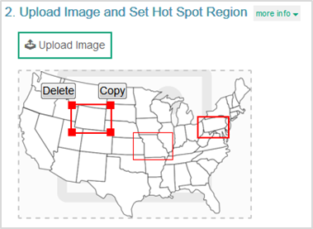
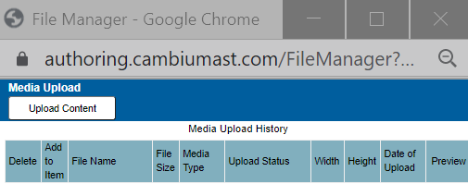
Hot Spot Items
Notes:
Hot Spot items require students to select one or more clickable regions on an image. A rectangular border appears around each region the students select. For example, a Hot Spot item could show a map of the United States and ask students to identify where Washington, DC is located.
To fill out the template, do the following. First, in the Compose Item Prompt section, replace the sample text with the item’s question or directions. You can use the toolbar to format the text and insert media elements. Next, in the Upload Image and Set Hot Spot Region section, upload an image for the item. To do so, click Upload Image. In the Image Properties window, click Browse Server. In the File Manager window, click Upload Content and select an image file from your computer. Then double-click the image you just added. The image must be 600×600 pixels or smaller and under 1.5 MB. In the Image Properties window, click OK.
Next, to create the selectable regions on the image, do the following. Click the image once to set the first corner of the selectable rectangle, then click one more time where you want to set its opposite corner (do not click and drag). A red box appears, but this will not be visible to students. To move a selectable region, click that region and drag it to the desired location. You can copy or delete a selectable region by selecting that region's box and then clicking Copy or Delete.

Slide 11
Hot Spot Items
Notes:
In the Construct Answer Keys section, enter the highest possible score in the Maximum Score field. Optionally, to limit the number of hot spot regions students can select at a time, enter a value in the Maximum Selections field. To create answer keys for the item, do the following. In the Point field, enter the score for a correct or partially correct response. If a sample response is already entered, you may need to unselect that hot spot first. In the provided response area, click the image regions that students would need to select in order to earn the score you entered in the Point field.

Slide 12
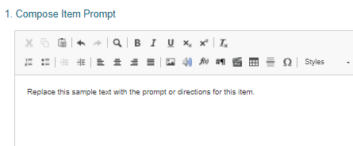
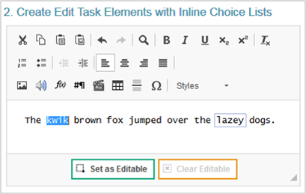
Edit Task Inline Choice Items
Notes:
Edit Task Inline Choice items provide a section of text in which one or more words appear as dropdown menus. Students select answer options from the dropdowns to replace the original words in the text. For example, an Edit Task Inline Choice item could provide a sentence with a misspelled word and ask students to select the correct spelling from the dropdown.
To fill out the template, do the following. In the Compose Item Prompt section, replace the sample text with the item’s question or directions. You can use the toolbar to format the text and insert media elements.
The Create Edit Task Elements with Inline Choice Lists section displays sample text content, including an editable word. Delete this sample text and enter new text content containing the words that students will replace.
To tag a word or phrase that students will be able to replace, do the following. Click and drag the cursor across the desired word or phrase to highlight it. Click Set as Editable below the text box. A border appears around the selected word and the Inline Choice window appears. In the Inline Choice window, enter a replacement option for the tagged word in the blank text box. To add additional replacement options, click Add Option and enter the replacement option in the new text box that appears.

Slide 13
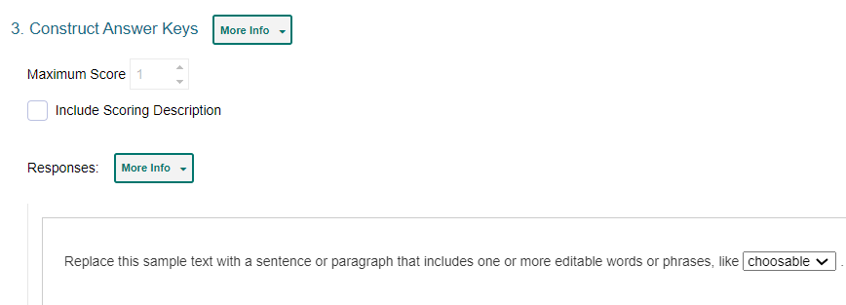
Edit Task Inline Choice Items
The maximum score is automatically set based on the number of editable elements you created. You cannot customize this score.
Notes:
In the Construct Answer Keys section, the maximum score is automatically set based on the number of editable elements you created. You cannot customize this score. To create the item’s answer key, click the editable words in the sample response area and replace each one with the correct answer option. The item will automatically assign students the appropriate number of points for their response based on the number of correct selections they made.

Slide 14
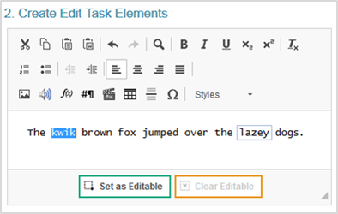
Edit Task Items
Notes:
Edit Task items require students to make edits to a specified word or phrase in a sentence or paragraph. Students can click each of these words or phrases to open a text box where they type a replacement for the original text. These items must be scored by an authorized user in the Reporting system. For example, an Edit Task item could provide a sentence with a misspelled word and ask students to enter the correct spelling for it in a popup text box.
To fill out the template, do the following. In the Compose Item Prompt section, replace the sample text with the item’s question or directions. You can use the toolbar to format the text and insert media elements.
The Create Edit Task Elements section displays sample text content, including an editable word. Delete this sample text and enter new text content containing the words that students will replace. To tag a word or phrase that students will be able to replace, do the following. Click and drag the cursor across a word or phrase to highlight it. Then click Set as Editable below the text box. A border appears for the selected word.

Slide 15
Edit Task Items
Notes:
In the Construct Answer Keys section, enter the item’s highest possible score in the Maximum Score field. Fill out the rubric for the correct, full-credit response for the item. In the Description field, describe how a student must respond to the item in order to earn full credit. In the Exemplar field, enter an example of a response that would earn full credit. Note that the template automatically creates a rubric tab for each possible score a student could earn, based on the maximum score. To fill out any additional rubrics for the item, click the tab for that rubric and enter a description and exemplar for the rubric’s score.

Slide 16
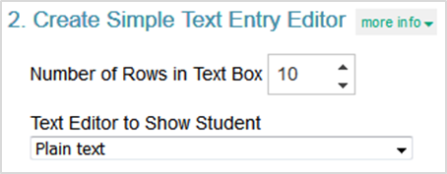
Simple Text Entry Items
Notes:
Simple Text Entry items require students to type a written response in a provided text box. You can choose what kind of toolbar to include in the text box. For example, a Simple Text Entry item might ask students to write a short essay about their favorite historical figure. Note that these items must be scored by a user in the Reporting system.
To fill out the template, in the Compose Item Prompt section, replace the sample text with the item’s question or directions. You can use the toolbar to format the text and insert media elements. To specify the height of the students' text box, enter a value in the Number of Rows in Text Box field. To specify the type of toolbar that will be available to students, select an option from the Text Editor to Show Student menu. You can choose to use no toolbar, or you can use a toolbar with buttons for spell check, formatting text, and/or adding bulleted lists or numbered lists.

Slide 17
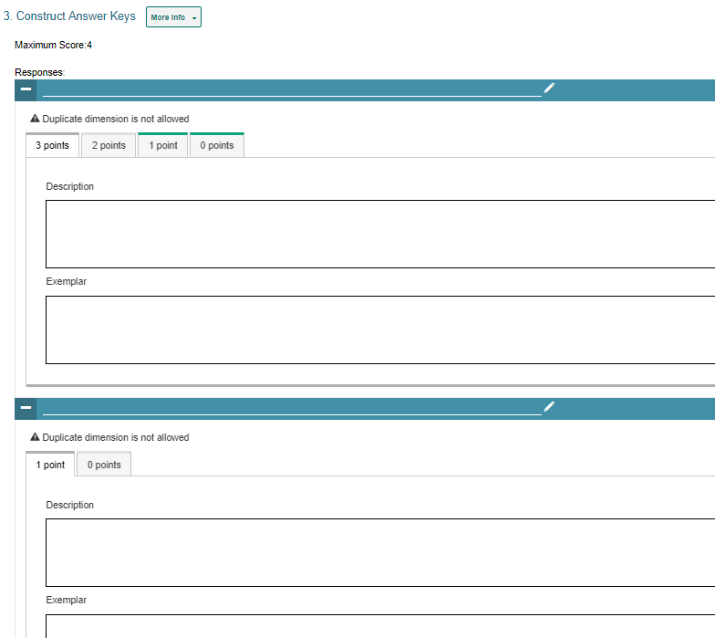
Simple Text Entry Items
The template automatically creates a rubric tab for each possible score a student could earn based on the maximum score.
If multiple scoring criteria should be used to evaluate the student’s response, you can click Add More.
Notes:
To fill out the rubric for the item’s full-credit response, enter the maximum score in the Points field. In the Description field, describe how students must respond in order to earn full credit. In the Exemplar field, enter an example of a response that would earn full credit. Note that the template automatically creates a rubric tab for each possible score a student could earn based on the maximum score. To fill out any additional rubrics, click the tab for that rubric and enter a description and exemplar for the rubric’s score.
If multiple scoring criteria should be used to evaluate the student’s response, you can click Add More at the bottom of the page to create a separate rubric for each criterion. For example, you could create separate rubrics for Spelling, Syntax, Comprehension, and so on.

Slide 18
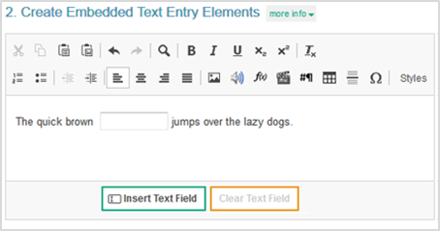
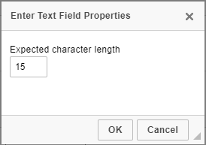
Embedded Text Entry Items
Notes:
Embedded Text Entry items require students to fill in one or more blank text boxes in a sentence by typing a response in the provided boxes. For example, an Embedded Text Entry item could provide a sentence with a missing word and ask students to fill in the blank with the appropriate vocabulary word that they learned in English class. These items must be scored by a user in the Reporting system.
To fill out the template, do the following. In the Compose Item Prompt section, replace the sample text with the item’s question or directions. You can use the toolbar to format the text and insert media elements.
The Create Embedded Text Entry Elements section displays sample text with a blank text box. Replace this sample content with the new text content and text boxes for your item.
To insert a blank text box in the response area, click the cursor where you want to place the text box, and then click Insert Text Field. You can insert multiple text boxes, if necessary. In the Insert Text Field Properties window, specify the length of the blank text box. If you need to remove a blank text box from the response area, click the box and then click Clear Text Field.

Slide 19
Embedded Text Entry Items
Notes:
In the Construct Answer Keys section, enter the item’s highest possible score in the Maximum Score field. Fill out the rubric for the correct, full-credit response for the item. In the Description field, describe how a student must respond to the item in order to earn full credit. In the Exemplar field, enter an example of a response that would earn full credit. Note that the template automatically creates a rubric tab for each possible score a student could earn, based on the maximum score. To fill out any additional rubrics for the item, click the tab for that rubric and enter a description and exemplar for the rubric’s score.

Slide 20
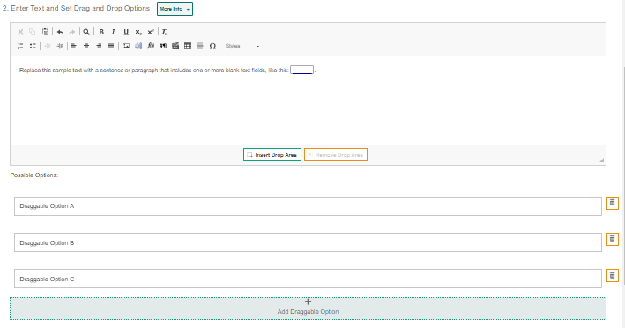
Text Drag and Drop Items
Notes:
Text Drag and Drop items require students to fill in one or more blank "drop" boxes in a sentence or paragraph by dragging response options into those boxes from a word bank. For example, a Text Drag and Drop item could provide a sentence with a missing word and ask students to fill in the blank with a vocabulary word from the provided word bank.
To fill out the template, do the following. In the Compose Item Prompt section, replace the sample text with the item’s question or directions. You can use the toolbar to format the text and insert media elements.
The Enter Text and Set Drag and Drop Options section displays sample text content, including a blank drop box. Replace this sample content with the new text content and the blank text boxes for your item.
To insert a blank drop box in the response area, click where you want to place the drop box, and then click Insert Drop Area. You can insert multiple drop boxes, if necessary. If you need to remove a blank drop box from the response area, select the box and click Clear Drop Area.
The template displays sample word bank options below the text box. You can click these answer options to replace the sample text with the text that students will drag into the drop boxes. To create additional answer options, click Add Draggable Option and enter the content for that answer option in the box that appears.
In the Construct Answer Keys section, enter the item’s highest possible score in the Maximum Score field. Optionally, you can set the maximum number of times students can drag each answer option into a drop box by entering the value in the Maximum Matches of Each Answer Option field. If you enter a number greater than 1, students will be able to reuse each word bank option in multiple drop boxes. Also optionally, you can require students to use each answer option a certain number of times. To do so, enter the required value in the Minimum Matches of Each Answer Option field. Students will not be able to complete the item until they have used each answer option the specified number of times.
To create answer keys for the item, do the following. In the Point field, enter the score for a correct or partially correct response. If a sample response is already entered, you may need to drag it out of the response area first. In the provided response area, drag the answer options into the drop boxes required in order to earn the score you entered in the Point field.

Slide 21
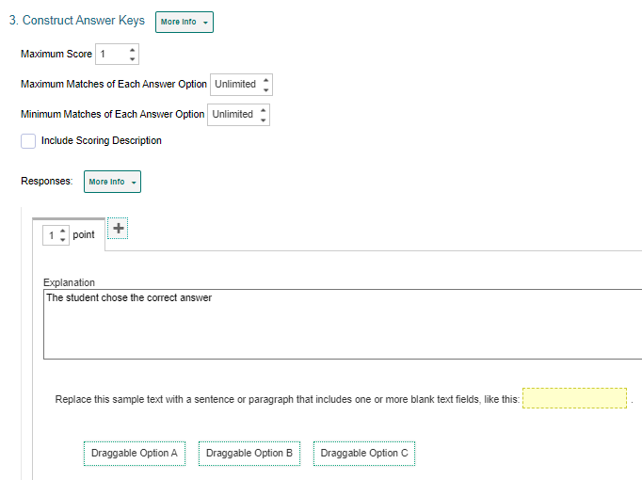
Text Drag and Drop Items
If a sample response is already entered, you may need to drag it out of the response area first.
Notes:
In the Construct Answer Keys section, enter the item’s highest possible score in the Maximum Score field. Optionally, you can set the maximum number of times students can drag each answer option into a drop box by entering the value in the Maximum Matches of Each Answer Option field. If you enter a number greater than 1, students will be able to reuse each word bank option in multiple drop boxes. Also optionally, you can require students to use each answer option a certain number of times. To do so, enter the required value in the Minimum Matches of Each Answer Option field. Students will not be able to complete the item until they have used each answer option the specified number of times.
To create answer keys for the item, do the following. In the Point field, enter the score for a correct or partially correct response. If a sample response is already entered, you may need to drag it out of the response area first. In the provided response area, drag the answer options into the drop boxes required in order to earn the score you entered in the Point field.

Slide 22
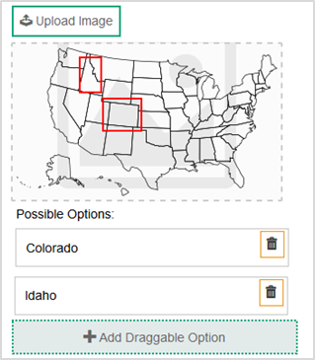
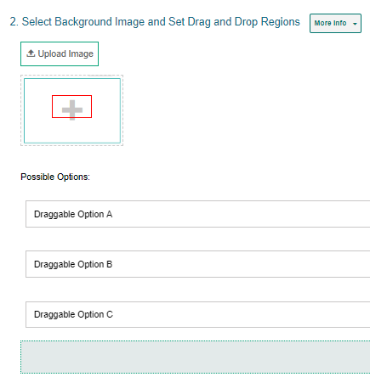
Image Drag and Drop Items
Notes:
Image Drag and Drop items require students to fill in the blank "drop" boxes on an image by dragging response options into those boxes from a word bank. You can specify the size and location of the drop boxes where students drag their answers. For example, an Image Drag and Drop item could provide a map of the United States and ask students to place state names on the map using a provided word bank.
To fill out the template, do the following. First, in the Compose Item Prompt section, replace the sample text with the item’s question or directions. You can use the toolbar to format the text and insert media elements. In the Select Background Image and Set Drag and Drop Regions section, click Upload Image. In the Image Properties window, click Browse Server. In the File Manager window, click Upload Image and select an image file from your computer. Then double-click the image you just added. The image must be 600×600 pixels or smaller and under 1.5 MB. In the Image Properties window, click OK.
To add the drop box areas to the image, do the following. Click the image once to set the first corner of the selectable rectangle, then click one more time where you want to set its opposite corner (do not click and drag). A red box appears, but this will not be visible to students. To move a drop box region, click that box and drag it to the desired location on the image. You can copy or delete a drop box region by selecting the box and then clicking Copy or Delete.
The item template displays sample answer options below the background image. You can click these answer options to replace the sample text with the new text or image that students will be able to drag into the drop boxes. If you want to create additional answer options, click Add Draggable Option and enter the content for that answer option in the box that appears.

Slide 23
Image Drag and Drop Items
Notes:
In the Construct Answer Keys section, enter the item’s highest possible score in the Maximum Score field.
To create answer keys for the item, do the following. In the Point field, enter the score for a correct or partially correct response. Note that if a sample response is already entered, you may need to drag it out of the response area first. Then, in the provided response area, drag the response options into the drop boxes required to earn the score you entered in the Point field.
If you want to limit how many times students can use each answer option in the word bank, enter the desired limit in the Maximum Matches of Each Answer Option field. If you enter a number greater than 1, students will be able to reuse each option in multiple drop boxes. If you want to require students to use each answer option a certain number of times, enter a value in the Minimum Matches of Each Answer Option field. Students will not be able to finish the item until they have used each response option the specified number of times.

Slide 24
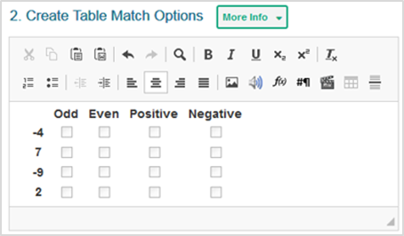
Table Match Items
Notes:
Table Match interactions provide two sets of match options in a table, with one set listed in columns and the other set listed in rows. Students match options in the columns to options in the rows by marking checkboxes in the cells where they intersect. In the example shown, the Table Match item lists a set of numbers in the rows and a set of properties in the columns (such as odd, even, positive, and negative), and students must select the properties that apply to each number.
To fill out the template, in the Compose Item Prompt section, replace the sample text with the item’s question or directions. You can use the toolbar to format the text and insert media elements.
The Create Table Match Options section displays a sample table. You can modify the match options that appear in each column header and row header. You can also modify the number of rows and columns that appear in the table.
To enter a caption for this table, click the text box above the table and type the caption. To enter match options in the table, click inside the row headers and column headers, and then replace the sample text with the content for the match options.
To modify the number of rows in the table, click the table rows button in the toolbar and select an option from the menu that appears. You can also right-click a row and select a menu option.
To modify the number of columns in the table, click the table columns button in the toolbar and select an option from the menu that appears. You can also right-click a column and select a menu option.

Slide 25
Table Match Items
Notes:
In the Construct Answer Keys section, enter the item’s highest possible score in the Maximum Score field. To set restrictions on the matches a student can make, do the following. In the Minimum Number of Total Matches field, enter the minimum number of checkboxes students must mark in the entire table. In the Maximum Number of Total Matches field, enter the maximum number of checkboxes students can mark in the entire table. In the Maximum Number of Checked Cells in Each Row field, enter the maximum number of checkboxes students can mark in any row. In the Maximum Number of Checked Cells in Each Column field, enter the maximum number of checkboxes students can mark in any column.
To create answer keys for the item, do the following. First, in the Point field, enter the score for a correct or partially correct response. Note that if a sample response is already entered, you may need to clear the checkboxes first. Then, in the provided response area, mark the checkboxes in the table cells that students would need to select in order to earn the score you entered in the Point field.

Slide 26
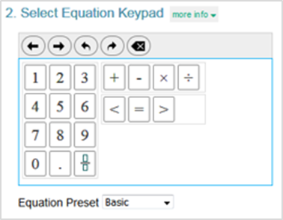
Equation Response Items
12 + 4 + 8 – 9 = 9x + 4
Notes:
Equation Response items require students to use an on-screen keypad or their physical keyboard to enter a mathematical expression or equation in the response area. For example, an Equation item could provide an algebraic equation and ask students to reduce it.
To fill out the template, do the following. In the Compose Item Prompt section, replace the sample text with the item’s question or directions. You can use the Add Math Equation button in the toolbar to insert a formula.
In the Select Equation Keypad section, select an option from the Equation Preset dropdown to determine which buttons will be available on the student’s keypad.
The keypad in this section displays the buttons associated with the selected Equation Preset type. All keypads include Back, Next, Undo, Redo, and Delete buttons at the top.

Slide 27
Equation Response Items
Notes:
In the Construct Answer Keys section, enter the item’s highest possible score in the Maximum Score field.
Optionally, to set the item to automatically simplify the student’s entered response, set the Simplify Response toggle to Yes. For example, if a student enters the answer 2/4 (two-fourths), the system would simplify that response as ½ (one-half) and accept all its equivalent expressions.
To create answer keys for the item, do the following. First, in the Point field, enter the score for a correct or partially correct response. If a sample response is already entered, you may need to clear the response area first. In the provided response area, use the keypad to enter the mathematical expression that students would input in order to earn the score you entered in the Point field. After entering a fraction, exponent, or root, you may need to click the right arrow button in order to enter additional characters.

Slide 28
For More Help
You can contact the Helpdesk for assistance with any technical issues you encounter. When contacting the Helpdesk, please be ready to provide:
Any error messages that are appearing (including codes)
Your operating system and browser information
Your network configuration information
Your contact information for follow-up by phone or email
Any other relevant information, such as test names or content areas, student IDs, session IDs, and search criteria
For test administration or policy issues, please contact your district test coordinator.
Further Information
HSAP Portal: https://alohahsap.org/
HSAP Help Desk
Phone: 1-866-648-3712
Email:
hsaphelpdesk@cambiumassessment.com
Thank you!
Notes:
You can find additional Checkpoint resources on the HSA-Science and EOC assessment portal. However, if you still require assistance with troubleshooting a technical issue, you may also contact the HSAP Helpdesk. When contacting the Helpdesk, please be ready to provide the following information:
Any error messages that are appearing (including codes)
Your operating system and browser information
Your network configuration information
Your contact information for follow-up by phone or email
Any other relevant information, such as test names or content areas, student IDs, session IDs, and search criteria
For questions about test administration or policy issues, please contact your district test coordinator.
Thank you for taking the time to view this training module. For detailed information, consult your Checkpoint Guide located on the HSA-Science and EOC portal or contact the HSAP Help Desk.

