Slide 1
How to Generate, Start, and Monitor a Teacher-Authored Test Session in the TA Interface
Checkpoint System Training Module
2020-2021
Copyright © 2020 Cambium Assessment, Inc. All rights reserved.
Notes:
Welcome to the How to Generate, Start, and Monitor a Teacher-Authored Test Session in the TA Interface training module. This module is part of a series of training modules on the Checkpoint System and its features. This module explains how you can start and monitor a teacher-authored test using the Test Administrator (TA) Interface.
Please note that your state’s TA Interface may be different from the images shown in this presentation. Please consult your state’s portal for additional information about specific features of your state's TA Interface.

Slide 2
Objectives
This presentation will show you how to do the following:
Start a teacher-authored test session using the Test Administration (TA) Interface
Monitor student test progress
Pause and stop a test session
Exit and log out of the TA Interface
Notes:
This presentation will show you how to do the following:
Start a teacher-authored test session using the Test Administration (TA) Interface
Monitor student test progress
Pause and stop a test session
Exit and log out of the TA Interface

Slide 3
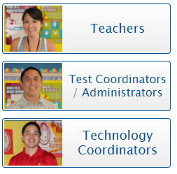
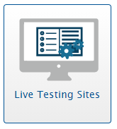
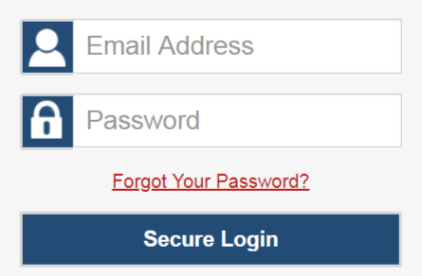
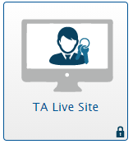
Logging in to the TA Interface
Notes:
The TA Interface is used to create and manage test sessions that students join to complete online tests. We will begin with detailed instructions on how to log in to the interface followed by a detailed review of each feature.
To log in to the TA Interface, go to your portal. Click the appropriate user role or assessment card. On the next page, click the system card used for operational test administration. Enter your username and password, and then click Secure Login to continue.

Slide 4
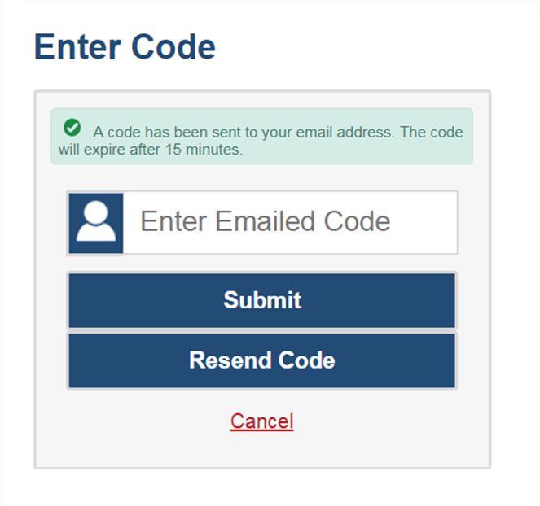
Logging in to the TA Interface (continued)
The system has an authentication process that will be triggered when you log in from a different device or browser, or after clearing your browser’s cache.
If you see this screen, an email containing the code will have automatically been sent to your email address.
Enter the code and click Submit.
If you need the code resent, click Resend Code.
Notes:
When logging in to the system using a new device or browser, or after clearing the cache on a previously used browser, you will see an Enter Code page.
If you see this screen, you will need to enter the code on this page within 15 minutes of receiving the email. If you do not receive a code or do not enter the code within the 15-minute time limit, click Resend Code. Click Submit after entering the authentication code to access the system.

Slide 5
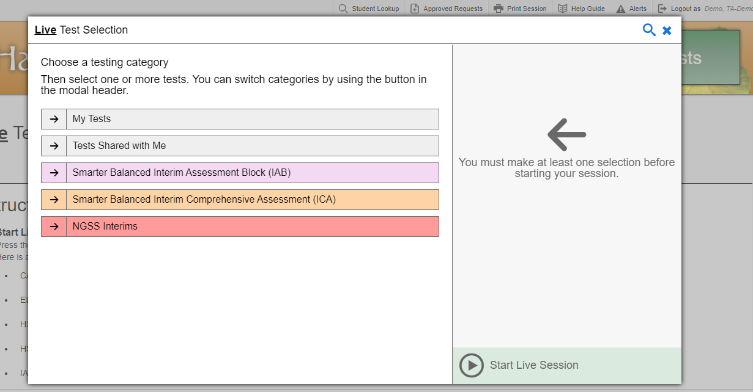
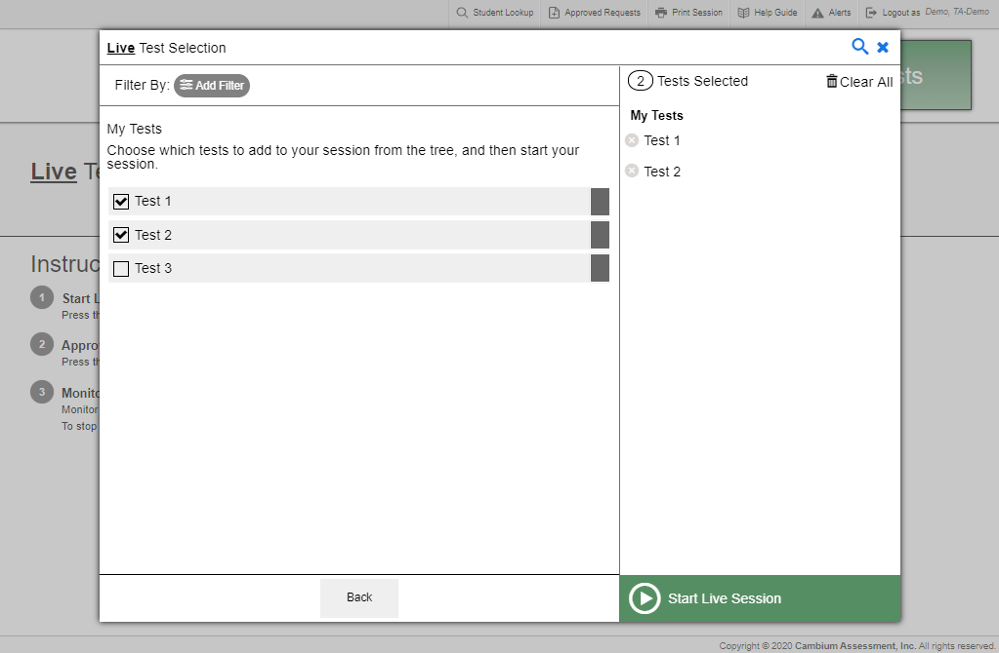
Create a Test Session: Test Categories
Notes:
Teacher-authored tests created and published in the Checkpoint system are administered through the Test Delivery System (TDS). The steps to create a test session for a teacher-authored test are the same steps you would use to create a test session for an interim or summative assessment.
The first step in administering a teacher-authored test is to create a test session. This should be done fewer than 20 minutes prior to starting the test in order to prevent the system from timing out.
After logging in to the TA Interface, the Test Selection pop-up window appears, displaying color-coded test categories. Tests created in Checkpoint that have been published to the Test Administration System will appear in a separate category. On this screen, the published tests created in Checkpoint can be found under the My Tests category.
Click the arrow next to the My Tests category to see all available teacher-authored tests. Mark the checkbox next to the test(s) you want to add to the test session. The tests you select will appear in the Tests Selected column. To unselect a test, click the “x” button to the left of the test name.

Slide 6
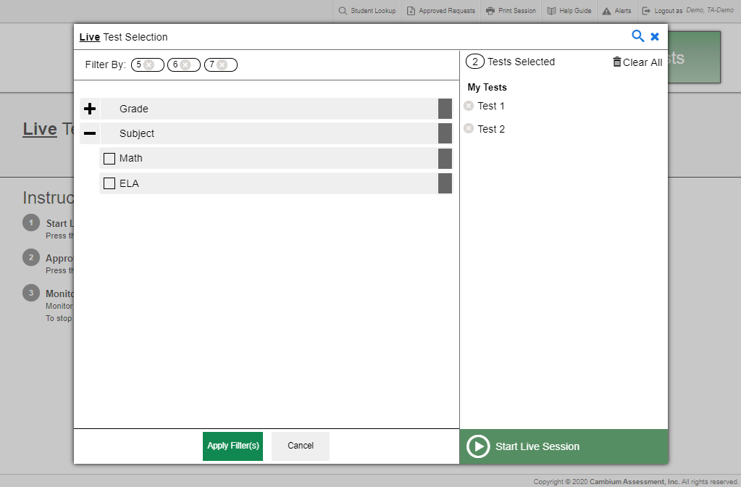
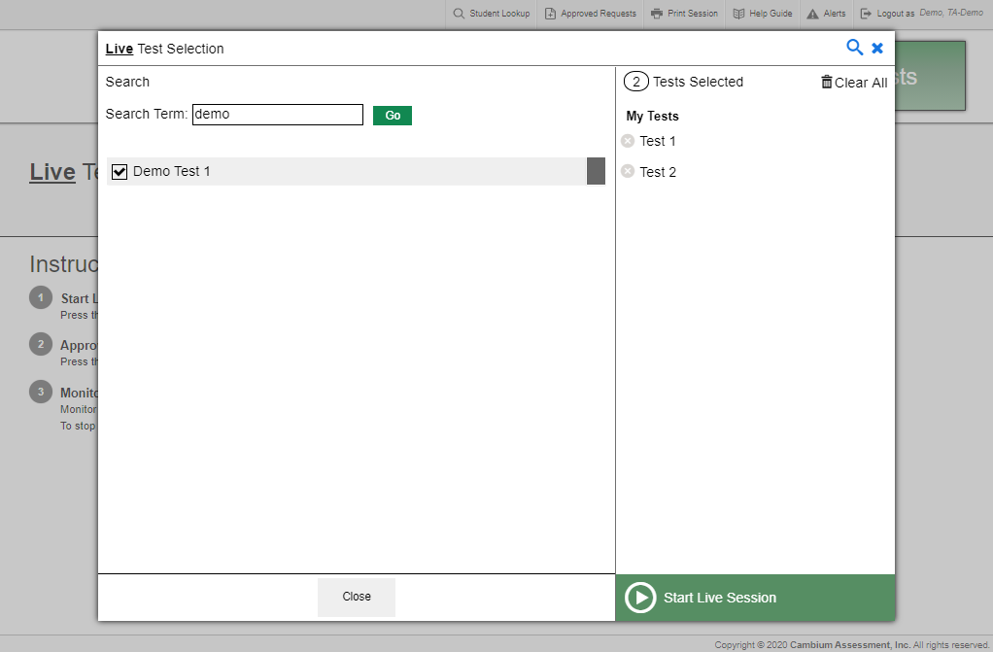
Filters and Search
Search
Filter
Notes:
You can filter a list of tests by grade and subject, in order to focus on specific types of assessments. Published tests created in Checkpoint can also be filtered by custom label and standards. The filters function is especially useful if a large number of tests exist.
To filter a list of tests, first click on the Add Filter button and the filters panel will appear. If needed, expand the filter categories by selecting the + sign. Then, mark the checkbox next to the filters you want to apply. Your selected filters will appear at the top of the window. To remove a filter, select the “x” button next to the filter you want to remove. Once you are finished selecting filters, click Apply Filter(s).
You can also search for specific tests to add by using the global search feature. To search for tests, select the magnifying glass in the upper right corner of the window. Enter the key search term(s) you want to search for and click Go. Tests matching your search criteria will appear.

Slide 7
Create a Test Session: Start Session
Notes:
Once you are finished selecting tests to add to your session, click the Start Session button.

Slide 8
Session ID
Notes:
Once you start a teacher-authored session, the system will automatically generate a session ID. The session ID will appear at the top of the TA Interface along with a Stop button. This ID must be provided to students for them to log in.
When students start signing into the test session, an Approvals button will also appear next to the session ID. Once you approve students for testing, the Test Session table will appear in the center of the TA Interface, displaying students’ testing progress. We will discuss more about this in later slides.

Slide 9
Screensaver Mode
Notes:
Since the student test progress tables in the TA Interface often contain sensitive student information, such as student IDs, the TA Interface contains a screensaver function to hide the data from view. If the screensaver mode is auto-enabled, the screensaver will automatically turn on if you are not active in the TA Interface for 10 minutes. If the screensaver mode is not auto-enabled, it is strongly recommended that you manually turn on the screensaver mode when stepping away from your device.
To turn on screensaver mode, select the box icon in the top right corner of the session ID. The screensaver displays the Session ID and the timer, if applicable. It also displays notifications if students are awaiting approval, there are pending print requests, or if students require other interventions.
The screensaver will automatically turn off if any mouse or keyboard activity is detected. It will also turn off automatically if the test session times out due to TA or student inactivity or once the allotted time expires for a timed test.

Slide 10
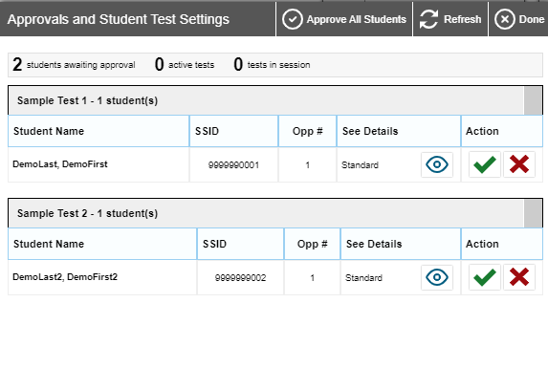
Approving Student Entry
Notes:
Once you start the test session and students log in, you must approve their test settings before they can access their tests. It is very important that you pay close attention to the test name prior to approval to be sure that students have selected the appropriate test. To approve students for testing, click the Approvals button next to the session ID. A list of students will display, organized by test name. You should review the list to make sure that all students chose the correct content area and test. To ensure that a student’s test settings are correct, select the Eye button in the See Details column.
To approve a single student, click the green checkmark button. If no changes are needed, select Approve All Students to admit all students to the session. You will see a confirmation message appear after clicking Approve All Students.
To deny a student entry to the test session, clicking the X button in the Action column. Denying the student entry into the test session will not prevent other approved students from beginning their tests.

Slide 11
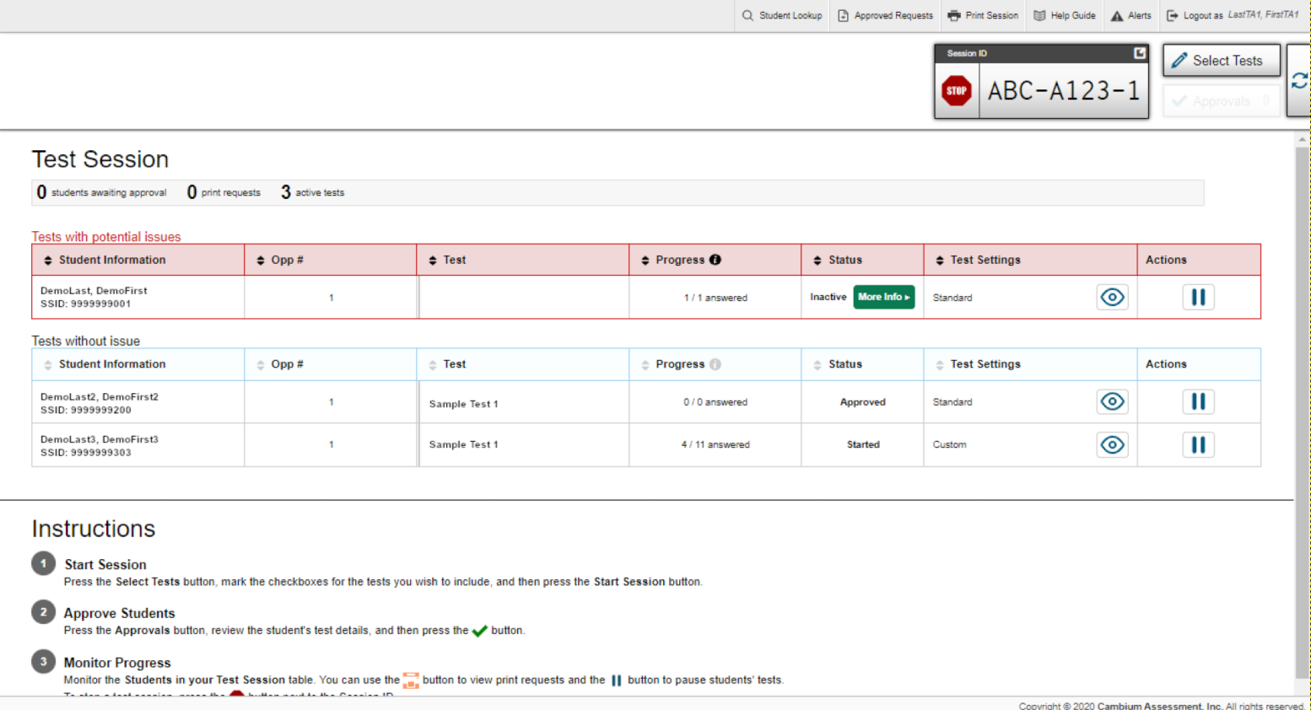
Test with Potential Issues Table
Notes:
Once students log in and are approved for testing, you can monitor their status from the table(s) displayed on the TA Interface that consist of the following columns - Student Information, Opportunity Number, Test Name, Progress, Status, Test Settings, and Actions.
The Progress column displays the student’s progress through the items in the test. It may display a progress bar to indicate the student’s progress through the test or display the total number of items completed thus far and the total number of items in the test.
The Status column indicates a student’s testing status. For a list of test statuses, please see the Guide to Navigating the Online HSAP Administration user guide.
The Test Settings column displays either Standard or Custom. This column displays Custom when a student’s test settings are different from the default settings for that test. Click the Eye button to view a student’s test settings. In some states, the number of accommodations and designated supports will also appear.
The Actions column includes a Pause button that allows you to pause a student’s test. If a student requests a printout, a printer icon will appear in this column.
If the TDS detects that a student may be having technical issues or requires assistance, a “Tests with potential issues” table will appear. A “more info” icon will appear in the Test Status column. Hovering over this icon will display more information about the issue.

Slide 12
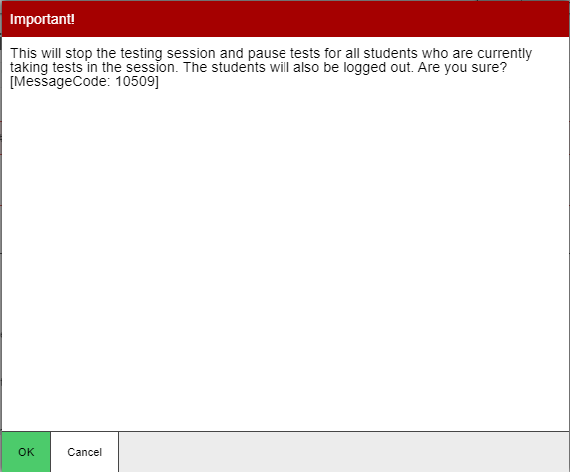
Pausing and Stopping Sessions
Notes:
You have two options within the TA Interface to pause or stop testing once it has begun. You can pause an individual student’s test or stop the entire session. To pause an individual student’s test, click the Pause button in the Actions column for that student. When prompted, click OK to confirm that you want to pause the test.
If you stop the session, all in-progress tests will be paused. If a session stops, it cannot be resumed. You will have to create a new test session and give the new session ID to students so that they can resume testing. To stop the entire test session for all students, do the following:
• Click the Stop button next to the session ID. A pop-up message will appear requesting verification to end the session and log students out.
• When prompted, click OK to continue.
If you forget to log out before leaving the testing area, the session will close automatically after 20 minutes of inactivity on both the TA and student computers. You would then need to create a new session and provide the new session ID to students in order to resume testing.

Slide 13
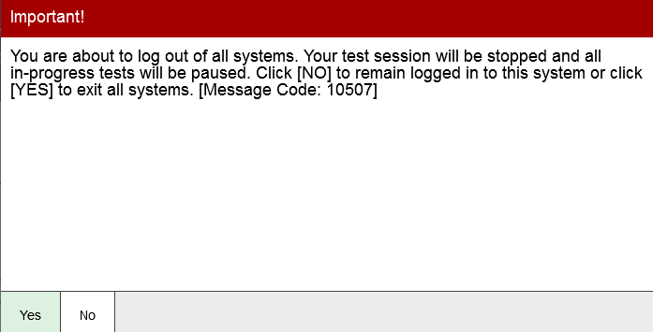
Logging Out of the TA Interface
Notes:
To log out of the TA Interface, click the Logout button in the upper-right corner of the page. It is preferable for you to log out only after stopping your active test session, as logging out will cause all in-progress tests to be paused. A confirmation message will appear, asking you to confirm that you want to exit the website and pause all students’ in-progress tests. This scenario also occurs when you navigate to another website from the TA Interface. However, regardless of when or how you log out or navigate away from the TA Interface, student data will NOT be lost. If you need to access another application, we encourage you to open it in a separate browser window.
Click Yes to log out of the TA Interface.

Slide 14
Thank You!
For further information, please visit
HSAP Portal: https://alohahsap.org/
HSAP Help Desk
Phone: 1-866-648-3712
Email: hsaphelpdesk@cambiumassessment.com
Thank you!
Notes:
Thank you for taking the time to view this training module. If you need further information about the Test Administration System, please consult the Guide to Navigating the Online HSAP Administration user guide. For additional information about Checkpoint, see the Checkpoint System User Guide. Both guides can be found on the HSA-Science page of AlohaHSAP.org portal. If you have technical issues, contact the HSAP Help Desk for assistance.

