Slide 1
How to Use the Roster Manager to Add, Modify, and Upload Rosters
Centralized Reporting System Training Module Series #3
Copyright © 2020 Cambium Assessment, Inc. All rights reserved.
Notes:
Welcome to training module #3 in the Centralized Reporting System series: How to Use the Roster Manager to Add, Modify, and Upload Rosters. In this training module we show you how to create a roster, then how to view or edit a roster, and how to upload multiple rosters using a template. NOTE: Roster functions described in this module are available to Principal (PR), Test Coordinator (TC) and Data Coach (DATA) users only.

Slide 2
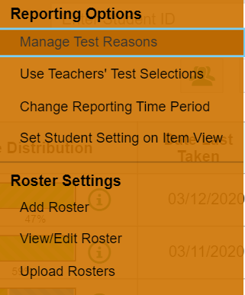
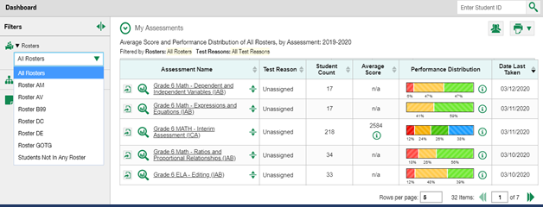
1
Roster Performance on Test Report
Roster Tool in Centralized Reporting
2
Roster Filter
Notes:
The Roster Manager tool is accessed by Principal (PR), Test Coordinator (TC) and/or Data Coach (DATA) users via the My Settings drop-down menu from the banner. The Roster Settings you see listed in your menu will depend on your user role. Here you can see options to Add Roster, View or Edit a Roster, and Upload Rosters. You may be familiar with this tool from using it in the Test Information Distribution Engine, or TIDE. It works the same way in both systems. There are advantages to creating and modifying rosters for students you have identified as sharing certain characteristics or belonging to a specific group. Any roster you create will appear in your (1) Roster Performance on Test reports, and you can filter for that specific group using the (2) Roster Filter, allowing you to keep a close watch on the students you put on that roster.

Slide 3
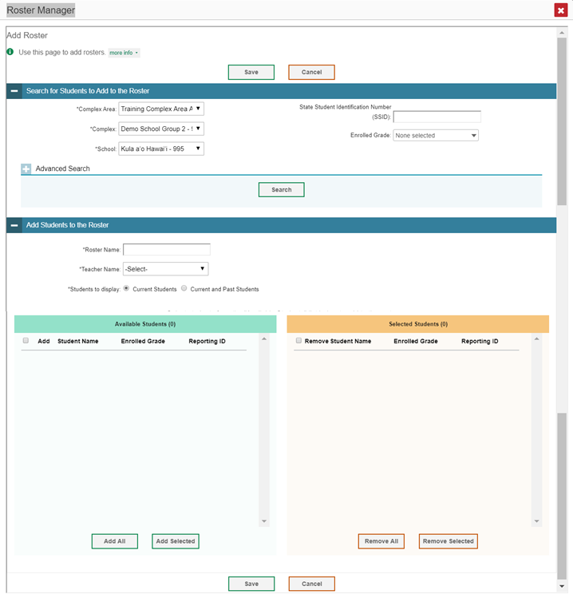
ADDING A ROSTER
3
4
6
7
5
1
2
Notes:
In order to add a roster, you will need to click on (1) My Settings in the banner, and use the dropdown menu to choose (2) Add Roster.
The Roster Manager windows include (3) “more info” buttons that display instructions for completing the fields specific to that window. You can click on them at any step in the process. The Add Roster page is organized into two panels, each headed by a blue bar. They are: (4) Search for Students to Add to the Roster and (5) Add Students to the Roster.
To search for students that you want to add to your roster, complete the fields under the (4) Search for Students to Add to the Roster panel. The fields marked with an asterisk are mandatory. Use the options under (6) Advanced Search to further refine your search. Fields to narrow your search include last name, first name, HSA-Alt flag, HLIP flag, ELL student, and more.
Under (5) Add Students to the Roster, you will name the new roster, associate it with a teacher, and choose whether to display only current students or current and past students. Past students include former students, including those who have left the selected school. Click (7) Search.

Slide 4
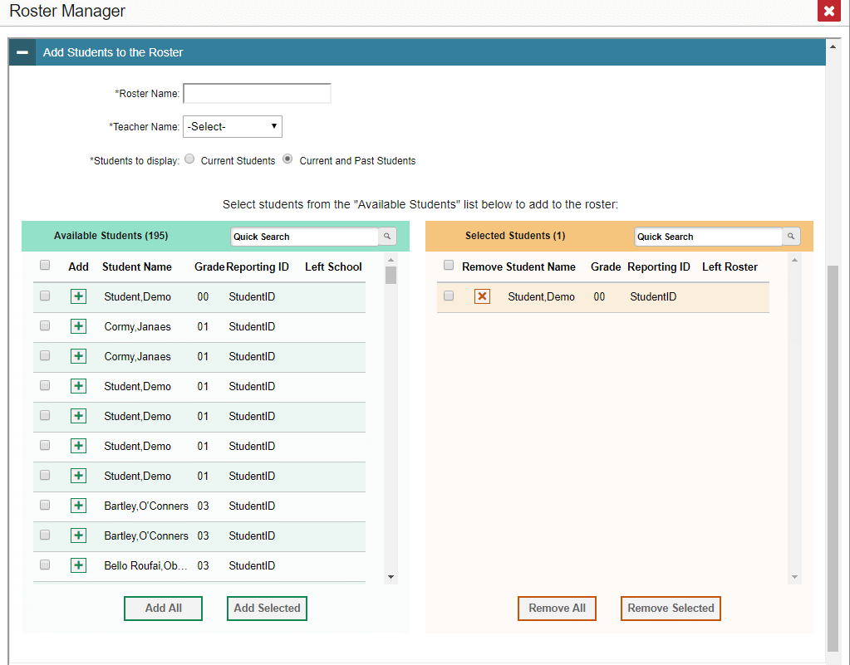
Adding Students to a Roster:
Move students from the green Available Students list to the orange Selected Students list by clicking the + button next to the student’s name.
Click Save
1
4
2
3
5
6
7
Notes:
The Roster Manager page updates to show Available Students under the green header on the left. Click the (1) + sign to move students from the green Available Students list to the orange Selected Students list. Or use the (2) Add All and (3) Add Selected buttons to move the students across. You can remove individual students from the roster by clicking the (4) orange X next to the student name. To remove multiple students, mark the checkboxes and use the (5) Remove All or the (6) Remove Selected buttons. When the roster is constructed to meet your needs, click (7) Save. The new roster will appear in any future roster search as a user-defined roster.

Slide 5
REVIEW OF STEPS TO ADD ROSTER
1. Search for Students to Add to the Roster:
Complete mandatory selections (*)
Search categories: SSID, Last Name, First Name, Grade, etc.
Advanced Search (optional)
HSA-Alt flag, Paper/Pencil Flag, Section 504, ELL Student, Text-to-Speech, etc.
To modify criteria: Remove All and Remove Selected buttons
2. Add Students to the Roster
Name the roster; select a teacher name.
Choose current students or current and past students.
CLICK SEARCH
Notes:
Above you will see a review of the steps for adding a roster.

Slide 6
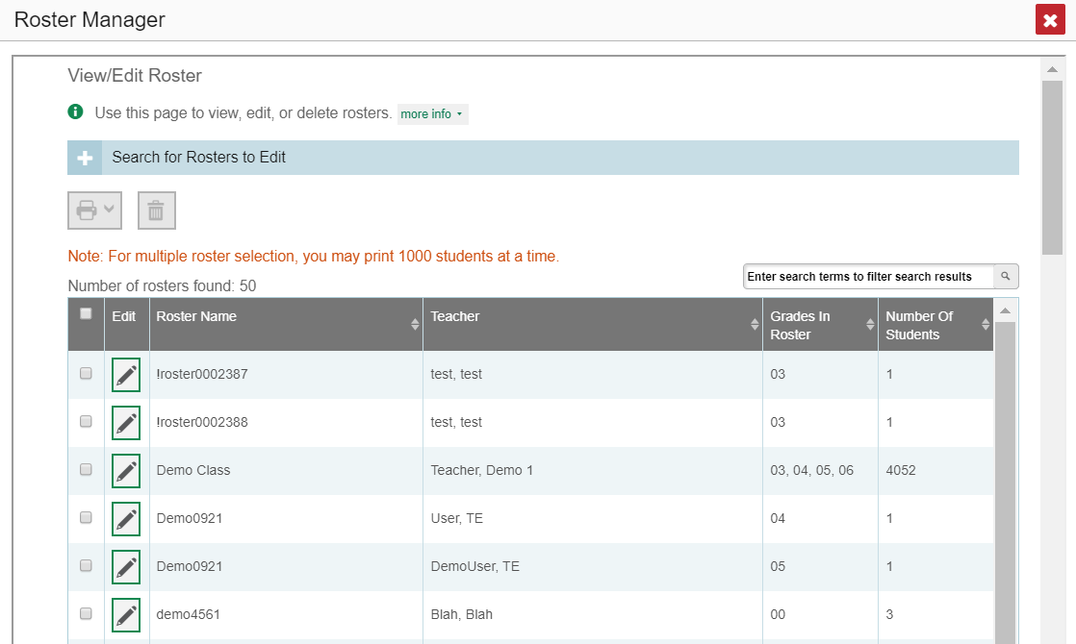
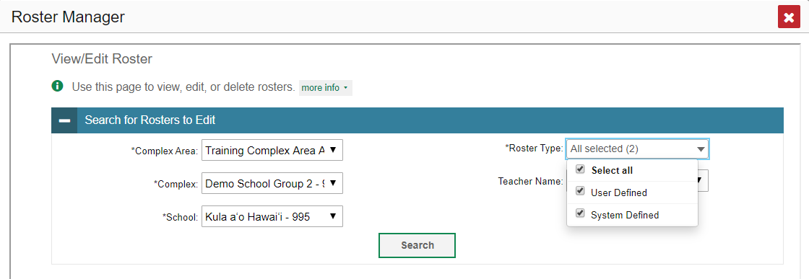
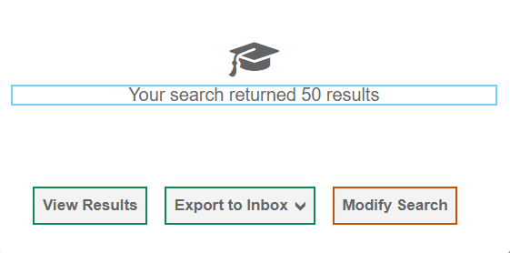
VIEW OR EDIT AN EXISTING ROSTER
5
Pencil Icon
6
1
2
4
3
Notes:
To view or edit an existing roster, choose (1) View/Edit Roster from the My Settings menu. The (2) View/Edit Roster window displays a Search for Rosters to Edit panel. The mandatory search boxes, marked with an asterisk, must be completed. The Roster Type box allows you to limit the search to User Defined rosters or System Defined rosters, or both. You can downsize the search results by entering a teacher name, as well. Make your choices and click (3) Search. A search results window opens. Click (4) View Results to continue. You will also have the option to Export to Inbox, which will send a list of rosters to your secure inbox. A list of (5) retrieved rosters is generated. Click the (6) pencil icon for the roster you want to view or edit. The View/Edit/Export Roster window (shown on the next slide) opens.

Slide 7
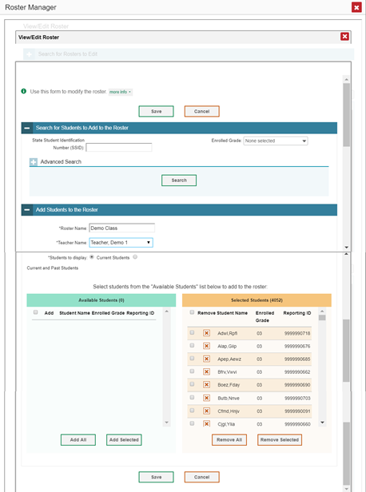
2
Pencil Icon
1
VIEW OR EDIT AN EXISTING ROSTER (CONTINUED)
3
Notes:
Once you choose a roster to view or edit and click on the (1) Pencil Icon, the (2) View/Edit Roster window opens. The View/Edit page is organized just like the one used for adding new rosters and it functions the same way. You can search for students to add to the roster or delete students from it. Remember to click the (3) Save button when you have made the necessary modifications.

Slide 8
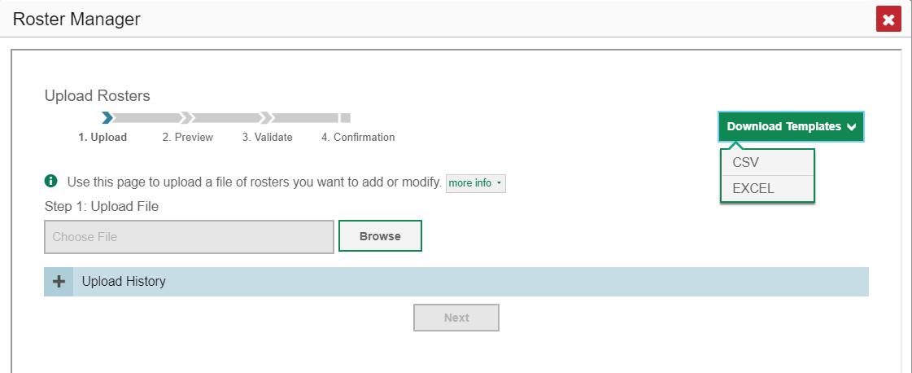
UPLOAD ROSTER
2
1
3
5
4
Notes:
If you have multiple rosters to create, it may be easier to use file uploads. This task requires familiarity with composing comma-separated values (CSV) files or working with Microsoft Excel. Choose the (1) Upload Roster option from the My Settings menu. The Roster Manager window displays, showing the Upload Rosters section. The Roster Manager window for the Upload Roster function requires four steps: (2) Upload, Preview, Validate, and Confirmation. To begin, click the (3) Download Templates arrow and select the desired file type. A (4) template will appear at the bottom of the Roster Manager window. Open the template, enter the required information, and save it to your computer. There is a (5) sample Excel worksheet showing the typical template shown on this slide.

Slide 9
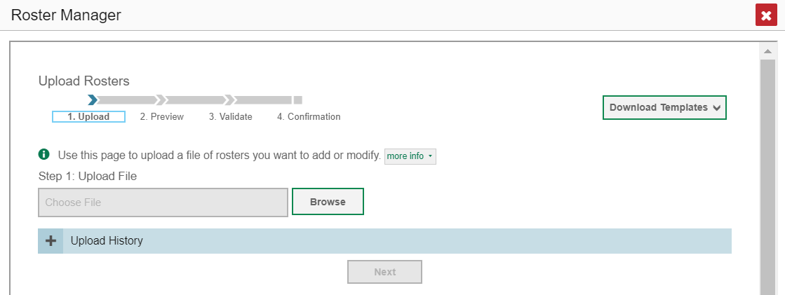
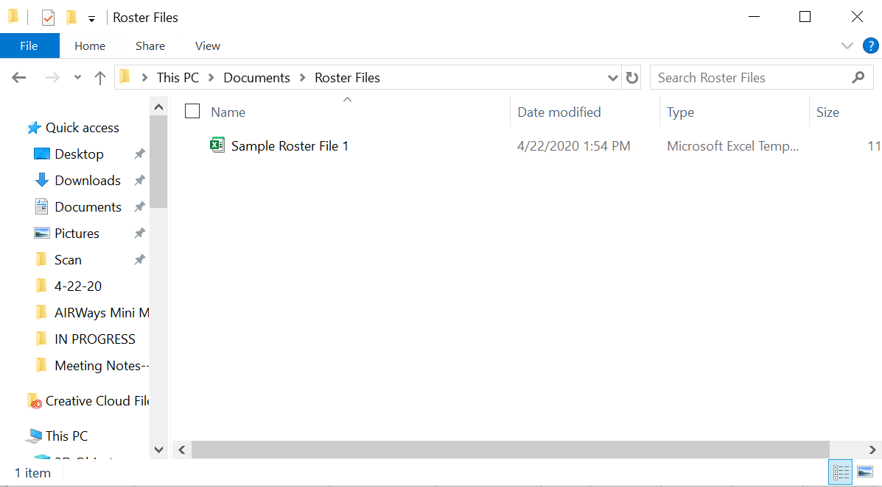
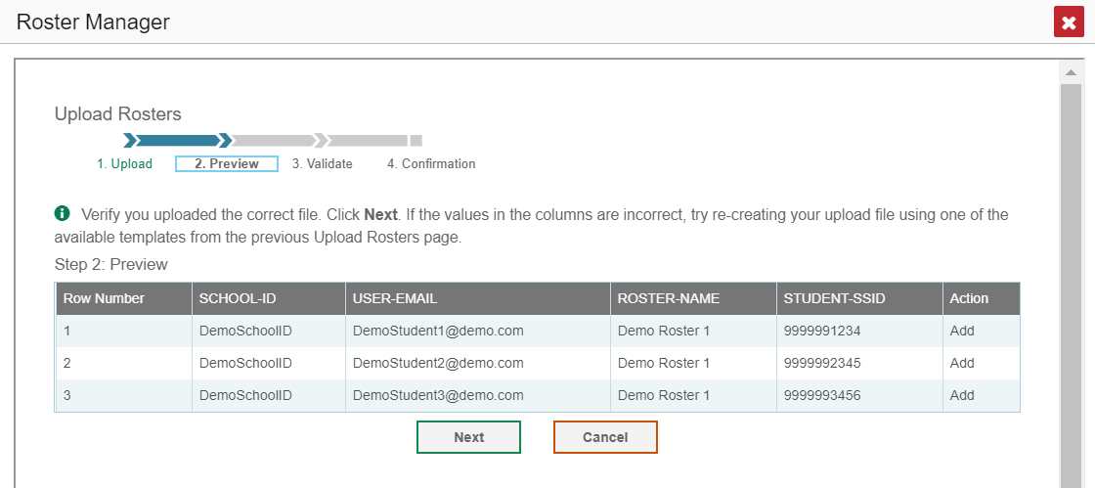
2
Choose file to upload
1
3
UPLOAD ROSTER (continued)
4
5
Notes:
On the same Upload Rosters page, click the (1) Browse button and (2) choose the file you created. Click (3) Next. The (4) Preview Page appears. Review the data in the table and verify that you uploaded the correct file. Click (5) Next to validate the file.

Slide 10
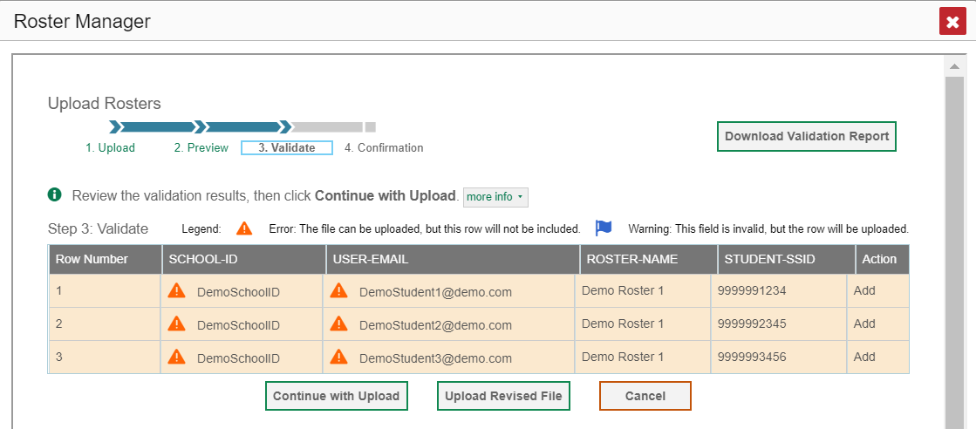
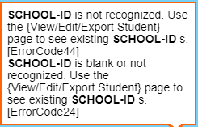
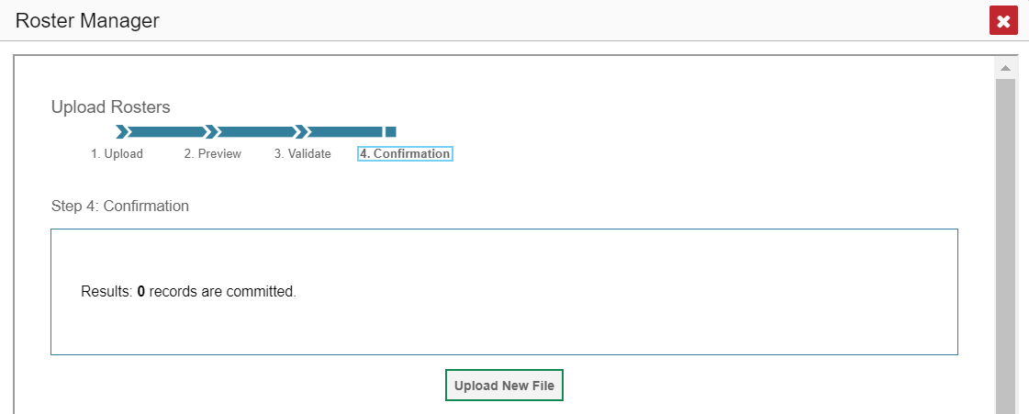
UPLOAD ROSTER (continued)
1
2
3
4
Notes:
Any (1) errors or warnings are displayed on the step #3 of the Upload Rosters page, the Validate step. If a record contains an error, that record will not be included in the upload. If a record contains a warning, that record will be uploaded, but the field with the warning will be invalid. Click the (1) icons to view the reason a field is invalid. Your choices at this step are to (2) Continue with Upload, Upload a Revised File, Cancel, or to Download a Validation Report. If you continue with the upload, the (3) Confirmation Page will appear, displaying a message about how many records were committed. Click the (4) Upload New File button.

Slide 11
Column Name | Description | Valid Values
Complex ID* | Complex associated with the roster. | Complex ID that exists in TIDE. Up to 20 characters.
School ID* | School associated with the roster. | School ID that exists in TIDE. Up to 20 characters. Must be associated with the complex ID. Can be blank when adding complex-level rosters.
User Email ID* | Email address of the teacher associated with the roster. | Email address of a teacher existing in TIDE.
Roster Name* | Name of the roster. | Up to 20 characters.
SSID* | Student’s unique identifier within the complex. | Up to 30 alphanumeric characters.
Action | Action to be taken on the student, either adding them to or deleting them from the roster. If blank, the student will be added. | Add or Delete.
UPLOAD ROSTER—TEMPLATE GUIDELINES
*Required field.
Notes:
This table provides the guidelines for filling out the roster template that you can download from the Upload Roster page.

Slide 12
Centralized Reporting System Training Module Series
1. How to Print ISRs and Student Data Files
2. How to Print and Export Data You Can See in Your Reports
3. How to Use the Roster Manager to Add, Modify, and Upload Rosters
4. How to Analyze Item-Level Reports
5. How to Hand-Score Unscored Items and Modify Machine Scores
Notes:
Thank you for viewing this training module on how to use the Roster Manager to add, modify, and upload rosters to the Centralized Reporting System. The full series is posted on the Aloha HSAP online portal. Refer to the Centralized Reporting System User Guide for more information.

