Slide 1
How to Print Individual Student Reports (ISRs) and Student Data Files
Centralized Reporting System Training Module Series #1
Copyright © 2020 Cambium Assessment, Inc. All rights reserved.
Notes:
Welcome to training module #1 in the Centralized Reporting System series: How to Print Individual Student Reports (ISRs) and Student Data Files. In this training module we show you how to generate the ISR, which is designed to be shared with parents and students, and the Student Data File, which is designed to help you arrange large amounts of data in a spreadsheet application.

Slide 2
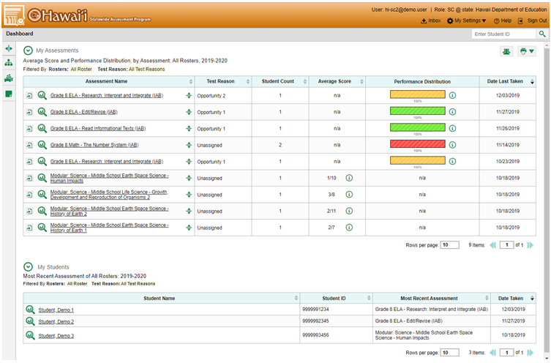
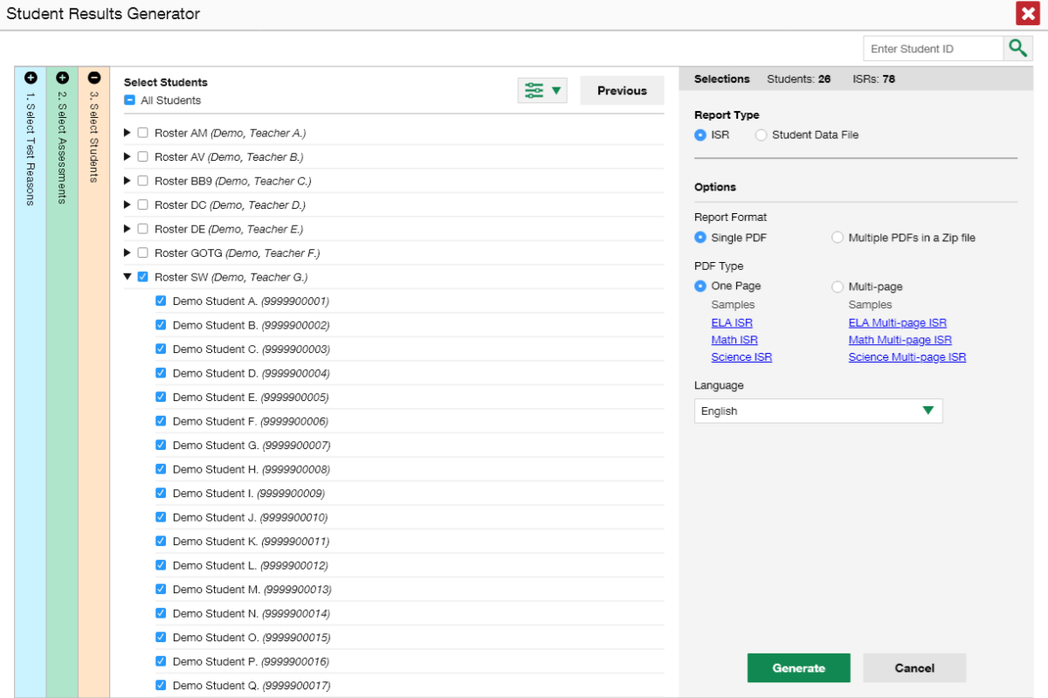
Student Results Generator
1
2
3
Student Results Generator Page
Notes:
The (1) Student Results Generator button is the “head and shoulders” icon located in the top-right corner of the dashboard and report pages. When you click on it the (2) Student Results Generator pop-up window displays. Both reports, the ISR and the Data File, are built by completing (3) three numbered and colored sections, #1 Select Test Reasons, #2 Select Assessments, and #3 Select Students. In this training module we show you several sample ISRs and then take you through the steps of generating an ISR. You construct the Student Data File in the same way, but your report will be in the form of an Excel or CSV spreadsheet. What you see in your Student Results Generator pop-up window may vary slightly from these images depending on the type of assessments administered in your state or complex.

Slide 3
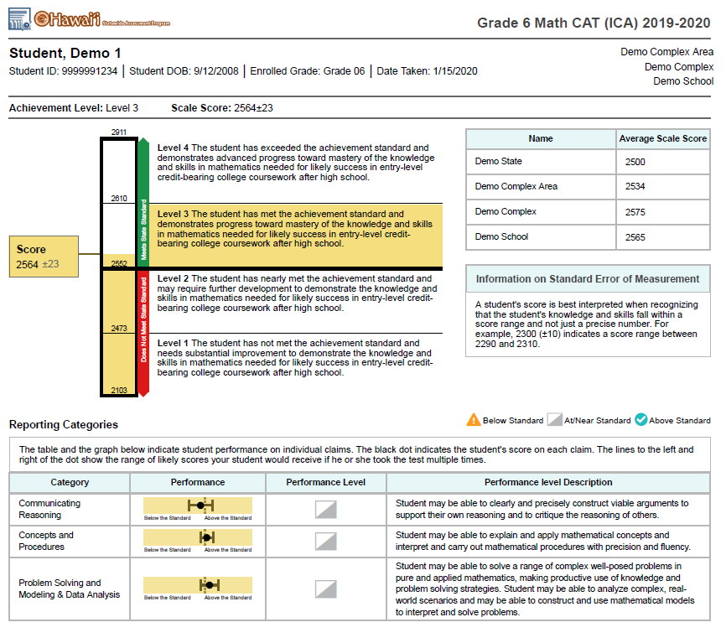
1
2
4
Simple ISR with Reporting Categories
3
5
Notes:
An ISR is a PDF that displays the performance results of one test taken by one student. It may consist of a single page, called the “simple report,” or multiple pages, called a “detailed report.” ISR layouts vary according to the type of test. This is a simple ISR, showing the results for a Grade 6 Interim Math assessment.
(1) Student, test, and school information is located at the top, followed by a (2) summary of performance. A (3) vertical scale of cut scores and performance levels features prominently on the report page. (4) State, complex area, complex, and school aggregate scores are included, if available. If the test is structured with (5) reporting categories, levels and descriptors for those are reported, as well. Other data are displayed depending on the state and type of test.

Slide 4
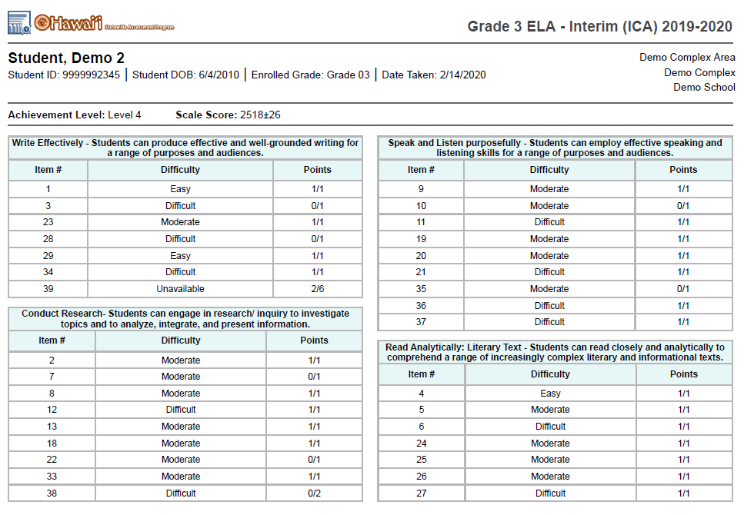
3rd Page of a Detailed ISR with Item-Level Data
2
3
1
Notes:
If a test report is for an Interim Comprehensive Assessment, you will have the option of printing a detailed ISR. This report is for the Interim Comprehensive Assessment in English Language Arts Literacy. The third page of the report, shown here, groups the test items into the four (1) reporting categories: Writing, Conducting Research, Speaking and Listening, and Reading Analytically. You see an (2) item difficulty column and a
(3) points earned column for each test item.

Slide 5
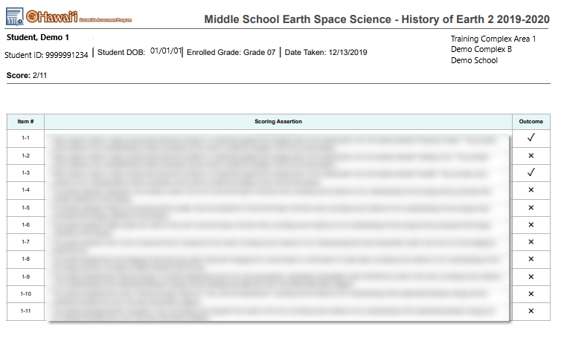
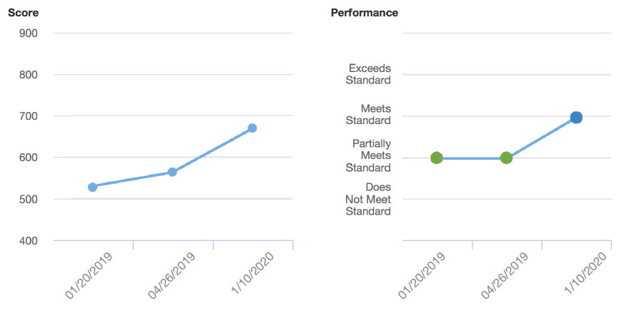
All scoring assertions that were assessed are listed here along with the outcome of each.
Sample ISR with Trend (Longitudinal) Report
Sample ISR with Scoring Assertions and Item-Level Data
Notes:
On the left is a sample of a detailed ISR for the grade 5 Science Interim test. It includes nine scoring assertions associated with item #1 on the test. Each numbered assertion describes the required task and the outcome indicates if the student fulfilled the expectation or not. On the right is a sample of a detailed ISR showing a trend report. A trend report is the same Longitudinal Report accessed in the Centralized Reporting System. This report shows that the student’s scores on the three instances of this test have risen over time. Now we show you how to build the ISRs you need.

Slide 6
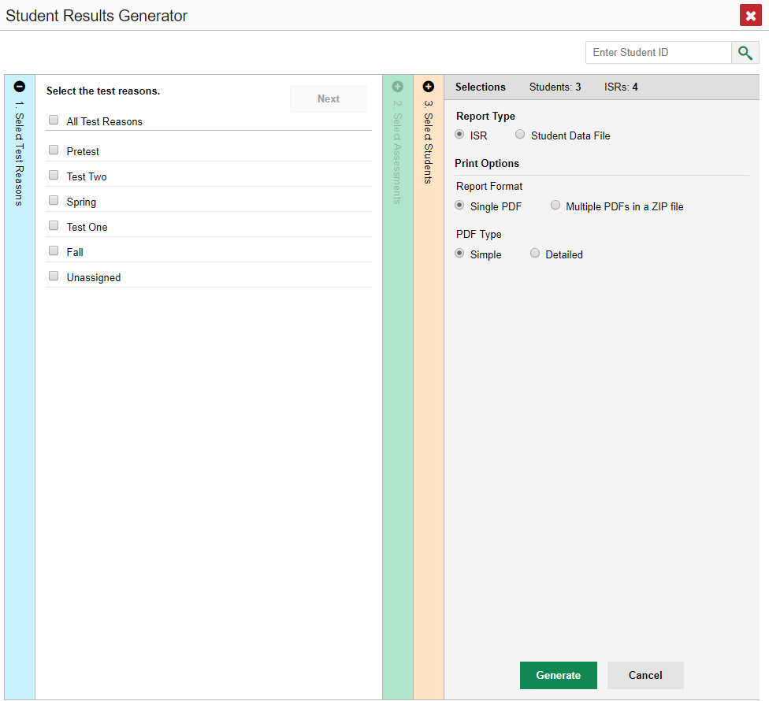
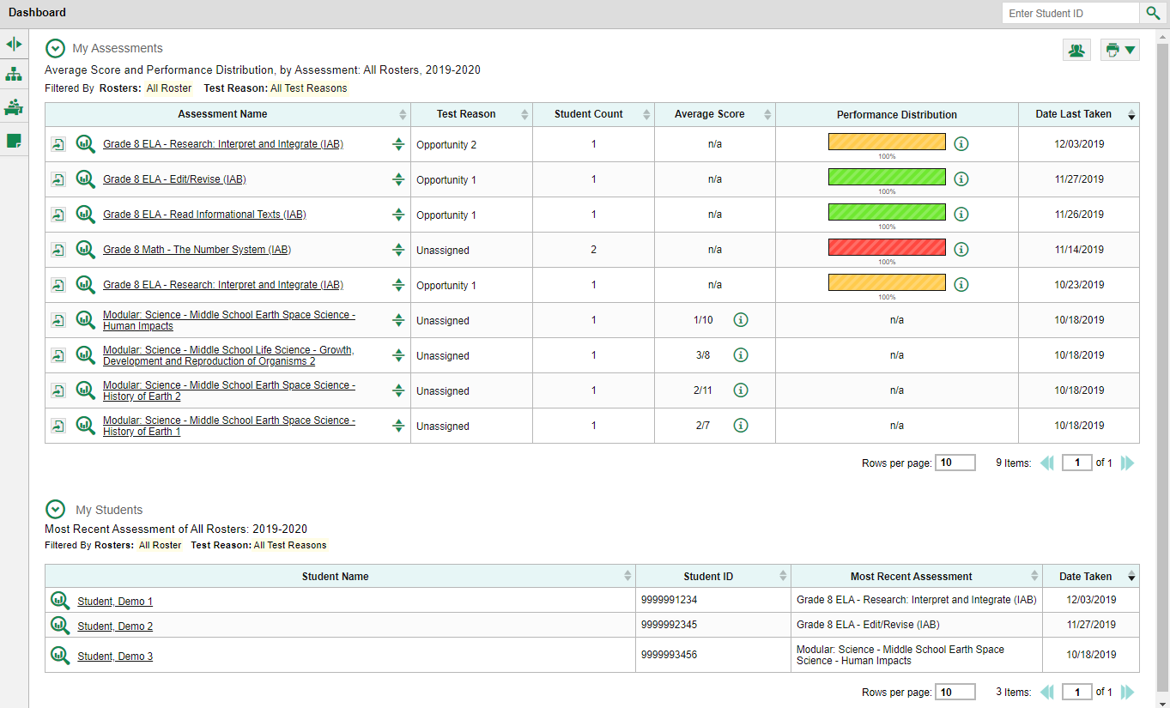
1
2
3
Student Results Generator
Notes:
You can build your ISRs from scratch or you can build them using pre-populated data. If you click the Student Results Generator button from the dashboard, as shown here, the Student Results Generator window opens with all the selection choices unpopulated. You generate the ISR or ISRs by selecting the (1) test reasons, (2) assessments, and (3) students that match your ISR needs. You can choose any combination of test reasons, assessments, and students. The pop-up window displays with column #1 open.

Slide 7
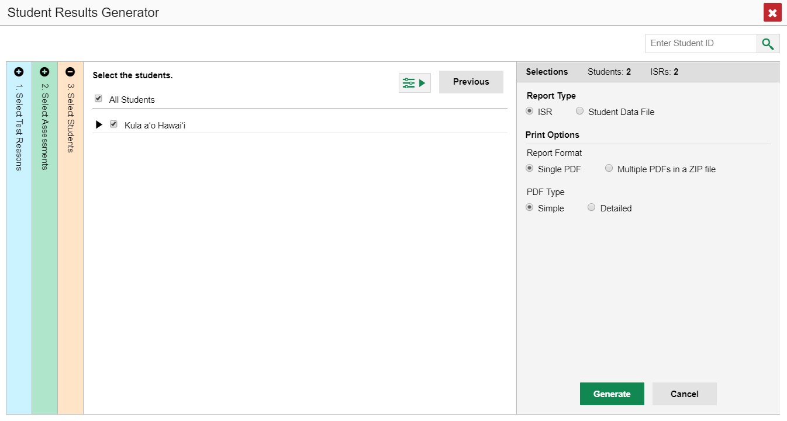
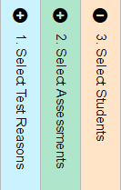
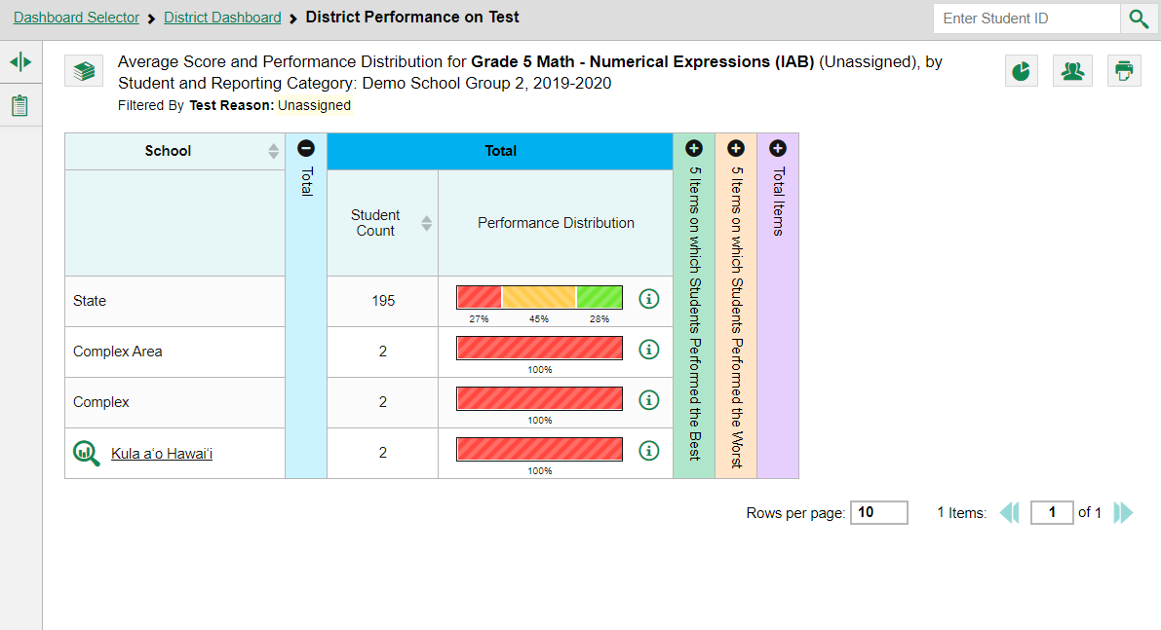
Student Results Generator—Pre-Populated from Report Page
4
3
1
5
2
Student Results Generator
Notes:
If you open the generator from a report page the Student Results Generator is pre-populated with data associated with the specific test report. The selections are made for you and you only need to confirm them or change them to generate the ISR or ISRs you need. Here is the Student Results Generator window showing pre-populated selections. Typically, when the generator button is clicked on from a test report page, the (1) Select Students column, #3 displays in the open position. This slide shows the window for a school-level user who is viewing the roster results of Kula a’o Hawai’i (a demo school) on a School Performance on Test report. The Select Students column will display the rosters for all the teachers in the school. Each roster can be expanded to show the students on that roster, by clicking on the (2) down arrow next to the roster name. Depending on the ISRs you need to generate, confirm that the pre-selections are those that you want or mark the checkboxes for the rosters and/or students you need. Now go to the (3) other two sections and confirm or change the selections. You open and close each column by clicking the (4) + or - symbols at the top of the columns, or you can click the (5) Previous and Next buttons at the top of each open column. We explain the sections on the next slide.

Slide 8
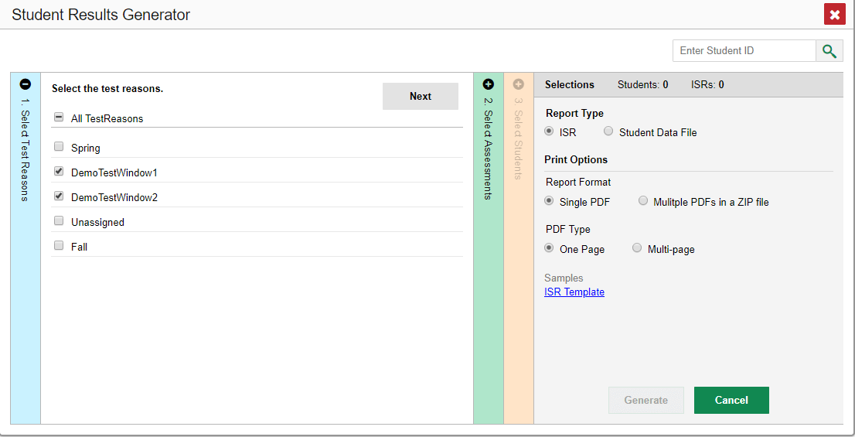
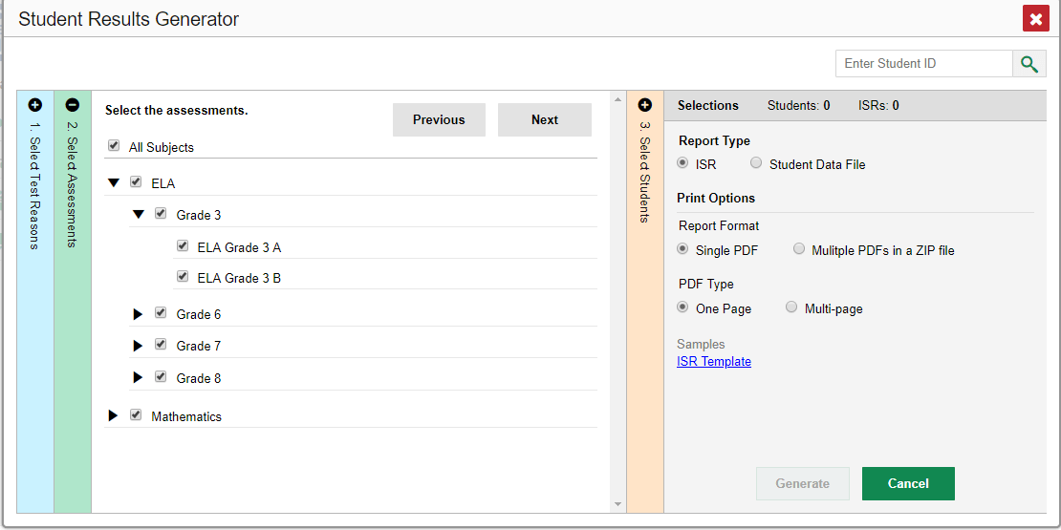
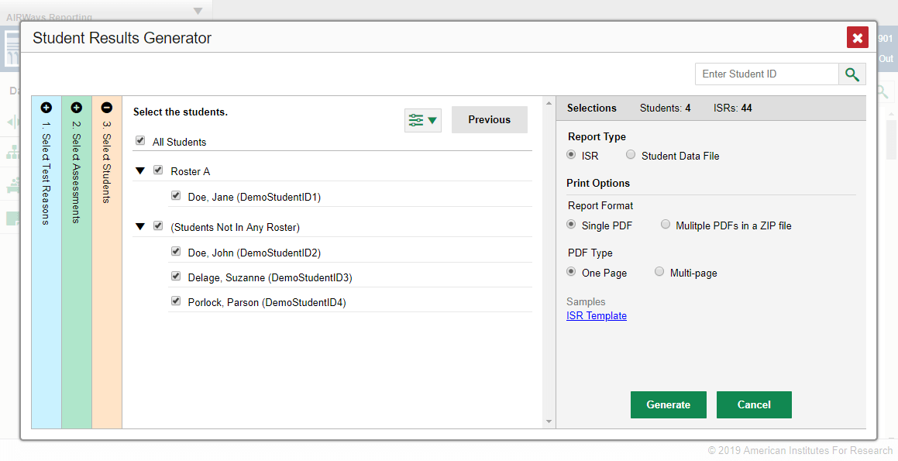
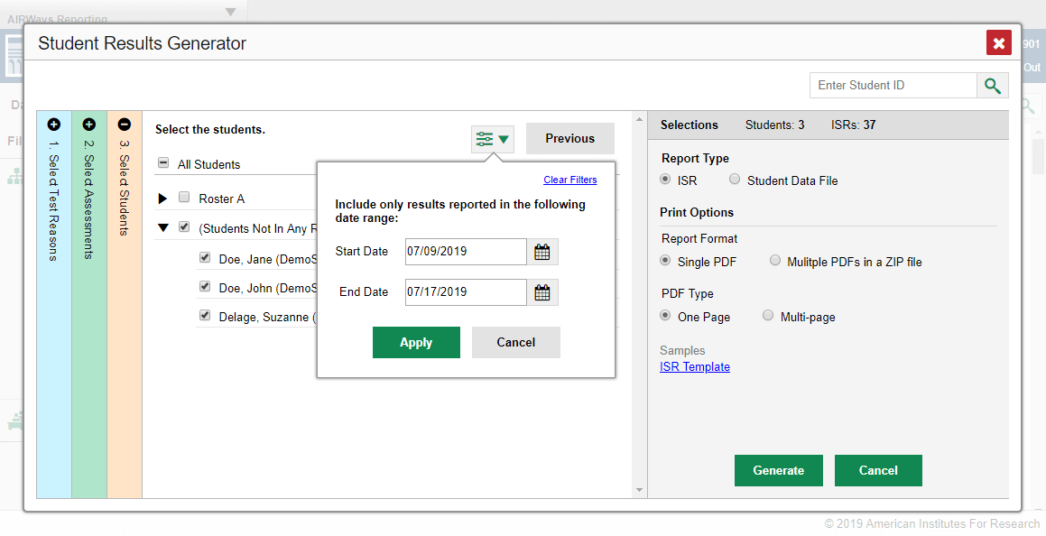
1. Select Test Reasons
1
2
2. Select Assessments
3. Select Students
3
4
4. Set Date Range
Filter Button
6
Selections Panel
5
Notes:
The first column is (1) Select Test Reasons. Test reasons are the test administration windows for summative tests. Test reasons for interim, benchmark, and modular tests can be categories, like Pre-test or Post-test, or a numbered opportunity. Mark the boxes for the reasons that apply to the ISRs you need to generate. The second column is (2) Select Assessments by type of test, subject, and grade. Select individual assessments or mark All Subjects. You can generate ISRs for any test in the list. The third column is (3) Select Students, will load results depending on the user’s role. Teachers and school-level users will see a list of rosters with student names below. District users will see a list of schools. The Selections panel on the right displays a count indicating the total number of students selected and the number of ISRs you have ordered. A (4) fourth customizing option is accessed via the filter button which is located to the left of the Next and Previous buttons. You can select a range of dates to be included in the ISR by using the calendar to enter a start date and an end date. Click (5) Apply. After making your customizations, click the (6) ISR radio button under Report Type in the Selections Panel. We now explain the Print Options available.

Slide 9
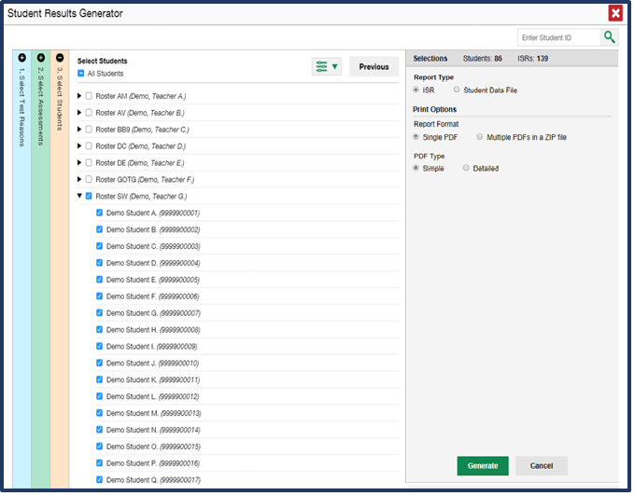
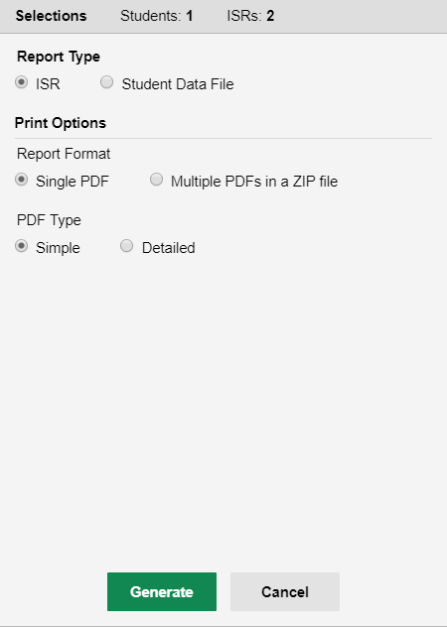
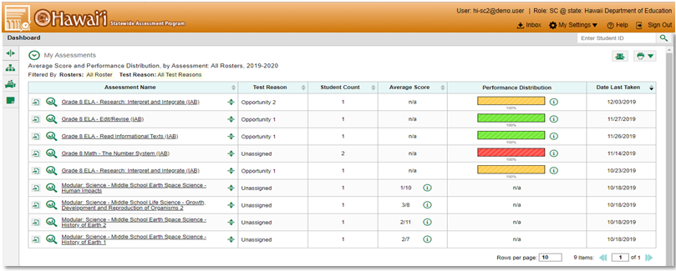
1
1
Print Options
2
3
Inbox Button
Notes:
After selecting your customization options for the ISRs you choose how to print the reports. (1) Print options for the ISR are listed under that heading in the Selections panel to the right. You can print simple single-page reports or detailed, multiple-page ISRs. After you have made your selections, click the (2) green Generate button. The ISR file, or multiple PDFs in a zip file, will be sent to your (3) Inbox, accessed via the banner on all pages in Centralized Reporting. We will explain how to print from the Inbox after we explain the Student Data File.

Slide 10
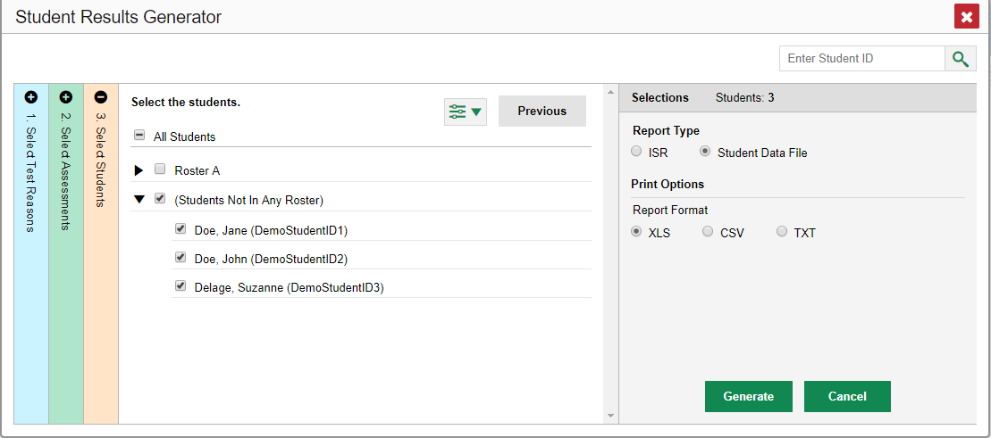
2
3
4
Generating a Student Data File
5
6
Student Data File—Excel Worksheet
1
Notes:
A (1) Student Data File is a user report of performance data, in Excel, CSV, or text format. Files of this nature allow the user to employ the workbook features of a spreadsheet application to organize and sort the data. A sample is shown here. The generation process for a Student Data File is the same one used for the ISR with different print options. Customize the Student Data File using the same (2) three selection columns and the (3) Filters button. Select (4) Student Data File, choose your desired (5) print format and click the (6) green Generate button. The Student Data File displays in the user’s Inbox. The next slide shows a sample Inbox.

Slide 11
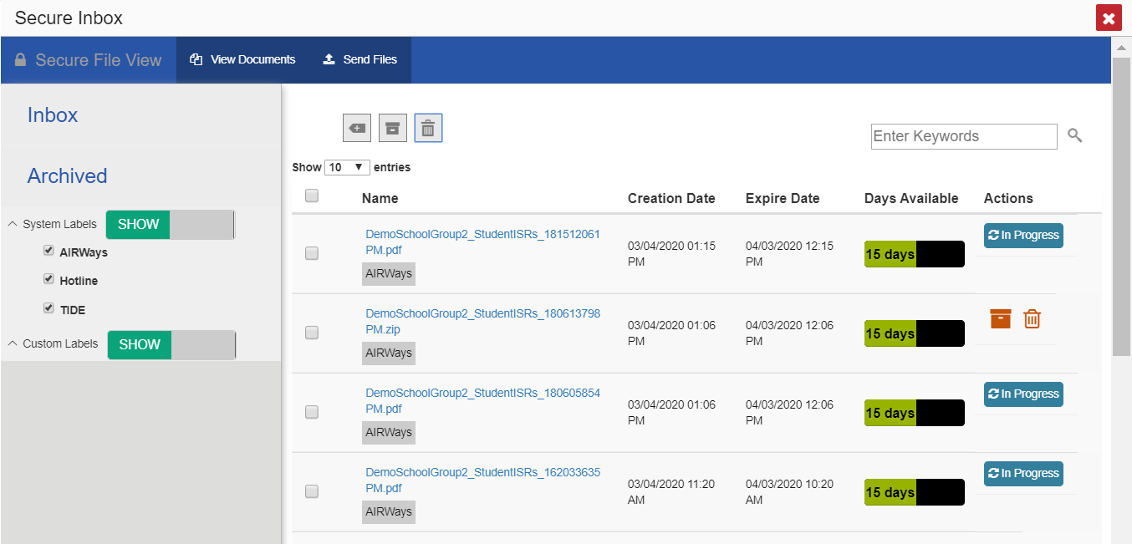
File Name
Notes:
The Inbox stores any reports you generate using the Student Results Generator tool. Click the name of a file to download it. To learn more about the features of the Inbox consult the appendix section of the Centralized Reporting System User Guide or view the training module How to Print and Export Data You Can See in Your Reports.

Slide 12
Centralized Reporting System Training Module Series
1. How to Print ISRs and Student Data Files
2. How to Print and Export Data You Can See in Your Reports
3. How to Use the Roster Manager to Add, Modify, and Upload Rosters
4. How to Analyze Item-Level Reports
5. How to Hand-Score Unscored Items and Modify Machine Scores
Notes:
Thank you for viewing this training module on printing Individual Student Reports and Student Data Files. More training modules are posted on the Aloha HSAP Portal. You may also consult the Centralized Reporting System User Guide for more information on these functions.

