Slide 1
Test Information Distribution Engine (TIDE)
Training Module
Notes:
Welcome to the online training module for the Test Information Distribution Engine, also known as TIDE. This training module includes many examples of TIDE’s features. The TIDE User Guide on alohahsap.org has additional information about features in TIDE.

Slide 2
Objectives
Preparing for Testing
Activating your new TIDE account and logging in to TIDE
Navigating the TIDE interface
Understanding account permissions
Managing user accounts
Managing student information and test settings
Administering Tests
Managing testing incidents
Monitoring test progress
After Testing
Managing non-participation codes
Notes:
This presentation will address numerous topics in TIDE, including tasks that typically take place when preparing for testing, during test administration, and after testing has concluded.

Slide 3
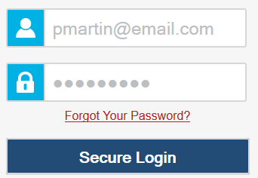
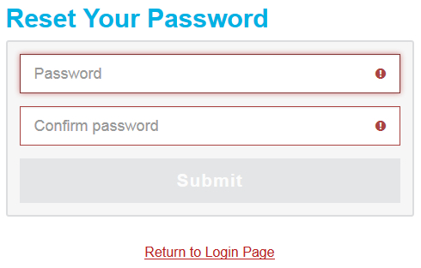
Activating a TIDE Account
Notes:
When you are initially added to TIDE, you’ll receive a TIDE activation email. This email contains your user role an activation link, and a second link to request a new activation email. The activation link is only valid for 15 minutes. After that time, the activation link will expire, and you will need to click the second link to request a new activation email.
When you click the activation link, the Reset Password page will appear, where you can create a password that you will use to access TIDE and other AIR systems. In the Password and Confirm Password fields, type a password for your account. Passwords have a length requirement and must include different character types; see your TIDE User Guide for details.
After entering your new password, click Submit. Return to the Login Page and log in using your email and new password. When you log in, a form for adding a security question will appear. Select a security question and enter an answer. You will be required to add three security questions in order to proceed. You’ll need this information in order to reset a forgotten password.
Please note that if an account is created for an incorrect email address, it will need to be deleted, and a new account created for the user.

Slide 4
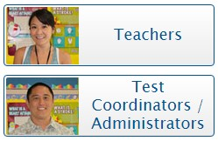
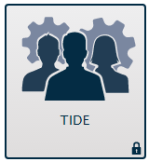
Logging in to TIDE
4
Notes:
To log in to TIDE, go to your portal. Click the appropriate user role or assessment card. On the next page, click the TIDE system card. Enter the username and password you created when activating your account. Then click Secure Login to go to the TIDE home page.

Slide 5
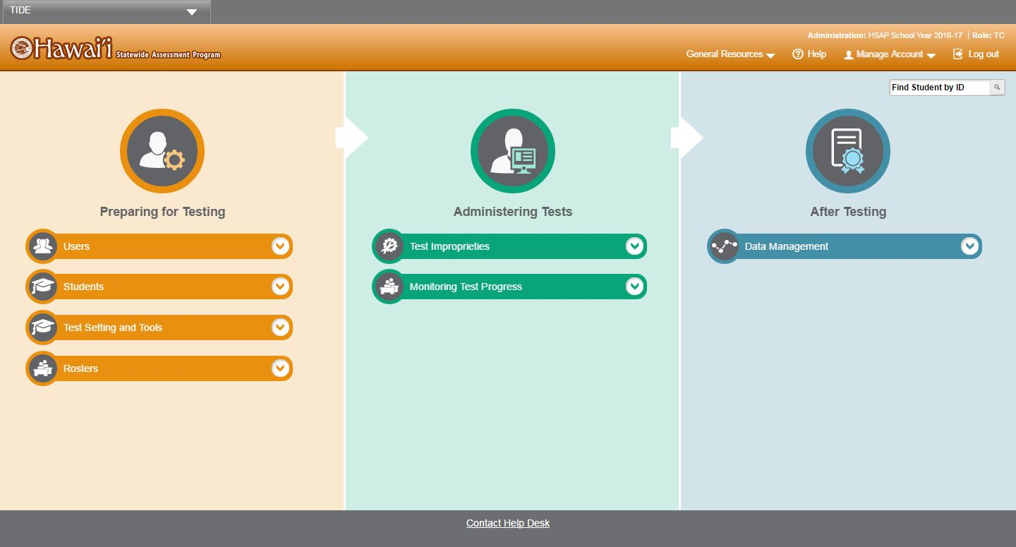
TIDE Home Page
Notes:
The TIDE home page appears after you log in. The home page is designed to reflect the stages of the testing process as directly and simply as possible. Each of TIDE’s three sections list menus for the tasks available in that section. For example, the Users menu contains options for adding users, viewing/editing/exporting users, and uploading users. To expand a task menu and view its set of related tasks, click the down arrow on the end of that menu. To perform a task, click the name of that task listed in the menu.

Slide 6
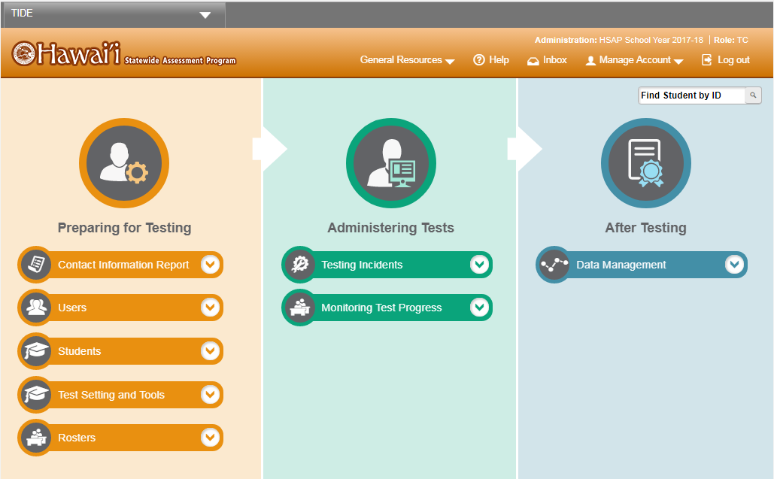
TIDE Tasks: Preparing for Testing
Notes:
Tasks in the Preparing for Testing section are typically performed before testing begins. This category includes tasks for managing records for users, students, test settings, and rosters.
TIDE can also group students into rosters. A roster is a collection of students sharing a similar characteristic who are assigned to a specific teacher. Rosters typically represent classrooms, but can also be used to group students with special needs or students participating in particular activities or programs. Once scores are calculated, users can visualize how a roster of students performed as a group.

Slide 7
TIDE Tasks: Administering Tests
Notes:
Tasks in the Administering Tests section are typically performed during the administration window.
Test administrators may use TIDE to invalidate a test, reset a test, or reopen a test.
In this section you may also monitor test progress and generate test participation reports.

Slide 8
TIDE Tasks: After Testing
Notes:
In the After Testing section, you can perform data cleanup operations, such as entering codes to explain student non-participation.

Slide 9
TIDE Banner
Notes:
A banner appears at the top of each TIDE page showing the current test administration and your current user role. On the left there is a drop-down list for accessing other AIR applications. You will also find a General Resources drop-down list, a Help button that displays the TIDE User Guide, an Inbox button, a Manage Account drop-down list where you may set up your account details, and a Logout button.

Slide 10
TIDE Banner: General Resources
Notes:
To download resources that may be needed for online testing, such as voice packs, forms, and secure materials used for hand scoring, click the General Resources drop-down list in the banner.

Slide 11
TIDE Banner: Inbox
Notes:
To access secure documents and student data files you have previously exported in TIDE, click the Inbox button in the banner. From the inbox you can download, archive, or delete previously exported files. For more information on this feature, see the TIDE User Guide.

Slide 12
TIDE Banner: Manage Account
Notes:
The Manage Account drop-down list allows you to change the role you are using in TIDE (if you have been assigned multiple roles), update your contact information, or reset your password.

Slide 13
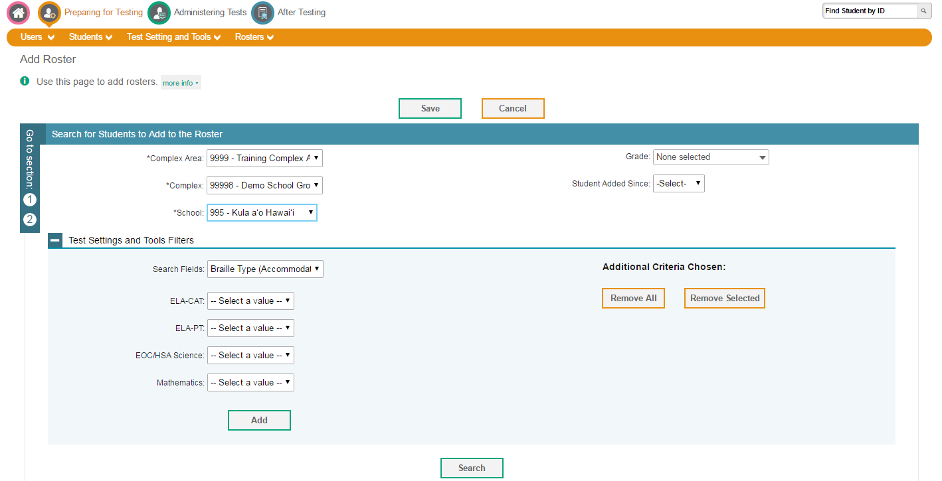
Navigation Toolbars
Notes:
When you enter any task page, a navigation toolbar appears at the top of the page. This toolbar allows you to access each task and action that was available on the dashboard. To view the task menus for a particular TIDE category, click the icon for that category above the toolbar.
Some pages in TIDE are divided into multiple panels. Each panel contains a group of related settings and fields that you can edit. You can click the minus sign in the upper-left corner of a panel to collapse it, or click the plus sign in a collapsed panel to expand it. Additionally, a floating Go To Section toolbar appears on the left side of pages with multiple panels. This toolbar includes a numbered button for each panel in the form. You can hover over a button to display the label of the associated panel and click the button to jump to that panel.

Slide 14
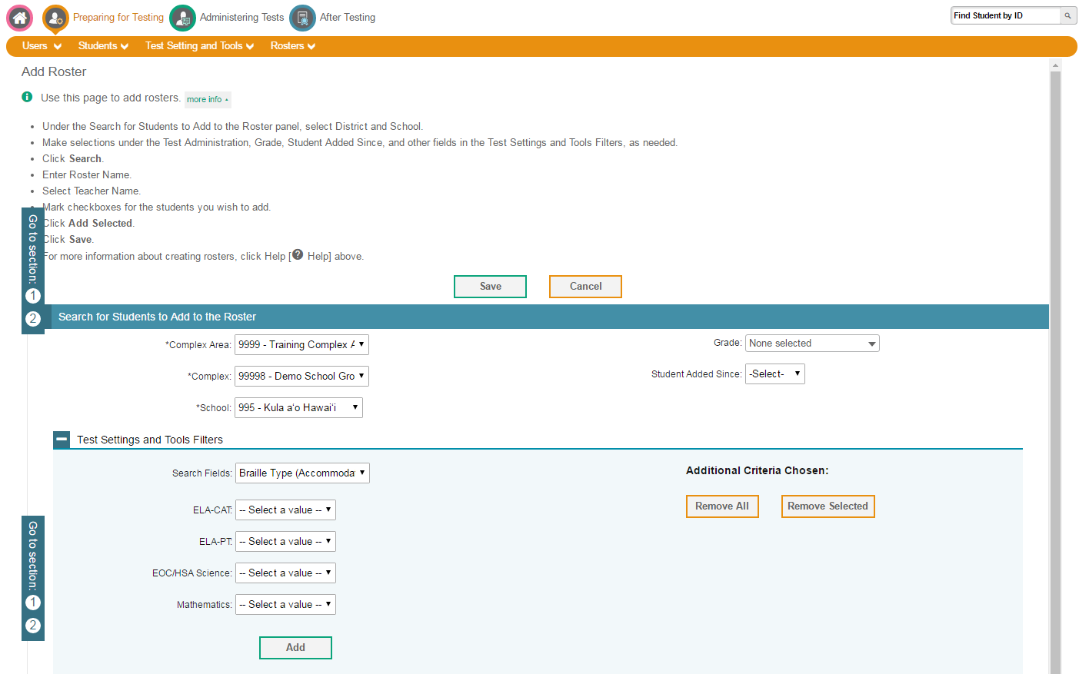
Help Text
Notes:
Most pages in TIDE have help text that describes the page and how to use it. To show or hide help text on a page, click the gray more info link under the page title.
To read more detailed information about the page that you are currently viewing, click the Help button in the banner.

Slide 15
Roles and Permissions
Task | Principal | Test Coordinator | Test Administrator
Viewing Students | ✓ | ✓ | ✓
Adding User Accounts | ✓ | ✓
Viewing and Editing User Details | ✓ | ✓
Creating Testing Incidents |  | ✓
Working with Rosters of Students | ✓ | ✓ | ✓
Generate Plan and Manage Testing Reports | ✓ | ✓ | ✓
For a detailed list of user roles and associated permissions, see the HSAP Systems User Roles and Access document.
Notes:
Your TIDE account is assigned a role, and that role has certain permissions. This table gives an example of the permissions associated with roles in Hawaii. For example, a Principal (PR) may be able to perform tasks that are not available to a Test Coordinator (TC) or Test Administrator (TA).
Permissions also limit the scope of data access. A complex-level user can work with data pertaining to that complex, and a school-level user can work with data pertaining to that school.

Slide 16
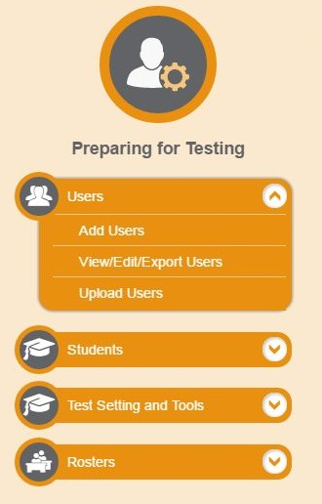
Users
Notes:
Before testing begins, and throughout the school year, TIDE is used to manage user accounts for TIDE itself, the TA Interface, the Online Reporting System (referred to as ORS), and other AIR systems. The Users task menu allows you to add users; view, edit, or export users; and upload users from an external file.

Slide 17
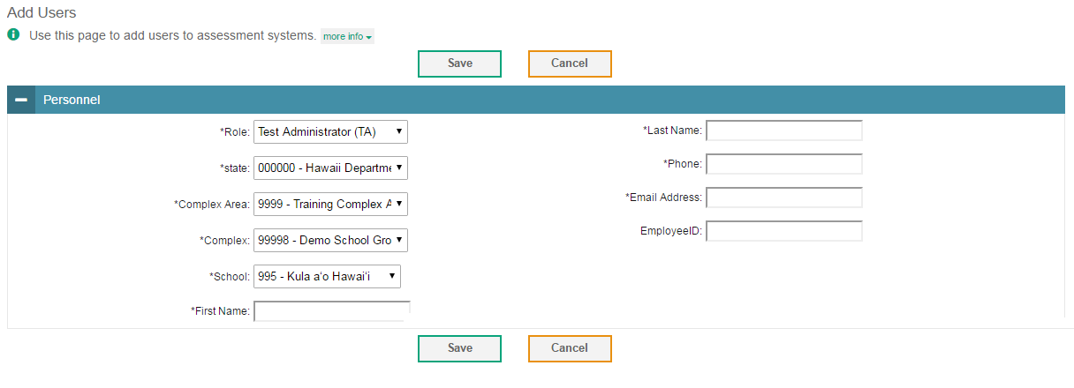
Add Users
Notes:
You can manually add new users from the Add User page. Fill out the information in the form, and click Save. The fields marked with an asterisk are mandatory. The new user’s email address will serve as their username when logging in to any AIR system.

Slide 18
Upload Users
Notes:
A second way to add new users to TIDE is to use the Upload Users page to compose an upload file in Excel or CSV format and then upload that file. This method is easiest if you have many new users and you don’t want to add them one at a time from the Add User page.
The easiest way to compose an upload file is to download an available template by clicking Download Templates. You may also access files that you have previously uploaded by clicking the blue plus sign to expand the Upload History panel.
Open the template, enter information for the users you wish to add using Excel or another program, and save the file in Excel or CSV format. Detailed instructions for composing an upload file can be found in the TIDE User Guide.
Once you return to TIDE, click Browse, and select the file you just saved.
Click Next to upload the file. A file preview page will appear, allowing you to verify you uploaded the correct file. If the preview is correct, click Next to continue.

Slide 19
Upload Users, continued
Notes:
Next, TIDE will validate the file and display any errors or warnings according to the legend on the page. Click the orange error icons and blue warning icons in the validation results to view the reason a field is invalid. If a record contains an error, that record will not be included in the upload. If a record contains a warning, that record will be uploaded, but the field with the warning will be invalid.
To complete the upload, click Continue with Upload.
To upload a different file, click Upload Revised File.
To cancel the upload, click Cancel.
If your file contains a large number of records, TIDE will process it offline and send you a confirmation email when complete. While TIDE is validating the file, do not press Cancel, as TIDE may have already started processing some of the records.
To view a PDF file listing the validation results for the upload file, click Download Validation Report in the upper-right corner.
When the upload is complete, a confirmation page will appear with a message that summarizes how many records were committed and how many were excluded.

Slide 20
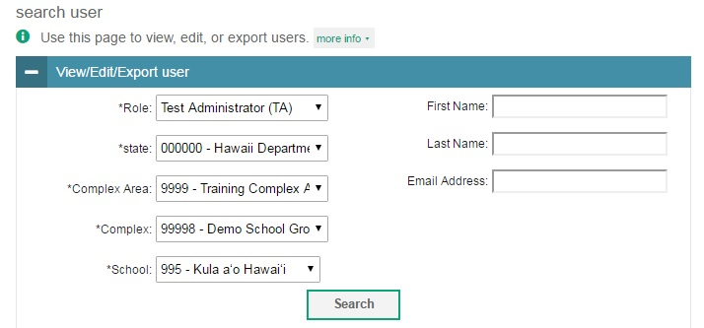
View/Edit/Export User
Notes:
The View/Edit/Export Users page includes a form for setting selection criteria to retrieve users. In this example, the required criteria are the user’s role, state, complex area, complex, and school. Other criteria are optional, such as the first or last name. Your particular version of TIDE may have other fields by which you can retrieve users. Click Search to continue. The search panel will automatically collapse, and your search results will appear below.

Slide 21
View/Edit/Export User Results
Notes:
After clicking Search, TIDE will display all the users satisfying the search criteria. If your user role permits, you can edit a user’s information by clicking the green pencil icon. Another page will appear where you can edit and save information.
To export user information, mark the checkboxes next to the users you wish to export and click the green export button above the search results.
To delete users from TIDE, mark the checkboxes next to the users you wish to delete and click the orange trash can button above the search results.
To make the search form re-appear and search for additional users, click the plus sign in the View/Edit/Export User panel, which appears as a blue bar.
For more detailed information on managing users, see your TIDE User Guide.

Slide 22
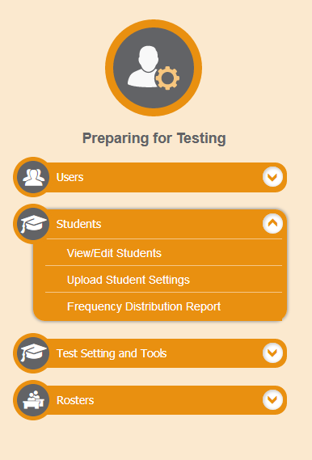
Students
Notes:
TIDE manages student information and keeps track of which assessments students are eligible to take. The Students task menu allows you to view, edit, or export students; upload student settings; and generate frequency distribution reports (depending on your user role).

Slide 23
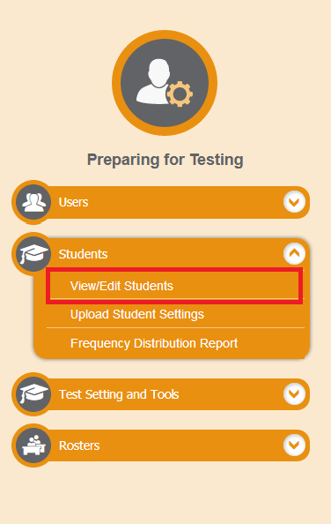
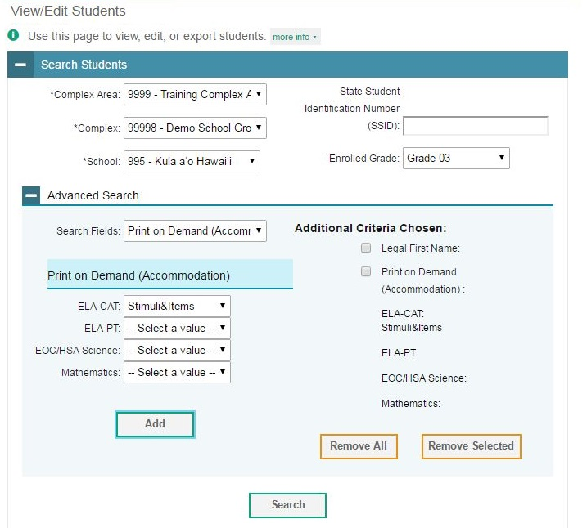
View/Edit Student
Notes:
The View/Edit Students page includes a form for setting selection criteria to retrieve students. Required criteria, such as the complex area, complex, and school in this example, are marked with asterisks. Other criteria are optional, such as the SSID and the enrolled grade.
You can further refine your criteria by entering additional demographic information or test settings in the Additional Search panel.
The students you can retrieve on this page are limited by your role’s scope. For example, if you are a complex-level user, you can retrieve students enrolled within your complex. If you are a school-level user, you can only retrieve students enrolled within your school.
Click Search to continue. The search panel will automatically collapse, and your search results will appear below.

Slide 24
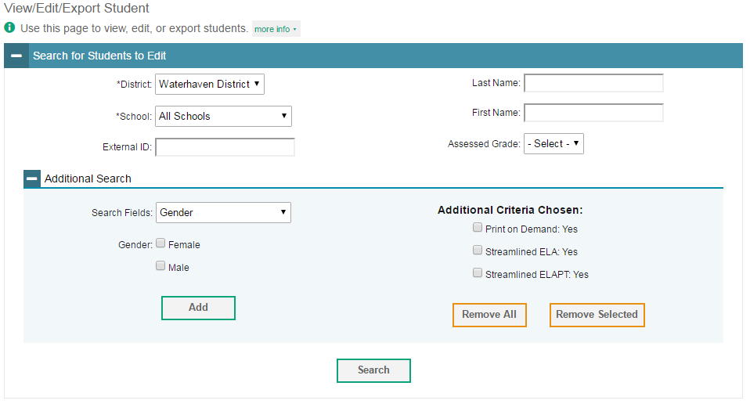
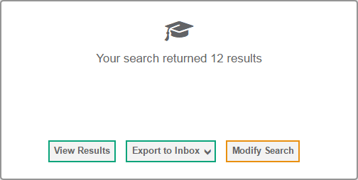
View/Edit Student, continued
Notes:
After you click Search, you’ll see a message asking whether you would like to view the results of your search, export the list of students to your inbox, or modify your search criteria and try again. If you choose to export the results to your inbox, you will receive an email when the file is ready for you to download.

Slide 25
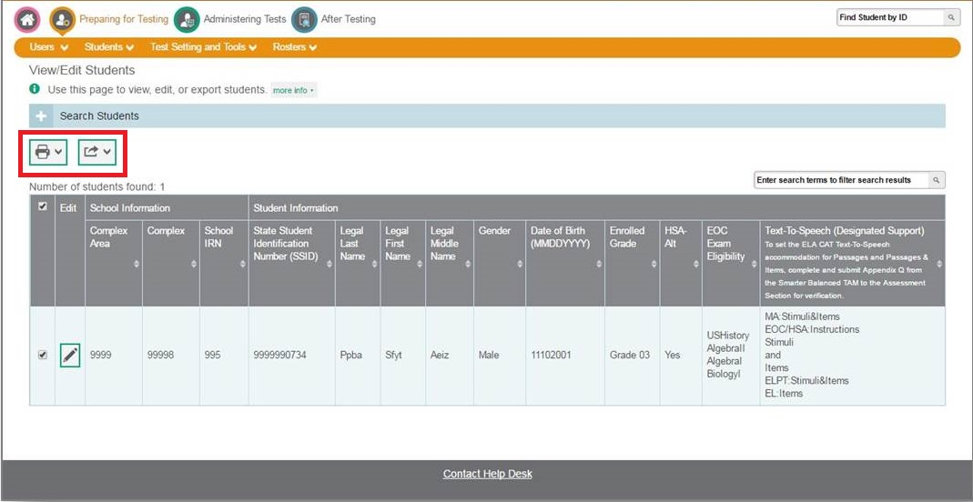
View/Edit Student Results
Notes:
When you click View Results, TIDE will display all the students satisfying the search criteria. Because not all columns can fit on the screen at once, you may need to click the blue arrow on the right side of the screen to scroll right and display more information. You can edit a student’s information, including test settings and accommodations, by clicking the green pencil icon.
Print or export student information from TIDE by selecting the desired students and clicking the Print or Export button above the search results.
To make the search form re-appear and search for additional students, click the plus sign in the Search for Students panel, which appears as a blue bar. For more detailed information on managing students, see your TIDE User Guide.

Slide 26
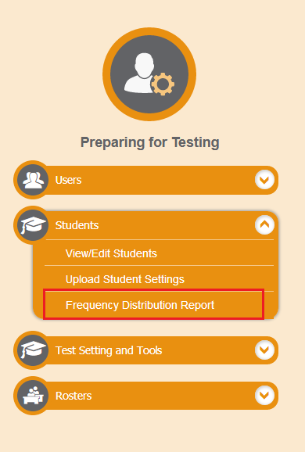
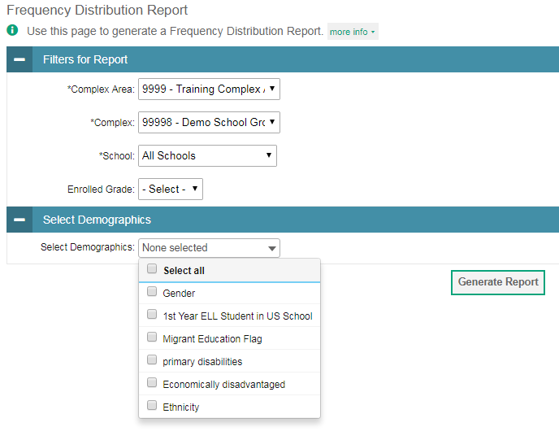
Frequency-Distribution Reports
Notes:
A frequency-distribution report pulls demographic and enrollment information based on the selected criteria.
To generate a report from the Frequency Distribution Report page, select a complex area, complex, and school from the drop-down lists. Mark checkboxes in the Select Demographics drop-down list to filter the report for additional demographics, as desired.
Click Generate Report to display a frequency distribution report using the selected criteria.

Slide 27
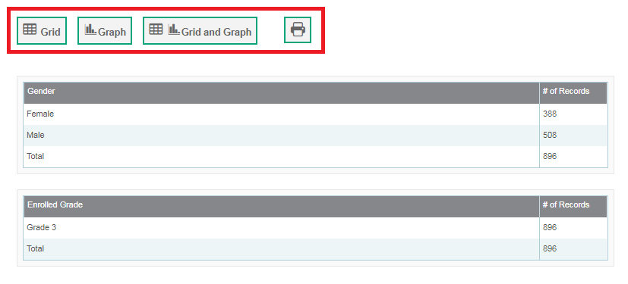
Frequency-Distribution Reports, continued
Notes:
TIDE will display the frequency-distribution report in grid format. This example shows a report by grade and gender.
To display the report in graphical format, click Graph.
To display the report in both tabular and graphical format, click Grid & Graph.
To revert back to the grid format, click Grid.
To download the report as a PDF, click the print icon.

Slide 28
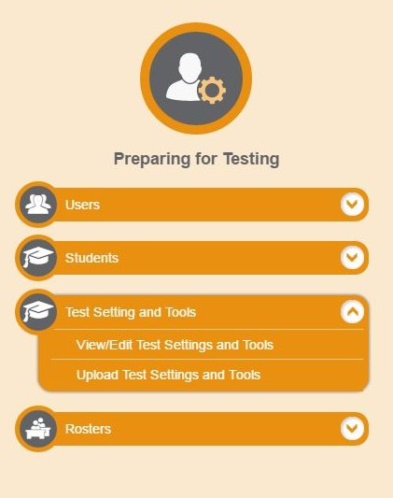
Test Settings and Tools
Notes:
TIDE keeps track of student test settings, such as font size and text-to-speech. The Test Settings and Tools task menu allows you to view, edit, export or upload test settings and tools.

Slide 29
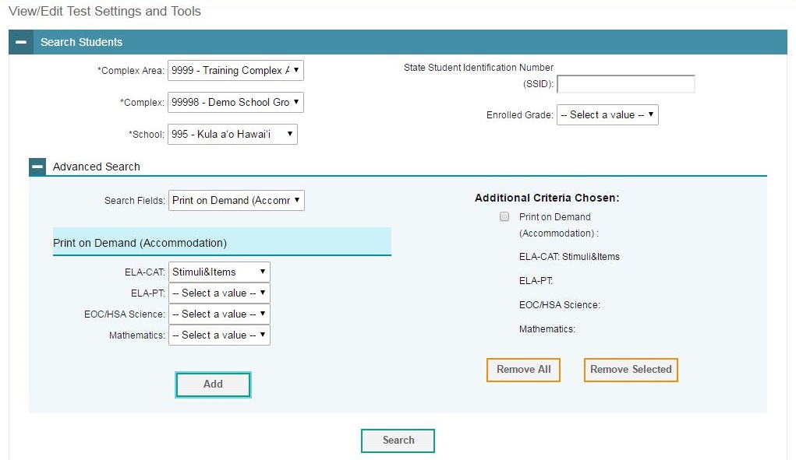
View/Edit Test Settings and Tools
Notes:
The View/Edit Test Settings and Tools page includes a form for setting selection criteria to retrieve a student’s test settings and tools. Required criteria, such as the complex area, complex, and school in this example, are marked with asterisks. Other criteria are optional, such as the SSID and the student’s first or last name.
You can further refine your criteria by entering additional demographic information or test settings in the Advanced Search panel, if it is available.
The students you can retrieve on this page are limited by your role’s scope. For example, if you are a complex-level user, you can retrieve settings for those students enrolled within your complex. If you are a school-level user, you can only retrieve settings for those students enrolled within your school.
Click Search to continue. You’ll see a message asking whether you would like to view the results of your search, export the list of students to your inbox, or modify your search criteria and try again. If you choose to export the results to your inbox, you will receive an email when the file is ready for you to download.

Slide 30
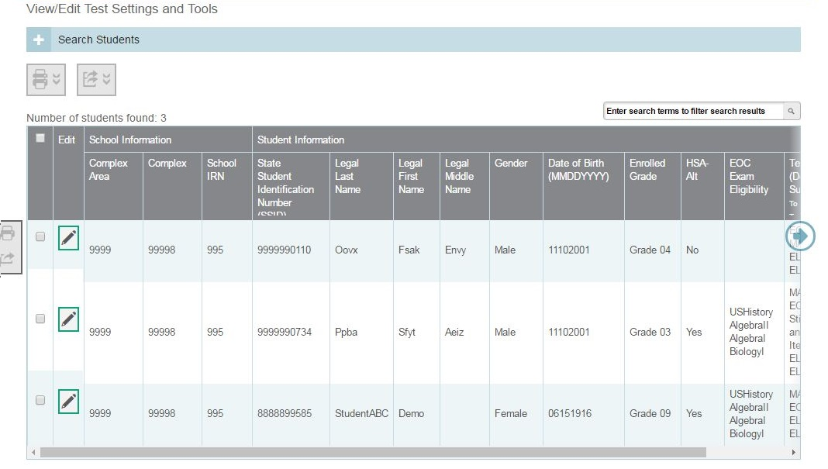
View/Edit Test Settings and Tools Results
Notes:
When you click View Results, TIDE will display all the students satisfying the search criteria. If all columns cannot fit on the screen at once, you can click the blue arrow on the right side of the screen to scroll right and display more information. You can edit a student’s test settings and accommodations, by clicking the green pencil icon.
To make the search form re-appear and search for additional students, click the plus sign in the Search Students panel, which appears as a blue bar. For more detailed information on managing student test settings and tools, see your TIDE User Guide.

Slide 31
View/Edit Test Settings and Tools Results, continued
Notes:
Print or export student information from TIDE by selecting the desired students and clicking the Print or Export button above the search results.

Slide 32
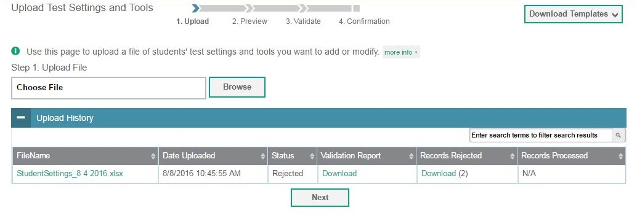
Upload Test Settings and Tools
Notes:
A second way to edit test settings and tools in TIDE is to use the Upload Test Settings and Tools page to compose an upload file in Excel or CSV format and then upload that file. This task is performed by following the same steps you would use to upload new users.

Slide 33
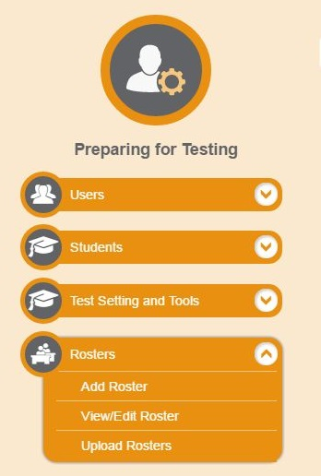
Rosters
Notes:
The Rosters task menu allows you to add rosters; view, edit, or export rosters; and upload rosters from an external file.
Once test scores are calculated, roster information is used to generate reports of how students in the roster performed as a group.

Slide 34
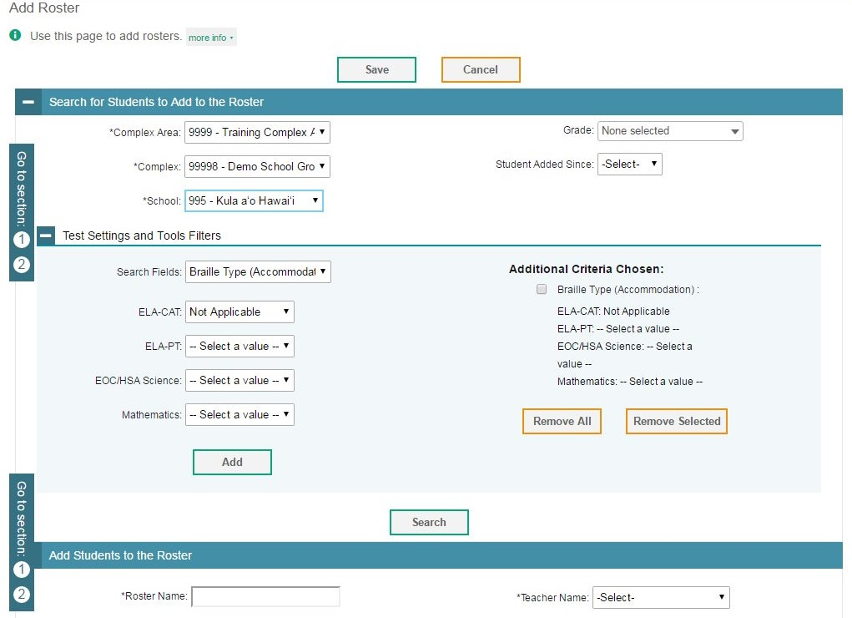
Add Roster
Notes:
You can manually create a roster on the Add Roster page. To add a new roster, select the complex area, complex, and school to which the roster belongs. Enter a roster name and select the name of the teacher who should be associated with the roster.
In the Test Settings and Tools Filters panel, refine the list of available students by selecting additional criteria from the drop-down lists and checkboxes. Then click Search Students.

Slide 35
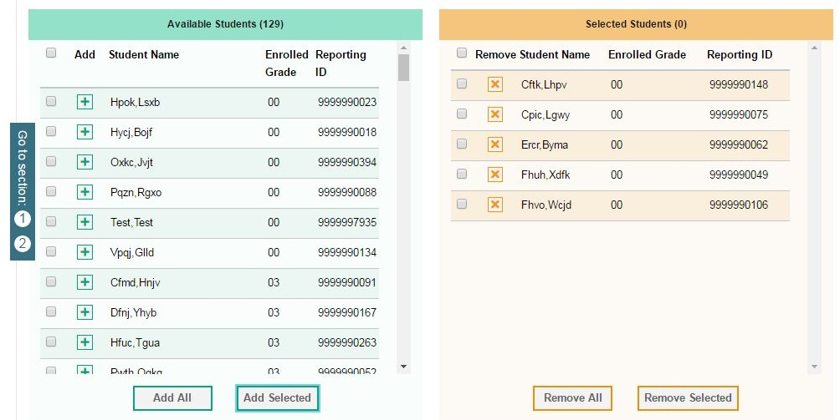
Add Roster, continued
Notes:
In the Add Students to the Roster section, the students in the left column are available to be added to the roster, and students in the right column are currently in the roster.
To add a single student to the roster, click the green plus sign next to a student in the left column. You can add multiple students to the roster by marking checkboxes next to the students you want to add, and then clicking Add Selected. Add all available students to the roster by clicking Add All.
To remove a single student from the roster, click the orange X next to a student in the right column. You can remove multiple students from the roster by marking checkboxes next to the students you want to remove, and then clicking Remove Selected. Remove all students from the roster by clicking Remove All.

Slide 36
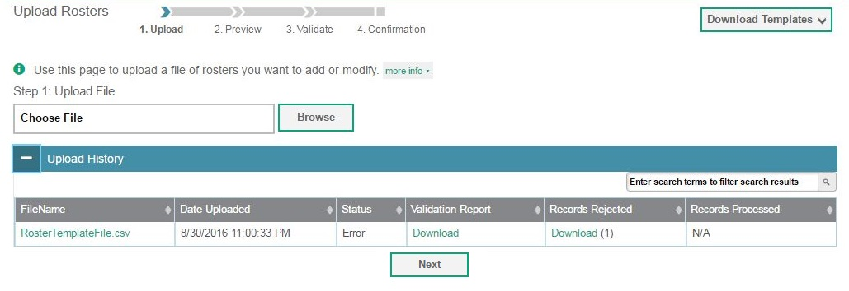
Upload Rosters
Notes:
A second way to add new rosters into TIDE is to use the Upload Rosters page to compose an upload file in Excel or CSV format and then upload that file.
This task is performed by following the same steps used to upload new users and students: download a template file, enter information into the template, save, and click the Browse button to locate the file and upload it in to TIDE.

Slide 37
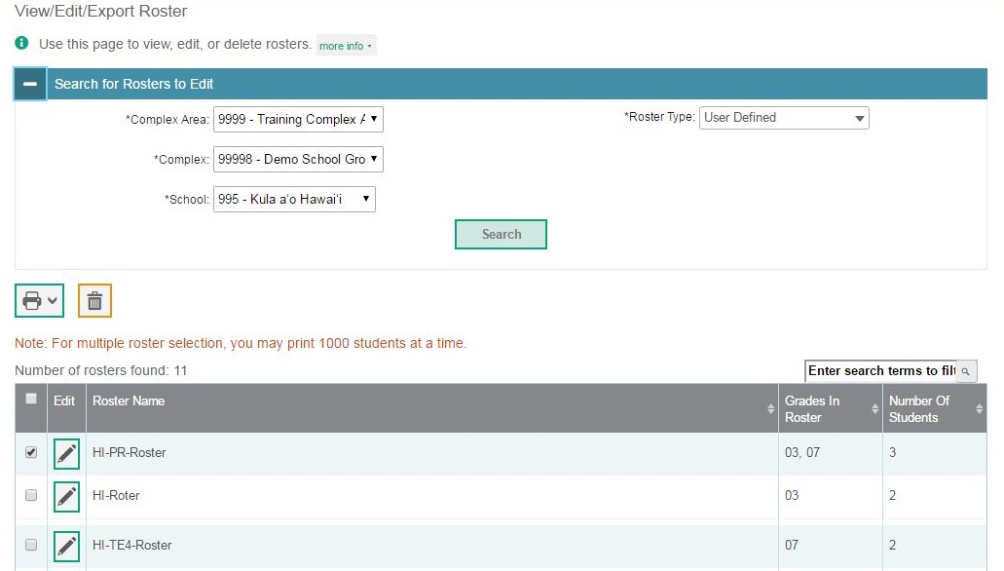
View/Edit Rosters
Notes:
The View/Edit Rosters page includes a form for setting selection criteria to retrieve rosters. In this example, the complex area, complex, and school criteria, and roster type are required. Click Search to display a list of rosters matching your criteria.
Print or delete rosters from TIDE by selecting the desired rosters and clicking the Print or Delete button above the search results.
Click the pencil icon next to a roster to view or edit its details. The View/Edit Roster form will appear. This form is similar to the form used to add rosters, and you may edit the roster name, teacher name, and students in the roster in the same way that you would for a new roster.

Slide 38
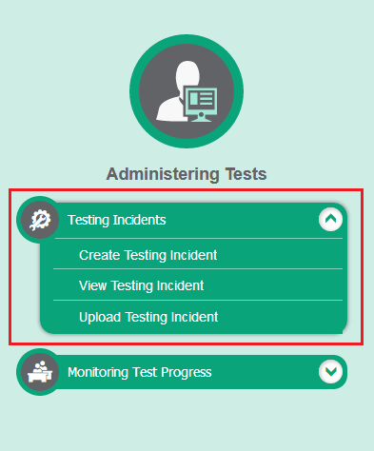
Testing Incidents
Notes:
In the Administering Tests section of the TIDE dashboard, the Testing Incidents task menu allows you to view pending testing incidents; create new testing incidents; and upload testing incidents.
In the normal flow of a test opportunity, a student takes the test in the Test Delivery System and then submits it. Next, the Test Delivery System forwards the test for scoring, and the Online Reporting System reports the test scores.
Testing Incidents are a way of interrupting this normal flow. Reasons for testing incidents can vary. For example, a student may need to retake a test or have another test opportunity. A Test Administrator may need to invalidate a test because of a hardware malfunction or an impropriety.
For information about testing incident policies and procedures, please consult the Test Administration Manual.

Slide 39
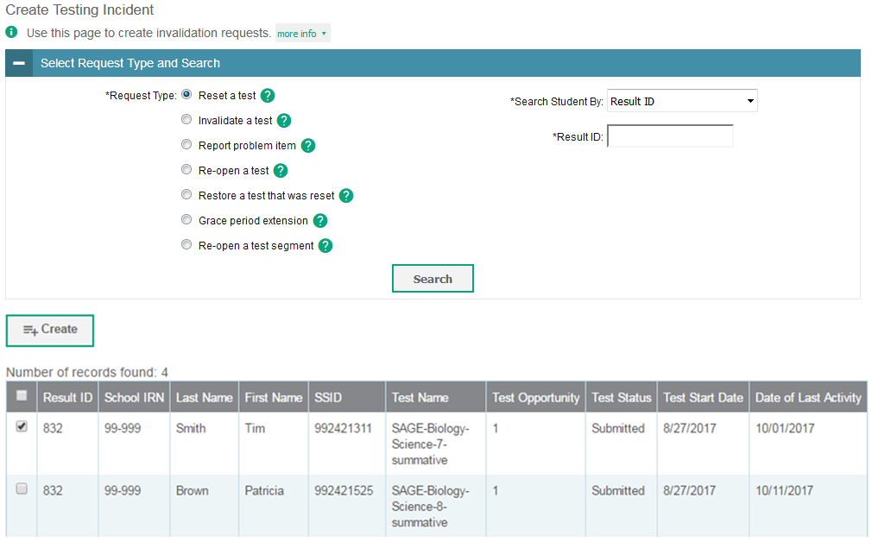
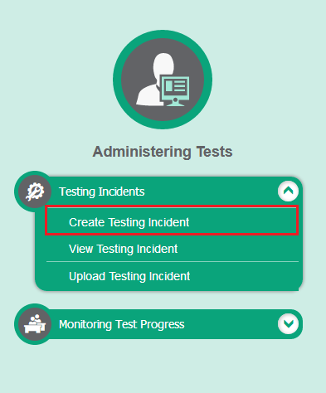
Create Testing Incidents
Notes:
The Create Testing Incidents page is where you create a testing incident for a test.
The first step is to select the type of testing incident you want to create. The TIDE User Guide lists the available testing incident types and explains the implications of each.
Next, search for the test result for which you wish to create an appeal. From the drop-down lists and in the text field, enter your search criteria and click Search. TIDE will display the search results below.
Mark the checkbox next to each test result for which you wish to create a testing incident, and click Create. A window will pop up asking you to enter a reason for the testing incident. To create the testing incident, enter a reason and click Submit.

Slide 40
Status of Testing Incidents
Appeal Status | Description of Status
Error Occurred | An error occurred while the testing incident was being processed.
Item Information Sent | Information regarding a Report Problem with Item testing incident was sent to the designated recipients.
Pending Approval | Testing incident is pending approval.
Processed | Testing incident was successfully processed and the test opportunity has been updated.
Rejected | Another user rejected the testing incident.
Rejected by System | Test Delivery System was unable to process the testing incident.
Requires Resubmission | Testing incident must be resubmitted.
Retracted | Originator retracted the testing incident.
Submitted for Processing | Testing incident submitted to Test Delivery System for processing.
Notes:
After a testing incident is created, its status can change throughout its life cycle. This table describes the possible statuses a testing incident can have.

Slide 41
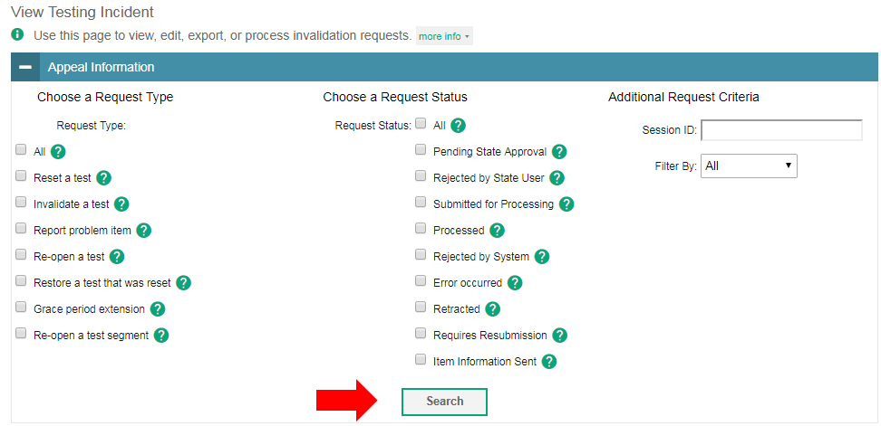
View Testing Incidents
Notes:
You can review submitted testing incidents from the View Testing Incident page. Select a testing incident type and status and enter additional search criteria as desired. Click Search to display testing incidents matching your criteria.

Slide 42
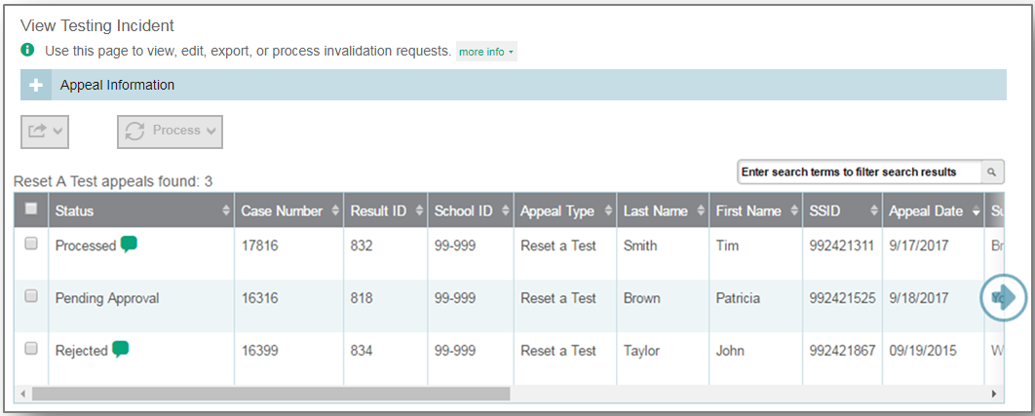
View Testing Incidents Results
Notes:
When you click Search, the search panel will automatically collapse, and your search results will appear below.
To view the approval and processing status of a testing incident, click the green comment icon in the Status column.

Slide 43
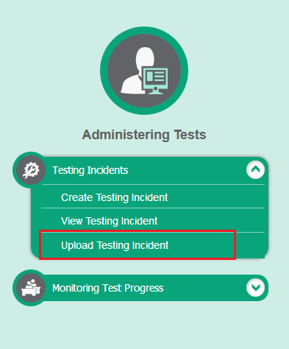
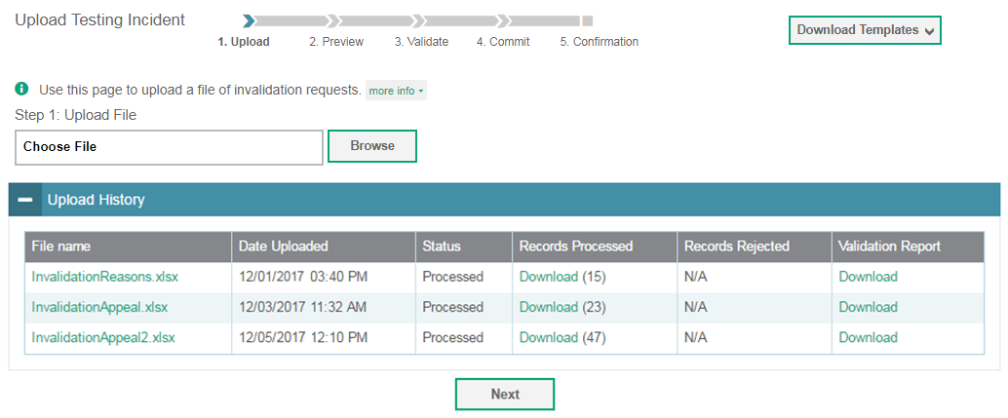
Upload Testing Incidents
Notes:
A second way to create new testing incidents in TIDE is to use the Upload Testing Incidents page to compose an upload file in Excel or CSV format and then upload that file. This task is performed by following the same steps used to upload new users and students.

Slide 44
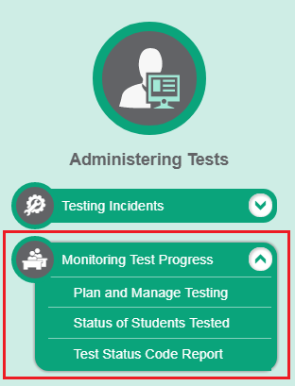
Monitoring Test Progress
Notes:
The tasks available in the Monitoring Test Progress task menu allow you to generate various reports that provide information about a test administration's progress.
Several types of participation reports are available:
The Plan and Manage Testing Report details all of a student’s test opportunities and the status of those test opportunities.
The Status of Students Tested Report summarizes the number and percentage of students who have started or completed a test.
And the Test Status Code Report displays all the non-participation codes for a test administration.

Slide 45
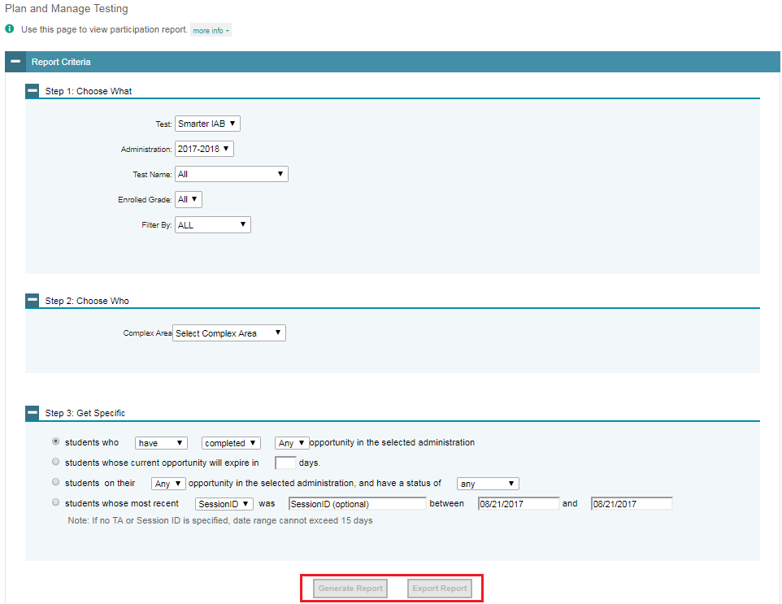
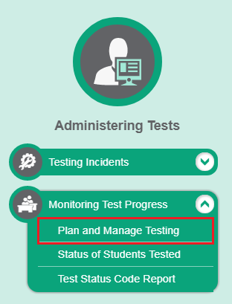
Plan and Manage Testing
Notes:
Plan and Manage Testing reports detail all of a student’s test opportunities and the status of each test opportunity. Because the report lists testing opportunities, a student can appear more than once on the report.
To generate a report from the Plan and Manage Testing page, first go to the Step 1: Choose What panel and select a test and administration. Optionally, you may also filter by test name, enrolled grade, or test settings.
Next, in the Step 2: Choose Who panel, select a complex area, complex, and school, if applicable. Optionally, you may also choose a teacher from the Teacher drop-down list.
Finally, in the Step 3: Get Specific panel, choose one of the available options and select parameters for that option.
Click Generate Report to view your Plan and Manage Testing report, or click Export Report to open the report in Excel.

Slide 46
Plan and Manage Testing Results
Notes:
Clicking Generate Report will display the report and collapse the Report Criteria panel. Because not all columns can fit on the screen at once, you may need to click the blue arrow on the right side of the screen to scroll right and display more information.

Slide 47
Plan and Manage Testing Examples
Which students have not yet tested?
Which students have paused tests?
Did all the students in a test session submit their tests?
Notes:
This slide illustrates some common questions that can be answered using the options available in the Step 3: Get Specific panel.
To find students who have not yet tested, select the first radio button and search for students who have completed their first opportunity in the selected administration.
To find students who have paused tests, select the second radio button and search for students on their first opportunity in the selected administration with a status of paused.
To find out if all students in a test session submitted their tests, select the third radio button and search for students by test session ID between the dates when the test session took place.

Slide 48
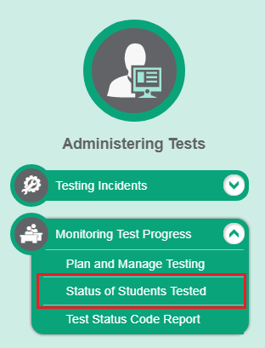
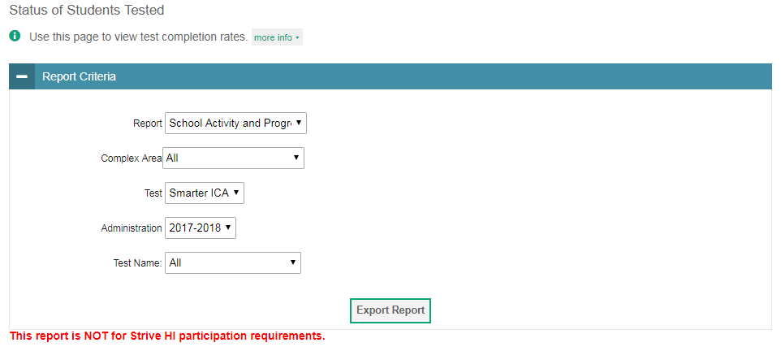
Status of Students Tested
Notes:
The Status of Students Tested report summarizes the number and percentage of students who have started or completed a test.
To download a report from the Status of Students Tested page, choose whether to generate a State, Complex Area, Complex, or School report from the Report drop-down list. Select a complex area, complex, and school from the corresponding drop-down lists, if available. Finally, select a test name and administration.
To download the report as an Excel spreadsheet, click Export Report.

Slide 49
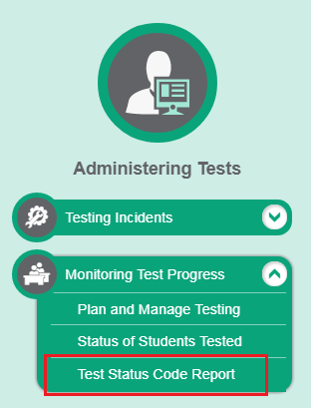
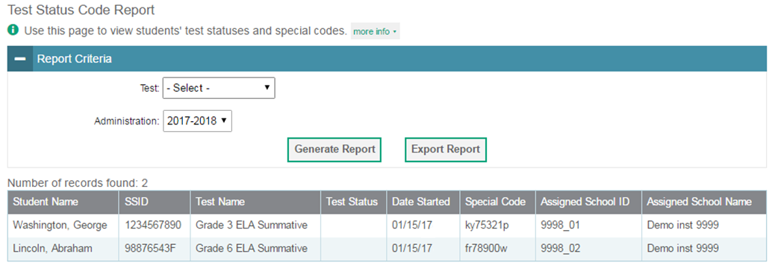
Test Status Code Report
Notes:
If students do not start or complete tests to which they are assigned, school officials assign non-participation codes to those tests indicating why students did not start or complete the test. These codes are referred to as reasons for non-participation or special codes. For information on reasons for non-participation policies and procedures, please consult the Test Administration Manual.
The Test Status Code report displays all the non-participation codes for a test administration. To generate a report from the Test Status Code Report page, select a test and administration from the drop-down lists. To view the report on the page, click Generate Report. The report will appear below the Report Criteria panel. To open the report in Excel, click Export Report.

Slide 50
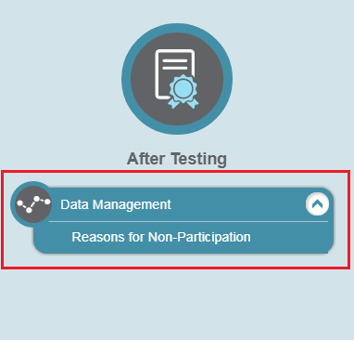
Data Management
Notes:
In the After Testing section of the TIDE dashboard, the Data Management task menu lets users enter non-participation codes to explain student non-participation.

Slide 51
Non-Participation Codes
A non-participation event occurs when a student does not take a test as scheduled.
You must assign a code to explain the non-participation for each test a student does not participate in.
Non-participation codes persist until they are changed.
Non-participation codes may also be referred to as special codes or reasons for non-participation.
Notes:
There are circumstances in which a student did not participate in an expected test or participated in a test but in a non-standard way. Examples could include a student inadvertently taking an incorrect test, a parent refusal, or the student having a medical emergency. In such instances, you need to assign a non-participation code to the student’s test so that the Online Reporting System can accurately explain the non-participation.
Please note that once you apply a non-participation code to a specific test for a student, that code persists until it is changed.
For a list of non-participation codes and their descriptions, please consult the TIDE User Guide.

Slide 52
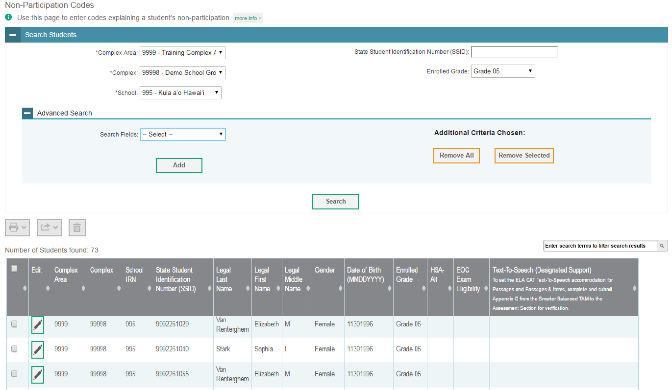
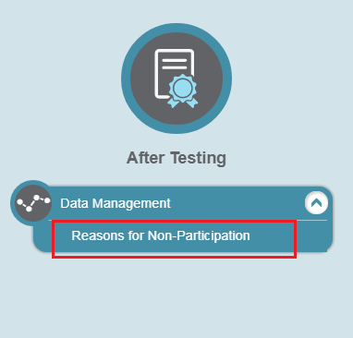
View Non-Participation Codes
Notes:
To view or edit a student’s non-participation codes from the Non-Participation Codes page, select a district and school from the drop-down lists, if available. You may enter a student’s first or last name, external ID, or assessed grade if desired. You can further refine your criteria by entering additional demographic information or test settings in the Additional Search panel.
Click Search to retrieve a list of students matching your selected criteria. If your user role permits, you can edit a student’s non-participation codes by clicking the green pencil icon.

Slide 53
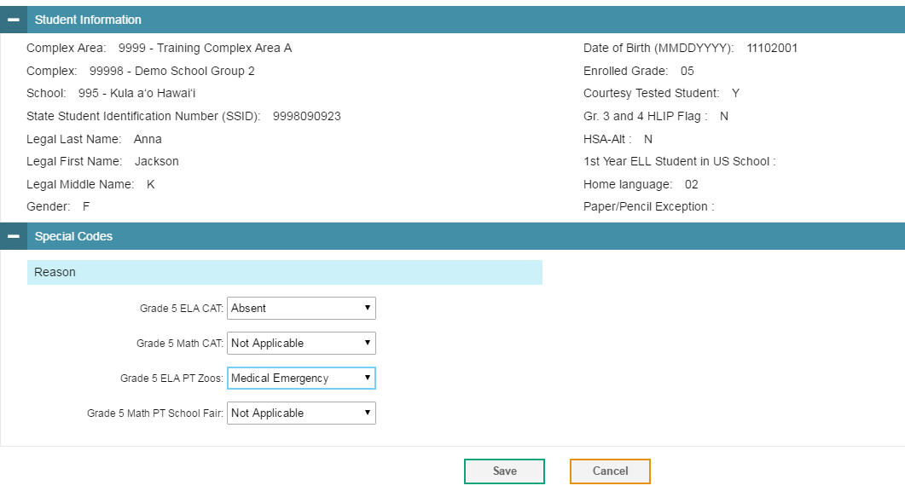
View Non-Participation Codes Results
Notes:
When you click the green pencil icon, a pop-up page will appear where you can edit and save the student’s non-participation codes. The Student Information panel provides the student’s demographic information. The student’s available tests and special codes are listed in the Special Codes panel.
To edit the student’s non-participation codes, from the drop-down lists in the Special Codes panel, select the special code for each available test, as required, and click Save.

Slide 54
Contact Your Help Desk
You can contact the Help Desk for assistance with any technical issues you encounter.
When contacting the Help Desk, please be ready to provide:
Any error messages that are appearing (including codes)
Your operating system and browser information
Your network configuration information
Your contact information for follow-up by phone or email
Any other relevant information, such as test names, student IDs, session IDs, and search criteria
For test administration or policy issues, please contact your school test coordinator.
Notes:
You can find the TIDE User Guide and other helpful resources on your state assessment portal. However, if you still require assistance with troubleshooting a technical issue, you may also contact your Help Desk. When contacting your Help Desk, please be ready to provide the following information:
Any error messages that are appearing (including codes)
Your operating system and browser information
Your network configuration information
Your contact information for follow-up by phone or email
Any other relevant information, such as test names, student IDs, session IDs, and search criteria
For questions about test administration or policy issues, please contact your school test coordinator.

Slide 55
Thank You!
Further Information
Visit
alohahsap.org
smarterbalanced.org
Call, fax, or email the American Institutes for Research HSAP Help Desk
Hours: 7:30 am to 4:00 p.m. HST, Monday-Friday (except holidays)
Phone: 1-866-648-3712
Fax: 1-877-231-7813
Email: HSAPHelpDesk@air.org
Notes:
Thank you for taking the time to view this training module. For additional information, refer to your TIDE User Guide located on www.alohahsap.org or contact the Help Desk.

