Slide 1
Student Interface for Online Testing
Training Module
Notes:
Welcome to the Student Interface for Online Testing training module. This presentation is designed to help Test Coordinators and Test Administrators (TAs) understand the interface that students use to take online tests.
Individual states’ systems may vary. Consult your state documentation for detailed information.

Slide 2
Objectives
After viewing this presentation, you should understand:
How students log in to the testing system and select a test
The layout of the test and functionality of test tools
How students navigate through the test
Please note: The navigation instructions that follow are from the viewpoint of a Windows PC user with a two-button mouse. Your steps may vary slightly depending upon the device and operating system you are using.
Notes:
After viewing this presentation, you should understand:
How students log in to the testing system and select a test
The layout of the test and functionality of test tools
How students navigate through the test
Please note, the navigation instructions that follow are from the viewpoint of a Windows PC user with a two-button mouse. Your steps may vary slightly depending upon the device and operating system you are using.

Slide 3
What Is the Secure Browser?
The Secure Browser is designed to ensure test security by prohibiting students from accessing any other programs or websites during testing.
AIR Secure Browser
If you have questions about installation of the Secure Browser, contact your Technology Coordinator.
Notes:
Students must use the secure browser to log in to the Student Interface. The secure browser is designed to ensure test security by prohibiting students from accessing any other programs or websites during testing. The most recent version of the secure browser can be found on AlohaHSAP.org.
Your school’s Technology Coordinator is responsible for ensuring that the secure browser has been correctly installed on all testing devices. If you have questions about installation of the secure browser, please contact your Technology Coordinator.

Slide 4
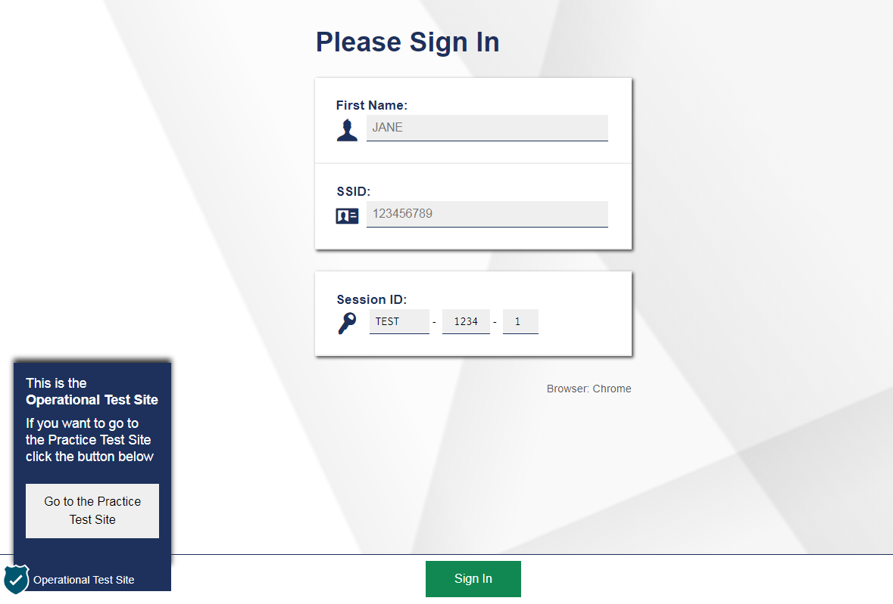
Secure Browser Login
Notes:
To log in to the online testing system, students must use the secure browser on a separate computer or device than the one used by the TA. Students must enter three pieces of identifying information: their legal first name as it appears in Test Information Distribution Engine (TIDE), their state-assigned student identifier (SSID), and the current session ID.
Schools may choose to make this information available on test tickets that can be printed out in advance. Test tickets should be treated as secure, confidential documents and collected after each test session and securely destroyed when no longer needed.
The session ID is generated when the Test Administrator creates the test session. It needs to be given to students by the TA when it is time for them to log in to the test. Session IDs should not be generated more than 20 minutes before students are ready to log in.
When entries are complete, students will click the Sign In button to log in to the test. You may assist students with logging in, if necessary.

Slide 5
Student Login Errors
Issue | Error Message | What to Do
Student first name and SSID do not exactly match what is in the system. | Please check that your information is entered correctly. If you need help, ask your Test Administrator. | Verify that the student has entered the correct first name and exact SSID. You may need to use the Student Lookup Tool, which is located in the Test Administrator Interface, to verify that the student is in the system.
Student enters the session ID incorrectly. | The session is not available for testing. | Verify that the student has entered the correct session ID with no extra spaces or characters.
Student enters a session ID for an incorrect or expired session. | Session has expired. | Ensure that the student enters the correct session ID for the current session. If this does not work, verify that your session is open using the Test Administrator interface.
One person (either the TA or the student) is using the Operational TA Live Site, and the other is using the Practice Site. | The session is not available for testing. | If taking a practice test, make sure that you and the student are both on the Practice Site. If taking an operational test, make sure that the student is using the Secure Browser and you are using the Operational TA Live Site.
Notes:
If a student is having difficulty logging in, an error message and code will display on the login screen. The most common errors occur when the student’s first name and SSID do not match what is in the system and when SSIDs are entered incorrectly. If the student receives an error message indicating that he or she has entered incorrect information in the first name or SSID fields, the TA should use the Student Lookup Tool in the TA Interface to verify the student’s information.
Another common error occurs when the student enters an incorrect session ID. If a student receives the message “The session is not available for testing,” verify that the session ID was entered correctly, with no extra spaces or characters. The session ID can be found in the TA Interface.
If a student receives the error message “Session has expired,” ensure that the student has entered the correct session ID for the current session. If the student has entered the session ID correctly, use the TA Interface to verify that your session is still open.
Finally, if administering a practice test, make sure that the TA and the student each use the appropriate practice and training test site. If administering an operational test, ensure that the TA is using the Operational TA Live Site and the student is using the Secure Browser.

Slide 6
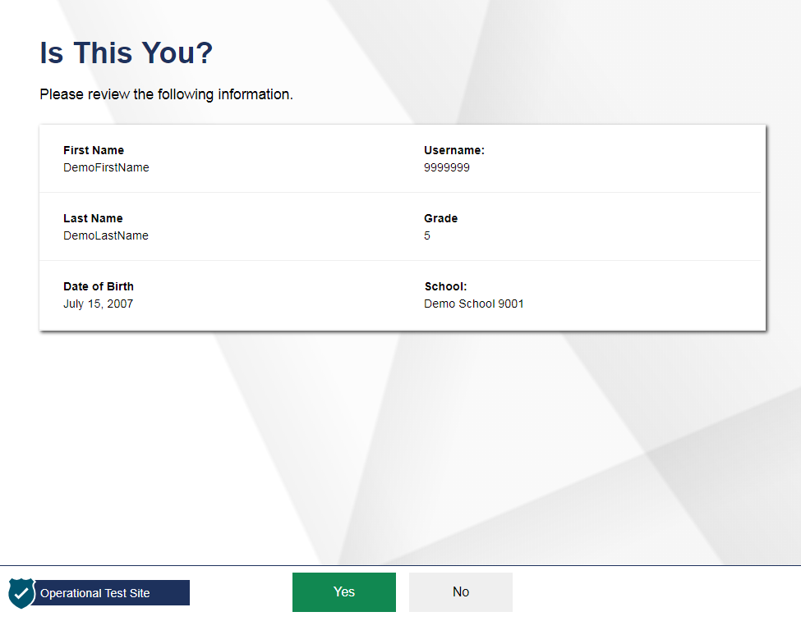
Student Verification
Notes:
After logging in, students need to complete a few more steps before they begin testing. Students will be asked to view and verify their personal information. If their information is correct, they should click Yes to proceed. If their information is incorrect, they should click No to return to the login page. You must then contact your School Test Coordinator to have the student’s information updated in the Test Information Distribution Engine (TIDE) before the student attempts to log in again.

Slide 7
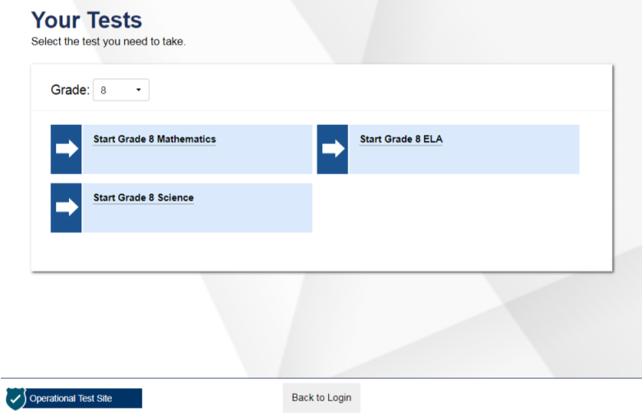
Student Test Selection
Notes:
On the “Your Tests” screen, students will see a list of their assigned tests for this test session. If the tests displayed are incorrect, or the expected test is not listed, students should click the Back to Login button to return to the login page, and consult the Test Administrator to resolve the issue. If there are no errors, students should select the correct test and wait for TA approval to proceed.

Slide 8
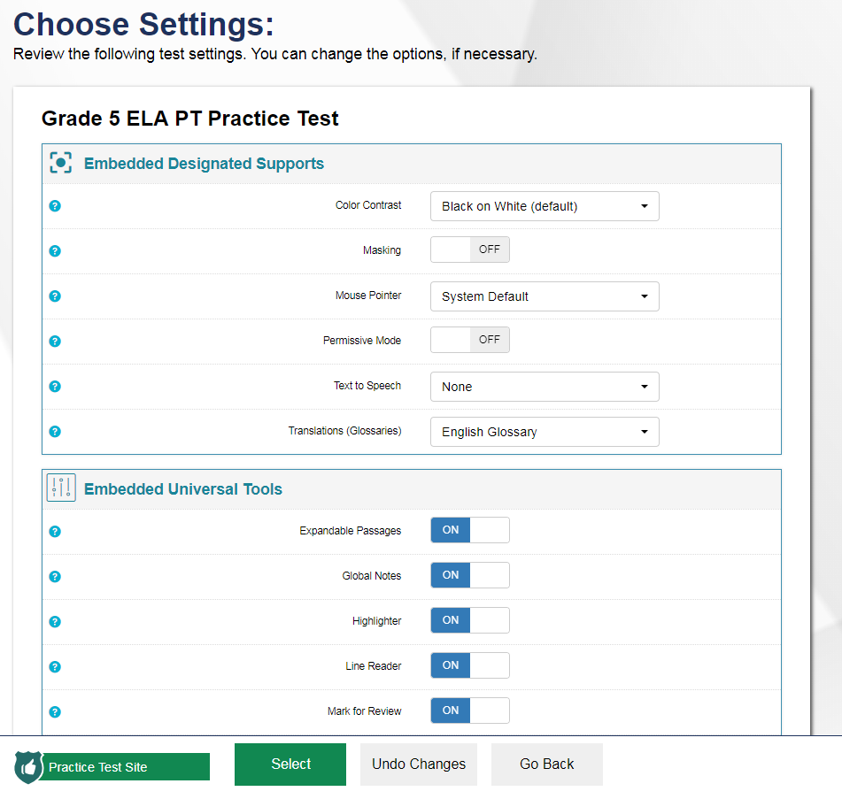
Verifying Test Information
Notes:
After the Test Administrator has approved students for a test session, students will see a screen titled “Choose Settings.” This screen displays the name of the test and any selected accessibility resources. If the information is correct, students should click Select. If any of the information is incorrect, they should click Go Back and then wait to be advised by the TA. Note that the actual settings students see may vary from what is shown on this slide. Be sure to refer to the scripts located in the Test Administration Manual (TAM) to guide your students through the login and confirmation process.
After verifying their test, students will proceed through one or more functionality checks to make sure that their testing device is functioning properly. The functionality checks that appear will depend on the test that the student is taking.

Slide 9
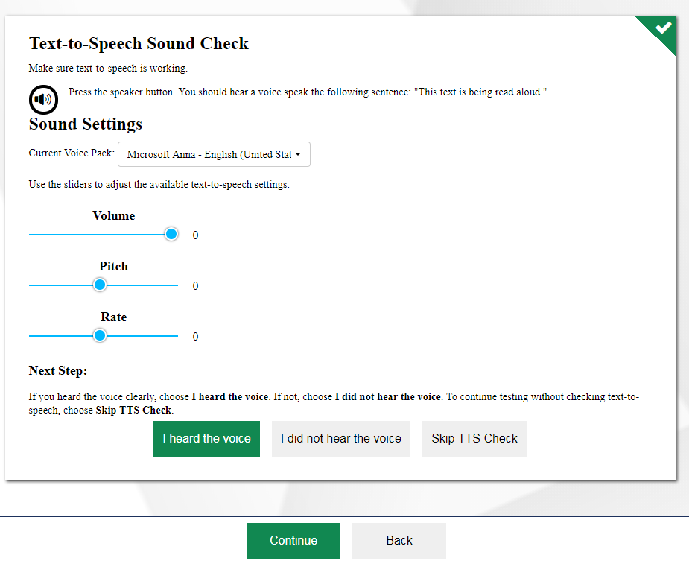
Audio/Video Checks
Notes:
Students with text-to-speech (TTS) enabled will be presented with a TTS Sound Check screen that verifies that text is being spoken correctly on their device. Students should press the speaker button to hear sample text being read aloud. If the voice is audible, students should click I heard the voice then Continue to proceed. If not, students may adjust their TTS settings using the sliders on this page and try again. If they still cannot hear the voice, they should log out of the Secure Browser and ask their TA for assistance with their headset and/or audio settings.

Slide 10
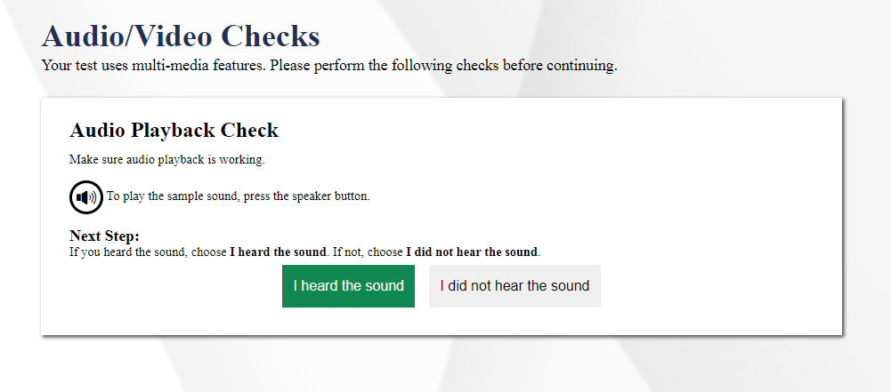
Audio Playback Check
Notes:
Be sure that all students taking ELA tests with listening items and students with Text-to-Speech have headphones. If students have selected a test requiring audio, students will see an “Audio Playback Check” panel on the Audio/Video Checks page. They will be prompted to click the sound icon and indicate whether the sound was audible by choosing either I heard the sound or I did not hear the sound.
If students click I heard the sound, they will proceed to the next audio/video check. If they click I did not hear the sound, they will receive a message advising them to tell the Test Administrator that they are having an audio problem. From there, they can click Try Again to listen to the sample audio again.

Slide 11
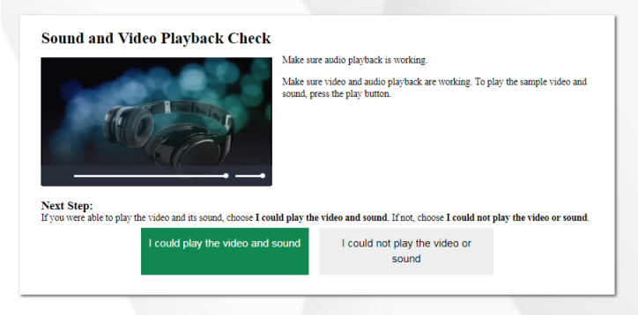
Sound and Video Playback Check
Notes:
Students taking tests with video content will be presented with a Sound and Video Playback Check panel. Students should click the play button to play the video and audio. If students can see the video and hear the audio, they should click I could play the video and sound to proceed. Otherwise, they should click I could not play the video or sound and ask their TA to help with troubleshooting the device and headphones. You may also move the student to another device with working audio and video.

Slide 12
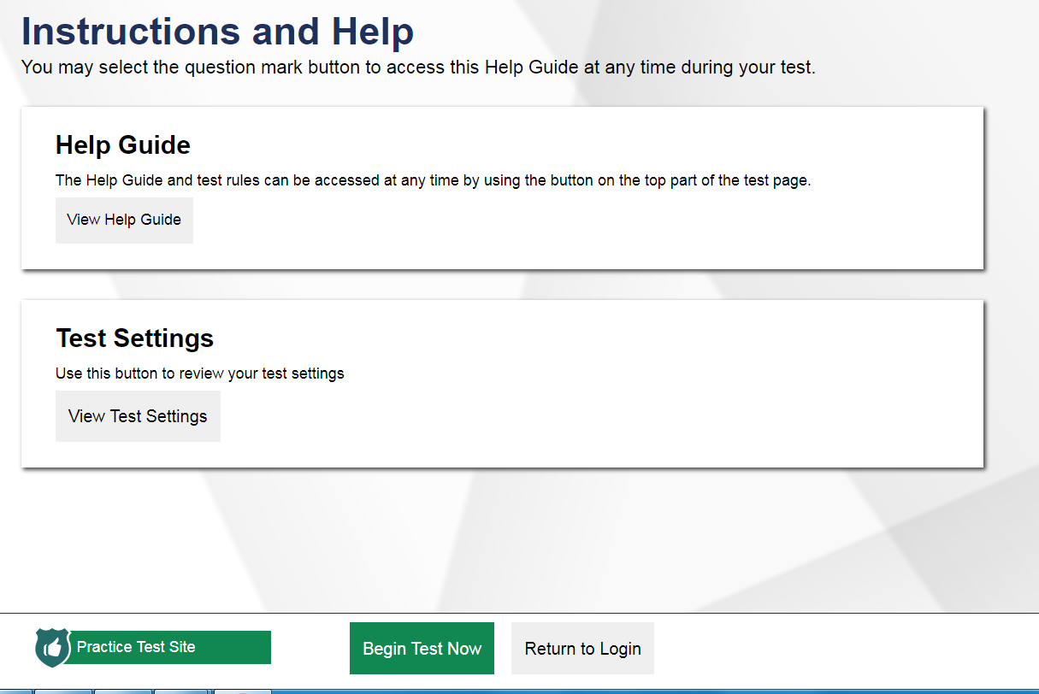
Instructions and Help Screen
Notes:
Next, students have the opportunity to review detailed information about the tools and navigation features they will use during testing from the Instructions and Help screen.
The Help Guide section contains an overview of the test site, test rules, and information on Text-to-Speech and Print on Demand features.
The Test Settings section allows students to view their current test settings.
When students click Begin Test Now, they will be presented with the first question of the test.

Slide 13
Accessibility Resources
http://www.smarterbalanced.org/assessments/accessibility-and-accommodations/
Notes:
The online tests offer several accessibility resources to help students test successfully, including universal tools, designated supports, and accommodations. Authorized users can use the Test Information Distribution Engine (TIDE) to manage accessibility resources for students. The next few slides will give an overview of accessibility resources as they impact the student’s testing experience. For more information on managing accessibility resources in TIDE, refer to the TIDE User Guide. For detailed information about individual accessibility resources, refer to the Usability, Accessibility and Accommodations Guidelines on the Smarter Balanced website at www.smarterbalanced.org.

Slide 14
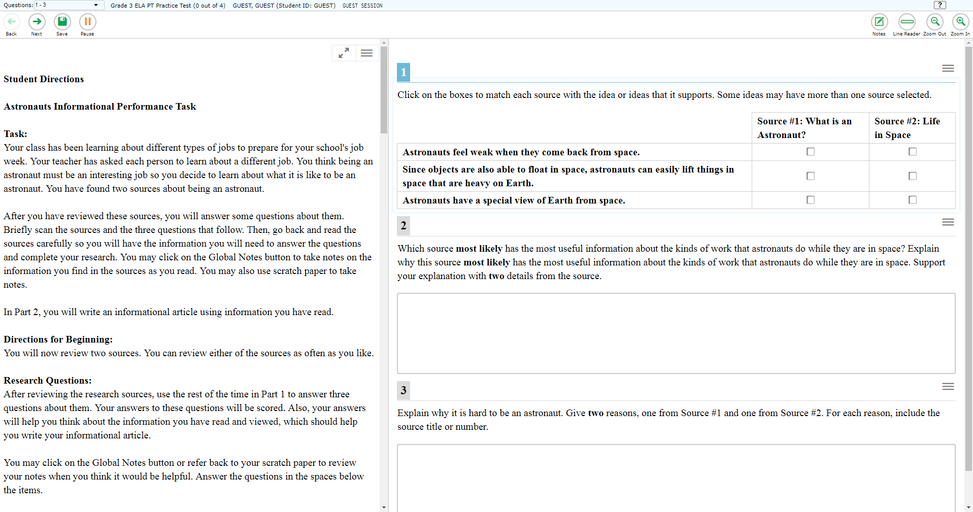
Test Interface
Notes:
Universal tools and other features are available for all students to use during testing. These tools and features will be discussed in detail on the following slides.

Slide 15
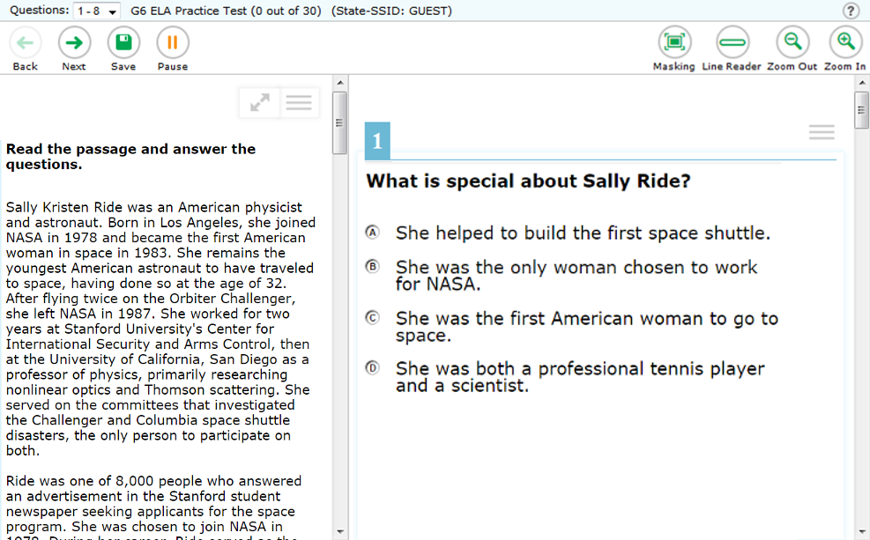
Global Menu
Navigation Buttons
Test Tools
Notes:
The global menu appears at the top of the Student Interface. The left side of the menu contains navigation buttons that students use to advance through the test:
All students can navigate between pages using the Back and Next arrow buttons. Students can also navigate between items using the Questions drop-down menu located above the navigation buttons.
The Save button ensures that a response is committed to the system. However, the Save button is not required to save an item. Other actions, such as moving forward to the next question, will also save the response.
The Pause button pauses a student’s test and logs the student out of the student interface. We will discuss how pausing works on the next slide.
The right side of the menu contains test tools that students may use during testing. Some test tools, such as the Zoom In and Zoom Out buttons, are universal tools available to all students. The Pause button pauses a student’s test and logs the student out of the Student Interface. We will discuss how pausing works on the next slide.
Other tools are designated supports or accommodations that must be set up in TIDE in order for students to use them.
The sample image on this slide is just one example of the test tools that may appear. For detailed information about individual accessibility resources, refer to the Usability, Accessibility, and Accommodations Guidelines on the Smarter Balanced website.

Slide 16
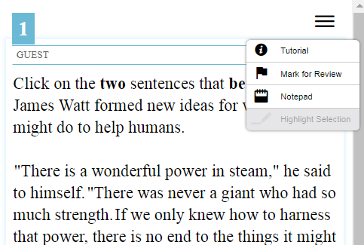
Context Menus
Context menus allow students to:
Mark items for review
View item tutorials
Send print requests to the TA
(if available)
Access additional features depending on test settings and item types
Notes:
Some test items and stimuli contain context menus. Students may use context menus to mark items for review, view item tutorials explaining how a particular item type works, send print requests to the TA (if test settings allow), and access additional test tools and features.

Slide 17
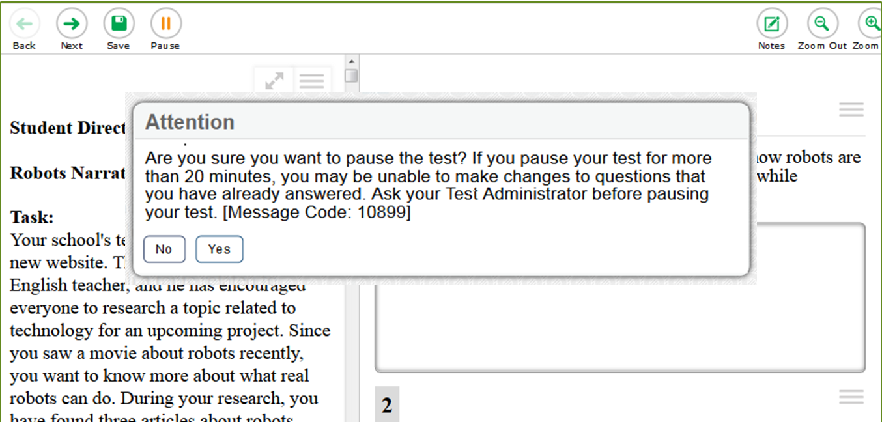
Test Pause
Notes:
You may allow a pause if students are taking a break from testing, or if they need to leave the room for any reason. Whether they have been instructed to do so or not, students have the ability to pause their test at any time by clicking the Pause button in the upper-left corner of the screen. When they do so, a pop-up message will appear, asking them to confirm that they want to pause the test. Students should click Yes to confirm the pause or No to resume testing. Limiting or restricting the number of items a student may answer in a test session constitutes a test security violation. Please refer to the Test Administration Manual (TAM) for guidelines on how many sessions each test should take to complete.

Slide 18
Test Pause Rules
For performance tasks and for computer adaptive tests (CATs) that have been paused for less than 20 minutes, students returning from a break in testing can revisit any items in the current test segment and change their answers if desired.
Students taking a CAT who have paused their tests for longer than 20 minutes may only return to the most recently visited page containing unanswered test items in the current test segment. They may change any answers present on this page but may not access any items on previous pages or in previous segments of the test.
If all items on the most recently visited page were answered prior to pausing, the student will resume the test on the next page with unanswered items and will not be allowed to access previous pages or segments of the test.
Notes:
Some rules apply when students pause their tests, depending upon the type of test and how long the pause lasts. For performance tasks and computer adaptive tests (CATs) that have been paused for less than 20 minutes, students returning from a break in testing can revisit any items in the current test segment and change their answers if desired.
Students taking a CAT who have paused their tests for longer than 20 minutes may only return to the most recently visited page containing unanswered test items in the current test segment. They may change any answers present on this page but may not access any items on previous pages. If all items on the most recently visited page were answered prior to pausing, the student will resume the test on the next page with unanswered items and will not be allowed to access previous pages or segments of the test.

Slide 19
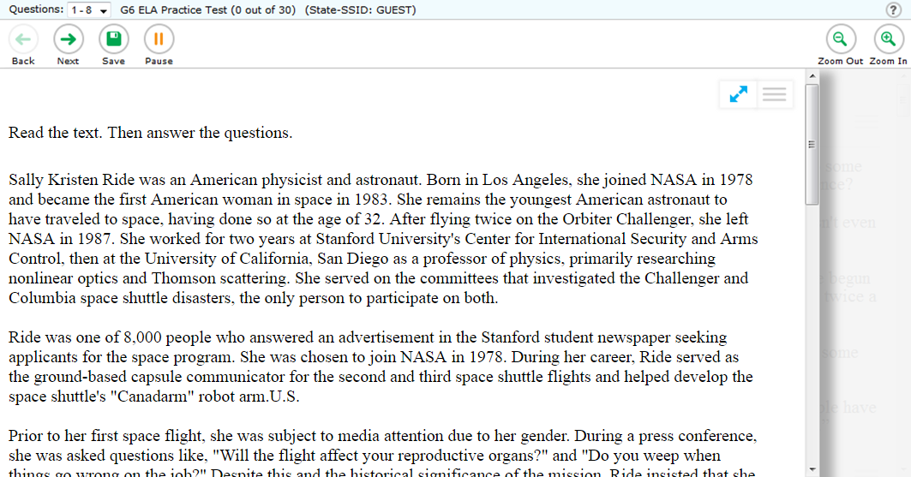
Universal Tools: Expandable Items
Notes:
Students can expand passages, stimuli, and test items so that they take up a larger area of the screen for easier reading. This can be done by clicking the double-arrow icon in the upper-right corner of the passage, stimulus, or item. This slide shows an expanded item in an ELA test. Note that the passage is hidden. To collapse the image and make the passage or stimulus viewable, students should click the double-arrow icon again.

Slide 20
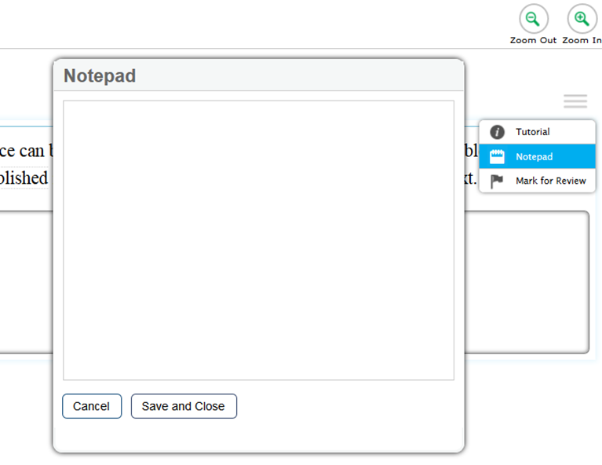
Universal Tools: Notepad
Notes:
Students can use the Notepad to make notes about an item. The Notepad is item-specific, so students can only access their notes for a question when they are on that question’s test page. Notes will continue to be saved when students move on to the next segment or if their tests are paused.

Slide 21
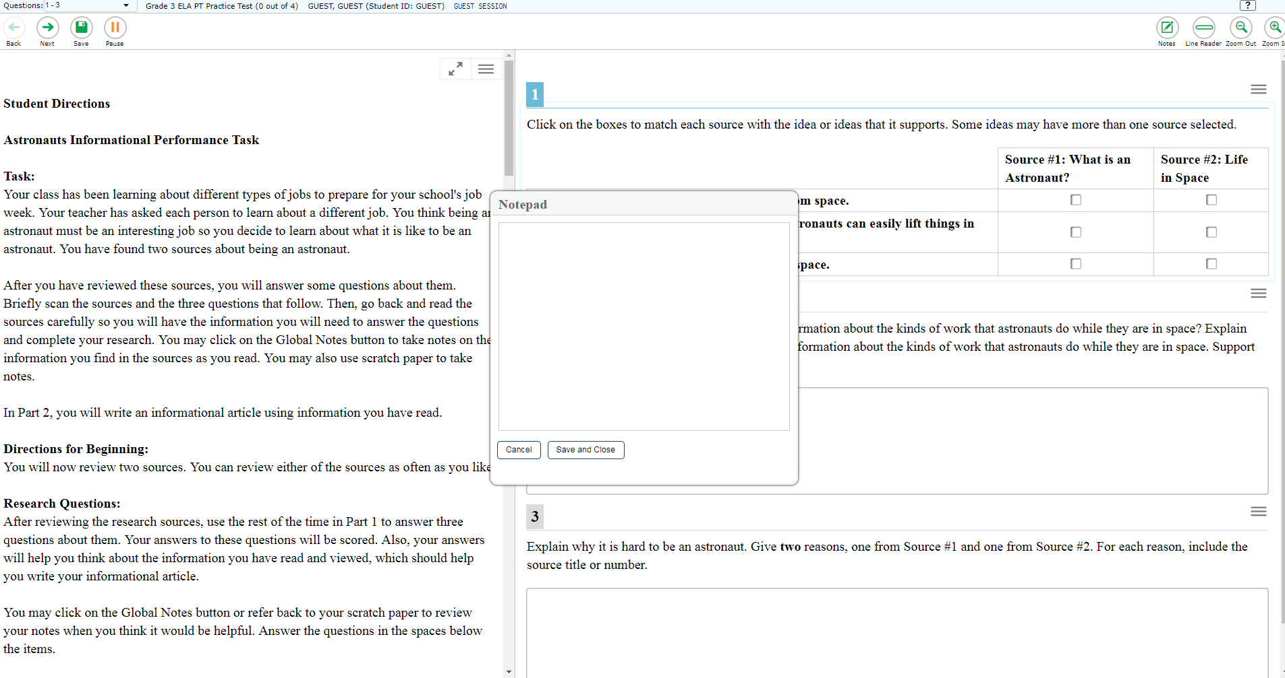
Universal Tools: Global Notes
Notes:
Available only in ELA Performance Task, students can use the Global Notes tool to make notes that will persist throughout the entire test. These notes will be saved and continue to be accessible for later segments in a segmented test, even if the student is not able to go back to the first segment after completing it. The notes will also be retained if the student logs out of the test to resume at a later time.

Slide 22
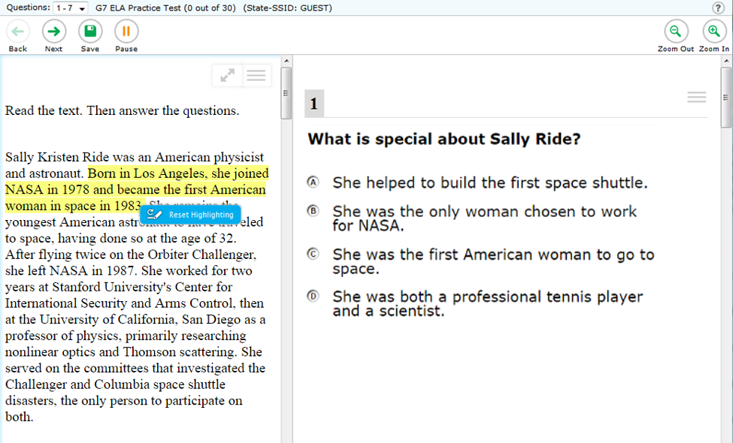
Universal Tools: Highlighter
Notes:
Students can use the Highlighter tool to mark text that they want to remember in reading passages, math stimuli, and in text-based answer options, such as those that ask the student to click a section of text to choose an answer. To do this, students must select the desired text, right-click, and then click the Highlight Selection button that pops up. Students can select the color in which to highlight the text (if available in your state). To remove highlighting, students will right-click in the area of the highlighted text and select the Reset Highlighting button that pops up. If a student pauses the test, any highlighting made before pausing will be retained. The highlighter tool can also be accessed from the context menu.

Slide 23
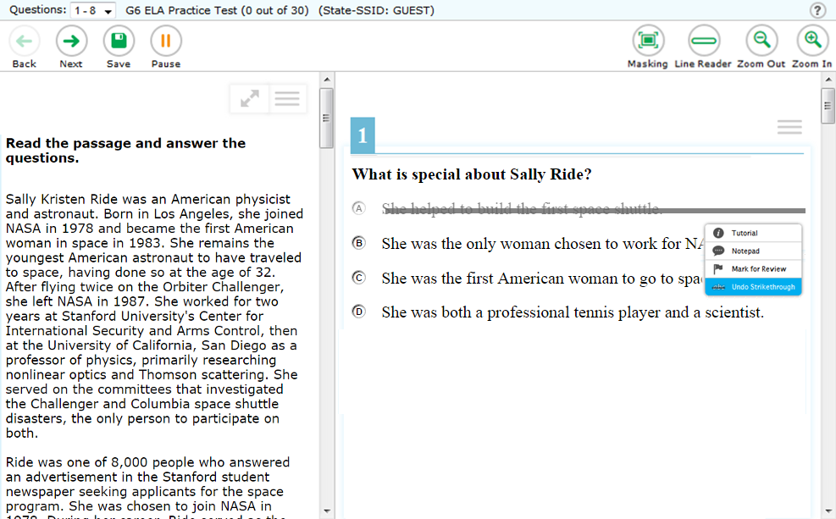
Universal Tools: Strikethrough
Notes:
Students can use the Strikethrough tool to help them mark the answers they do not wish to choose for a particular question. To do this, students must right-click on the text of the answer they want to mark, and then click the Strikethrough button that pops up. The answer text will then display with a line through it. To remove the strikethrough, students must right-click and then click the Undo Strikethrough button that pops up. It is important to note that striking through answers does not indicate a response to the question. Students must still select a response to answer each question. Also, applying the strikethrough tool does not prevent the student from selecting the marked answer as a response.

Slide 24
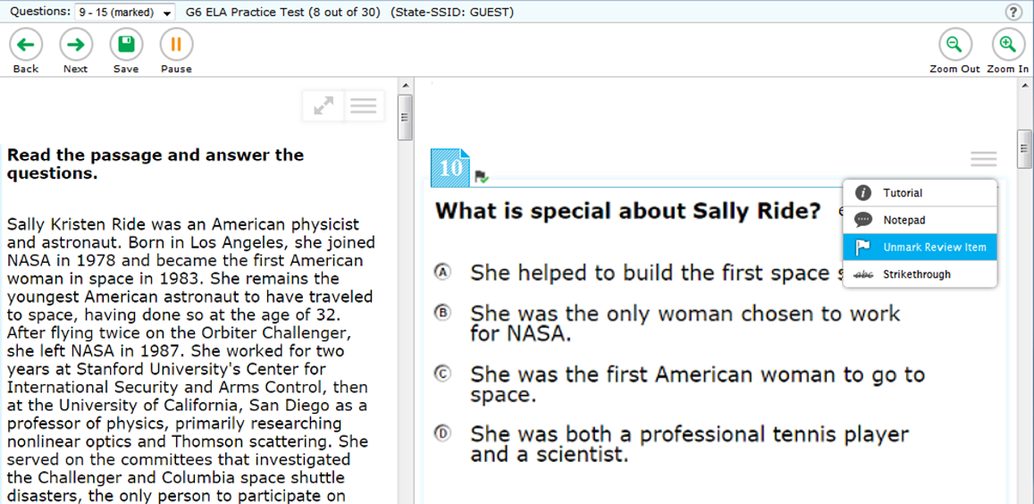
Universal Tools: Mark for Review
Notes:
Another element of the online test that helps students succeed is the Mark for Review feature. As they proceed through a test, students are required to answer each question on the screen before they can go on. If they are unsure of an answer, they should provide what they think is the best answer; there is no penalty for guessing. Students can then mark these items to review before completing the test segment. To mark an item for review, the student can open the context menu for an item and select Mark for Review. The item number will display a dog-eared corner and a small flag badge.
At any time during a test segment, students can navigate back to marked items (within the segment) and review and change their answers as desired. This can be done either by clicking the Back button in the navigation toolbar until they reach the desired item or by using the Questions drop-down menu, located in the upper-left corner of the page, to select a specific item. To unmark an item, students can open the context menu for the item and select Unmark Review Item. Note that once a student has completed a test segment in a test that prohibits navigation to previous segments, or if his or her test is paused for more than 20 minutes, returning to the items marked for review will not be allowed. However, the 20-minute rule does not apply to performance tasks.

Slide 25
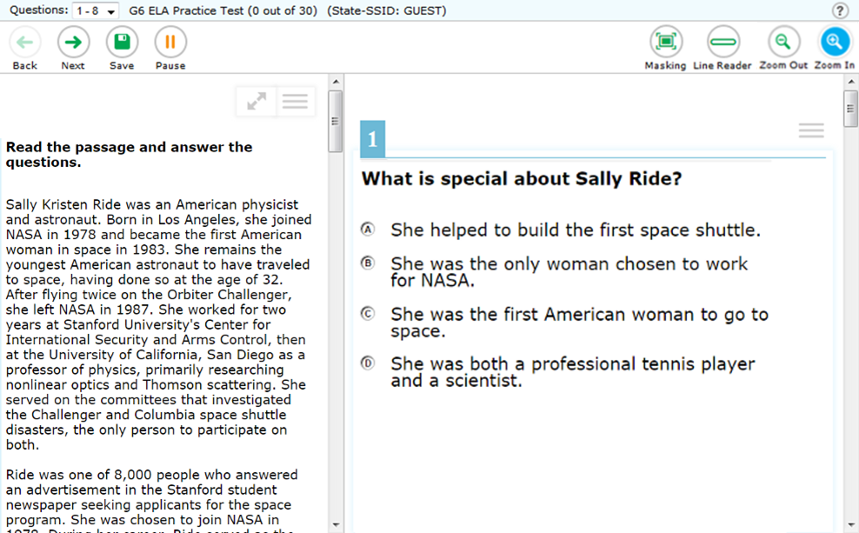
Universal Tools: Zoom
Notes:
During testing, students can use the Zoom feature to increase the size of text and graphics from 1.5 to 20 times their default size by using the Zoom In button. Text can be returned to a smaller size using the Zoom Out button. The default size for all tests is 14-point type. If desired, prior to testing, a Test Coordinator may increase the default print size for the entire test by setting the zoom level in TIDE, or the Test Administrator can change the text size setting in the TA Interface during the approval process.
Zoom levels beyond 3 times the default size will require streamlined mode to be enabled for the student. Please note that the Zoom tool is not the same as magnification, which students can access using their own assistive devices.

Slide 26
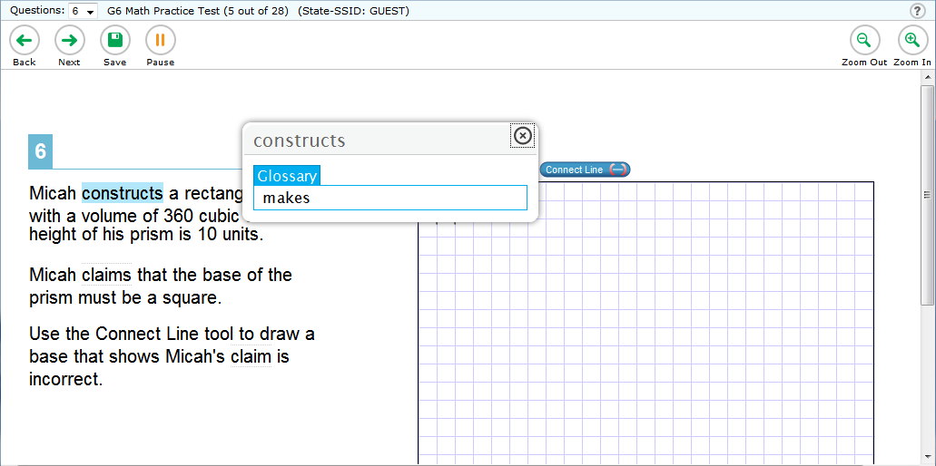
Universal Tools: English Glossary
Notes:
An English Glossary feature is available for students to use for some ELA and math items during testing. The glossary is not available for ELA Reading items. The student can access the glossary by clicking any of the pre-selected terms, which are indicated on the screen by a gray dotted outline. When the student hovers the mouse over the term, it will highlight in blue. If the student clicks a highlighted term, a pop-up box will appear with a definition of the term. Students can return to the item by clicking the X in the upper-right corner of the pop-up box to close it.

Slide 27
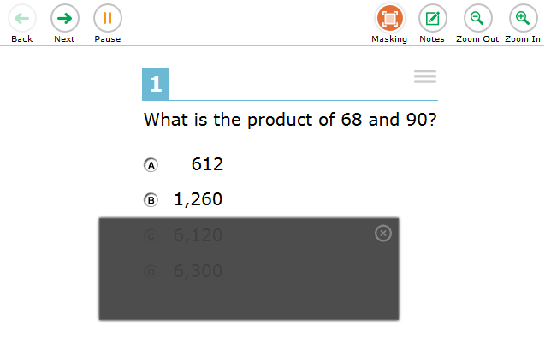
Universal Tools: Masking
Notes:
The Masking tool allows students to cover up a distracting area of the test page. To use this tool, students click the Masking button and then click and drag their mouse to select a rectangular area on the screen. To deactivate masking mode, students must click the Masking button again. Masked areas remain on the screen even after masking mode is deactivated. To remove a masked area, students click the X button in the upper-right corner of the masked area.

Slide 28
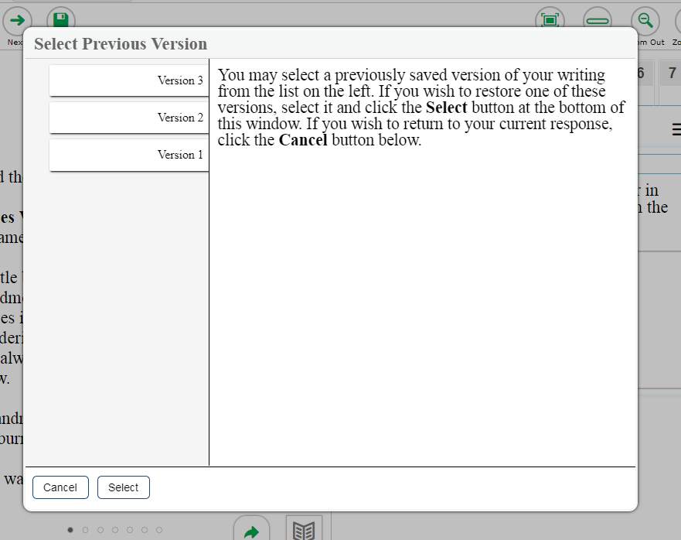
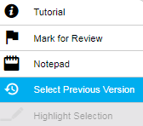
Universal Tools: Select Previous Version
Notes:
The Select Previous Version tool allows students to view and restore responses that they previously entered and saved for a Text Response item. To use this tool, students open the context menu for a Text Response item and click Select Previous Version. A window will appear, listing any saved responses for the item and the text associated with each one. To view previous responses, students select a response version in the left panel and read the associated text in the right panel. To restore a selected response, students click Select at the bottom of the window. The selected response will appear in the answer area for the item.
Please note that the Select Previous Version tool cannot restore responses that were entered prior to pausing a test.

Slide 29
Designated Supports: Color Contrast
Black on White
Black on Rose
Yellow on Blue
Medium Gray on Light Gray
Reverse Contrast (White on Black)
Notes:
In addition to universal tools, which are available to all students, designated supports are available for use by any student for whom the need has been indicated by an educator. Accommodations are changes in procedures or materials that increase equitable access during the test. Accommodations are available for students with documentation of the need for the accommodations on an Individualized Education Program (IEP) or Section 504 accommodation plan.
For detailed information about designated supports and accommodations, please refer to the Usability, Accessibility, and Accommodations Guidelines on the Smarter Balanced website.
Color Contrast is an accessibility resource that is available to eligible students. By default, tests are presented with black text on a white background. Students who require a different combination of font color and background color should be assigned the appropriate accommodation in TIDE. The color contrast selected will apply to all tests for that student. Color contrast options may include the following: Black on White; Black on Rose; Yellow on Blue; Medium Gray on Light Gray; and Reverse Contrast (White on Black). Other options may be available in your state.

Slide 30
Designated Supports: Text-to-Speech
Notes:
Text-to-Speech (TTS) allows eligible students to listen to test content. TTS must be set up in TIDE prior to testing. It is available as either an embedded designated support or as an embedded accommodation for students with an identified need. Students can use this feature as a designated support for mathematics stimuli items and ELA items but not for reading passages. Students in all grades may have Text-to-Speech for ELA reading passages as an accommodation.
To use this tool, the student will select a portion of text and then right-click the selected area or click the context menu icon. Students then select the desired Text-to-Speech option from the pop-up menu to hear the audio (for example: Speak Question or Speak Question and Options). We recommend that students who will be using this feature have the opportunity to try it by taking the practice test prior to testing. As mentioned earlier, you should ensure that all students requiring the Text-to-Speech feature have headphones and that they have completed the audio check successfully.
Some tests may also display ear icons by questions and answer options when TTS is enabled. The student can click these icons to listen to the content.

Slide 31
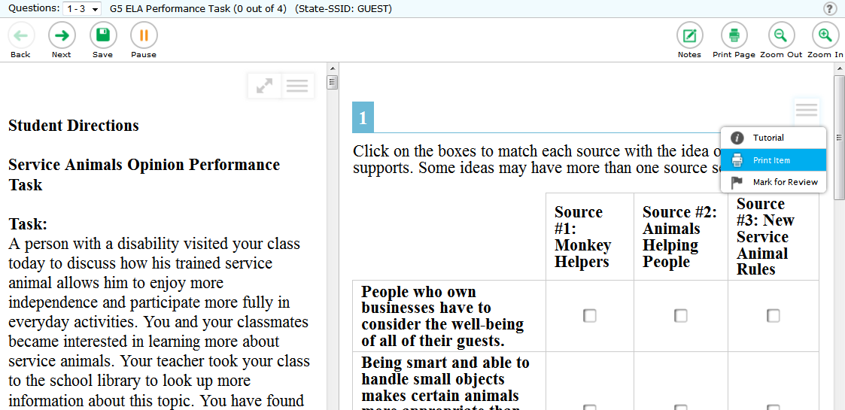
Designated Supports: Print on Demand
Notes:
The Print on Demand feature is available only for students who require it. It is a testing impropriety to apply this restricted resource for a student without documentation of actual need. This feature is not intended as a method for printing the test in order to administer it on paper. Depending upon whether they are allowed to print items, passages, or both, students with this accommodation will see either a Print Page button at the top of the screen, a Print Item option in the context menu, or both. When a student clicks either Print option, the TA will receive a request for approval. The student will see a pop-up message that indicates that the request for approval has been sent. Before approving the request, the TA should ensure that the printer is monitored by staff who have been properly trained in test security.
Test items that students have requested to print will display with a small printer badge next to the item number.

Slide 32
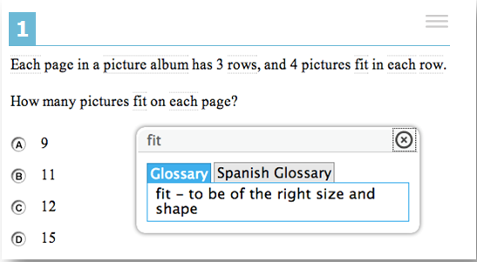
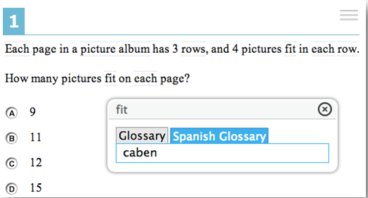
Designated Supports: Translation Glossaries
Notes:
Students who are English Learners (ELs) may benefit from using a Translation Glossary for some tests. These students should have the Translation Glossary option selected in TIDE for the appropriate language. See the Translation Glossaries section in the Usability, Accessibility and Accommodations Guidelines, available on the Smarter Balanced website, for information on how to determine if this support is appropriate for particular students. Available languages include Spanish, Arabic, Burmese, Cantonese, Filipino, Hmong, Korean, Mandarin, Punjabi, Russian, Ukrainian, and Vietnamese. A dual-language option is also available, which allows students to see both the English glossary and another language glossary at the same time.
When the Translation Glossary is enabled, some terms in mathematics items will appear with a gray dotted outline around them. When the student hovers the mouse over the term, it will highlight in blue. If the student clicks a highlighted term, a pop-up box will appear with the translation of the term. Students can also select the audio icon next to the glossary term and listen to the audio recording of the glossary. Clicking the X in the upper-right corner of the pop-up box will close it. If the student has dual-language mode enabled, the glossary will appear with two tabs, one for each language.

Slide 33
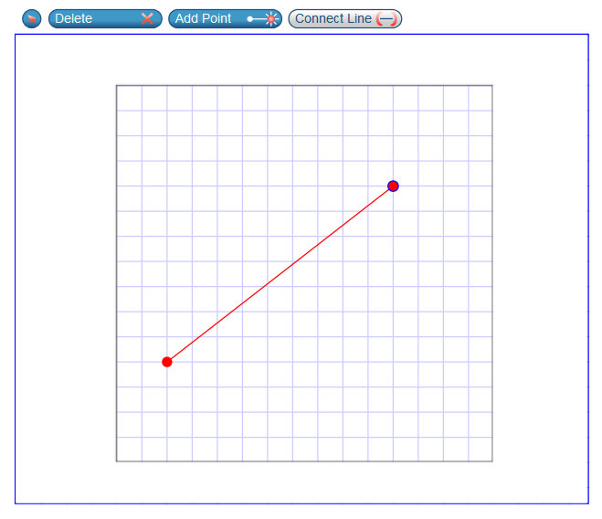
Test Items: Example of an Interactive Item
Notes:
Next we will discuss some types of items that students may see. Students will encounter several types of items during testing. They must answer each item before proceeding to the next one. To answer selected-response items, students must click the desired answer option so that the letter A, B, C, or D becomes shaded. For interactive items, students need to follow the instructions given to know how to indicate their answer. For example, students may be told to click an object to identify the appropriate answer, drag pictures or words in a table, or click on a keypad. If they wish, students may click the Save button while working on interactive items to save their work. Regardless of whether they click Save or not, their answers will save automatically when they navigate to the next part of the test. After answering all items on a page, the student will click Next to go on.

Slide 34
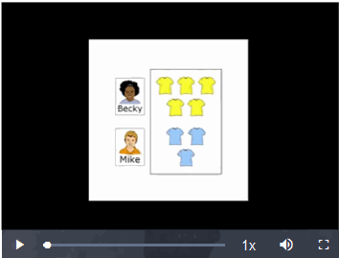
Test Items: Video Playback
Notes:
If a stimulus appears as a video, students can use the standard controls shown here to control the playback.
To play a video, click the play button in the lower-left corner of the player.
To jump to a different point in the video, drag the slider to the desired location.
To adjust the speed at which the video plays, click the 1x button, and then select the desired speed from the menu that will appear.
To mute or unmute the video, click the speaker icon in the lower-right corner.
To expand the video to full screen mode, select the full-screen icon in the far lower-right corner. To exit full screen mode, click the full-screen icon again.

Slide 35
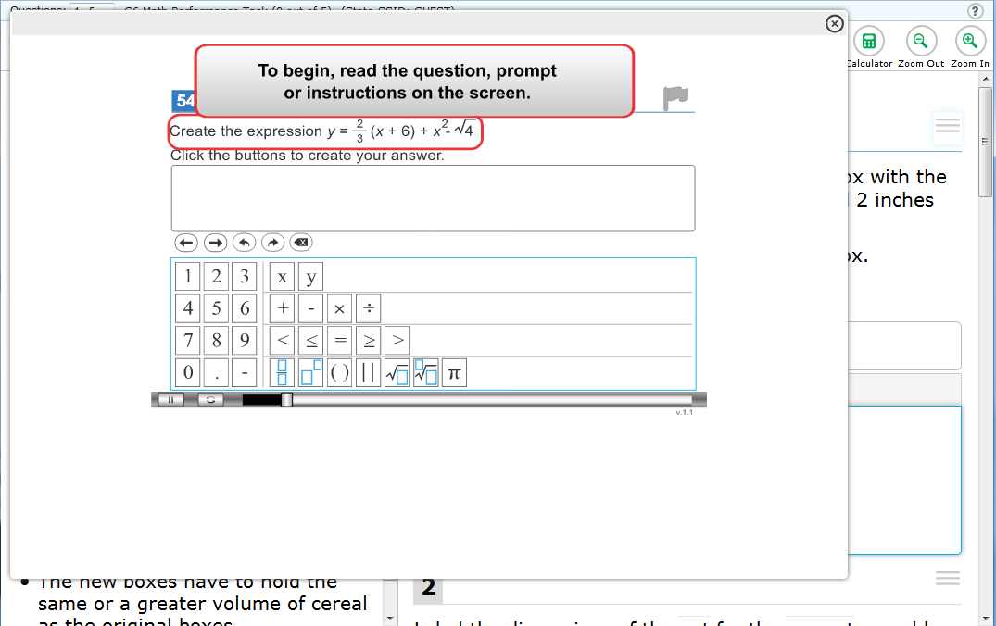
Item Tutorial
Notes:
Students can use the Item Tutorial tool to get more information about a particular item type. Selecting Tutorial from the context menu for a question opens a pop-up box that will show the student how that type of item works (for example, whether they should select an answer, drag-and-drop answers, or type a response in an answer space).

Slide 36
Test Timeout
Test Timeout Due to Inactivity
As a security measure, after 30 minutes of test inactivity, students are logged out and their tests are paused automatically.
Inactivity is determined by whether the student is interacting with the test by selecting answers or using navigation tools. Clicking an empty space on the screen is not considered activity.
Students will receive a warning message prior to being logged out and must click OK on the pop-up message within 60 seconds in order to avoid automatic logout and pausing of their test.
If a student’s test is paused due to inactivity, the same rules apply as when the student intentionally pauses the test.
Notes:
As a security measure, after 30 minutes of test inactivity, students are logged out, and their tests are paused automatically.
Inactivity is determined by whether or not the student is interacting with the test by selecting answers or using navigation tools. Clicking an empty space on the screen is not considered activity.
Students will receive a warning message prior to being logged out and must click OK on the pop-up message within 60 seconds in order to avoid automatic logout and pausing of their test. If a student’s test is paused due to inactivity, the same rules apply as when the student intentionally pauses the test. The student can log in to the test again and resume from the point that testing was interrupted, subject to the pause rule, if applicable.
Additionally, if a screen saver is activated during testing, the security breach feature will log the student out of the test. To avoid any such interruption, schools should either deactivate screen savers before students start testing or ensure that screen savers are set to more than the allocated testing time.

Slide 37
End of Segment
Notes:
The ELA performance task, Math computer-adaptive test, Algebra 1 and Algebra 2 End of Course tests are presented in segments. When students reach the end of a test segment, they will receive a warning message asking them to confirm that they want to move on to the next segment. The warning also advises that they cannot return to change their answers in the current segment once they have moved on. Test Administrators should ensure that students understand the outcome of ending the test segment and encourage students to check their answers before moving on.

Slide 38
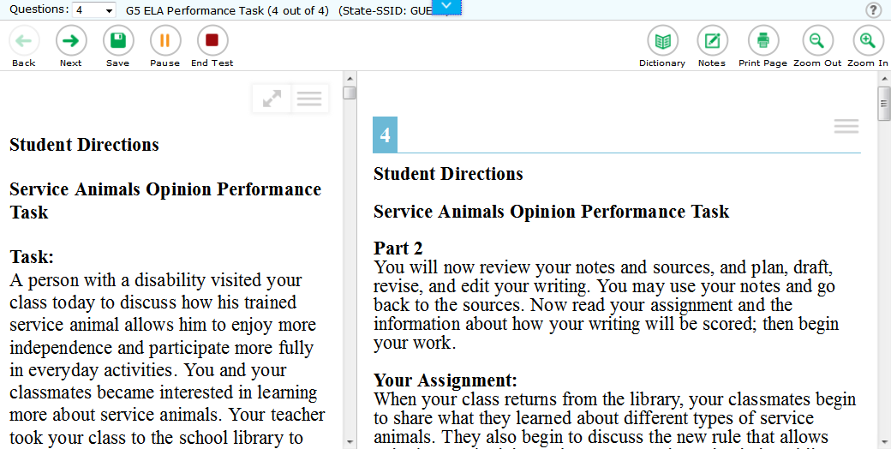
End Test
Notes:
When students answer the final question on the test, the End Test button will appear in the upper-left section of the screen, along with a message advising them that the test has been completed and is ready to be submitted. The End Test button does not become visible until the student has selected at least one response to every question on the test. If students click the Next button at this point, they will see a pop-up message advising them to click the End Test button when they have completed reviewing their answers. They may also click the Back button to go back and revisit previous items, subject to the pause rule if it has been applied during the test.
For the ELA performance task full-write, Test Administrators should be sure that students have completed the entire full-write task before submitting their test. If students are taking a break during the full-write portion, they should pause their test rather than click the End Test button. The End Test button will appear on screen as soon as the student has begun answering the full-write task, but it should not be clicked until the student is ready to finish and submit the test.

Slide 39
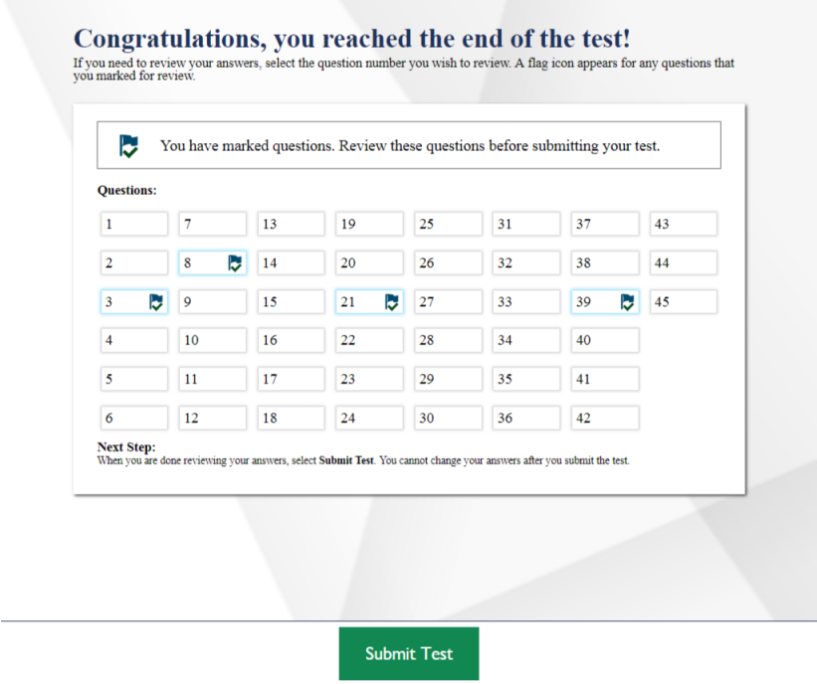
Test Submission
Notes:
When students are ready to end the test, they should click the End Test button. A pop-up message will appear allowing them to select Yes if they are ready to finish the test and No if they are not. If students click No, they will return to the last item of the test and can revisit previous items. If students click Yes, they will be taken to the review screen, where they have the choice to review their answers or submit the test. Their ability to review and change answers is subject to the pause rule, if applicable, for this test.
Students who are ready to submit their tests should click Submit Test to finish. They will receive a confirmation pop-up message asking if they are sure they want to submit. Clicking No will return them to the review screen. Clicking Yes will take them to Test Completion page, which shows a message indicating that the test was successfully submitted and advises the student to log out.

Slide 40
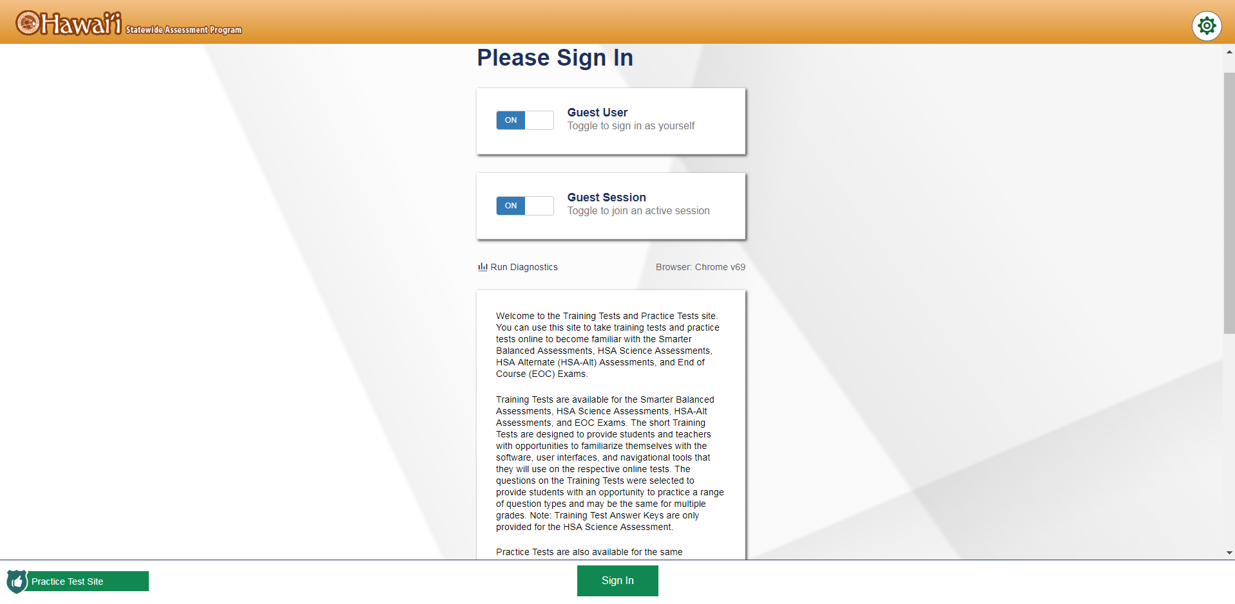
Preparing Students
Notes:
This overview was given from the perspective of a student using a Windows PC. Remember that your students’ experience with the test will vary slightly depending upon the computers they are using for testing. Regardless of the type of device they will use, we strongly recommend that all students take the practice and training tests to familiarize themselves with the login process, the testing interface and its features, and the types of items they will encounter during testing. Practice and training tests can be accessed via your state portal or the Smarter Balanced website.

Slide 41
Thank You!
Further Information
Visit
www.alohahsap.org
www.smarterbalanced.org
Call, fax, or email the American Institutes for Research HSAP Help Desk
Hours: 7:30 am to 4:00 p.m. HST, Monday-Friday (except holidays)
Phone: 1-866-648-3712
Fax: 1-877-231-7813
Email: HSAPHelpDesk@air.org
Notes:
Thank you for taking the time to view this training module. If you have general questions or need further information, visit the AlohaHSAP.org portal, the Smarter Balanced website, or consult the HSAP Help Desk for assistance.
For information about accessibility resources, consult the Usability, Accessibility and Accommodations Guidelines, available on the Smarter Balanced website. You may also wish to view additional training modules and resources available the AlohaHSAP.org portal.

