Slide 1
Technology Requirements for Online Testing
Training Module
Notes:
Welcome to the Technology Requirements for Online Testing training module. It is designed to help Technology Coordinators prepare for the administration of online tests.

Slide 2
Topics
Site Readiness
Network Requirements
Hardware and Software Requirements
Secure Browser Installation
Network Diagnostics and Configuration
Notes:
This module outlines the hardware requirements, software installation processes, and system configurations you will need in order to ensure that your school’s systems are ready for online testing. We will cover five basic topics: site readiness, network requirements, hardware and software requirements, secure browser installation, and network diagnostics and configuration.

Slide 3
Objectives
By the end of this presentation, you should be able to:
Understand your role and responsibilities
Prepare for online tests at your school
Install the secure browser
Troubleshoot technical problems during the tests.
Notes:
By the end of this presentation, you should be able to:
Understand your role and responsibilities
Prepare for online tests at your school
Install the secure browser
Troubleshoot technical problems during the tests

Slide 4
Technology Coordinator Tasks
Logins and passwords
Minimum system requirements
Secure browser
Determining system readiness/network capacity
Troubleshooting technical issues
Notes:
As your school’s Technology Coordinator, you will be responsible for ensuring that all of the systems and configurations necessary to administer online tests are in place and functioning correctly. Your tasks include:
Understanding the basic functionality of online systems, including logins and passwords
Checking all computers to be used for testing to make sure they meet the minimum system requirements to run the test
Installing the appropriate secure browser on testing devices
Determining initial and ongoing system readiness and network capacity
Troubleshooting technical issues that may arise during the test

Slide 5
Network Requirements
Network Connection:
A stable, high-speed (wired or wireless) network and Internet connection are required for the test.
The response time for each test depends on your network’s bandwidth, number of students simultaneously testing, size of test content, proxy server (if used), and other factors.
Notes:
A stable, high-speed (wired or wireless) network and Internet connection are required for the test. The response time for each test depends on your network’s bandwidth, number of students simultaneously testing, size of test content, proxy server (if used), and other factors.

Slide 6
Network Requirements
Network Configuration:
Session timeouts on proxy servers and other devices should be set to values greater than the average scheduled testing time. For example, if test sessions are scheduled for 60 minutes, consider session timeouts of 65–70 minutes.
Web proxy servers must be configured to NOT cache data received from servers.
For any device that performs traffic shaping, packet prioritization, or quality of service, the URLs to be used for testing should be given a high priority to ensure the best performance.
Notes:
For online testing applications to work properly, it is important that your network settings are configured correctly. Session timeouts on proxy servers and other devices should be set to values greater than the average scheduled testing time. For example, if test sessions are scheduled for 60 minutes, consider session timeouts of 65–70 minutes. This will help limit network interruptions during testing. Web proxy servers must be configured to NOT cache data received from servers. If your client network uses any device that performs traffic shaping, packet prioritization, or quality of service, the URLs to be used for testing should be given a high priority to ensure the best performance.

Slide 7
Network Requirements
Whitelisting:
Content filters, firewalls, and proxy servers should be configured to allow the URLs for testing sites and applicable non-testing sites.
The most current whitelisting URLs can be found in your Technical Specifications Manual for Online Testing on the Resources page at alohahsap.org.
Notes:
Content filters, firewalls, and proxy servers should be configured to allow the URLs for testing sites and applicable non-testing sites.
The URLs for the following sites need to be accessible for testing:
Secure Browser
Test Administrator Training Sites
Practice and Training Test Sites
Test Administrator Interface
Test Information Distribution Engine (TIDE)
Online Reporting System (ORS)
It is important that session timeouts on proxy servers and other devices are set appropriately, that web filters are not blocking test-related websites, and that test data are not being cached.

Slide 8
Network Requirements
Performance Factors:
Bandwidth
Number of students simultaneously testing
Wireless networking configuration
Secure browser
Notes:
In general, the performance of the Test Delivery System depends on a number of factors, including bandwidth, number of students simultaneously testing, wireless networking configuration (if used), and secure browser. We will go into further detail about these factors in the next few slides.

Slide 9
Network Performance
Bandwidth:
At least 20K bps bandwidth per student being tested
Affected by both Local Area Network (LAN) traffic and Internet traffic from the router
LAN should always be analyzed to determine potential traffic bottlenecks
Notes:
We recommend having at least 20 Kbps bandwidth per student being tested. This is in addition to any network demands by other users within the school. Bandwidth performance can be affected by both Local Area Network (LAN) traffic and Internet traffic from the router. Regardless of hardware or network topology, we recommend a performance analysis of both the LAN and the Internet infrastructure in order to identify any bottlenecks that may impact test performance.

Slide 10
Network Diagnostics Tool
Number of students simultaneously testing:
Network performance may slow when large numbers of students are testing at one time.
Multiply the number of students being tested by 20 Kbps to get an estimate of bandwidth needed, and compare that estimate with the network speed test.
Perform network analyses at different times to ensure adequate capacity.
Notes:
A factor that may affect network performance is the number of students who are testing at one time. Just as traffic speed decreases on a busy highway, network performance may slow when large numbers of students are testing simultaneously. It is recommended that network performance analyses be performed at various times prior to testing to ensure adequate capacity. Multiply the number of students who will test simultaneously by 20 Kbps to get an estimate of bandwidth needed. Compare that estimate with the results of the network speed test, and ensure that there is a sufficient margin.

Slide 11
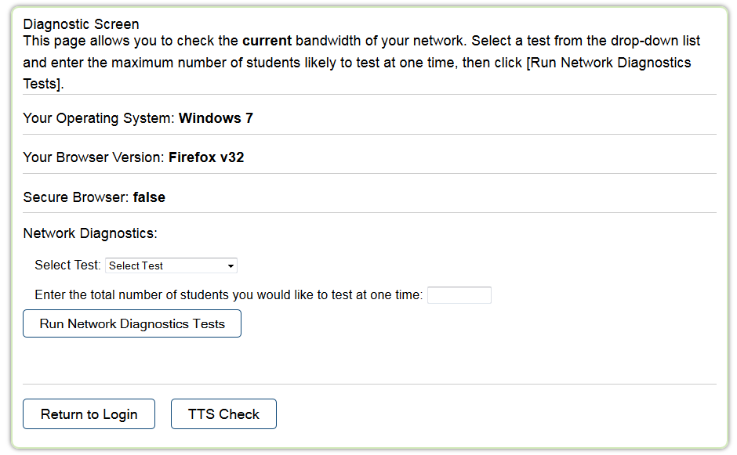
Network Diagnostics Tool
Notes:
The Network Diagnostics tool compares the number of students testing simultaneously (as entered in the box) to an estimate of that particular test’s required bandwidth. It then displays a message indicating if the network can adequately support the entered number of students.
The Network Diagnostics tool can be accessed on the Student Practice and Training Tests Site at alohahsap.org or by using the Secure Browser.
In the Network Diagnostics section, do the following:
Select a test.
Enter the number of students who will take that test at one time.
Click [Run Network Diagnostics Tests].

Slide 12
Network Performance
Wireless Network Configuration:
Wireless traffic must use encryption.
Wi-Fi Protected Access II (WPA2)
Advanced Encryption Standard (AES)
Wireless access points have limits on total bandwidth and number of simultaneous devices in use.
Notes:
In order to maintain the security of sensitive test‐related data, wireless traffic must use encryption. Wi-Fi Protected Access II (WPA2) with Advanced Encryption Standard (AES) is strongly recommended.
Wireless access points have limits on total bandwidth as well as on the number of simultaneous devices in use. A properly configured wireless network should provide adequate bandwidth and wireless access points for testing. To be sure of sufficient capacity, you need to have the number of computers in the room that will be used for testing, and access Wi-Fi on them simultaneously.

Slide 13
System Requirements
Computers
Operating System | Minimum Requirements for Current Computers | Recommended Minimum Requirements for New Purchases
Windows Vista, 7, 8.0, 8.1, 10 Server 2003, 2008, and 2012 | Pentium 4 or newer processor that supports SSE2 512 MB of RAM 200 MB hard drive space Minimum screen resolution 1024x768 | Pentium 4 or newer processor that supports SSE2 2 GB+ RAM 80 GB+ hard drive Minimum screen resolution 1024x768
Mac OS X 10.6–10.10 | Intel x86 processor 512 MB RAM 200 MB hard drive space Minimum screen resolution 1024x768 | Pentium 4 or newer processor (10.6–10.10) 2+ GB RAM 80+ GB hard drive Minimum screen resolution 1024x768
Linux Fedora 20-22 openSUSE 13.1 Red Hat Enterprise Linux 6.5 Ubuntu (LTS)12.04, 14.04 | Intel x86 processor 512 MB RAM 200 MB hard drive space Minimum screen resolution 1024x768 | Pentium 4 or newer processor 2+ GB RAM 80+ GB hard drive Minimum screen resolution 1024x768
Notes:
You must ensure that your school’s computers meet the minimum hardware and software requirements in order for assessments to function effectively.
However, online testing performance can be improved by using computers with faster processors and more disk space than is minimally required. The table shown provides minimum information about supported operating systems and related system requirements. The most current system requirements can be found in your System Requirements for Online Testing.

Slide 14
System Requirements
Appropriate Monitor Display
Monitor settings may need to be adjusted if test items with shaded images are very light or cannot be seen.
The larger the monitor, the more “real estate” students will have.
Resolution: 1024 x 768 or better
Notes:
As monitors vary widely, support for specific monitors cannot be provided. We cannot guarantee that the “default” settings that monitors are shipped with are optimal. Use the student practice and training tests to verify that test items with shaded images (e.g., pie charts) can be seen clearly. Monitor settings may need to be adjusted if a student says test items with shaded images are very light or cannot be seen.
In general, the larger the monitor, the more “real estate” students will have. Some assessments may include pages that have multiple items and/or reading passages that require scrolling. Resolution should be set to 1024 by 768 or better.
Individuals using small monitors or tablets may need to scroll vertically and/or horizontally in order to view all information on the screen. Students may also use the Zoom tool available in the tests to enlarge content on the screen. The most current system requirements can be found in your Technical Specifications Manual for Online Testing.

Slide 15
Supported Mobile Devices
Operating System | Supported Tablets | Browsers for TA Sites | Browsers for Student Sites
Android 4.3, 4.4, 5.0, 5.1 | Google Nexus 10 Motorola Xoom Samsung Galaxy Note (2014 edition) Samsung Galaxy Tab 3 and 4 LearnPad Quarto | Native browser Chrome | AIR Mobile secure browser
Chrome 41 to 46 | Chromebook | Chrome | AIRSecureTest kiosk application
iOS 7.0, 7.1, 8.0–8.2 | iPad 2 iPad 3 Fourth-generation (Retina Display) iPad Air iPad Air 2 | Safari | AIRSecureTest Mobile Secure Browser
Notes:
The online assessments are available on multiple mobile devices using a variety of operating systems. Tablets must have at least a 10-inch screen. iPads with a 9.5-inch display are acceptable. A minimum screen resolution of 1024x768 is required for all testing devices. An external keyboard is required. The table shows the mobile devices that are supported for use in testing. However, the most current list can be found in your System Requirements for Online Testing.

Slide 16
Secure Browser
The secure browser prevents students from accessing other computer or Internet applications and copying test information during testing.
Practice and training tests can be accessed with either the secure browser or with Chrome, Firefox, Safari, Internet Explorer 10 and 11, or most native tablet web browsers.
Notes:
Online tests are delivered using a secure browser in order to protect the security and integrity of the test. The secure browser prevents students from accessing other computer or Internet applications and copying test information during testing. If the system detects other applications popping up or running on the computer, the student is logged out of the testing session. Students cannot access the operational tests without using the secure browser. The practice and training tests can be accessed with either the secure browser or with supported web browsers, including Chrome, Firefox, Safari, and Internet Explorer 10 and 11.

Slide 17
Secure Browser
The Student Testing Site requires the use of a secure browser.
The correct secure browser for each operating system must be downloaded and installed on all computers that will be used for student testing.
Notes:
The Student Testing Site requires the use of a secure browser. The correct secure browser for each operating system must be downloaded and installed on all computers that will be used for student testing.

Slide 18
Secure Browser
Computer/Device | Secure Browser Location
Windows, Mac, and Linux computers | alohahsap.org/HSA/browsers
Android tablets | Play Store
iPad tablets | App Store
Chromebooks | Chrome Web Store
Notes:
The secure browser for desktops and laptops is located on your portal. The secure browser for tablets and Chromebooks can be downloaded from the corresponding web stores.
Refer to your Secure Browser Installation Manual for instructions on downloading and installing the secure browsers.
For Android tablets, the secure browser should be downloaded from the Google Play Store. The secure browser keyboard must be selected before students can access the login page.
For iPads, the secure browser should be downloaded from the App Store. The Guided Access or Autonomous Single App Mode feature must be enabled for iPads.
For Chromebooks, installation varies for managed and non-managed Chromebooks.
Detailed instructions for these settings can be found in your Technical Specifications Manual for Online Testing.

Slide 19
Secure Browser Installation
Installation Methods:
Download the secure browser from your portal and install it.
Download and save the secure browser onto a media device (such as a flash drive), and copy and install the files on each computer.
Download and save the secure browser to a network folder, and copy and install the files on each computer.
Notes:
You can install the secure browser on individual computers or devices using several methods:
Download the browser directly from your portal and install it.
Download and save the secure browser onto a media device (such as a flash drive), and copy and install the files on each computer.
Download and save the secure browser to a network folder, and copy and install the files on each computer.
Secure Browser Installation Manual
If you need to install the secure browser on a system for which you do not have administrative rights, see the instructions in your. If you prefer, you may push the secure browser out to all of the testing computers and devices on your network, using whatever software tools you normally use for managing deployments.

Slide 20
Secure Browser Installation Windows
MSI file type enables deployment using a number of tools:
Active Directory Group Policy
Microsoft SMS
Microsoft SCCM
Microsoft WSUS
Windows NT Batch
Notes:
There are several methods to deploy the secure browser depending on your platform. For the Windows platform, we provide the secure browser in an MSI package file. This file type enables deployment using a number of tools including:
Active Directory Group Policy
Microsoft SMS
Microsoft SCCM
Microsoft WSUS
Windows NT Batch

Slide 21
Secure Browser Installation Mac and Linux
Mac
DMG file type enables deployment using Apple Remote Desktop.
Munki
Filewave
Linux
TAR file type enables deployment using a number of tools including the following:
Shell scripts
Puppet
Notes:
For the Mac OS X platform, we provide the secure browser as a DMG package file. This file type enables deployment using Apple Remote Desktop.
For the Linux platform, we provide the secure browser in a generic TAR file. This file type enables deployment using a number of tools including shell scripts and puppet.

Slide 22
Secure Browser Automatic Update Feature
Starting with the 2015–2016 test administration, districts may be able to choose to install the desktop version of the secure browser with an auto-update option.
Leave your computers turned on and at the secure browser login and AIR will conduct the updates when the computers are idle.
An installation message on the screen will appear with the option to cancel. If not cancelled, we will download.
A secure browser restart message on the screen will appear. If not cancelled, the browser will restart and install the latest version.
Note: This feature is optional and may not be offered/supported by your district or state online assessments.
Notes:
Some states and complexes have opted to use the Secure Browser auto-update feature.
When a new secure browser becomes available, AIR will send notice and will tell you when the update will be available and you will be asked to leave all computers turned on overnight with the secure browser open to the sign in page.
The auto-update software will check to see if anyone is actively using the computer. If they are not, a message will be sent out saying that the computer wants to install an auto-update and asking anyone working on the computer to click a message. If this action is not cancelled, the auto-update will install.
As part of the installation process, the secure browser will automatically restart. The auto-update software will check to make sure that no one is using the computer before restarting.
The auto-update process should take approximately 10 minutes. Because the auto-updates will be installed in the middle of the night, the process should not interfere with students’ use of the computers.
Note:
The secure browser will continue to be updated only once a year. However, updates may need to be pushed out during the year if there is an update to a major operating system. Serious security or other issues with the secure browser could also necessitate an update during the academic year.
This is an optional feature for the field to use.
The 2015–2016 version of the secure browser must be installed in order to access the auto-update functionality.
For more details, refer to the Secure Browser Installation Manual and the Technology Requirements Manual.

Slide 23
Pop-Ups
Configure Internet browsers on Test Administrator devices to allow pop-ups from your testing websites.
Notes:
Many of our sites use pop-ups to provide additional information. Devices used by Test Administrators should have their Internet browsers configured to allow pop-ups from your testing websites.

Slide 24
OS X Secure Browser Configuration Disabling OS X Features
Disable Exposé or Spaces
Disable application launches from function keys
Disable updates to third party apps
Disable updates to iTunes
Notes:
Mac OS X has a number of built-in features that can compromise a test’s integrity, such as Exposé, Spaces, and other features listed in this slide. Instructions for disabling these features appear in your Technical Specifications Manual for Online Testing.

Slide 25
Text-to-Speech
Voice technology must be available and functioning for students who require this accommodation.
For Windows and Mac operating systems, default voice packs are generally pre-installed.
A customized voice pack may be available for Windows computers from TIDE’s Voice Pack tab.
Linux users may need to install a Text-to-Speech package if one was not installed with the operating system.
Notes:
Text-to-Speech works by tapping into the computer’s built-in speech engine to allow eligible students to listen to test content. It is only available via the secure browser. This year, volume, rate and pitch for TTS are adjustable while the student is taking the test. Technology Coordinators are responsible for ensuring that this voice technology is available and functioning.
For Windows and Mac operating systems, default voice packs are generally pre-installed. Linux users may need to install a Text-to-Speech package if one was not installed with the operating system. Detailed information about voice packs can be found in your Technical Specifications Manual for Online Testing.

Slide 26
Text-to-Speech on Mobile Devices
iPad users will be able to adjust volume, pitch, and speaking rate.
Chromebook users will be able to adjust volume and speaking rate.
These settings are also adjustable in the test.
Currently, these features are not available on Android devices.
Notes:
This year, students will be able to adjust the volume, pitch, or speaking rate on some devices.
iPad users will be able to adjust volume, pitch, and speaking rate.
Chromebook users will be able to adjust volume and speaking rate.
Both iPad and Chromebook users will be able to adjust these settings while taking a test.
Currently, these features are not available on Android devices.

Slide 27
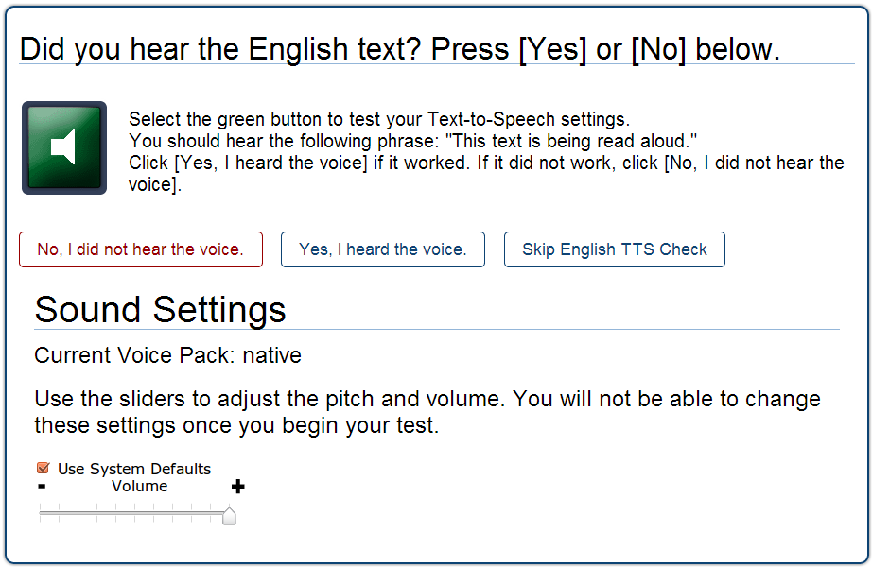
Notes:
To check Text-to-Speech settings, you must use the secure browser. After clicking the [Run diagnostics] link, click the [TTS Check] button.
On the TTS check screen, do the following:
Click the green audio button.
Verify whether you heard the recorded voice.
If you do not hear the voice, do the following steps:
Check your machine’s audio controls.
Confirm that the headphones are plugged in and functioning properly with other applications.
Ensure an appropriate voice pack is installed.
Adjust the available sound settings as necessary.

Slide 28
Thank You!
Further Information
Visit
alohahsap.org
smarterbalanced.org
Call, fax, or email the American Institutes for Research HSAP Help Desk
Hours: 7:30 am to 4:00 p.m. HST, Monday-Friday (except holidays)
Phone: 1-866-648-3712
Fax: 1-877-231-7813
Email: HSAPHelpDesk@air.org
Notes:
Thank you for taking the time to view this training module. For detailed information, consult your Technical Specifications Manual for Online Testing located on your state portal or contact your help desk.

